Slide 1
Formula 1 Driver Analyser A Visual Analytics Project
Luca Sannino 1542194

Slide 2
Brief Overview
“Driver Analyser” is a Javascript application that uses the D3.js library to create a visual environment where a user can choose a Formula 1 driver (from 1994 to present day), so that they can learn more about their performance and place in the sport’s history.
This is achieved by interacting with visualizations that focus on the aspects of a driver’s career that are of particular interest, like points achieved, results against their teammates, DNFs and consistency of their placements.
Such visualizations, that are all synchronized between each other, include bar graphs, lollipop charts, box plots and scatter plots on multidimensional data achieved through PCA.

Slide 3
Target User
The target user is someone interested in having a greater understanding of a driver’s performance.
It can be someone internally in the teams themselves who is looking for the next best hire.
Or it can be just a passionate fan, the type that spends hours discussing which driver is better and why.
Or it can be just someone who likes to bet and win (hopefully) some easy money.

Slide 4
Target User (Part 2)
What may a user be interested in? Let’s try to guess it with a list!
● Is the driver on an upward trajectory, or are his best days clearly behind him?
● How does his performance compare against the ones of his teammates across his career?
● Does he gets DNF’d often? If so, it’s because he is a hothead who constantly gets involved in crashes/collisions, or it’s due to unlucky reliability issues?
● How constant he is in his placements? In which constructor did he gain the better results? In which circuits?
● How does he fit in the history of the sport itself, in terms of achievements reached?

Slide 5
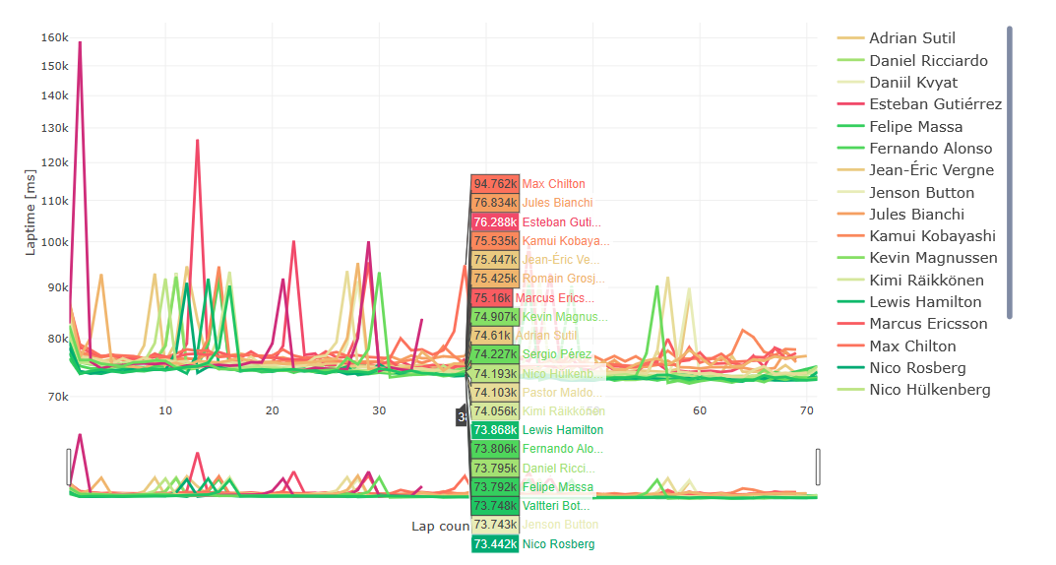
Related Works
Is there already another work that can help or be taken as inspiration? Sort of!
This is “Visual Analysis of F1 races” by Lampprecht et al.

Slide 6
Related Works (Part 2)
Even though the work of Lampprecht et al. is still finalized to the study of a driver’s performance, there is one key difference.
That environment is “race-focused”, meaning that a user can learn about the drivers’ performances in relation to a given selected race, where they have the possibility to inspect their times down to single laps in a timeline graph.
This work is, instead, meant to offer a “driver-focused” prospective, meaning that users get to choose drivers in order to gain a better knowledge about their performances across the entire stretch of their careers, and not for a race in particular.

Slide 7
Related Works (Part 3)
The work proposed here is then meant as companion piece, since both tools together can now allow analyses that can be both focused on more narrower details, or that can look at the bigger picture.

