Slide 1


By Ilakiya Emily
Analysis of Healthare in India

Slide 2
Data Overview
Description of Dataset and Cleaning Process:
Dataset: Health data from various Indian states focusing on disease prevalence and demographics.
Cleaning Process:
Removed irrelevant columns: ‘Lower bound’ and ‘Upper bound’.
Renamed columns for clarity: ‘Area’ to ‘Location’, ‘M/F’ to ‘Sex’, and ‘Cause of death or injury’ to ‘Disease’.
Excluded rows where ‘Measure’ is ‘Affected rank’ to focus on actual rates of affected individuals.
Key Columns and Rows Included:
Columns:
Location: The state or region in India.
Age: Age demographics of affected individuals.
Sex: Gender of affected individuals.
Disease: Type of disease or cause of death/injury.
Value per 100,000: Rate of incidence or prevalence.
Rows:
Total Number of Rows: 14,259
Focus: Data points relevant to disease rates and demographic information.

Slide 3
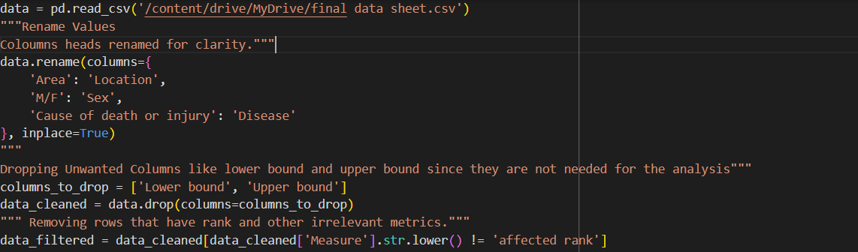
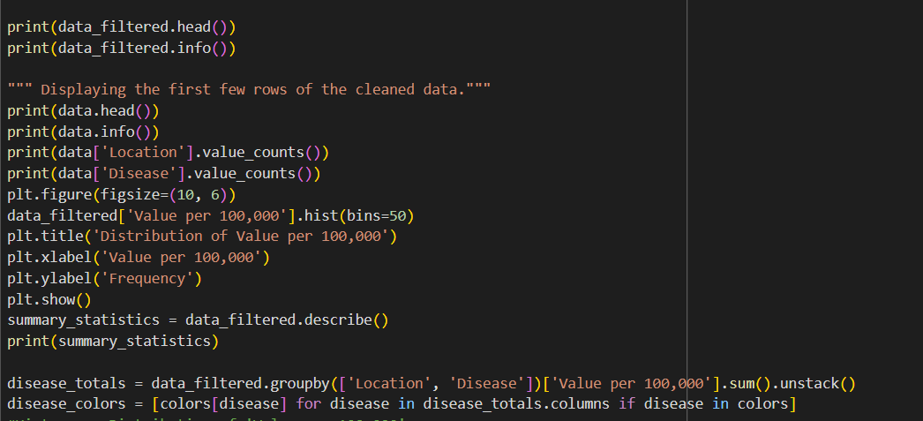

Slide 4


Distribution Analysis
The distribution of disease incidence per 100,000 people varies widely across different states.
The data shows a range of values, indicating varying levels of disease occurrence across the population.
Notable outliers are present, which may represent either exceptionally high incidence rates or errors in data reporting.
Histogram Showing Spread and Frequency
The histogram visually represents the frequency of different incidence rates per 100,000 people.
The histogram reveals a right-skewed distribution, where the majority of values are clustered towards the lower end of the scale.
Higher values are less frequent but are still significant, suggesting that while most states have lower disease incidence rates, there are some with much higher rates.
Summary Statistics:
Mean: The average value per 100,000 people, which may be influenced by outliers.
Median: The middle value, providing a central tendency that is less affected by skewness.
Mode: The most frequently occurring value, if applicable.
Range: The difference between the maximum and minimum values, indicating the spread of the data.
Standard Deviation: Measures the variability or dispersion of the values around the mean.
Key Observations:
The right skew suggests that while most regions have lower disease incidence, there are significant outliers with much higher rates.
Understanding this distribution helps in identifying regions with exceptional cases and guiding targeted health interventions.

Slide 5
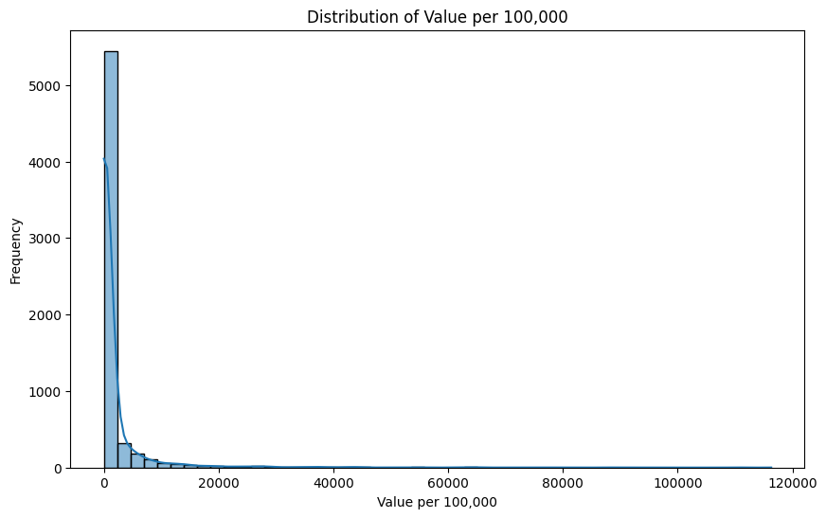
Distribution for Value per 100,000-Histogram

Slide 6
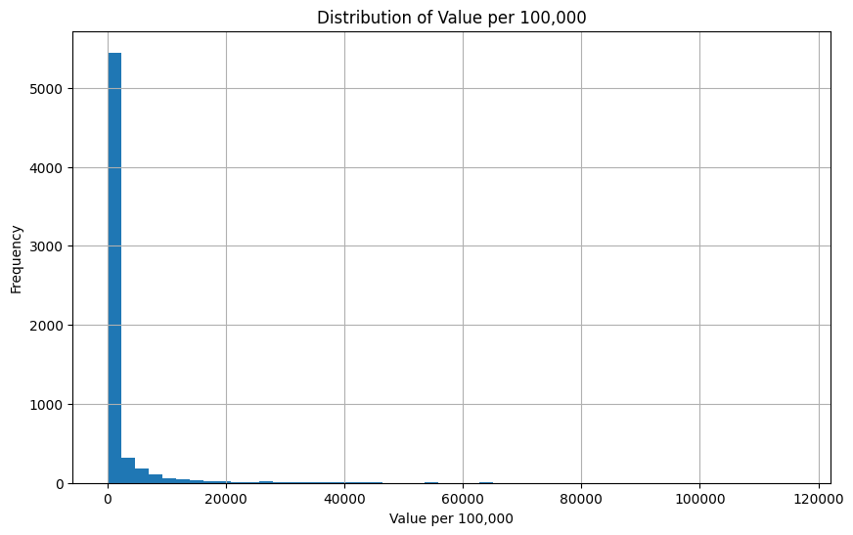

Slide 7
Disease Distribution by State-Stacked bar chart
The stacked bar chart illustrates the distribution of various diseases across Indian states.
The total value is represented per 100,000 population for each state.
Key Observations:
Uttar Pradesh has the highest disease burden, with significant contributions from respiratory infections, tuberculosis, and other non-communicable diseases.
Maharashtra, Bihar, and West Bengal also show a high prevalence of diseases, particularly in categories such as respiratory infections, cardiovascular diseases, and maternal and neonatal disorders.
States like Kerala, Karnataka, and Tamil Nadu display a more diverse distribution across multiple disease categories, indicating a broader range of public health challenges.
Smaller states or regions like Goa, Sikkim, and Union Territories exhibit lower overall disease burdens but still face notable issues in specific areas like chronic respiratory diseases and mental disorders.
Nagaland, Mizoram, and other northeastern states show lower overall disease values, with some focus on infectious diseases.

Slide 8
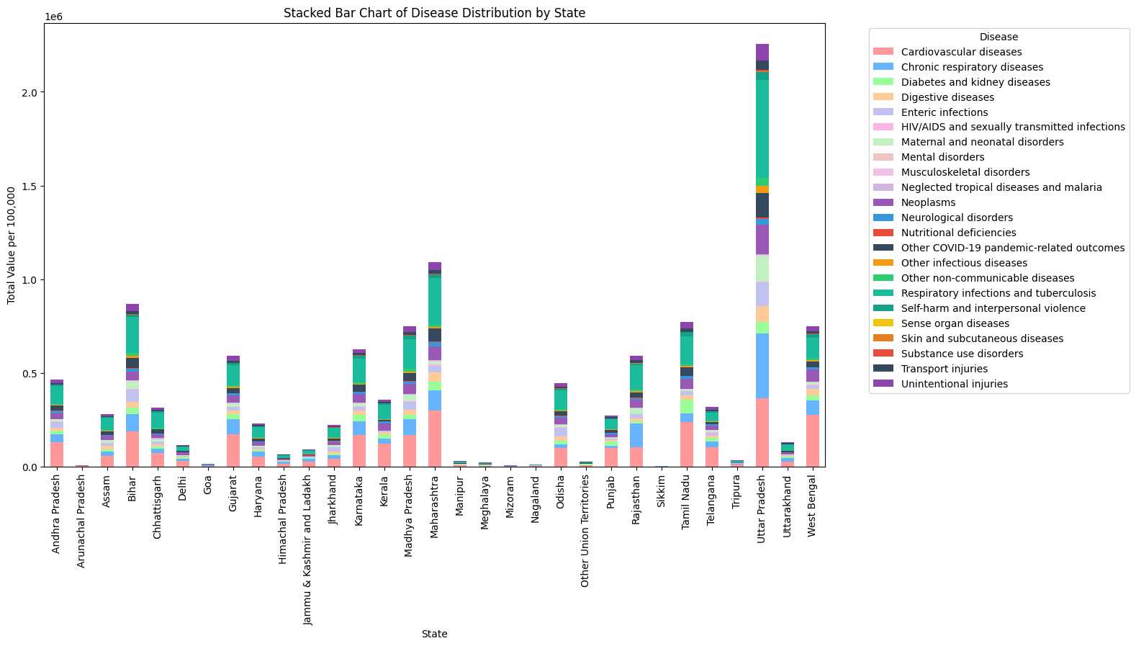

Slide 9
Age group analysis-Heatmap
The heatmap displays the average disease prevalence across different age groups and states.
Age groups include <5 years, 5-14 years, 15-49 years, 50-69 years, and 70+ years.
Key Insights:
Highest Disease Prevalence:
The 70+ years age group shows the highest disease burden, particularly in Uttar Pradesh, Maharashtra, and West Bengal.
Uttar Pradesh stands out with extreme values, especially in the 50-69 years and 70+ years age groups, indicating a significant health burden among the elderly.
Young Adults (15-49 years):
States like Bihar, Maharashtra, and Madhya Pradesh exhibit high disease prevalence in the 15-49 years age group.
This suggests that working-age adults in these states face considerable health challenges.
Children and Adolescents:
The 5-14 years age group generally has lower disease prevalence, but Bihar and Odisha show notable values.
Regional Variations:
Southern states like Kerala and Tamil Nadu show moderate to high disease prevalence across various age groups, especially among the elderly.
Northeastern states like Nagaland and Mizoram display relatively low disease prevalence across all age groups.

Slide 10
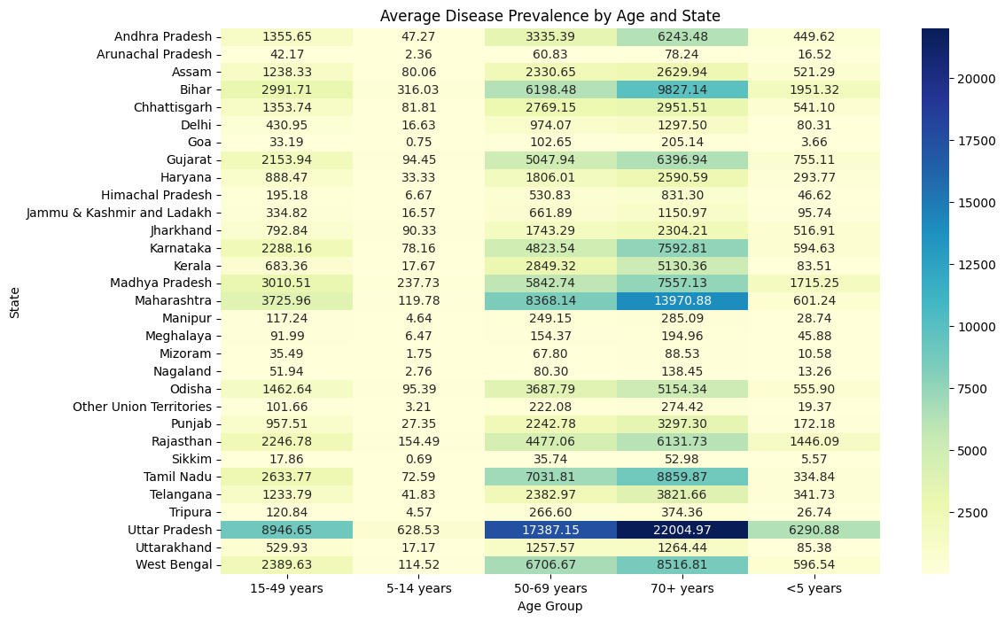

Slide 11
Correlation Between Age and Disease Incidence-Scatterplot
The scatterplot visually represents the relationship between different age groups and the incidence rates of various diseases.
Each point on the scatterplot corresponds to a specific disease incidence rate per 100,000 individuals within an age group.
The x-axis categorizes the population into five distinct age groups: <5 years, 5-14 years, 15-49 years, 50-69 years, and 70+ years.
The y-axis quantifies the disease incidence rate, showing how many individuals per 100,000 are affected by each disease within these age groups.
Observations suggest that disease incidence tends to increase with age, particularly in the 70+ years group, where a higher concentration of data points is observed at higher incidence rates.
Diseases such as cardiovascular and chronic respiratory diseases exhibit a noticeable increase in incidence in older age groups, while diseases like maternal and neonatal disorders are more prevalent in younger age categories.
Custom Color Palette for Disease Categories:
A custom color palette was applied to distinguish between the various disease categories in the scatterplot, improving visual clarity and aiding in the differentiation of trends across diseases.
The color scheme allows for quick identification of disease clusters and patterns, making it easier to observe how specific diseases affect different age groups.

Slide 12
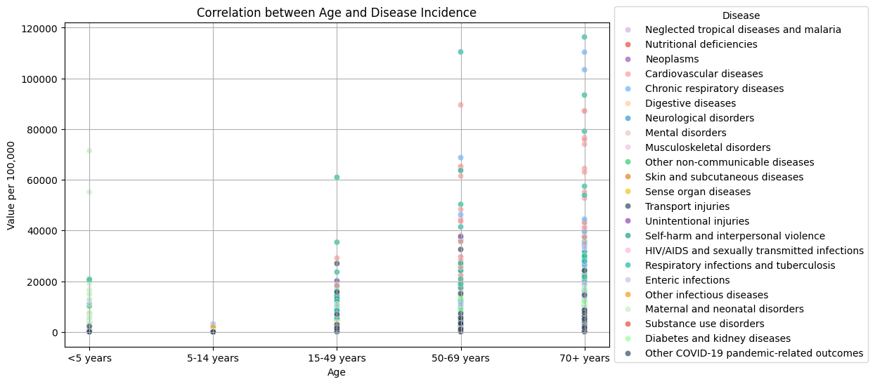

Slide 13
Summary:
Summary of Key Findings:
Age and Disease Incidence:
Older age groups, especially 70+, show higher disease rates, notably for cardiovascular and chronic respiratory diseases. Younger populations face challenges like maternal and neonatal disorders.
Regional Variations:
States like Uttar Pradesh, Maharashtra, and West Bengal have the highest disease burdens, with Southern states like Kerala and Tamil Nadu showing diverse health challenges. Northeastern states generally have lower prevalence.
Disease Distribution:
Disease incidence varies widely across states, with significant outliers indicating areas of concern.

