Slide 1
CAPSTONE · ENTERPRISE ASSISTANT TRACK
01 Reading
Self-Healing
Multi-Agent Tax Filing
02 Tax Processing
03 Verification
LLMs read. Deterministic code decides. Every number traces to a source.
04 Remediation
A local-first system that turns a pile of US tax documents into a verified,
line-numbered Form 1040 — without letting a model do the tax arithmetic.
05 Documentation
TEAM [ Team Member Names ]
FinTech · RegTech

Slide 2
THE PROBLEM
Filing a return is high-stakes — and today’s tools force a bad trade.
Meet the target user: an individual filer (or a small tax-prep shop) with a shoebox of W-2s, 1099s, K-1s and 1098s. One wrong figure means an IRS notice, a penalty, or an audit. The stakes are real; the margin for error is zero.
DIY software
Human preparers
Naïve “AI tax bots”
You re-key every box by hand. A typo in Box 1 flows silently into the return — no evidence trail, and the error surfaces months later in the mail.
Accurate but slow and expensive. Turnaround is days, cost is hundreds of dollars, and you still can’t see how any number was reached.
An LLM will happily invent income, withholding, or a credit. A hallucinated number on a legal filing is not a bug you can ship — it’s a liability.
Why it matters: a tax return is a signed legal document. Filers need software speed with preparer-grade accountability — a return that is fast, correct, and auditable to the source.

Slide 3
SOLUTION OVERVIEW
Drop in your documents. Get back a return you can defend.
Five cooperating agents extract every figure from your source documents — grounding each to evidence — compute the return on a deterministic 2025 federal + state engine, challenge it with two independent verdicts (correctness and completeness), run a bounded self-healing loop on any failure, and emit an official-style Form 1040 PDF.
BEFORE
WITH THIS
Re-key every box by hand
Upload W-2s / 1099s / K-1 / 1098 — done
No trail from a number to its document
Every figure carries page-level evidence
Errors surface late — in an IRS letter
Two verdicts catch wrong AND missing docs
“Trust me” numbers from an LLM
A model never authors a number on the return
Core value: a tax return where every monetary value is reproducible and traceable to a source document — preparer-grade accountability at software speed.

Slide 4
TECH STACK
Local-first by default. One optional cloud component.
LLM / INFERENCE
ORCHESTRATION
DOCUMENT EXTRACTION
Ollama — local, no hosted API
llama3.2-vision · qwen2.5-coder:7b
LangGraph state machine
checkpointed per submission_id
PyMuPDF + Tesseract OCR
label-anchored W-2 parser
Role: read & classify only
never authors tax numbers
5-agent graph + verify gate
bounded self-healing loop
Azure Document Intelligence
optional — prebuilt-tax.us.w2
TAX ENGINE
DATA & PERSISTENCE
API · UI · REPORTING
Pure-Python 2025 1040 engine
deterministic, decimal-safe
SQLAlchemy 2.x — SQLite default
PostgreSQL via Docker
FastAPI + Uvicorn · Pydantic v2
async 202 + poll
Versioned, source-cited rules
42 states + DC · tenforty
ChromaDB vector store
embedded or standalone
React 18 + TS + Vite · ReportLab
line-numbered 1040 PDF
No hosted LLM dependency — if the local models aren’t pulled, the pipeline degrades gracefully and the deterministic engine still carries the core flow.

Slide 5
SYSTEM ARCHITECTURE
Verification gates the flow. Failures heal or escalate.
React 18 + Vite UI
→
FastAPI · async 202 + poll
→
LangGraph Orchestrator (checkpointed)
valid ✓
01 PARSE
02 CALCULATE
03 VERIFY
04 DOCUMENT
Reading agent
Tax Processing
Verification
Documentation
OCR + vision extraction, grounded to evidence
Deterministic 1040 on versioned rules
Recompute · invariants · evidence · completeness
Line-numbered 1040 + schedules → PDF
invalid ✗
→ Completed + filing receipt
re-extract /
recompute
REMEDIATE
MANUAL REVIEW
Bounded deterministic fixes or re-extract. Never invents values.
Attempts exhausted → escalate. No silent acceptance.
INPUTS
READ SERVICES
PERSISTENCE
W-2 · 1099s · K-1 · 1098 (PDF/PNG/JPG)
Tesseract OCR · llama3.2-vision · Azure DI*
SQLite / PostgreSQL · ChromaDB · file storage

Slide 6
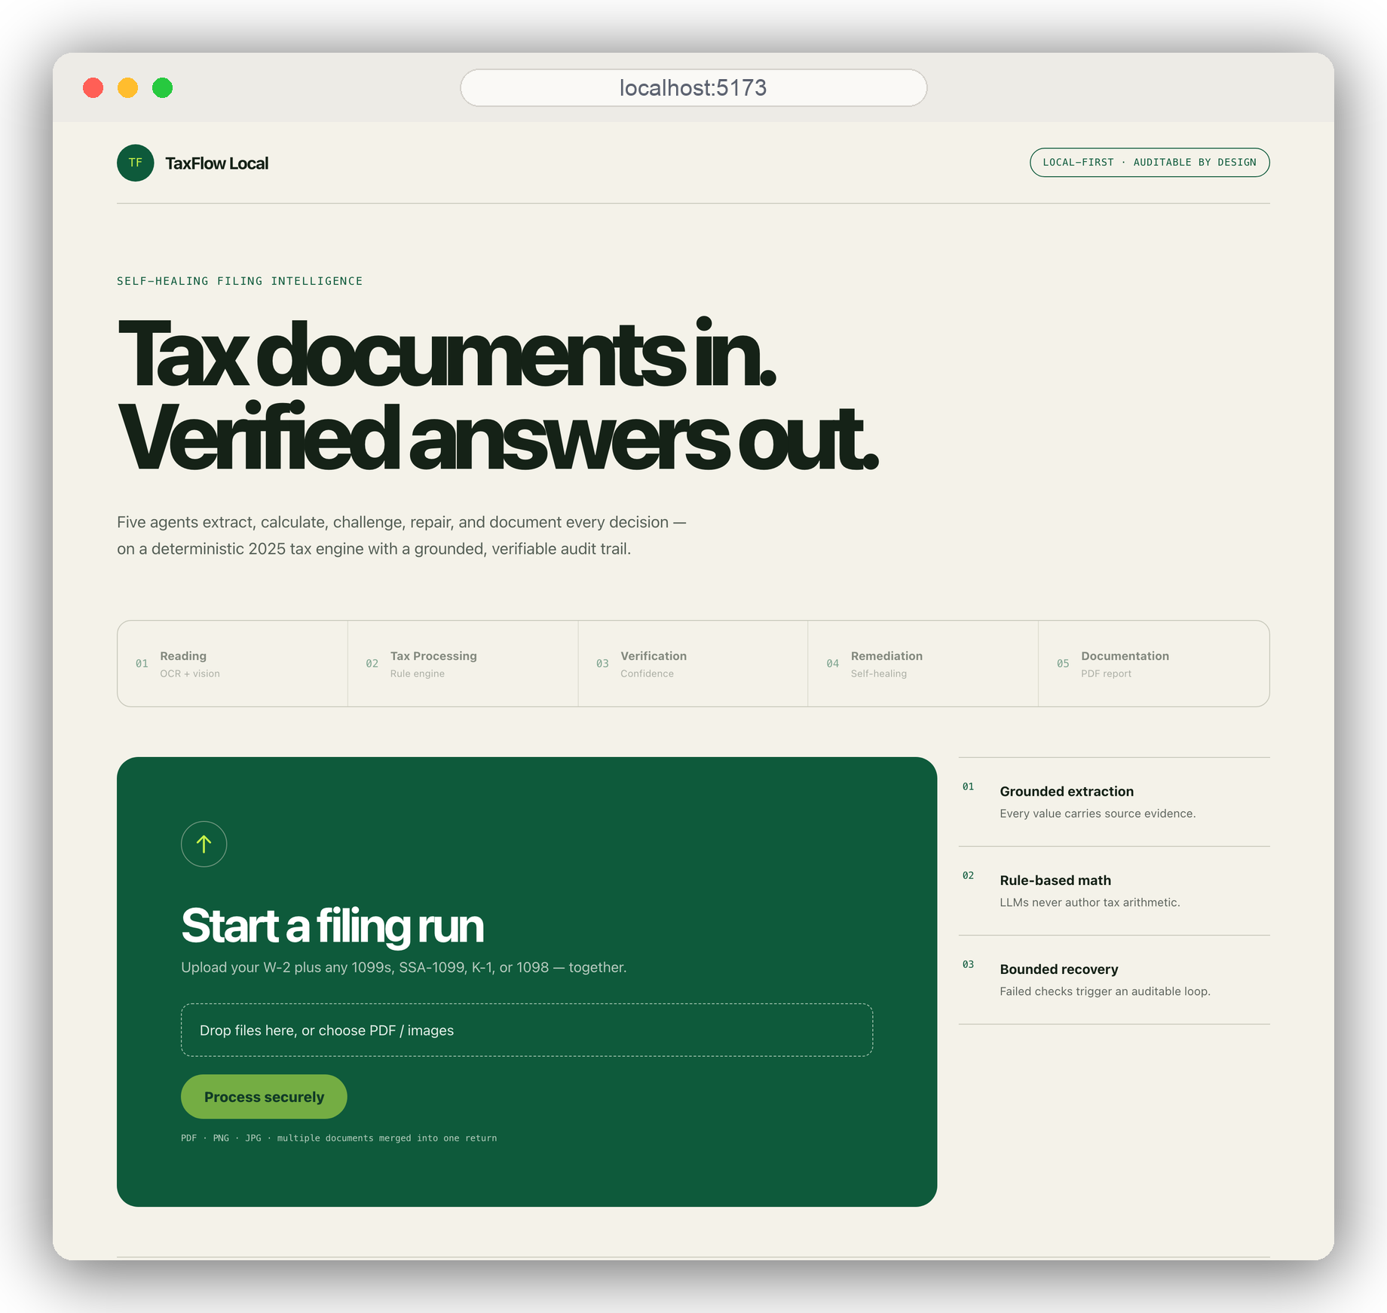
LIVE DEMO · STEP 1 OF 4
Drop the documents in
POST /api/v1/submissions
Returns 202 + submission_id instantly — the five-agent graph runs in the background.
GET /submissions/{id} · poll
The UI polls every 1.5s and streams live status until the run is terminal.
ONE RUN, MANY FORMS
W-2 + 1099s + SSA-1099 + K-1 + 1098 are merged into a single return.
On stage: narrate each agent as it fires, keep it deliberate, and trigger the edge case at the end.

Slide 7
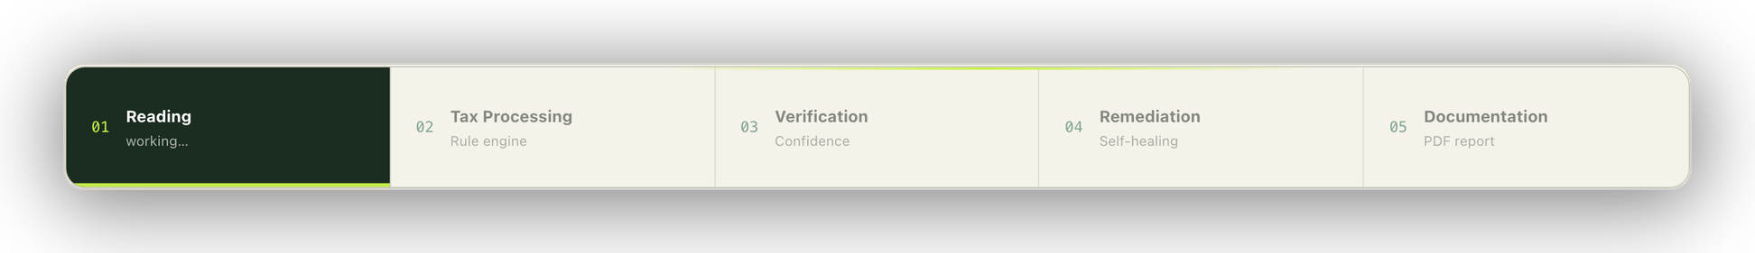
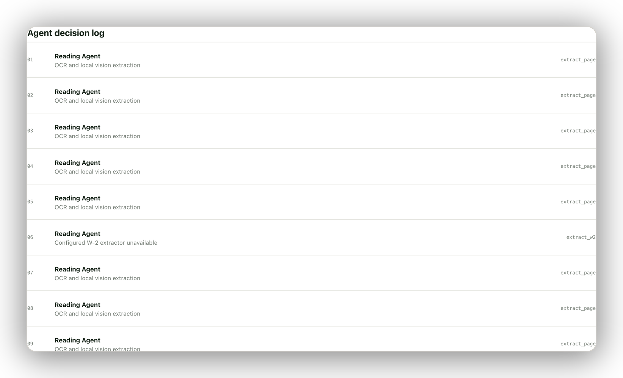
LIVE DEMO · STEP 2 OF 4
Five agents run — narrate the backend
READING · extract_page / extract_w2
OCR + local vision + optional Azure DI — every value grounded to SourceEvidence.
TAX PROCESSING · calculate_tax
Deterministic 2025 Form 1040 engine — no LLM ever authors a number.
VERIFICATION · verify_submission
Independent recompute + W-2 statutory invariants + completeness.
GRACEFUL DEGRADATION
Log flags 'extractor unavailable' & 'ChromaDB unavailable' — the run never crashes.

Slide 8
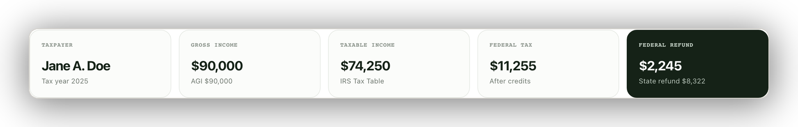
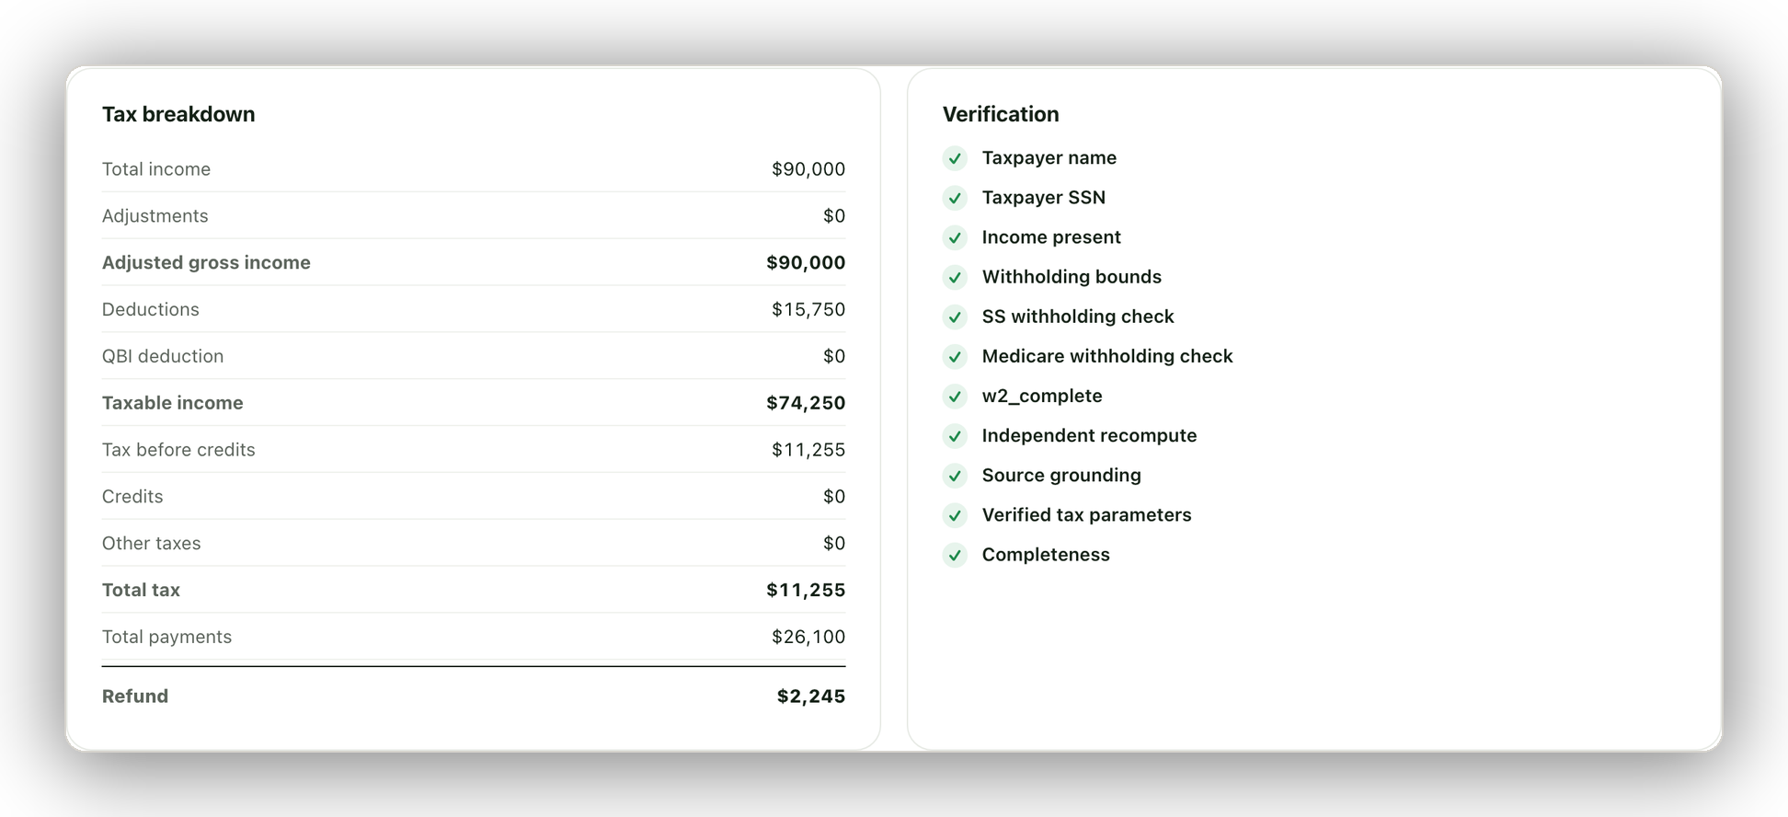
LIVE DEMO · STEP 3 OF 4
A return you can defend
99% CONFIDENCE
Two independent verdicts: correctness ✓ and completeness ✓.
INDEPENDENT RECOMPUTE
The verifier re-derives the return from raw inputs.
EVERY FIGURE GROUNDED
11 checks incl. W-2 statutory invariants — all green.
DOWNLOAD 1040 PDF
Line-numbered form + only the schedules it used.

Slide 9
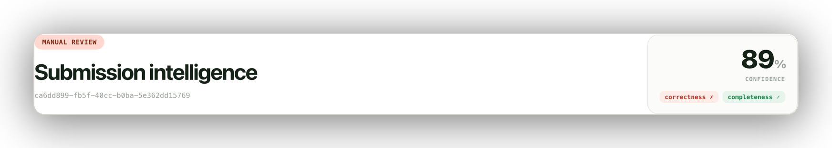
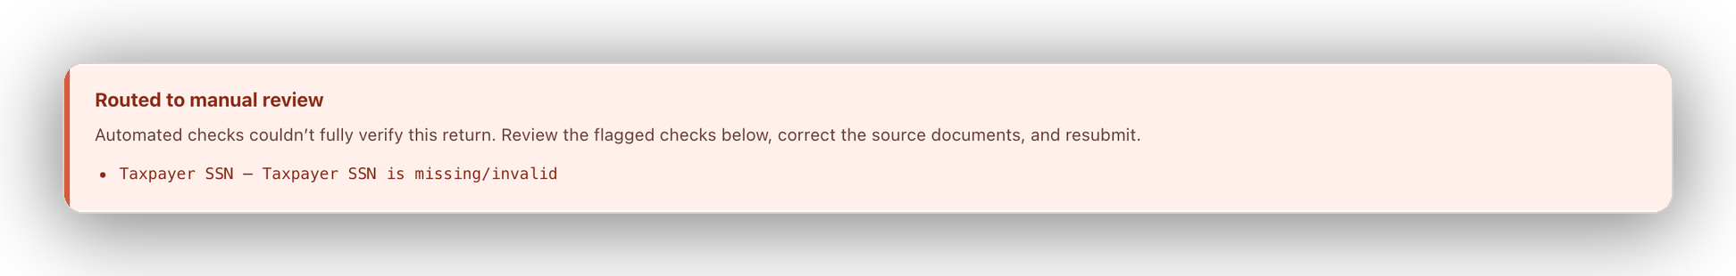
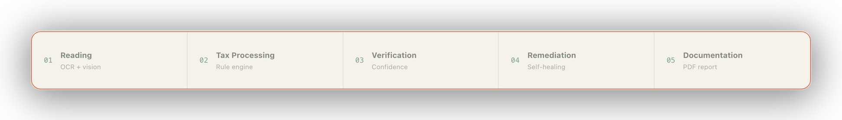
LIVE DEMO · STEP 4 OF 4 — THE “WHAT IF”
What if a document is bad?
TRIGGER LIVE
Upload a W-2 with the SSN box blanked.
VERIFY ✗ → REMEDIATE
The 'Taxpayer SSN' check fails; remediation retries within its bounded cap (MAX_REMEDIATION_ATTEMPTS).
ATTEMPTS EXHAUSTED → MANUAL REVIEW
No silent acceptance — the return is escalated, not guessed.
Same run, live — the pipeline halts at Verification and refuses to finalize.
WHY IT MATTERS
The safety property: the system refuses to invent a legal value it can’t verify to a source.

