Slide 1
Classification Part I: Logistic Regression
Justin M. Rao, MSR-NYC

Slide 2
Outcome types
Binary outcomes: equal to 1 or 0. Examples: coin is heads or tails, person is guilty or innocent, default or not on a loan, etc.
Continuous outcomes: can take an real value
Categorical outcomes: can take one of N qualitative values. Example: mapping symptons to a well-defined disease.
Traditional regression is designed for continuous outcomes.
We use classification for binary and categorical outcomes

Slide 3
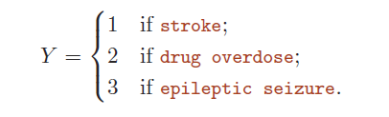
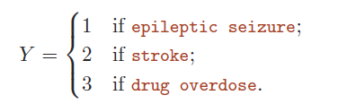
Why not linear regression?
A mapping of categories to numbers comes with strong implications
Would imply different “differences” across qualitative conditions
Vs.

Slide 4

Classification with binary outcomes
Outcome: 0 or 1
Given features X, we want to say “what is the probability the outcome=1”.
We can write this as $P(outcome=1|X)$
Our model will output a probability even though real outcomes will always be 0 or 1

Slide 5
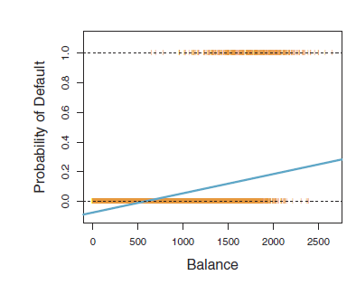
Linear models and probabilities
Linear models will tend to make predictions outside [0,1]
Since probabilities should never be outside [0,1], this is a bad feature
We will instead use non-linear models

Slide 6
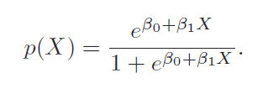
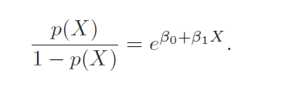
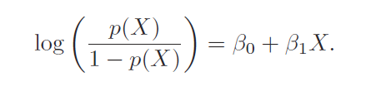
Logistic regression
Odds: ratio of probability outcome=1 to probability outcome=0
Examples
p(x)=.5. Odds=1 (or 1:1)
p(x)=.75. Odds=3 (or 3:1)
p(x)=.9. Odds=9 (or 9:1)
Logit says: the log of the odds is a linear function of the features.
Just like with regular regression, we can add more features

Slide 7
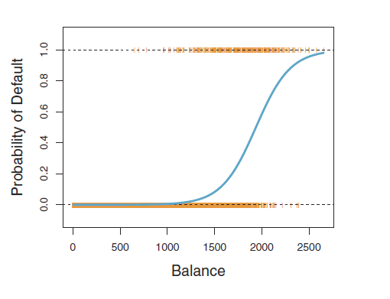
Visualizing a logistic function
The estimate parameters will make the function steeper or flatter (stretch it out) or shift it left or right
Estimation will minimized squared loss

Slide 8
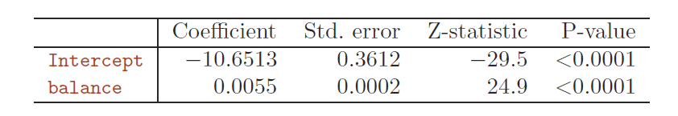
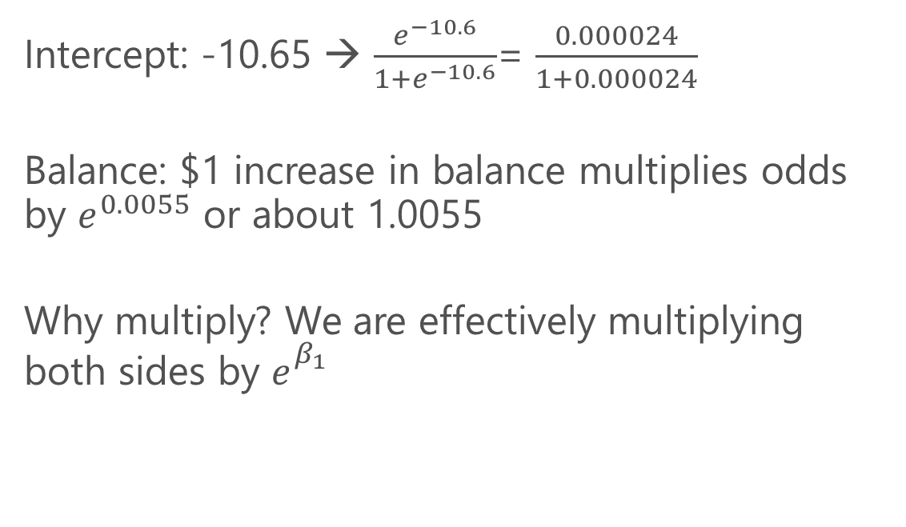
Logistic regression output
Intercept: -10.65 → $\frac{e^{−10.6}}{1+e^{−10.6}}$= $\frac{0.000024}{1+0.000024}$
Balance: $1 increase in balance multiplies odds by $e^{0.0055}$ or about 1.0055
Why multiply? We are effectively multiplying both sides by $e_{}^{β_{1}}$

Slide 9
Non-linear response
Increases in balance at the sat the start have a limited impact.
Similarly at the end.
In the middle region, increase are particularly important

Slide 10
Logistic regression in R
We will use the glm() function. “Generalized linear models”. family=binomial specifies Logit
predict(my_model, type=“response”) will output the fitted probabilities
To convert this to a 0,1 prediction, we simply set a threshold of when we want to predict 1 (0.5 will minimize prediction error)

Slide 11
Next class and problem set We will learn more advanced models for classification The problem set is on the Git and should boost our familiarity with R Reading: Chapter 4 in ISL

