Slide 1
Classification Part II: K class models
Justin M. Rao, MSR-NYC

Slide 2
Outcome types
Binary outcomes: equal to 1 or 0. Examples: coin is heads or tails, person is guilty or innocent, default or not on a loan, etc.
Continuous outcomes: can take an real value
Categorical outcomes: can take one of K qualitative values. Example: mapping symptoms to a well-defined disease.
Traditional regression is designed for continuous outcomes.
We use classification for binary and categorical outcomes

Slide 3
Why not just Logit?
Alternative methods can perform better with more than 2 outcomes
Different functional forms can offer better performance in different settings.

Slide 4

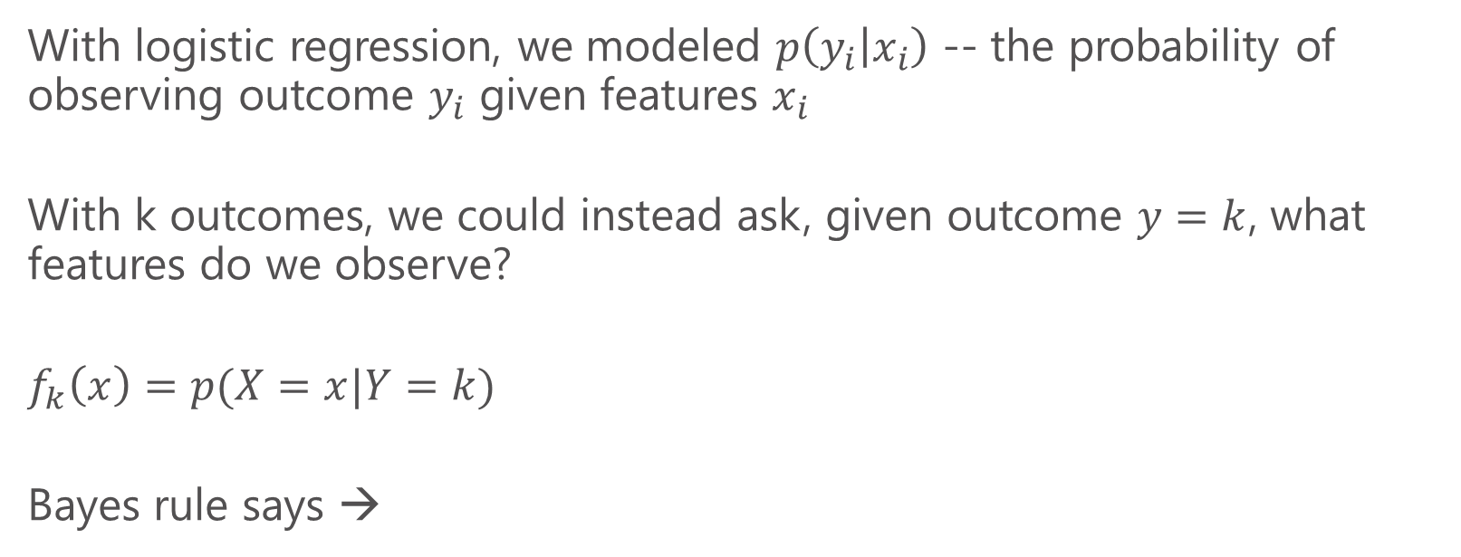
Using Bayes rule
With logistic regression, we modeled $p\left(y_{i} | x_{i}\right)$ -- the probability of observing outcome $y_{i}$ given features $x_{i}$
With k outcomes, we could instead ask, given outcome $y=k$, what features do we observe?
$$f_{k}\left(x\right)=p(X=x|Y=k)$$
Bayes rule says →
Base rates
Can be estimated from overall frequency in population

Slide 5
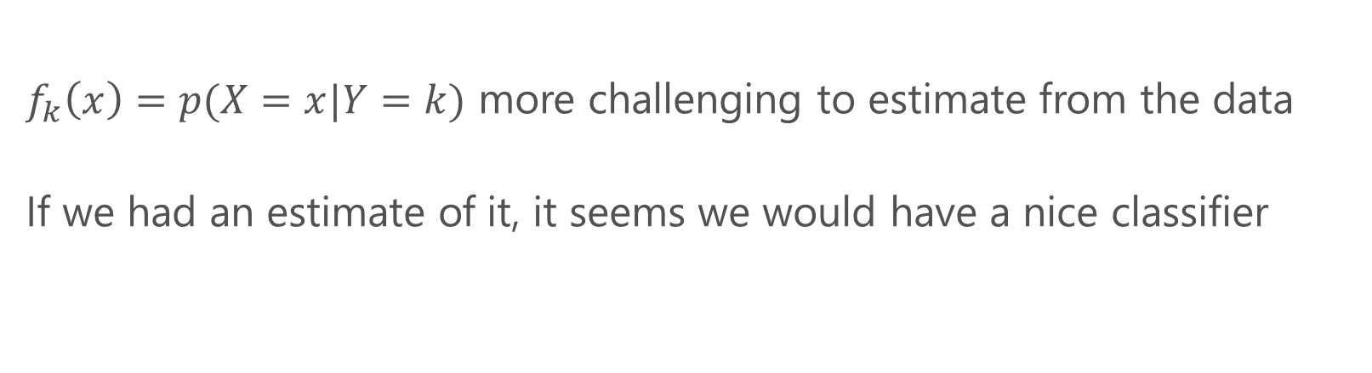
Using Bayes rule
$f_{k}\left(x\right)=p(X=x|Y=k)$ more challenging to estimate from the data
If we had an estimate of it, it seems we would have a nice classifier

Slide 6
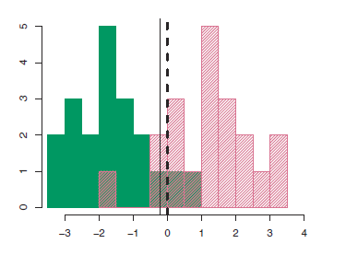
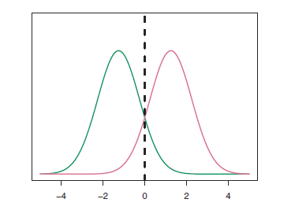
Linear discriminant analysis
We observe this data. Green observations are class 1, pink are class 2.
We estimate with normal distributions and set a boundary

Slide 7


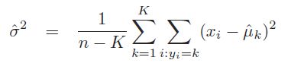
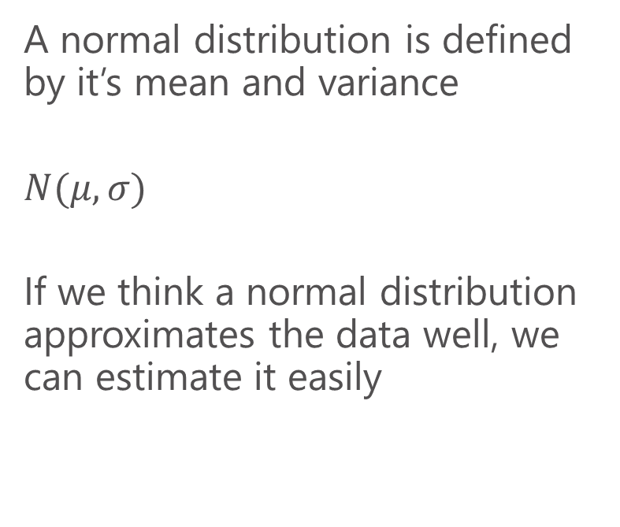
Linear discriminant analysis
A normal distribution is defined by it’s mean and variance
$$N(μ,σ)$$
If we think a normal distribution approximates the data well, we can estimate it easily

Slide 8
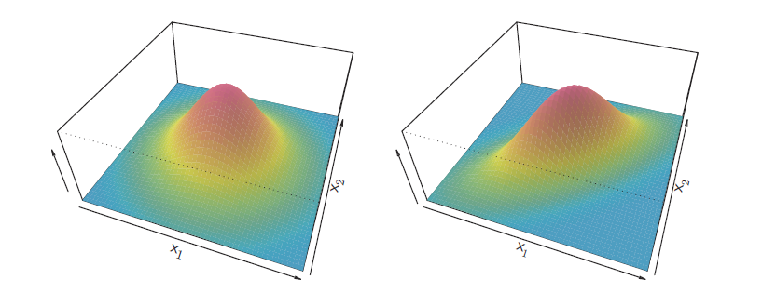
Visualizing with two features
The features are uncorrelated with each other
The features are positively correlated

Slide 9
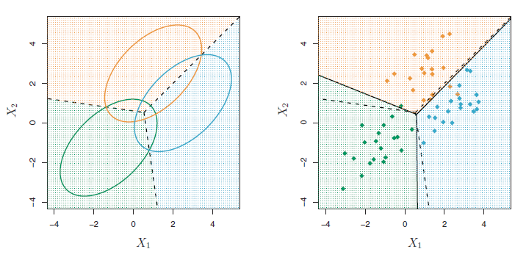
Classification w/ 2 features and 3 outcomes

Slide 10
LDA review
Assume data is distributed normally, set’s linear decision boundaries to maximize the chance of making the right prediction
Easy to implement in R. MASS package, lda() function
lda syntax is just like lm

Slide 11
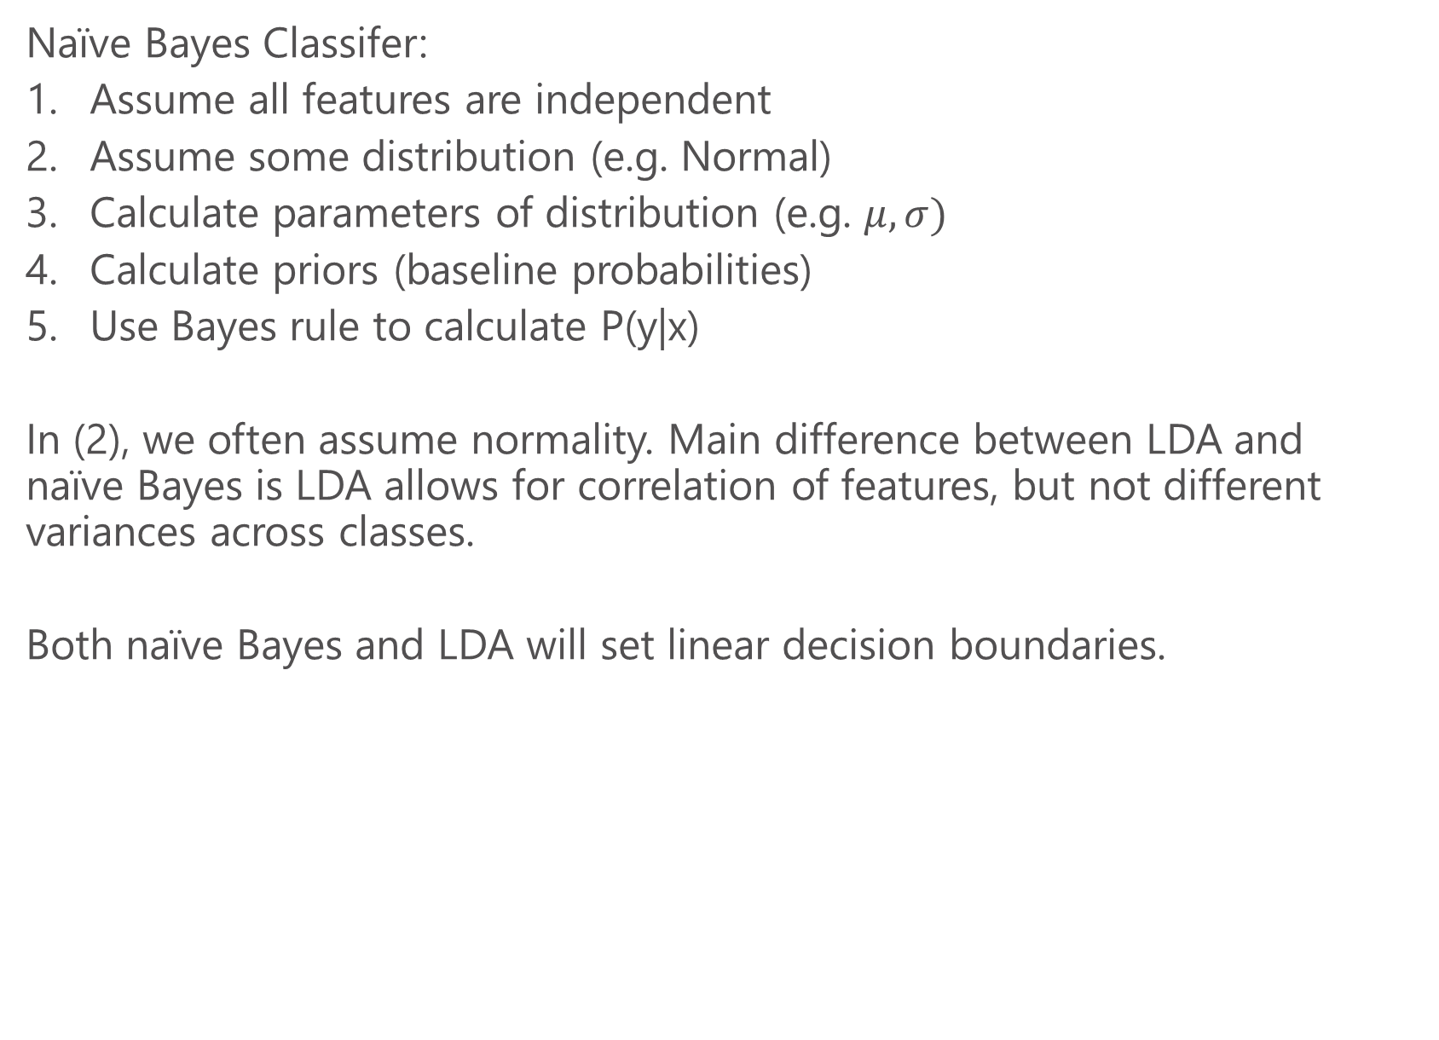
Relationship to “naïve Bayes”
Naïve Bayes Classifer:
Assume all features are independent
Assume some distribution (e.g. Normal)
Calculate parameters of distribution (e.g. $μ, σ)$
Calculate priors (baseline probabilities)
Use Bayes rule to calculate P(y|x)
In (2), we often assume normality. Main difference between LDA and naïve Bayes is LDA allows for correlation of features, but not different variances across classes.
Both naïve Bayes and LDA will set linear decision boundaries.

Slide 12
Evaluating predictions
If there are two outcomes:
[when we get it right]
True positive: predict class true (1), observation is true
True negative: predict class false (0), observation is false
[when we get it wrong]
False positive: predict true, observation is false
False negative: predict false, observation is true

Slide 13
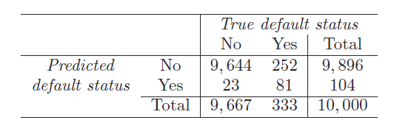
Evaluating predictions, example
Predict 1 if p(x)>0.5
False positives: 23
False negatives: 252
True negatives: 9,644
True positives: 81
Error rate: (252+23)/10000=2.75%
How good is that? Always prediction NO gives error rate of 3.33%

Slide 14
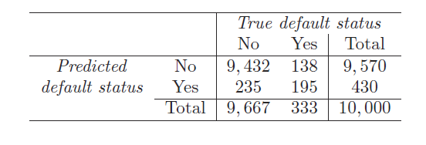
Changing the prediction threshold
Predict 1 if p(x)>0.2
Why might we want to do this?
False positives: 235
False negatives: 138
True negatives: 9,432
True positives: 195
Error rate: (235+138)/10000=3.72%

Slide 15
Precision
Precision: when I predict true, what % of the time am I right
= (true positives)/(all positive labels)
=(true positives)/(true positives + false positives)
Here: 195/430=0.453
For the first threshold, 81/104=0.778

Slide 16
Recall
Precision: when the outcome is true, how often do I predict true
= (true positives)/(all positive cases)
=(true positives)/(true positives + false negatives)
Here: 195/333=0.585
In first case: 81/333= 0.243

Slide 17
Comparing the two thresholds
When set a rule, if p(x)>0.5 then predict TRUE, we observed
Precision=0.77
Recall=0.24
When we set a rule, if p(x)>0.2 then predict TRUE, we observed
Precision=0.45
Recall=0.58
By setting a lower threshold we predict TRUE more often. This leads to more false positives (lower precision), but fewer false negatives (higher recall)

Slide 18
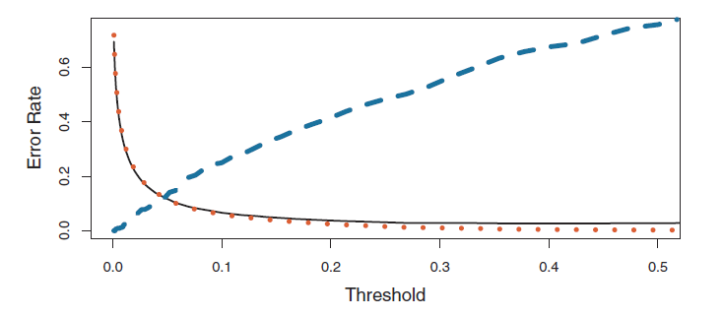
Comparing many thresholds
False negative rate
A threshold of 0.5 minimizes error, but leads to more false negatives
Actual choice of threshold will depend on needs

Slide 19
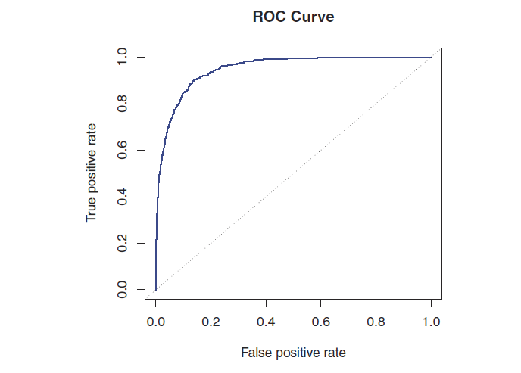
ROC curve
Top right=predict all positive
Bottom left=predict all negative
Area under curve tells me how well the method is doing

Slide 20
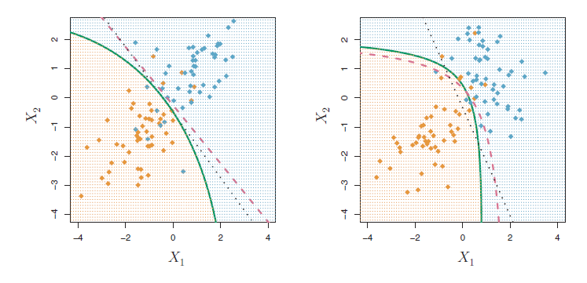
Quadratic discriminant analysis
Again assume everything is jointly normally (Guassian) distributed
This time, let’s allow each class k to have own variance, this will allow for a quadratic decision boundary

Slide 21
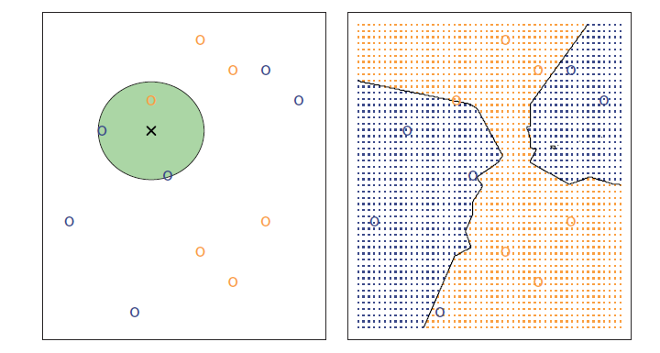
kNN classification
We can use nearest neighbors similar to how we did in regression
Example: find 3 nearest neighbors. Label the point based on the “majority vote”
The implied decision boundaries are given to the right (this is done by just evaluating at any given point)

Slide 22
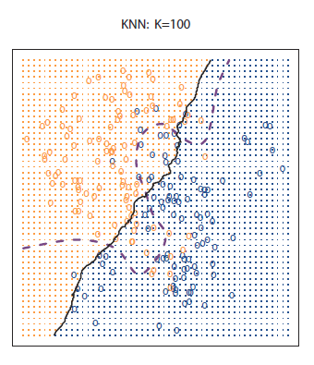
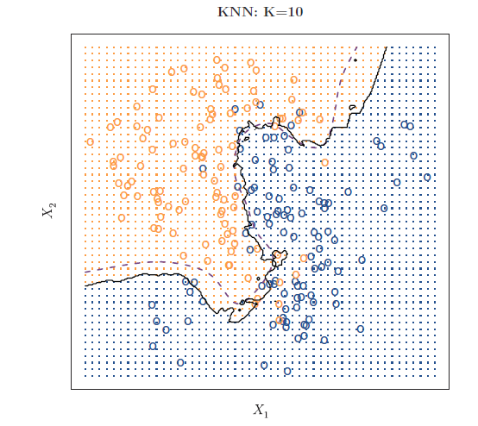
kNN classification

Slide 23
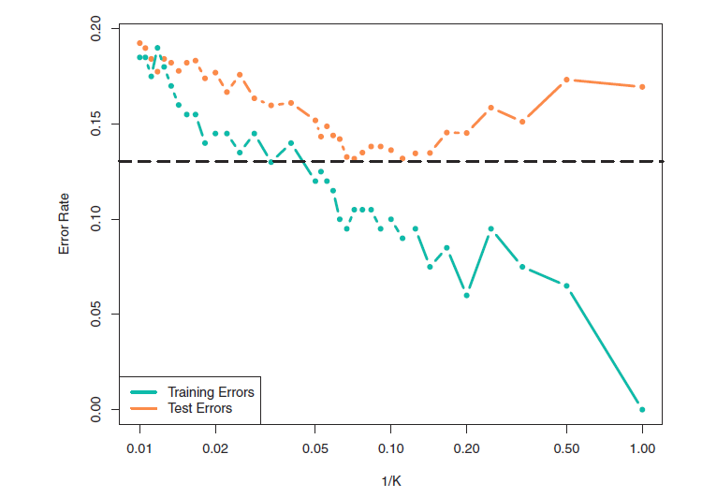
kNN classification, error rates vs. neighborhood size
a
Number of neighbors getting smaller

