Slide 1
Introduction to Regression
Justin M. Rao, MSR-NYC

Slide 2

Terminology
$X:features$.
$$y:\text{outcomes}$$
Goal is to model outcomes as a function of features.
Width of $X$ is $p$
Length of $X$ and $y$ is $n$

Slide 3
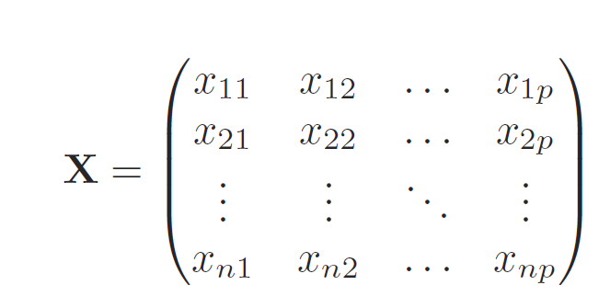
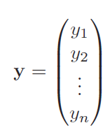
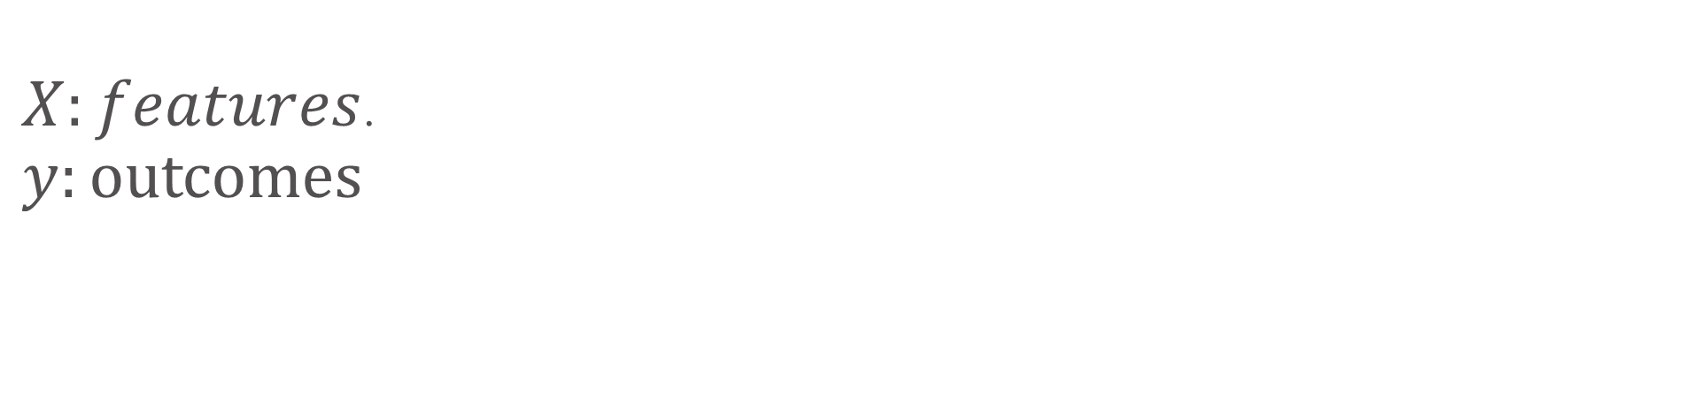
Terminology cont.
$X:features$.
$$y:\text{outcomes}$$
Feature 1
Obs 1
Obs 1

Slide 4
Terminology cont.
$X:features$.
$$y:\text{outcomes}$$
Feature 1
Obs 1
Obs 1

Slide 5

Estimating equations
$$Y=f\left(X\right)+ε$$
$$y_{i}=f(x_{i})+ε_{i}$$
Where $ε_{i}$ is call the error term.

Slide 6

Example: coin flipping
$$Y=f\left(X\right)+ε$$
$${flip}_{i}=p_{i}+ε_{i}$$
$$if outcome=1 then ε_{i}=1−p$$
$$if outcome=0 then ε_{i}=−p$$
$p_{i}$ is a constant, called the “success rate”

Slide 7
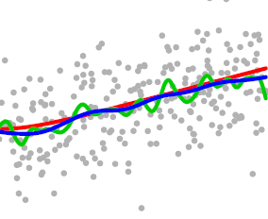
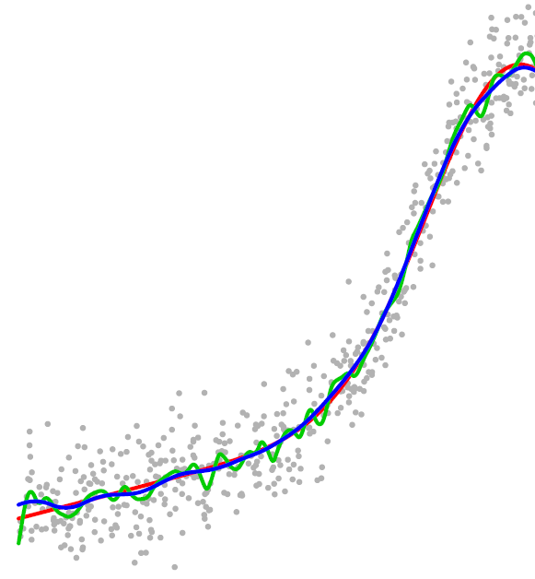
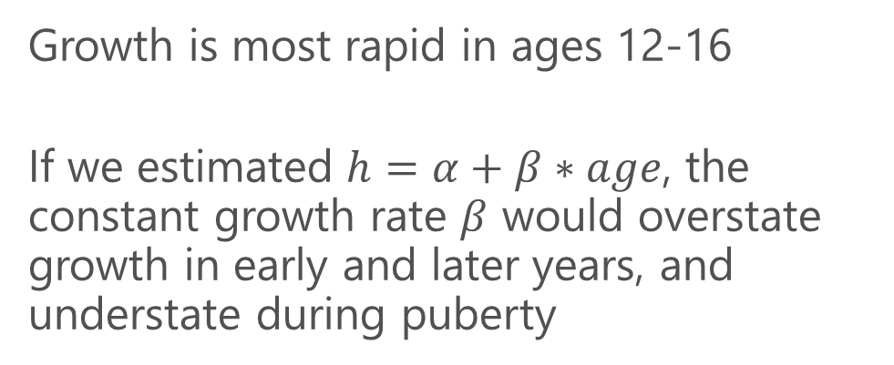
Height as function of age
Growth is most rapid in ages 12-16
If we estimated $h=α+β∗age$, the constant growth rate $β$ would overstate growth in early and later years, and understate during puberty
AGE

Slide 8
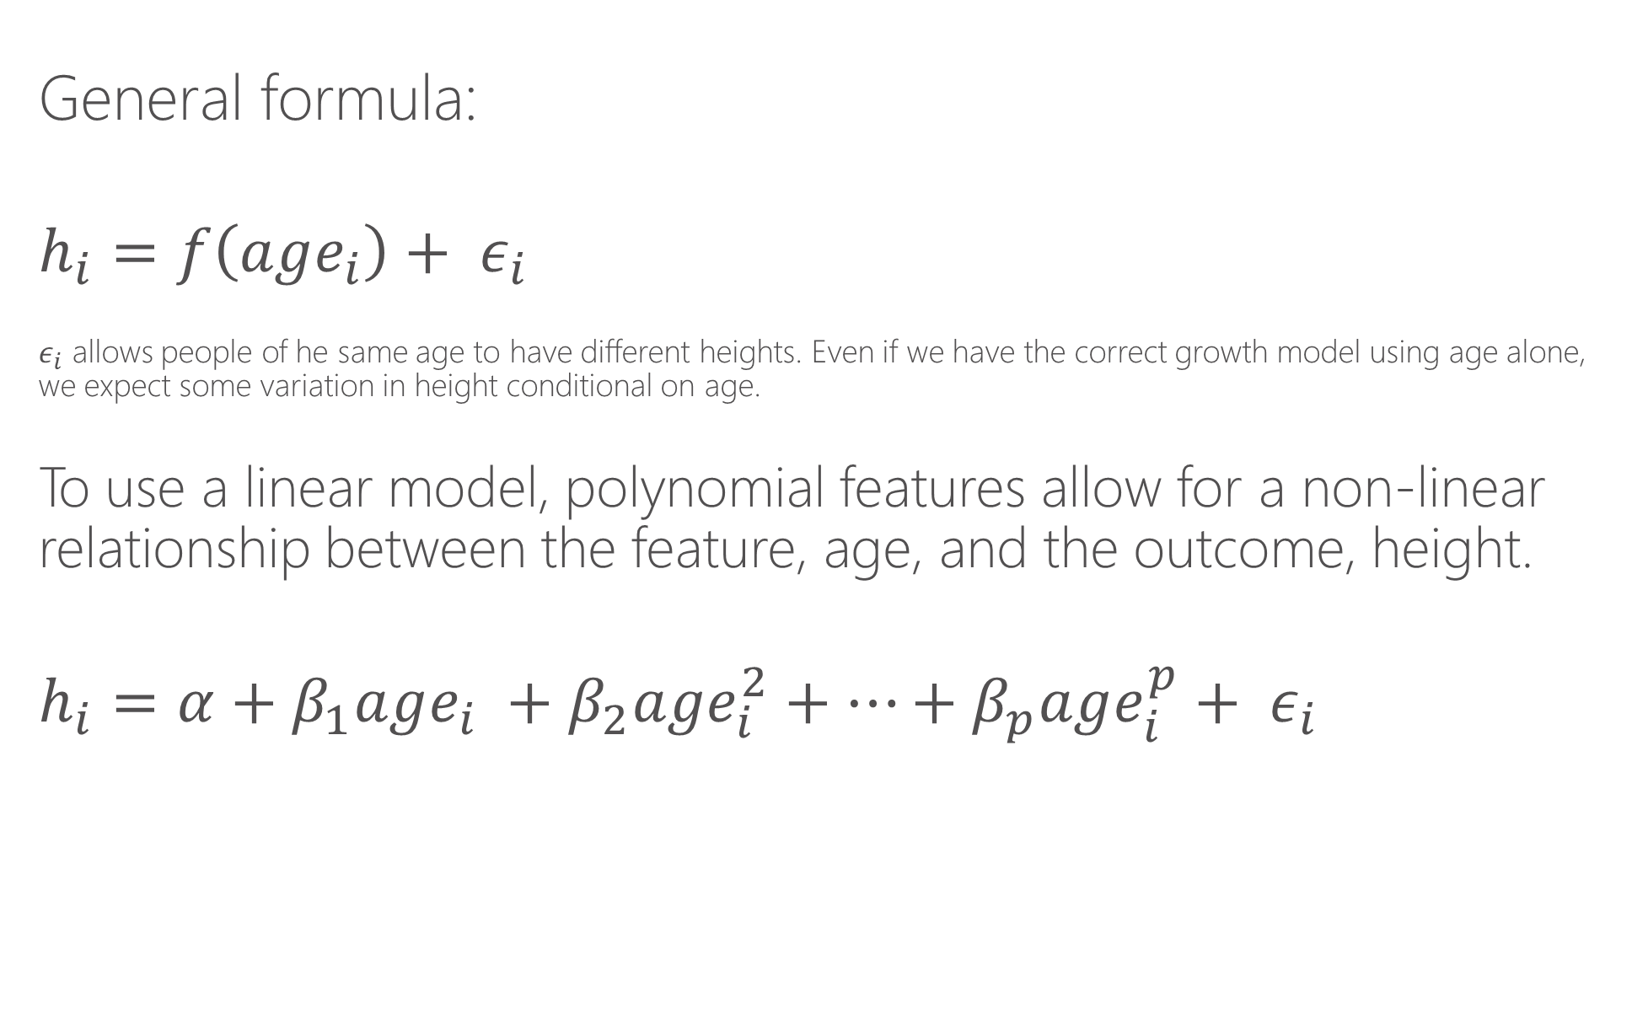
How would we estimate this relationship?
General formula:
$$h_{i}=f\left(age_{i}\right)+ ε_{i}$$
$ε_{i}$ allows people of he same age to have different heights. Even if we have the correct growth model using age alone, we expect some variation in height conditional on age.
To use a linear model, polynomial features allow for a non-linear relationship between the feature, age, and the outcome, height.
$$h_{i}=α+β_{1}age_{i} +β_{2}age_{i}^{2}+…+β_{p}age_{i}^{p}+ ε_{i}$$

Slide 9
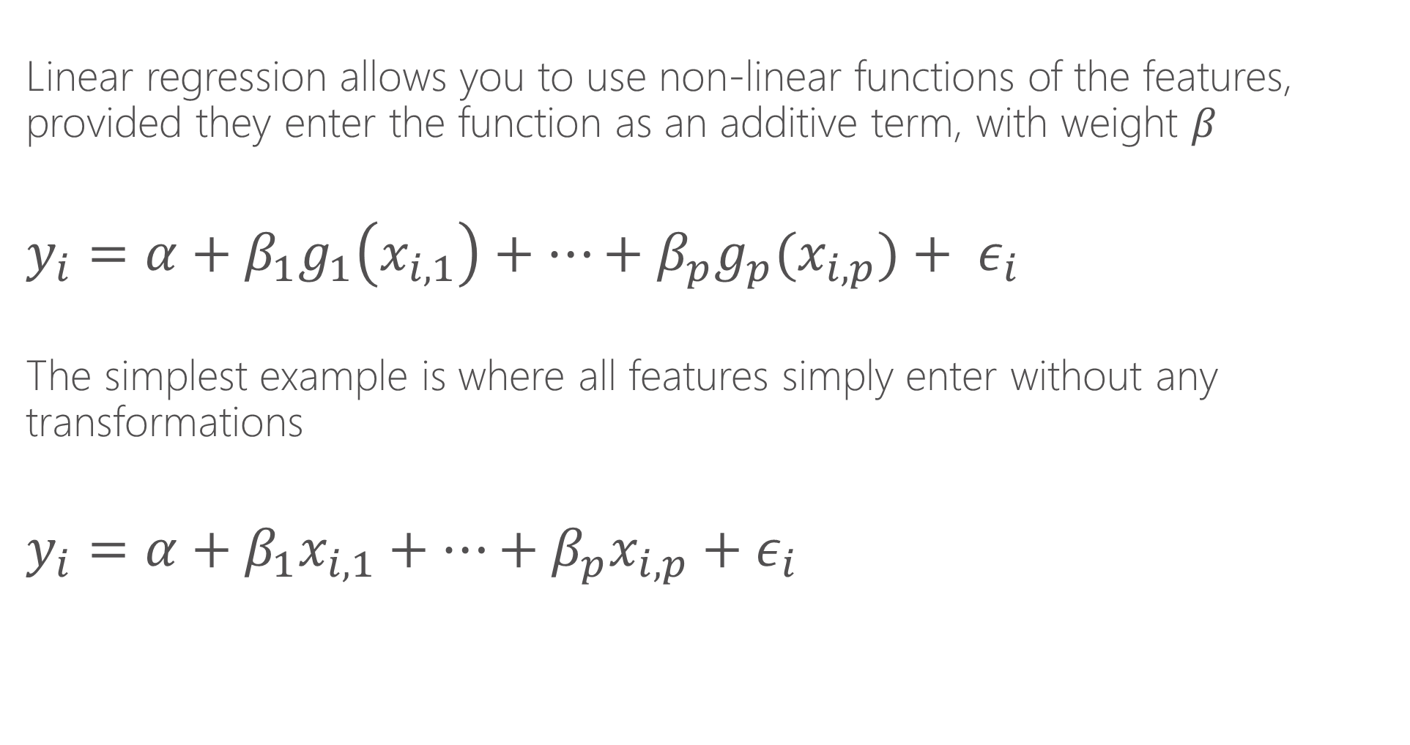
Linear regression
Linear regression allows you to use non-linear functions of the features, provided they enter the function as an additive term, with weight $β$
$$y_{i}=α+β_{1}g_{1}\left(x_{i,1}\right)+…+β_{p}g_{p}(x_{i,p})+ ε_{i}$$
The simplest example is where all features simply enter without any transformations
$$y_{i}=α+β_{1}x_{i,1}+…+β_{p}x_{i,p}{+ ε}_{i}$$

Slide 10
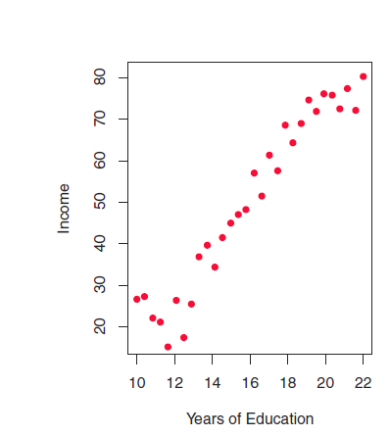
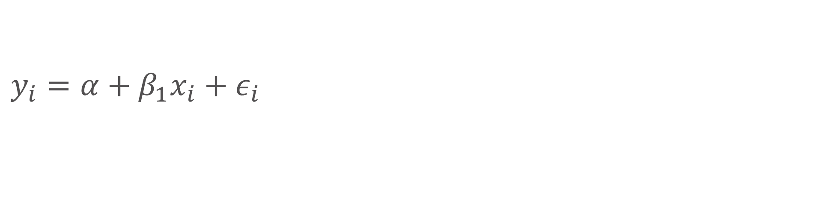
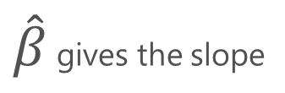
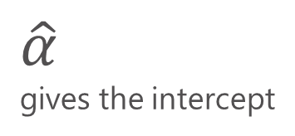
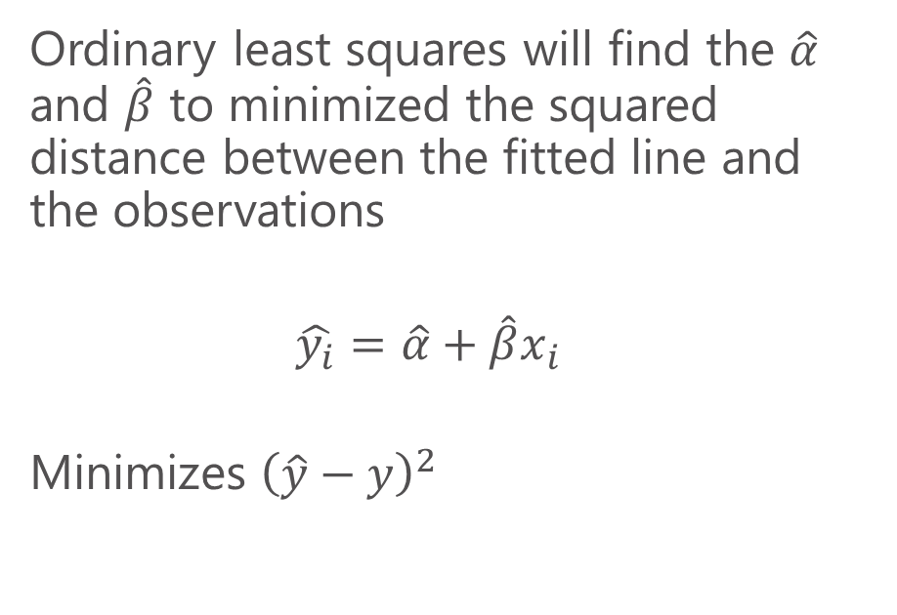
Linear regression
$\hat{β}$ gives the slope
$$y_{i}=α+β_{1}x_{i}{+ ε}_{i}$$
Ordinary least squares will find the $\hat{α}$ and $\hat{β}$ to minimized the squared distance between the fitted line and the observations
$$\hat{y_{i}}=\hat{α}+{\hat{β}x}_{i}$$
Minimizes ${\left(\hat{y}−y\right)}^{2}$
$\hat{α}$
gives the intercept

Slide 11
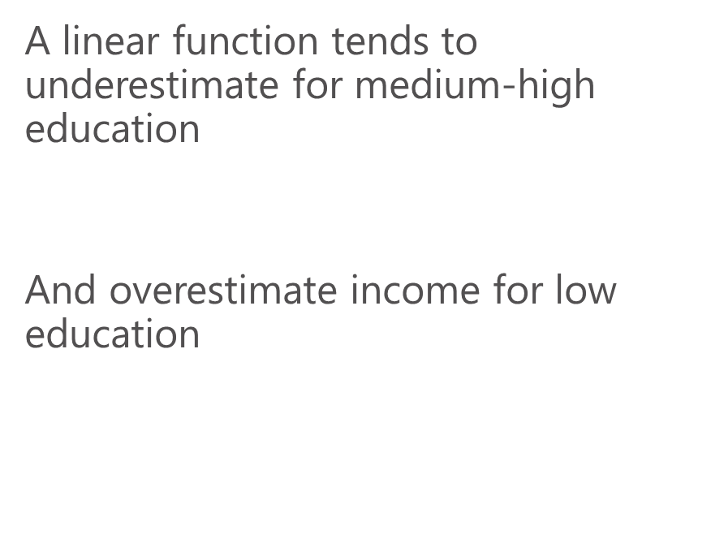
Linear regression
$$y_{i}=α+β_{1}x_{i}{+ ε}_{i}$$
A linear function tends to underestimate for medium-high education
And overestimate income for low education

Slide 12
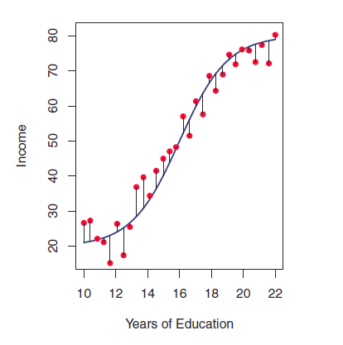

Linear regression
A cubic polynomial fits the data much better
$$\hat{y_{i}}=\hat{α}+{\hat{β_{1}}x}_{i}{+{\hat{β}}_{2}x}_{i}^{2}+{{\hat{β}}_{3}x}_{i}^{3}$$
${\left(\hat{y}−y\right)}^{2}$is now much smaller

Slide 13
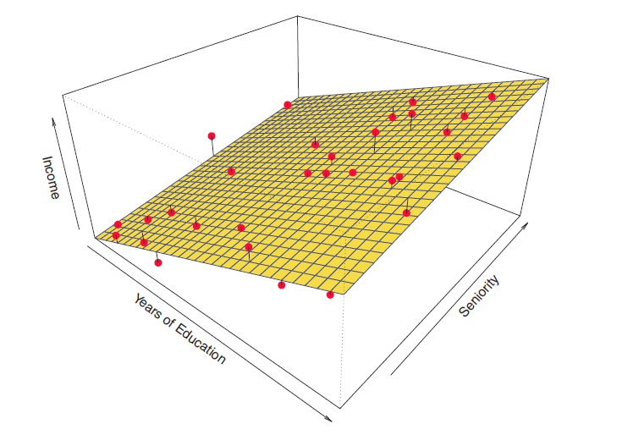
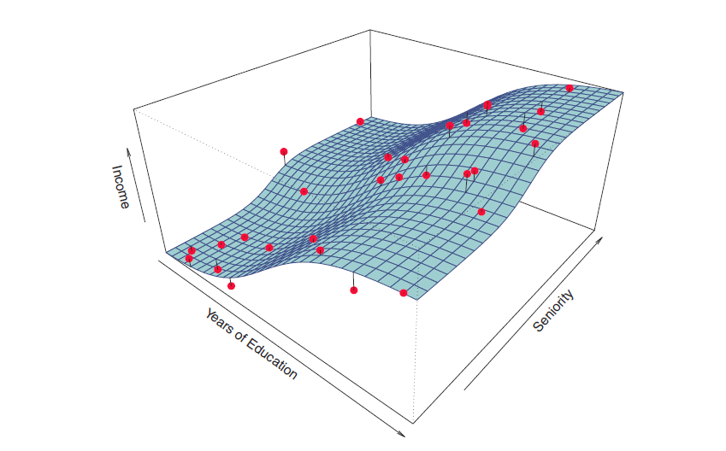

Visualizing in two dimensions
Higher order polynomial in educ and seniority could approximate this function
$$y_{i}=α+β_{1}educ_{i}{+ β_{2}seniority+ ε}_{i}$$

Slide 14
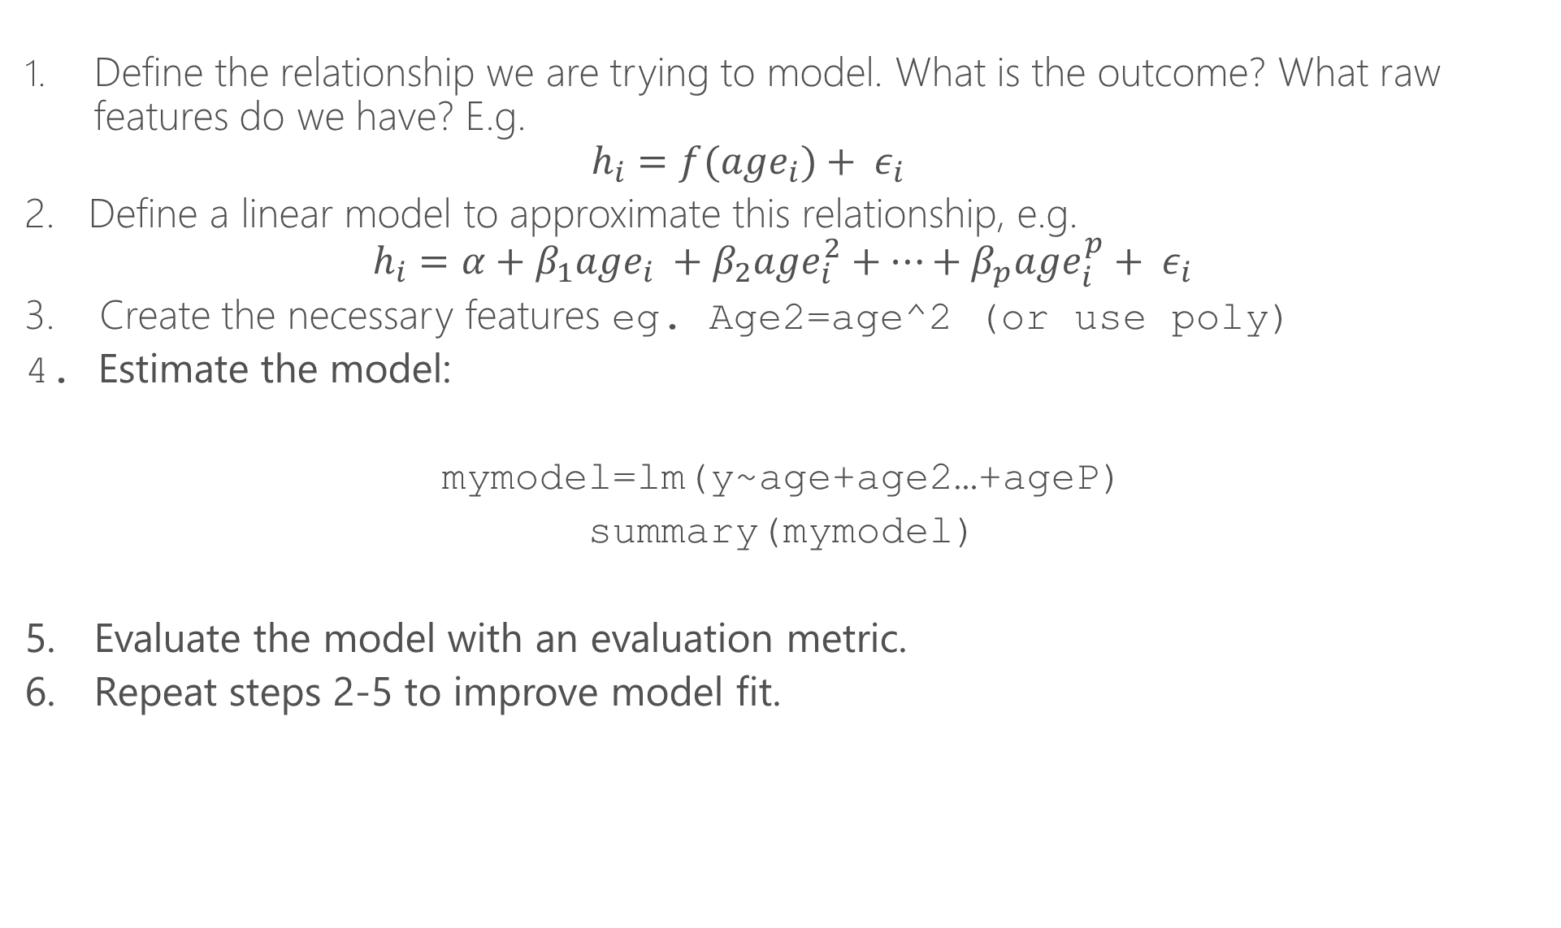
First steps to do a linear regression
Define the relationship we are trying to model. What is the outcome? What raw features do we have? E.g.
$$h_{i}=f(age_{i})+ ε_{i}$$
2. Define a linear model to approximate this relationship, e.g.
$$h_{i}=α+β_{1}age_{i} +β_{2}age_{i}^{2}+…+β_{p}age_{i}^{p}+ ε_{i}$$
3. Create the necessary features eg. Age2=age^2 (or use poly)
4. Estimate the model:
mymodel=lm(y~age+age2…+ageP)
summary(mymodel)
5. Evaluate the model with an evaluation metric.
6. Repeat steps 2-5 to improve model fit.

Slide 15
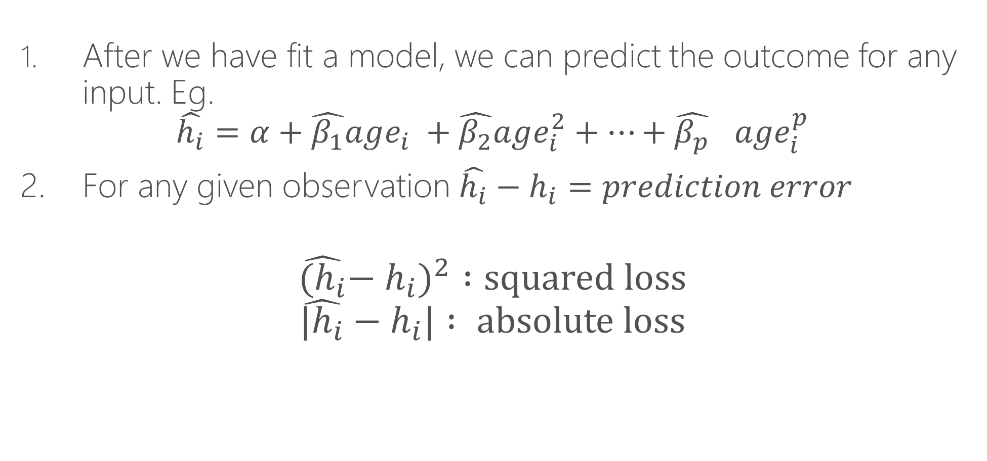
Model prediction
After we have fit a model, we can predict the outcome for any input. Eg.
$$\hat{h_{i}}=α+\hat{β_{1}}age_{i} +\hat{β_{2}}age_{i}^{2}+…+{\hat{β_{p}}}_{}age_{i}^{p}$$
2. For any given observation $\hat{h_{i}}−h_{i}=prediction error$
$${\hat{{(h}_{i}}−h_{i})}^{2} :squared loss$$
$$\hat{{|h}_{i}}−h_{i}| : absolute loss$$

Slide 16
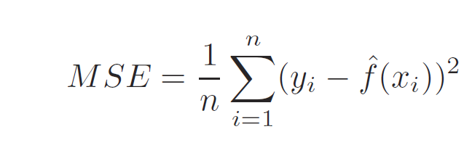
Assessing Model Fit, MSE
Fit refers to how well our model, an approximation of reality, matches what we actually observe in the data
Mean squared error is the average of squared loss for each data point (row) we evaluate

Slide 17
Training vs. Test
We typically want to “train” the model on the data “we have” and test the model on “new data”
This is a realistic test of how well the model predicts outcomes.
In practice, we will subset our data:
X%: Training
Y%: Test
80% is commonly used for training.

Slide 18
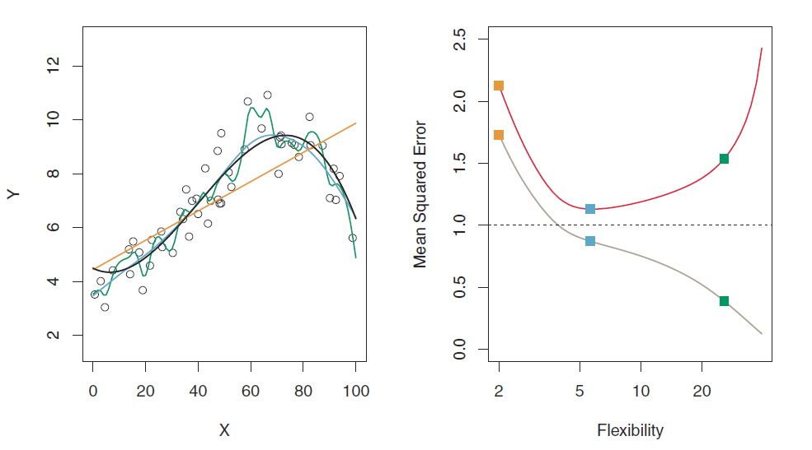
Why do we need training vs. test?
MSE: test set
MSE: training set

Slide 19
Why do we need training vs. test?
The green curve “overfits” the data. It fits the noise.
Using a “out of sample” test set guards against “overfitting”
The blue curve gets closest to the black (truth) curve

Slide 20
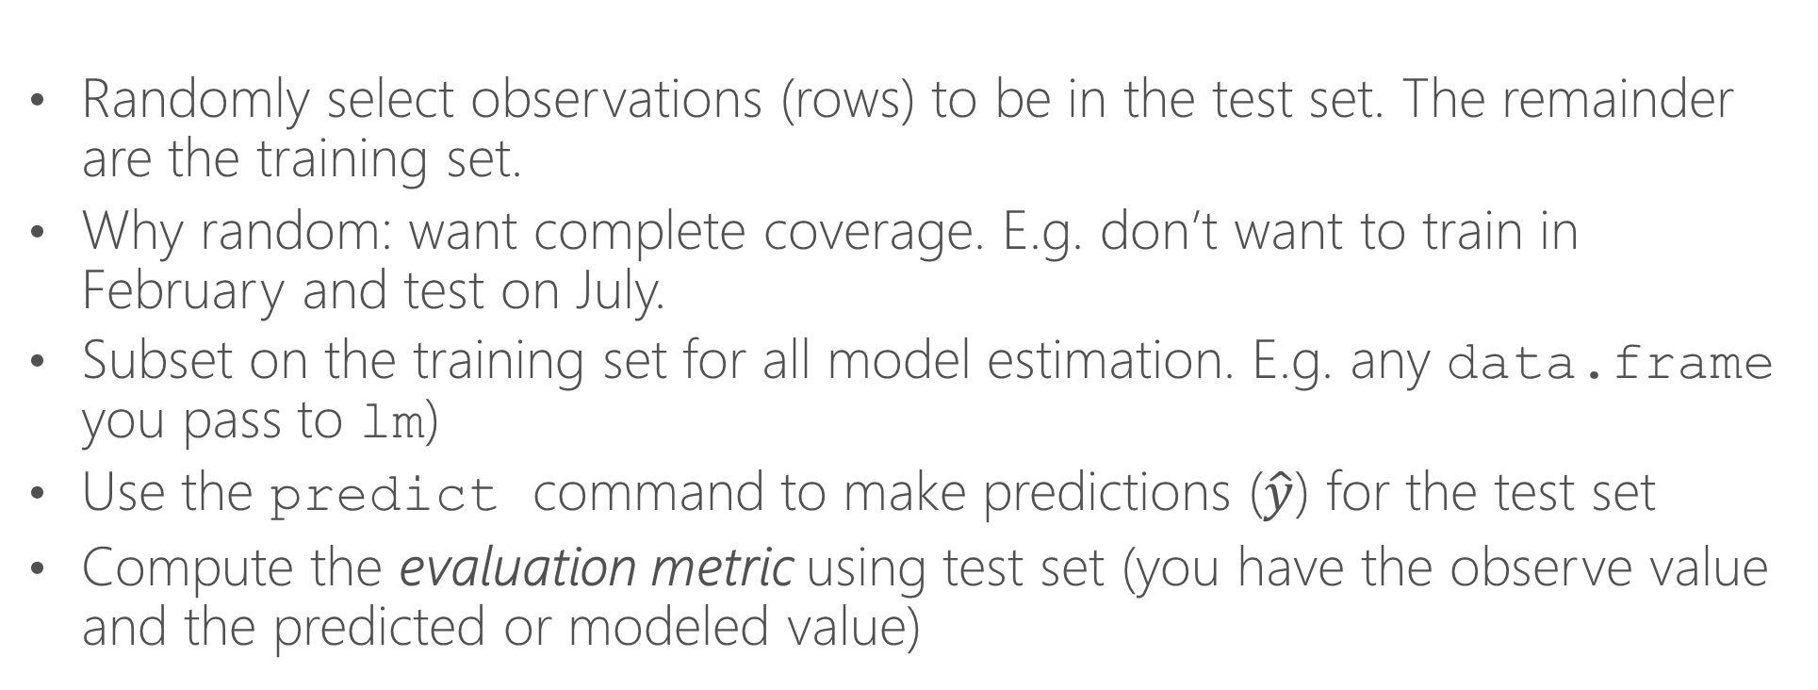
Training vs. test in practice
Randomly select observations (rows) to be in the test set. The remainder are the training set.
Why random: want complete coverage. E.g. don’t want to train in February and test on July.
Subset on the training set for all model estimation. E.g. any data.frame you pass to lm)
Use the predict command to make predictions ($\hat{y}$) for the test set
Compute the evaluation metric using test set (you have the observe value and the predicted or modeled value)

Slide 21
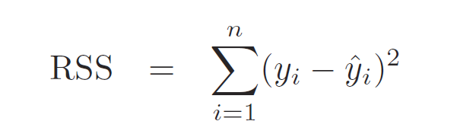

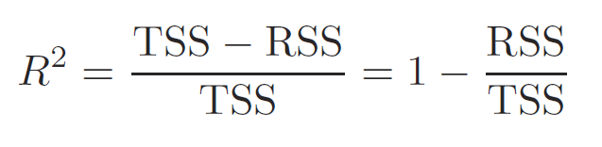
R-squared
Residual sum of squares
Total variation in outcome variable
Fraction of the variation in the outcome variable captured by the model

Slide 22
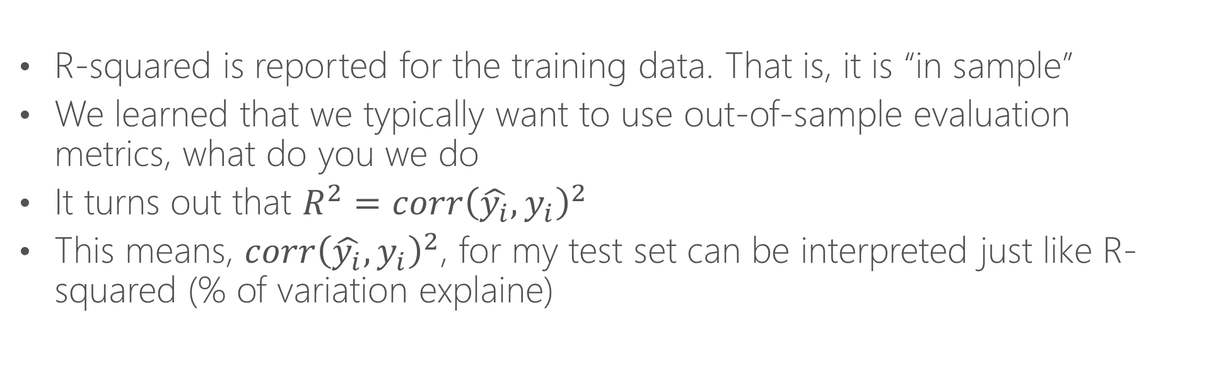
R-squared cont.
R-squared is reported for the training data. That is, it is “in sample”
We learned that we typically want to use out-of-sample evaluation metrics, what do you we do
It turns out that $R^{2}=corr{\left(\hat{y_{i}},y_{i}\right)}^{2}$
This means, $corr{\left(\hat{y_{i}},y_{i}\right)}^{2}$, for my test set can be interpreted just like R-squared (% of variation explaine)

