Slide 1

Community Structure and Dynamics in the Dublin Meetup Network 2018

Slide 2
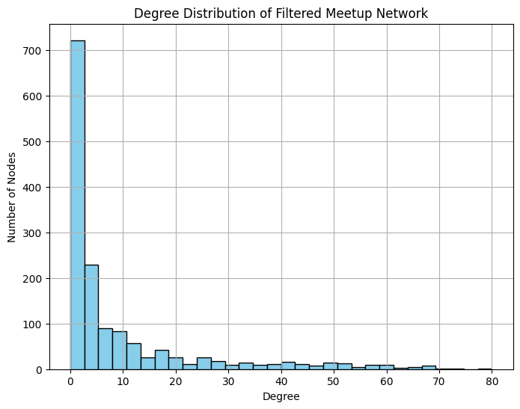
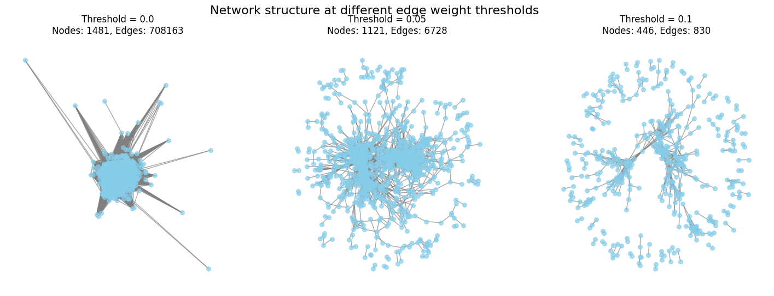
NETWORK CHARACTERIZATION AND THRESHOLDING
1481 nodes
6756 edges
Density = 0.0062

Slide 3
Do meaningful communities emerge in such a sparse network? - Louvain algorithm - 21 communities (>5 nodes) were detected. - Modularity score: Q = 0.6789 - SEMANTIC ANALYSIS USING TF-IDF technique

Slide 4
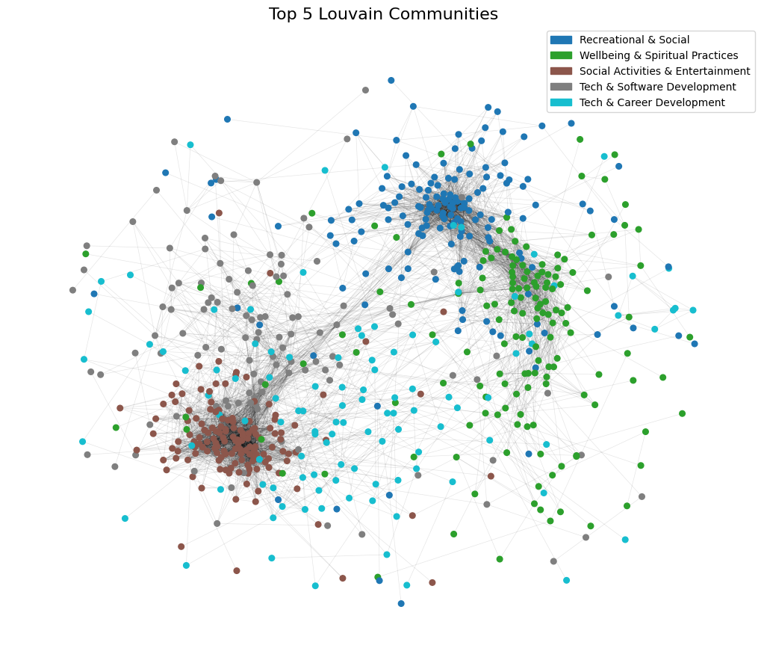
Community 0, 1, 32 – No tech had the highest internal density (0.2016) and the lowest external connectivity (0.17)
Community 2 and 25 – Tech had the lowest density (0.0387) and the highest external connectivity (0.42)

Slide 5
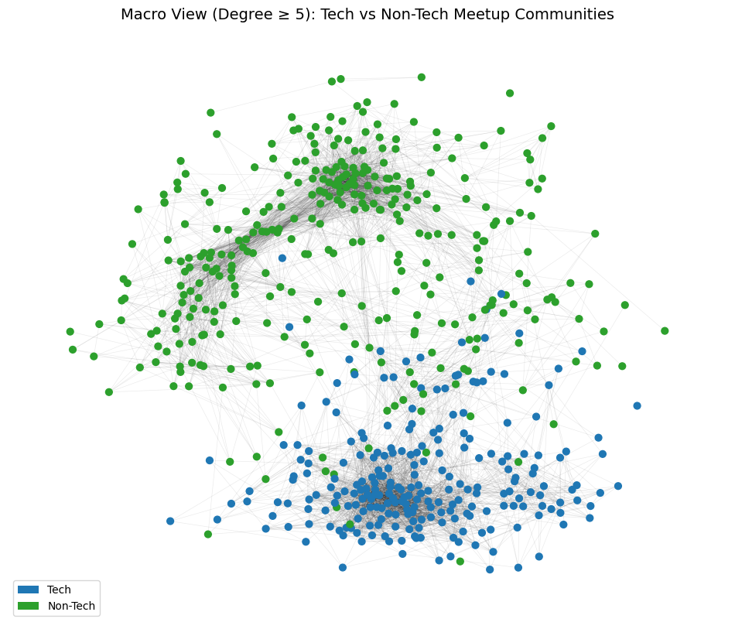
Is there a systematic distinction between Tech and Non-Tech communities?
Tech network:
- More active and interconnected
Higher density (0.0962), more high-degree nodes, more hubs, higher betweenness centrality
Non-Tech network:
- More closed and connected
- Lower density (0.0506), more compact clusters.
- Higher clustering coefficient → tighter communities.

Slide 6
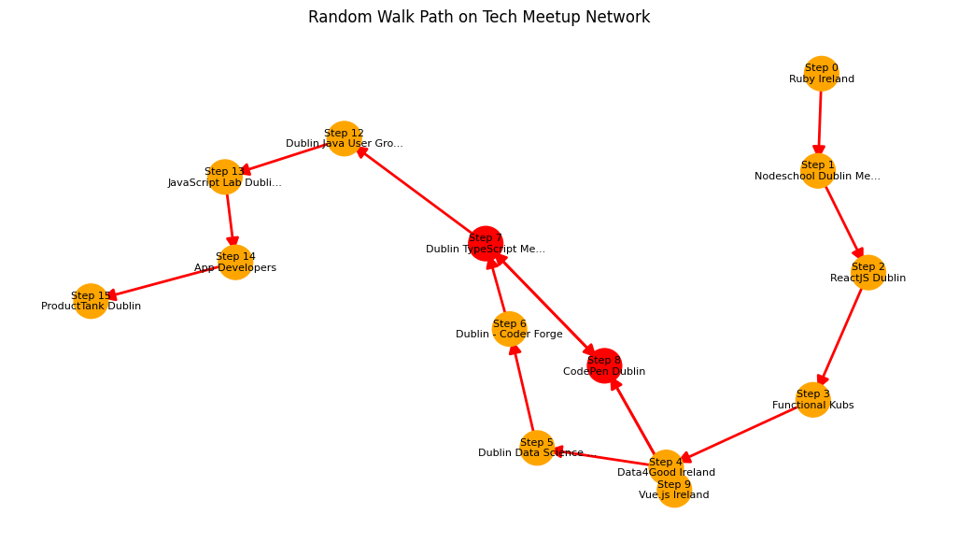
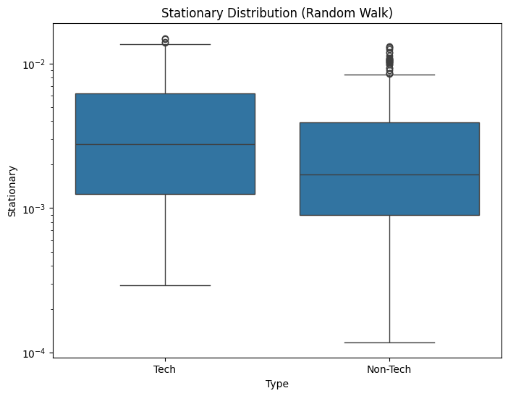
Dynamic Overview: Long-Term Visibility of Communities

Slide 7
conclusion
Strong, coherent communities emerge even in a sparse network
Clear structural difference between Tech and Non-Tech:
Tech → more open, central, interconnected
Non-Tech → more cohesive, local, and stable
Network structure reflects how people organize, connect, and move

Slide 8
Future Work:
Apply overlapping community detection (e.g. OSLOM) to capture hybrid groups
Analyze temporal dynamics: how communities grow or change over time
Extend the approach to other cities for comparison

