Slide 1
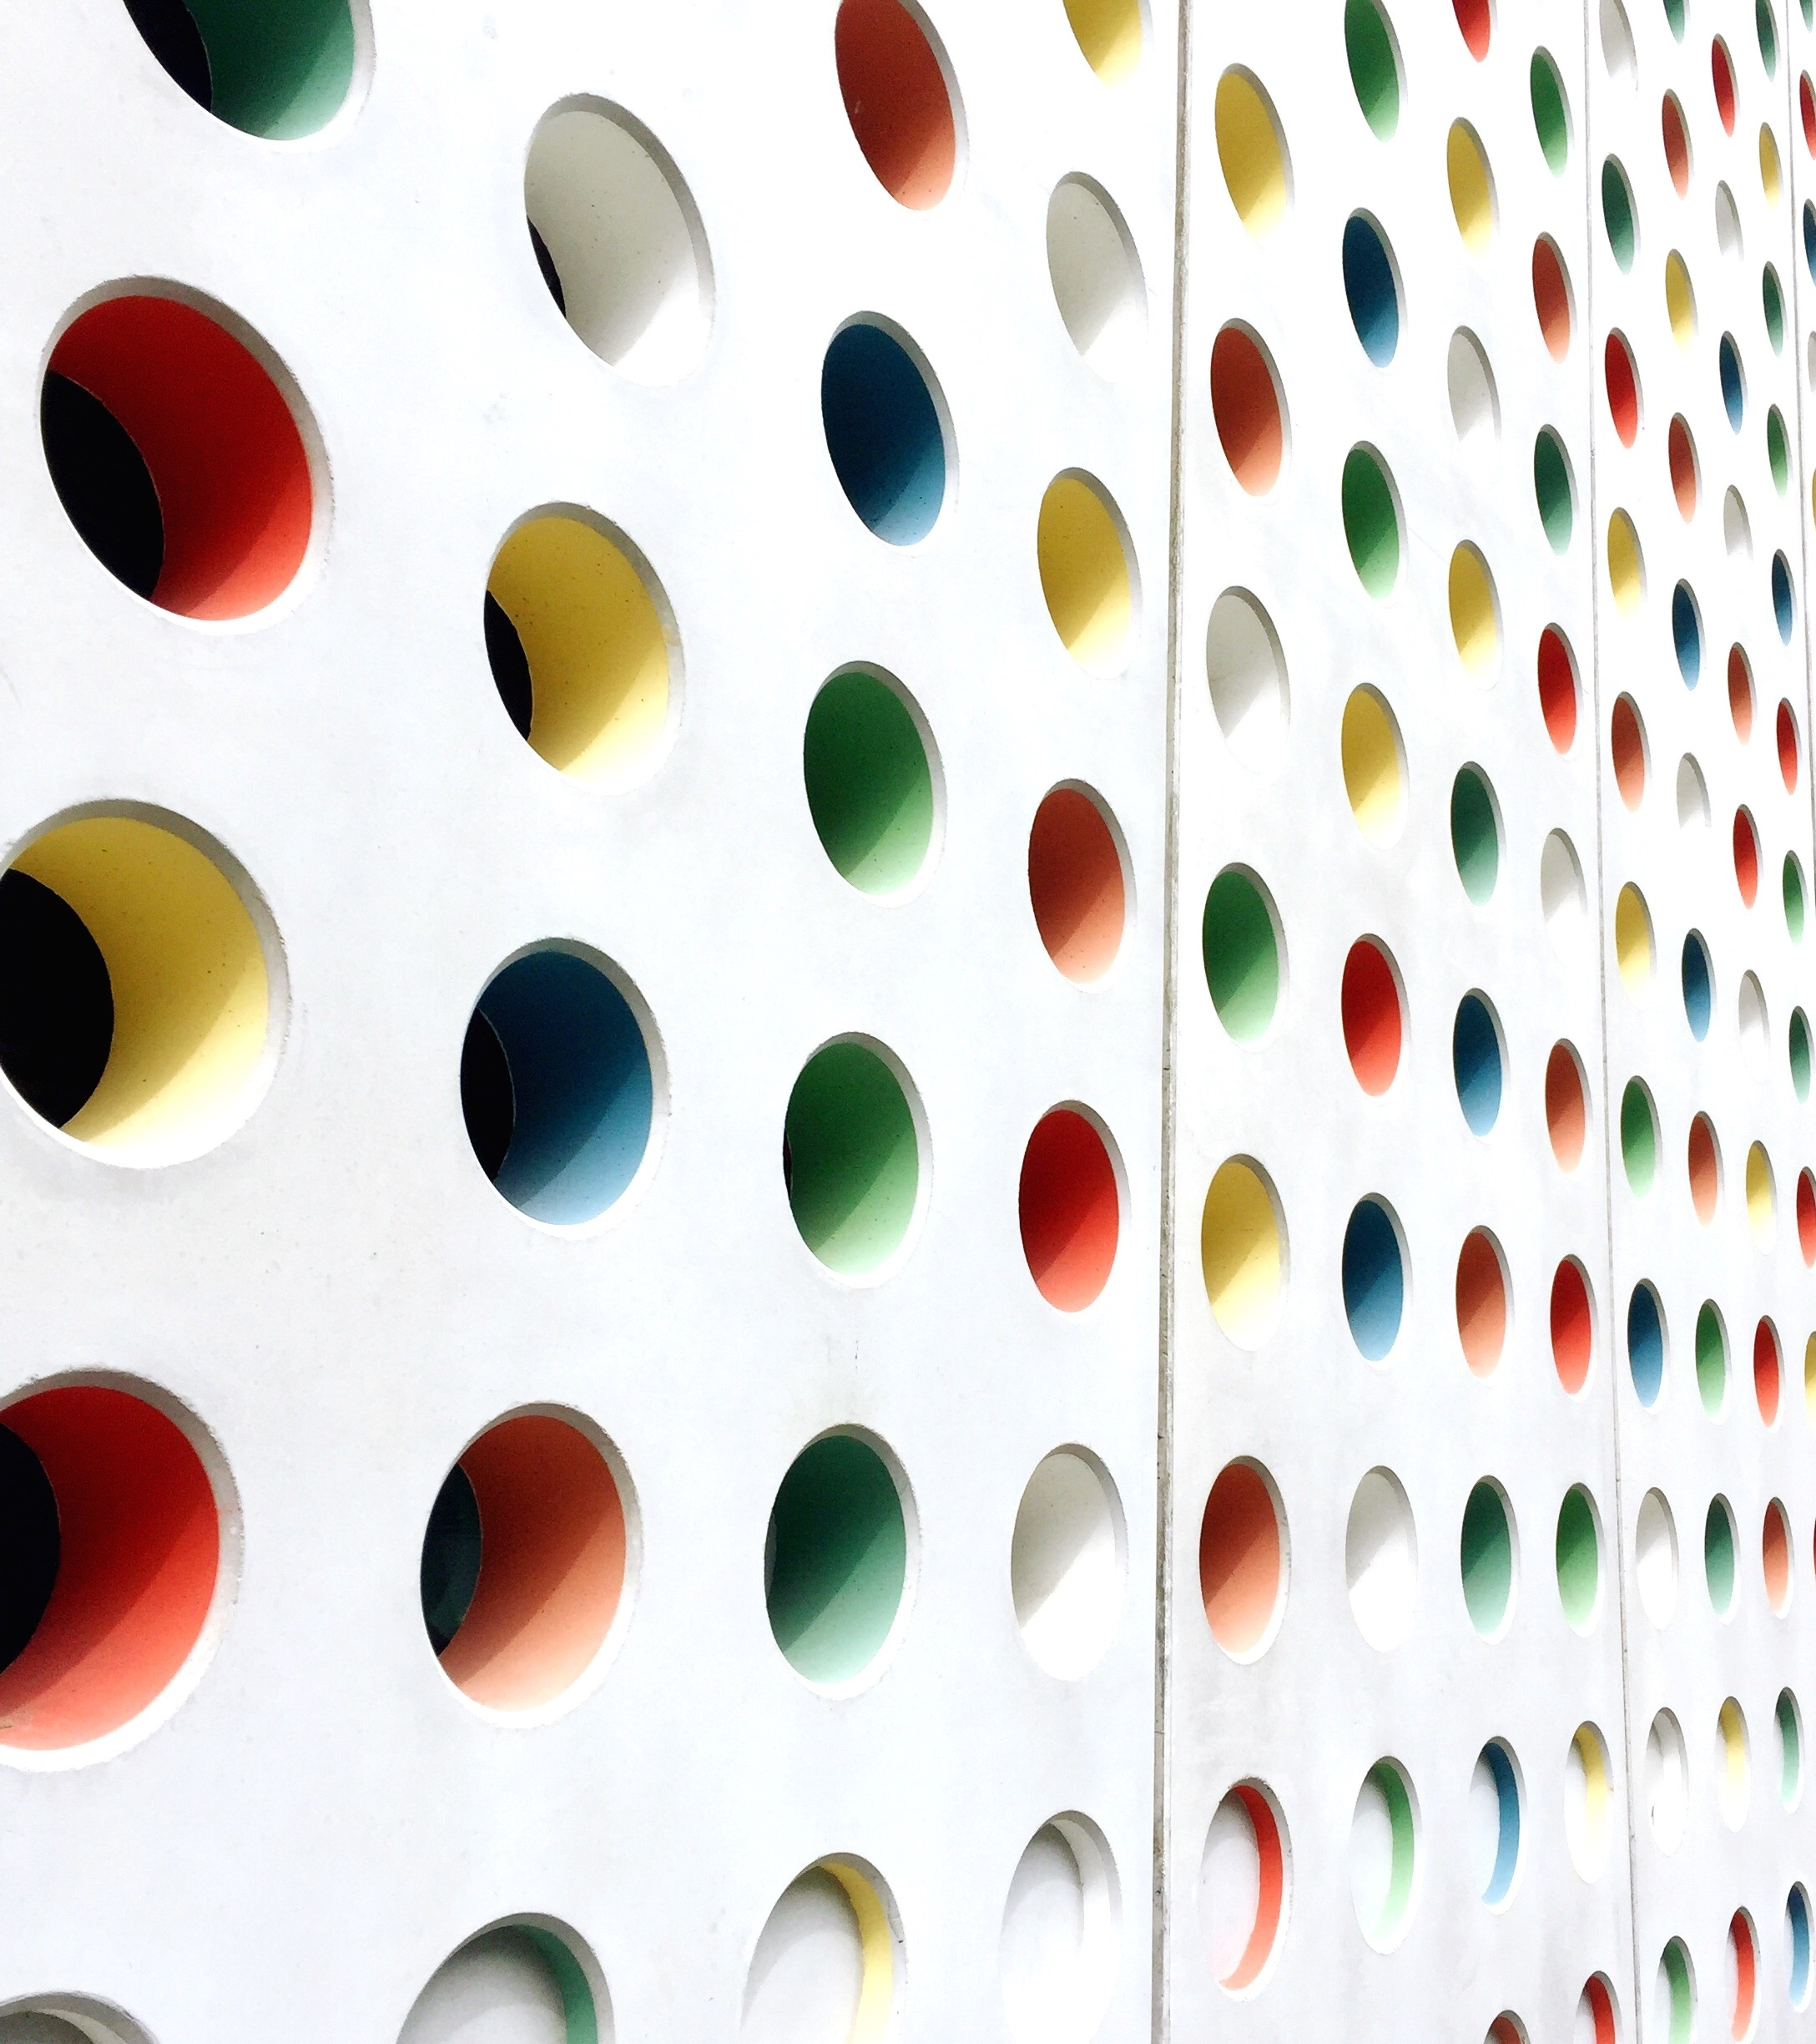
Machine Learning Project Presentation
Image restoration
Roberto Sonedda 70/83/65244
Ilaria Cabiddu 70/83/65206

Slide 2
Introduction
Aim of the Project: recover an image from a degraded version
What is Image Restoration all about?
How does a picture get degraded?

Slide 3
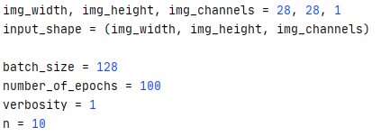
Configuration
Import all the required modules
Definition of input images
Definition of Hyperparameters:
batch_size
number_of_epochs
Declaration of how many pictures to be shown

Slide 4
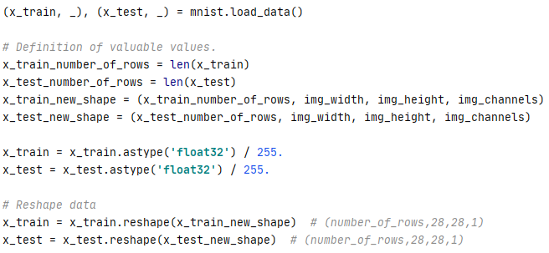
Data Import
Load MNIST dataset (60000 x 28 x 28)
Definition of valuable values
i.e.: number_of_rows and new_shape
Data Normalization
float32 type
0/1 normalization by 255 division
Reshape Data (60000 x 28 x 28 x n_chan)

Slide 5
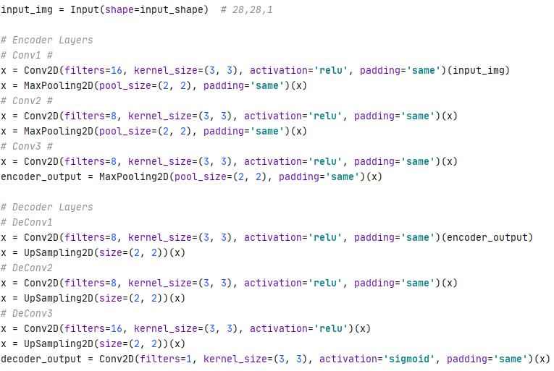
Model definition pt.1
Definition of the layers of the autoencoder
Encoder:
Conv2D
MaxPooling2D
Decoder:
Conv2D
UpSampling2D

Slide 6
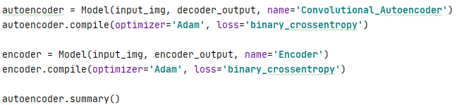
Model definition pt.2
Instantiate & compile the Autoencoder:
optimizer = ‘Adam’
loss = ‘binary_crossentropy’
Instantiate & compile the Encoder:
optimizer = ‘Adam’
loss = ‘binary_crossentropy’

Slide 7
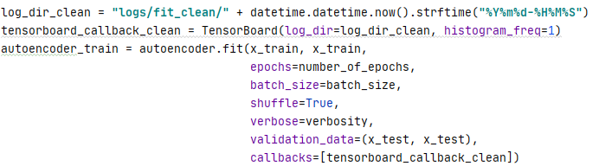
Autoencoder Training
Creation of a log folder for Tensorboard
Training (fitting) the Autoencoder over x_train
x_train as input
x_train as target
Evaluate Validation Error over x_test

Slide 8
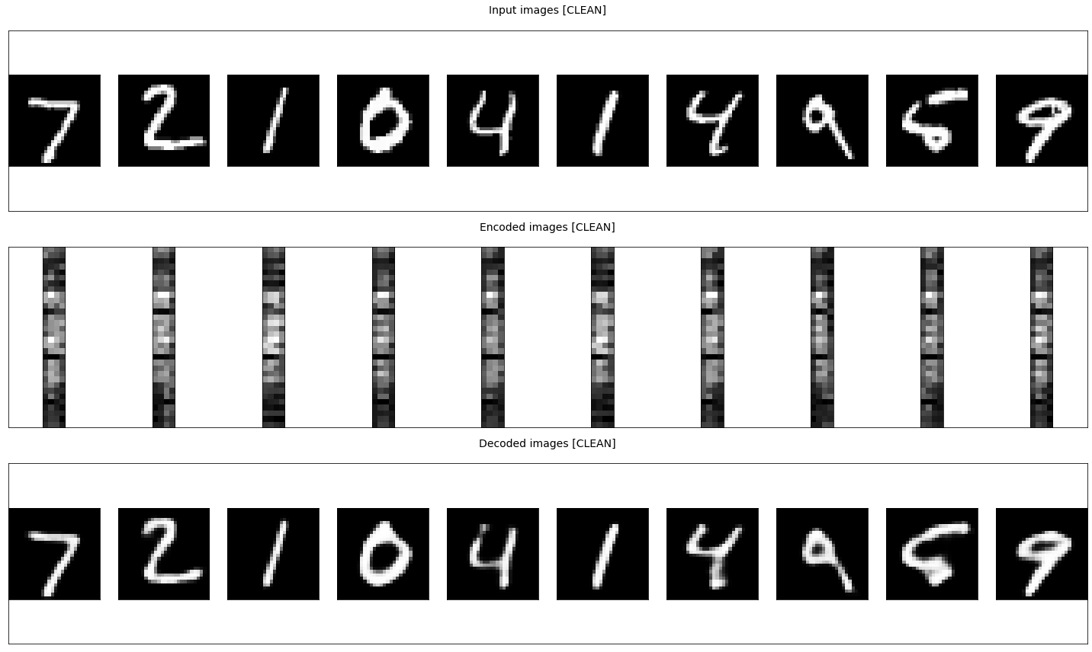
Visualization of the MNIST Dataset

Slide 9
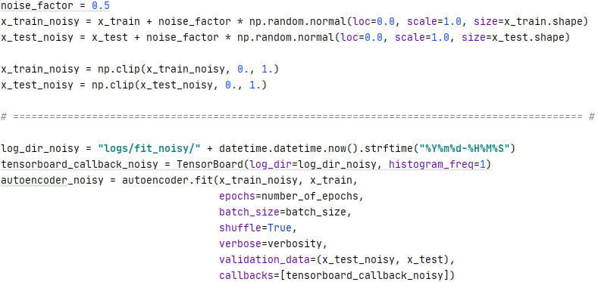
De-Noising Application
Autoencoder can be used to clear noisy pictures. Here’s a toy application.
Generation of noisy data
Gaussian noise has been added
Normalization of noise-affected data
Training of the Autoencoder over x_train_noisy
x_train_noisy as input
x_train as target
Evaluate Validation Error over x_test_noisy
Notes:
In this section of the code, we'll try one of the most common applications for which autoencoders have been developed: we'd like to implement a picture-reconstruction tool.
What does it mean? It means that we'd like to be able to feed a noisy (and absolutely not clean) picture into our autoencoder, so that it will return us a nice and crisp version of it.
In order to achieve such aim, we need to train our autoencoder once more. This time we’re going to need a noisy toy dataset as input, while still having the original and clean dataset as the target dataset. This way our autoencoder will be able to map the noisy input to the clean output
In the following slides, we’ll check if the autoencoder is behaving correctly and cleaning the images that we feed him into.
First of all, noisy data needs to be generated in order to put our autoencoder under test. For this purpose, we take our original datasets and we apply them a certain amount of Gaussian noise, measured by the variable noise_factor. This variable allows us to control the "noisiness" of images we'll use for the fitting process. We may say that it represents an hyperparameter that can be tuned until we find the optimal learning curve.
After applying some noise, we proceed to clip the previously obtained values to make sure that every element of each feature vector representing an image falls between 0 and 1.
Finally, we can now proceed with the training of our autoencoder. Like we already did the first time, we call the .fit() function train the model. As already stated, the .fit() function is configured so that the autoencoder will be able to map the noisy images on the inputs side to their clean counterpart on the outputs side.
Like the first time, we create a log folder for this training too, so that we’ll be able to evaluate the performance using the Ternsorboard callback.

Slide 10
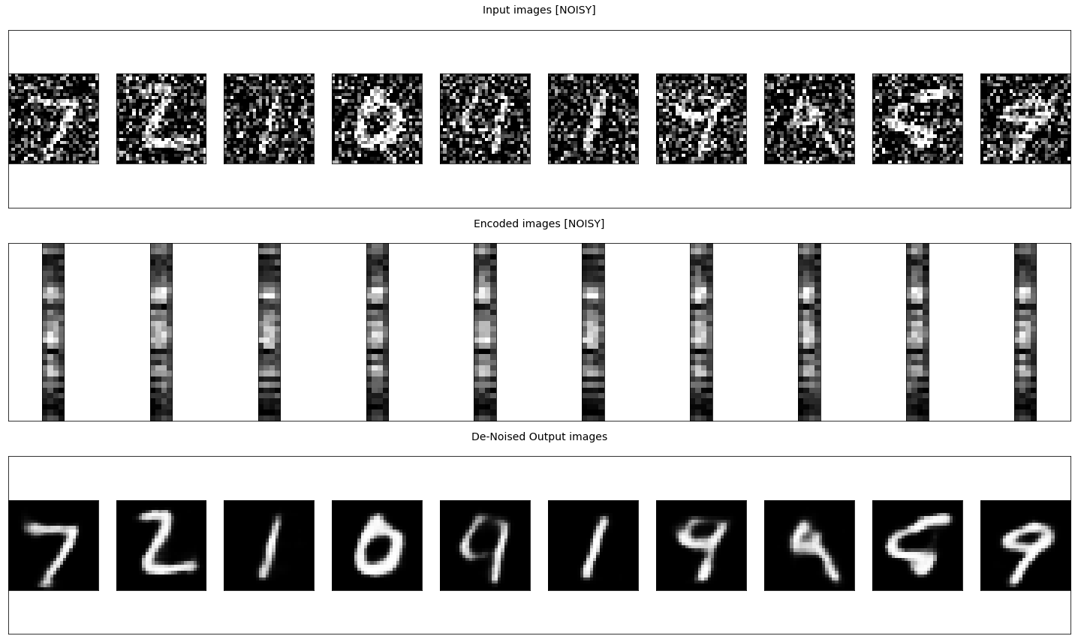
Visualization of Cleaned Pictures
Notes:
The best way to show if everything is working correctly is to try and plot how the noisy pictures are handled by the autencoder, to see if it's actually capable of de-noising.
Therefore, in this slide too, we are showing how the data appears before, through and after being fed into our autoencoder.
The top row represents some elements of the noisy toy dataset. The mid row represents their encoded state, while the bottom row represents the decoded output.
We can clearly see that, after having trained the autoencoder on the noisy dataset, it is now capable of fully restoring pictures from noisy ones.
Since we have appured that the autoencoder is working correctly, we may now evaluate its overall performance.
Before we start, we may anticipate that we already expect a particular behaviour from our model, because we expect it to converge after a sufficient amount of epochs.
In order to have an idea of how long the convergence process is going to take, we'll plot how the values for the training loss and validation loss will change with respect to the number of epochs.
We will evaluate training and validation loss, both in the clean and noisy instances, then we'll compare one against the other.

Slide 11
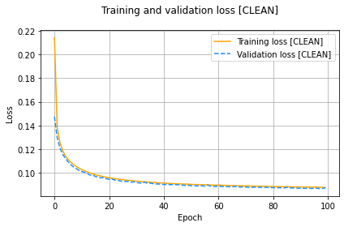
Performance Evaluation 1
Model converges to a loss around 0.087
Validation Loss and Training Loss are in sync
Good generalization capabilities as seen in the small gap between both curves
No overfitting
Curves always decreasing
Notes:
From what we can see in our first comparison, Train VS. Validation Loss [CLEAN], we may say that our model converges to a loss around 0.087.
Moreover, from the same graph, we can see that the validation loss and the training loss both are in sync, therefore, we can say that our model's generalization capability is quite good.
We may now inquire: does the model overfit our dataset? Always from the same graph we can clearly that it’s not:
the validation loss appears to be decreasing and not increasing, and there is rarely any gap between training and validation loss.

Slide 12
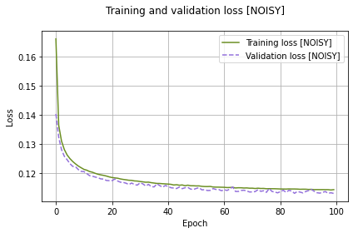
Performance Evaluation 2
Validation Loss and Training Loss almost in sync
Several spikes appear on the Validation Loss
Overfitting at some epochs
Improvements can be achieved by increasing complexity
Notes:
Next, we can look at the second comparison, Train VS. Validation Loss [NOISY].
From the shown plot, we may infer the our model is overfitting at some epochs contrary to the previous training,
given the little spikes that appear on the plotted curve.
Even though the model slightly overfits, overall we may say that both curves stay quite in sync for most of the time.
In order to achieve better results, we may try to introduce some more complexity into our model, for example adding more layers thus making the net deeper, so that the loss can be reduced even further.

Slide 13
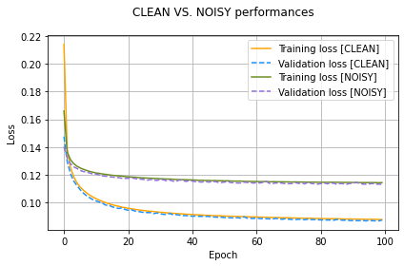
Performance Evaluation 3
Clean VS Noisy curves are not so far away
Overall, good generalization capabilities are shown
Notes:
Finally, we can take in exam the last comparison, CLEAN VS. NOISY, which manages to depict quite well the generalization capabilities of our model.
As shown from the graph, the achieved performance appears not so far away between the two cases, therefore showing, once again, good generalization capabilities when given noisy test data too.

Slide 14
Conclusions
Perks of higher dimensionality
Trade between higher entropic capacity and overfitting
Picture Restoration is a feasable application for the Autoencoder model developed
Keras VS PyTorch: ease of use VS granularity
Epochs increasing needs to be evaluated on a case by case basis
Notes:
In the end, from what we’ve seen and learned from this project, we can formulate some conclusions.
Overall, we may say that the achieved performance is significantly better than those that would have be obtained with less complex model implementations of the autoencoder.
This is in large part due to the higher entropic capacity of our encoded representation, that is, like we’ve already seen, 4*4*8 = 128 dimensions.
Having an higher entropic capacity, means that it’s allowed to store more information than the models which happen to have a smaller encoded dimensionality. As a matter of fact, we’ve seen that it enables it to perform quite respectably.
Given this assumption, we may inquire that "the higher the dimensionality, the better", but that's not always the case. Actually, we have to remember that we decided to employ an autoencoder manifold with the aim of simplifying the learning
process and make it less prone to overfit. Therefore the dimensionality of the encoded representation needs to be fine tuned. As we’ve seen, we found that a good balance
between the entropic capacity and the risk of overfitting is represented by the encoded dimensionality implemented.
All in all, we’ve learned that it’s been possible to develop a machine learning algorithm that is capable of reconstructing quality pictures from noisy ones, thanks to the use of an autoencoder model.
The results achieved are pretty good, especially if we consider how easily accessible the tools that made it possible are.
For our task, we decided to adopt Keras libraries and tools, because they have proved to be notably immediate and user-friendly, particularly when compared to the PyTorch alternatives. The latter ones generally require a finer tuning in order to achieve comparable results. On the contrary side, thanks to its lower level parametrization, we may say that PyTorch
provides us a deeper look on how the data are handled by the algorithms.
Finally, looking at the shown graphs, we can see good generalization capabilities, given the fact that it barely overfits. We've also seen that the most important imporvements over performance can be already achieved around the first 50
epochs. Letting the model train for longer will surely reduce the losses even more, but the improvements will become so little that not always the cost of improvement may be justified, both in terms of time and of resources utilization.

Slide 15
Thanks for Your attention
Anno Accademico 2019/2020
Roberto Sonedda 70/83/65244
Ilaria Cabiddu 70/83/65206

