Slide 1
Creating Customized Fact Sheets with Patchwork and R-Markdown
Marschall Furman (ORISE/CPHEA/PHITD), Twitter Nichole Kulikowski (ORD/CPHEA), Github, Twitter
EPA R-User Group Workshop 2021

Slide 2
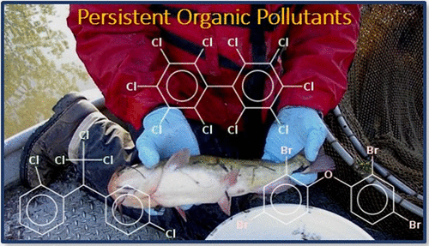

Background
EPA has conducted three fish contamination studies as part of the National River and Stream Assessment (NRSA) cycle
We analyzed the data from Batt et. al. 2017, which was taken from the 2008-2009 Fish Tissue Study
Samples from 163 Urban and 377 Non-Urban Sites along rivers across the US were analyzed
Notes:
Both

Slide 3
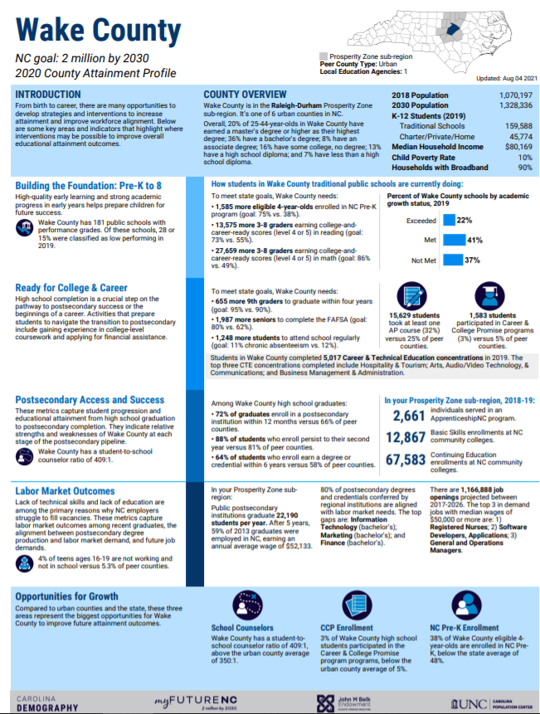
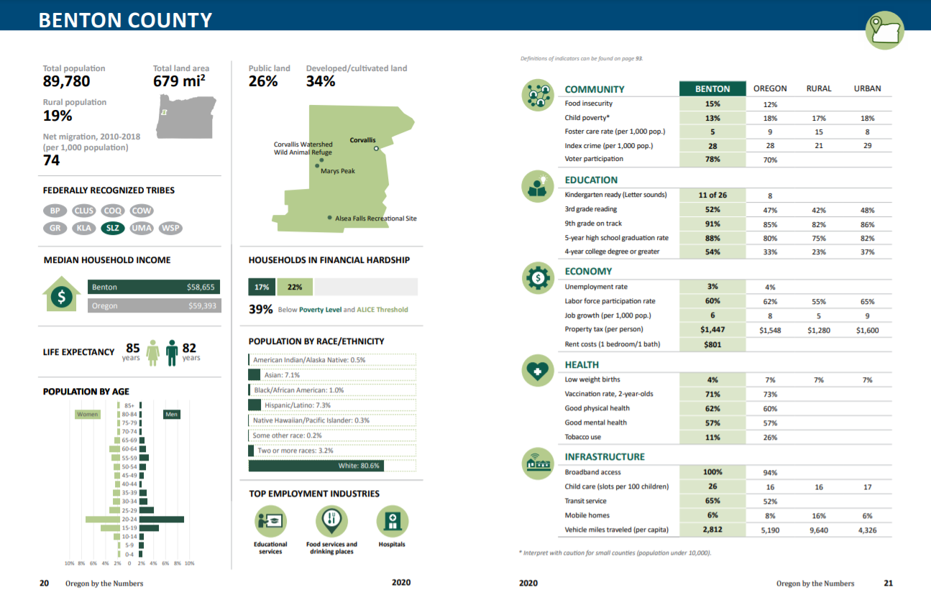
Motivation
We found ourselves repeating graphics with different subsets of our dataset
We looked for R Markdown templates to make factsheets/infographics- we did not find any publicly available, so we instead researched packages to assemble our own
“Oregon by the Numbers” Report (link)
“myFutureNC”
Dashboard - County profiles (link)

Slide 4
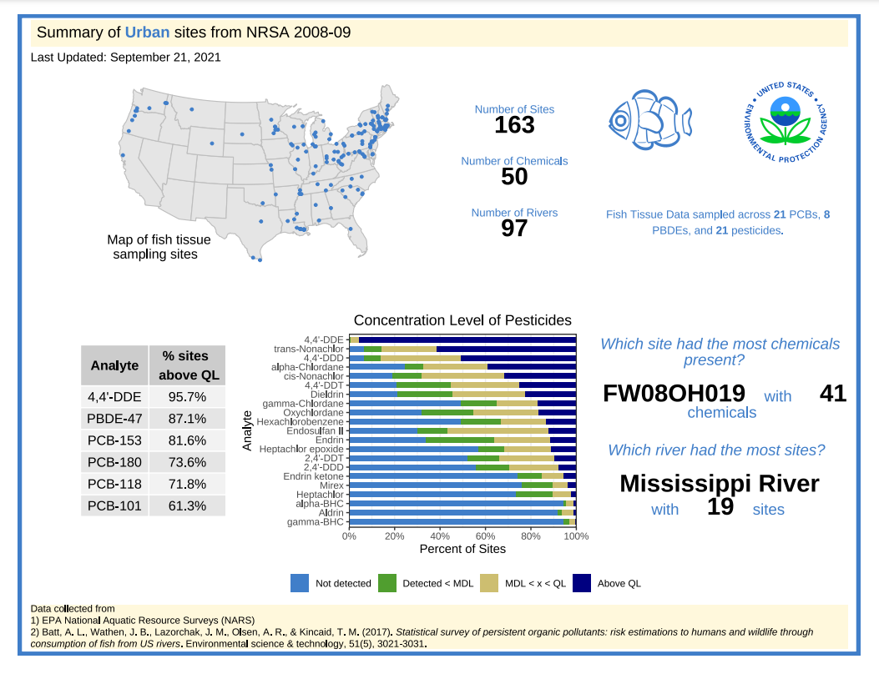
Our Factsheet

Slide 5
Components of Fact Sheet
Grid-based layout
Our approach to doing this was using the Patchwork package
Objects
Plots (ggplots or base plots)
Images (photos, logos, PNG pictures)
Maps (USMap gg package)
Text (Summary statistics, data descriptions)
Tables
Design
Theme- Individual plot themes and page theme
Colors- fonts, borders, visualizations
Margins/Header/Footer
Title/Caption
Notes:
Nichole

Slide 6

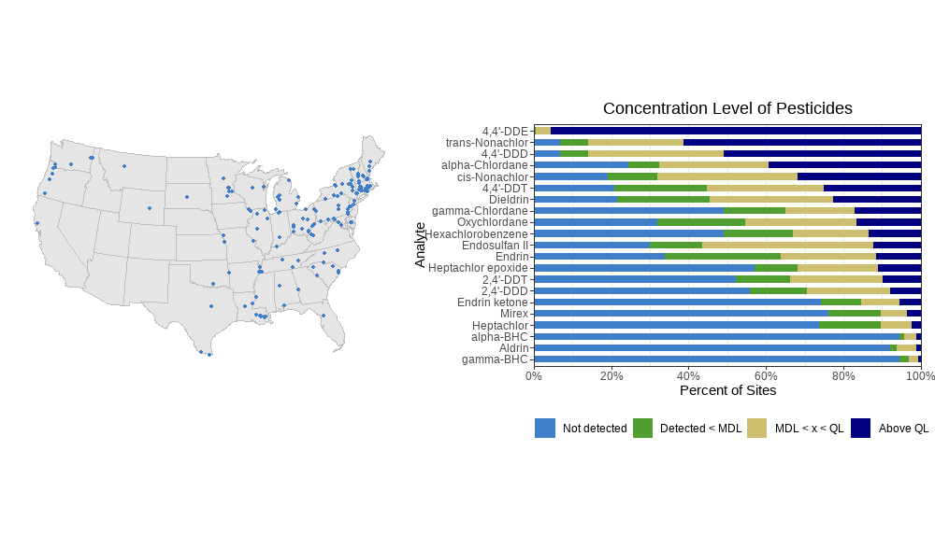
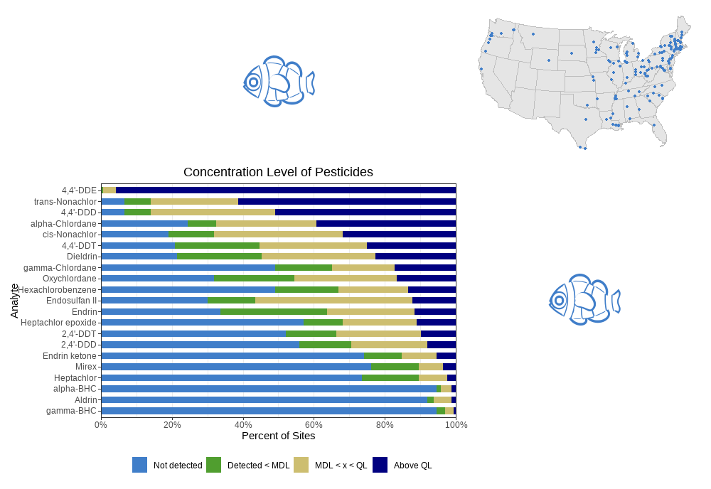
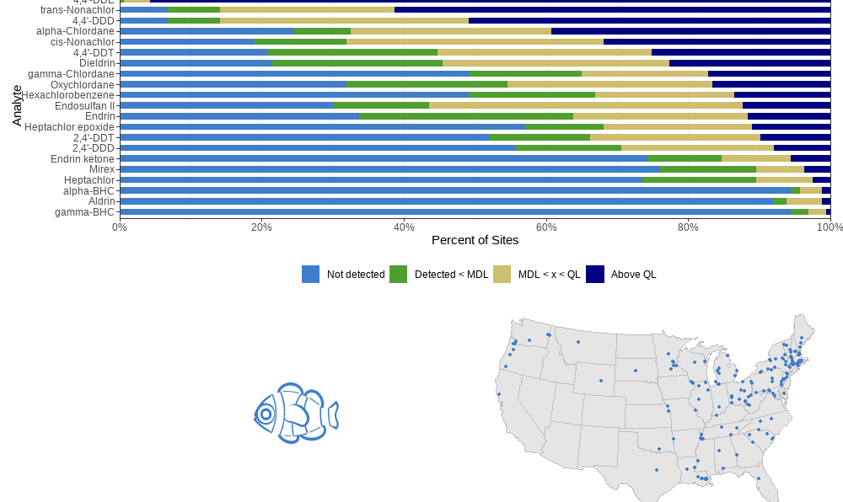
Basics of patchwork
p_map + p_bar
Package for creating composite graphics
Uses “plot arithmetic” to arrange plots into panels
wrap_plots(p_fish, p_map, p_bar, p_fish)
p_bar / (p_fish | p_map)
Notes:
Marschall

Slide 7
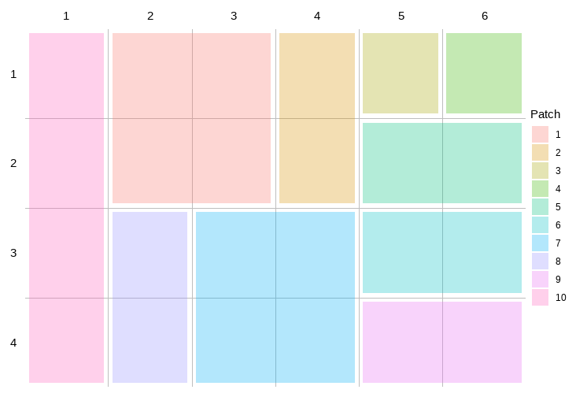
Grid-Based Layout
While a lot can be accomplished using +, |, and / in Patchwork, we needed more control to tell R where to place the components of our fact sheet
plot_layout() function in patchwork allows you to specify the layout
You can specify the number of rows and columns within this function
Rectangles can be manually built using the area( ) constructor
Notes:
Nichole

Slide 8
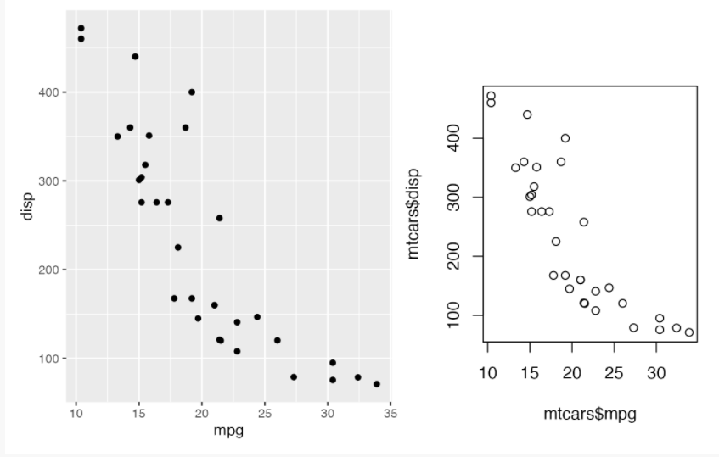
Objects- Plots
ggplot objects work seamlessly with patchwork out of the box!
Base R graphics can be also be included using the wrap_elements function and/or formula syntax (~)
p1 + wrap_elements(full = ~ plot(mtcars$mpg, mtcars$disp))
Notes:
Marschall

Slide 9


Objects- Images
PNG, JPEG, and internal format images can also be added to patchwork
We added an EPA logo and a fish image (from emojifont package)
wrap_elements( ) function is used again to convert non-ggplot2 elements to a compliant representation
### read in images ###
epa_logo <- png::readPNG("../images/epa_logo.png", native = TRUE)
emoji_fish <- ggplot() +
emojifont::geom_emoji("tropical_fish", color = "#407EC9", size = 30) + theme_void()
### patch elements together ###
wrap_elements(epa_logo) + emoji_fish
Notes:
Nichole

Slide 10
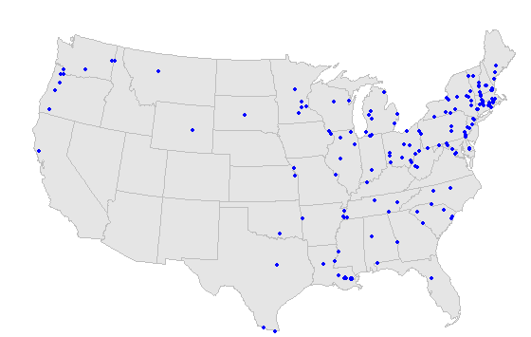
Objects- Maps
map_transformed <- df %>%
filter(`Site Type` == "Urban") %>%
dplyr::select(long, lat) %>%
usmap_transform()
plot_usmap(exclude = c("Hawaii", "Alaska"),
color = "gray",
fill = "gray90") +
geom_point(data = map_transformed,
aes(x = long.1, y = lat.1),
color = "blue",
size = 1)
Static maps can also be incorporated
We used ggplot2 and usmap packages- we plotted longitude and latitude of sites as points
Rasters or shapefiles can also be incorporated using add-on packages
Notes:
Since we were making a PDF, we only focused on static maps

Slide 11
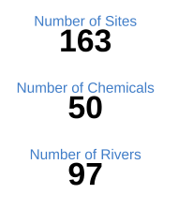
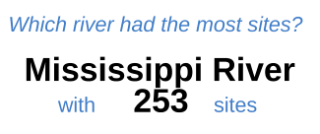
Objects- Text
Text is useful for fact sheets to convey summary statistics and bulleted facts about your data
Text can be incorporated into Patchwork as non-gg objects using wrap_elements( )
Font and color style can be adjusted by assembling strings formatted with html
We used textbox_grob( ) from the gridtext package. You can pass character strings to this function
Notes:
Nichole

Slide 12
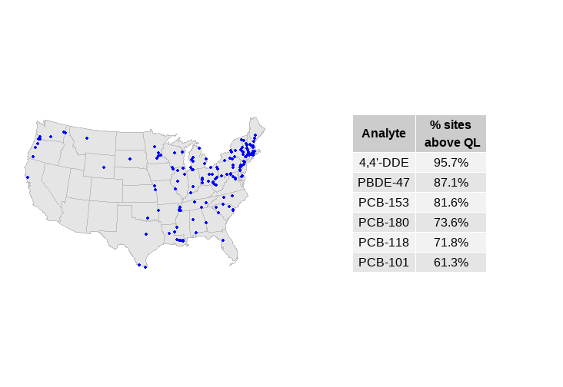
Objects- Tables
Simple tables can be integrated into patches using the gridExtra package
freq_table <- gridExtra::tableGrob(tab_above_ql, rows = NULL)
p_map + freq_table OR wrap_elements(p_map, freq_table)
* Patchwork does not support {gt} or {kable} output at this point
Notes:
Marschall

Slide 13
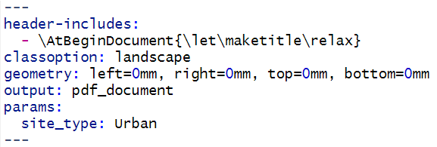
Design
After creating our grid layout and “patching” our objects together, we focused our time on making our sheet more visually appealing
Some customization can be done within the R Markdown YAML header itself, some can also be done using patchwork functions
We used the ggtext package to customize the title and caption
plot_annotation(
title = “My Fact Sheet”,
caption = “Data taken from NRSA”,
theme = theme_factsheet
)
Notes:
Nichole

Slide 14
Reproducibility
R Markdown allows for reproducibility
Use params from YAML to filter data
df_filtered <- df %>% filter(site_type == params$site_type)
Summaries are calculated from the filtered data
Render reports programmatically
rmarkdown::render(“fact_sheet_template.Rmd", params = list( site_type = ‘Urban’, conc_limit = ‘QL’))
Notes:
Both

Slide 15
Takeaways
Pros of doing it this way
Easy to create complex arrangements with variety of media types
Saves time- makes reports more reproducible
Iterated fact sheets will have a uniform appearance since they come from the same template
Limitations
Full customization requires lots of specified parameters (e.g. font)
Each project has different needs, so layouts may need to be altered each time for different projects
Not all types of graphics/packages we wanted were supported. We gathered packages that already exist, and worked with what is already compatible
Notes:
Both

Slide 16
Questions?
Patchwork site: https://patchwork.data-imaginist.com/
NARS
Main website: https://www.epa.gov/national-aquatic-resource-surveys
Datasets used: Rivers and Streams 2008-2009 ‘Site Information’
Fish Tissue Data: https://www.epa.gov/fish-tech/2008-2009-national-rivers-and-streams-assessment-fish-tissue-study
Batt et al 2017 paper and SI files: https://doi.org/10.1021/acs.est.6b05162
Packages used: tidyverse, readxl, patchwork, gridExtra, usmap, ggtext, emojifont, gridtext, png, knitr
Code, data, and images can be found on Github
Notes:
Both

