Slide 1


Deployment Options for EPA Shiny Apps
Steve Pfeiffer
EPA-ORD-OSIM
Notes:
Hi, everyone! Thank you for being here, and thank you to Jeff and Ann for inviting me to speak. My name is Steve Pfeiffer, and I work in ORD. More specifically I lead the ORD Application Team, which is our panel of experts on all things software. Also, I have consulted on various projects in other Program Offices and Regions, so if you’d like to reach out to me with any kind of software-related question, even if you’re not in ORD, I’ll be happy to answer it; or if I myself cannot answer it, I will find someone who can. Let me put my email-address in the chat here. So, today, I want to talk to you about how to make a Shiny app public at EPA.

Slide 2

Consider your users
Shiny = heavy-duty stats without the pain
Friendly for a non-IT audience (but subject-matter expertise may be needed to interpret results)
Do your users want to be able to go to a URL and use the Shiny app?
Sometimes this is the case
Other times it’s not

Slide 3

Deploying on cloud.gov
Advantages
Cloud.gov is currently the only approved web-deployment option for R/Shiny apps
Although security approvals are required, they can be completed in a couple of months now.

Slide 4
Deploying on cloud.gov
Disadvantages
Cloud.gov often doesn’t play nice with packages requiring compilation
Cloud.gov requires you to restage your apps regularly, which will reinstall all of its packages
difficulties vendoring packages
uses lots of memory to install, then much less to actually run the shiny app

Slide 5


Slide 6
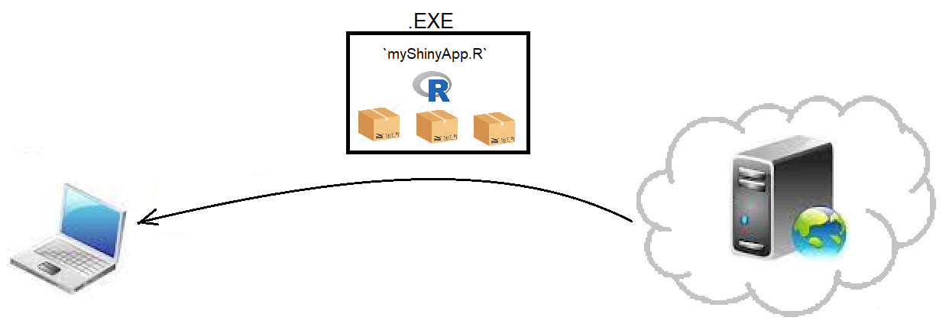

Slide 7

Providing as a downloadable desktop app
-take your code files together with...
- a list of all the CRAN packages you need
- a couple of batch files I've written
- a self-contained, "portable" version of R
... and wrap them all into a Windows .EXE installer which can be downloaded and installed onto `C:/Program Files` of the user's local machine (with freeware/shareware permission)

Slide 8
Providing as a downloadable desktop app
Advantages
Updates will rarely be required
Already contains all dependencies
No hosting cost
Fewer security approvals
Once downloaded & installed, can be run without an Internet connection

Slide 9
Providing as a downloadable desktop app
Disadvantages
Sometimes, prospective users don’t want to download anything
Works only on Windows machines
All packages must be in `win-binary` form already (can't build from source)
Future developers must be familiar with Windows batch files and InnoSetup

Slide 10

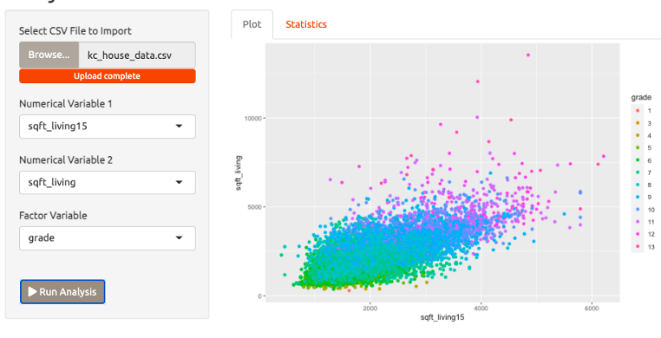
To get started, reach out to me or your Program/Region support staff ☺

