Slide 1
Introduction to R
Wendy L. Martinez
U.S. Bureau of Labor Statistics
Mathematical Statistics Research Center
Office of Survey Methods Research
September 2017
EPA R Users Conference

Slide 2
Acknowledgements and Disclaimers
The views expressed here are those of the authors and do not necessarily reflect the policies of the U.S. Bureau of Labor Statistics (BLS).
The U.S. Government and the BLS do not endorse any software or products mentioned in this tutorial.
Source for most of the material is An Introduction to R: https://cran.r-project.org/doc/manuals/r-release/R-intro.pdf

Slide 3
Intended Audience
This course will focus on the basics of R.
Prior knowledge of statistics or programming is NOT needed, but it is helpful.
The focus will NOT be on statistical applications or methods.
Suitable for mathematicians, economists, social scientists, computer scientists, etc.

Slide 4
Assumptions & Objectives
We assume you have basic knowledge of:
Computers and software concepts
Microsoft Windows
At the end of this tutorial, you should:
Understand the R environment
Know how to install R packages
Have the ability to get data in and out of R
Create vectors and matrices
Work with simple expressions
Be able to construct simple plots

Slide 5
Outline – Part 1
Introduction – Getting to Know R
Getting Data In and Out of R
Data Types
Simple Data Manipulation – Vectors
Matrices and Arrays
Lists and Data Frames

Slide 6
Outline – Part 2
Probability Distributions
Basic Models
Graphics in R
Loops and Conditional Execution

Slide 7
Notation Conventions
Examples of commands that you can enter directly in the R command window will be shown in Courier font, bold, red.
Words in Courier font, bold, red, italics indicate a place-holder for a variable, filename, function name, etc.
This is something you specify.
References to pull-down menu items will be shown in this font, bold, red with the first letter capitalized.
Followed for the most part in the slides.

Slide 8
Introduction

Slide 9
I. Introduction
In this Section, we will:
Describe R and the CRAN website
Start R and explore the interfaces – R GUI and R Studio
Install and load R packages
Show how to get help
Understand directories and the workspace

Slide 10
I. Introduction: What is R? Where did it come from?
S is an interactive environment for data analysis, and it came before R.
Developed at Bell Labs – 1976
System for statistical computing
Based on Fortran and C
Purchased by Insightful Corporation and became S-Plus
R was developed by Ross Ihaka and Robert Gentleman at the Department of Statistics at the University of Auckland.
Largely compatible with S and later S-Plus
Joined the collection of no-cost, open-source computing environments
“R: A language for data analysis and graphics” by Ihaka and Gentleman, Journal of Computational and Graphical Statistics, 5:299-314, 1996.
Recent article said the name ‘R’ is from their first names.

Slide 11
I. Introduction: How can I get R?
R is an open-source (no cost) computing environment and language for data analysis and graphics.
It has a copyright – Gnu Public License:
http://www.gnu.org/licenses/gpl.html
Type license() or licence() at the command line to get information on the distribution rights for R.
R can be downloaded from the CRAN (Comprehensive R Archive Network) website:
http://cran.r-project.org/

Slide 12
I. Introduction: How can I get R?
Benefits of open-source:
COST!
Quality control – extensive community to verify and test
Bug tracking by users
Spirit of community
New methods are made available more quickly
Other open-source software you might be interested in:
Python: http://www.python.org/
Perl: http://www.perl.org/
QGIS: http://www.qgis.org/en/site/
PSPP: http://freestatisticalsoftware.com/pspp-overview/

Slide 13
I. Introduction: What Does R do?
Analyze data: numbers and text
Array or linear algebra – calculations and more
High-level data analytic and statistical functions
Object-oriented language – makes some things easier
Graphics and visualization
High-level computer language
Emphasis is on statistical computing
Simulations and random number generation
Statistical modeling
Programming: loops, branching, subroutines, GUIs

Slide 14
I. Introduction: What Does R NOT have?
R is not a database…
BUT it will connect to DBMSs; e.g., Oracle.
It does not have graphical user interfaces (GUIs), for the most part…
BUT it connects to Java, Tcl/Tk, ESS for GUI development
GUIs have been developed for many applications – data mining, development
R Shiny for Apps!!
The language interpreter can be slow…
BUT one can call C/C++, Fortran
Does not have a spreadsheet view of data in default R Gui
BUT it connects to Excel and other software packages
It has a simple data editor (under Edit menu)
Does not have professional commercial support…
BUT some commercial add-ons to R are available – Microsoft!

Slide 15
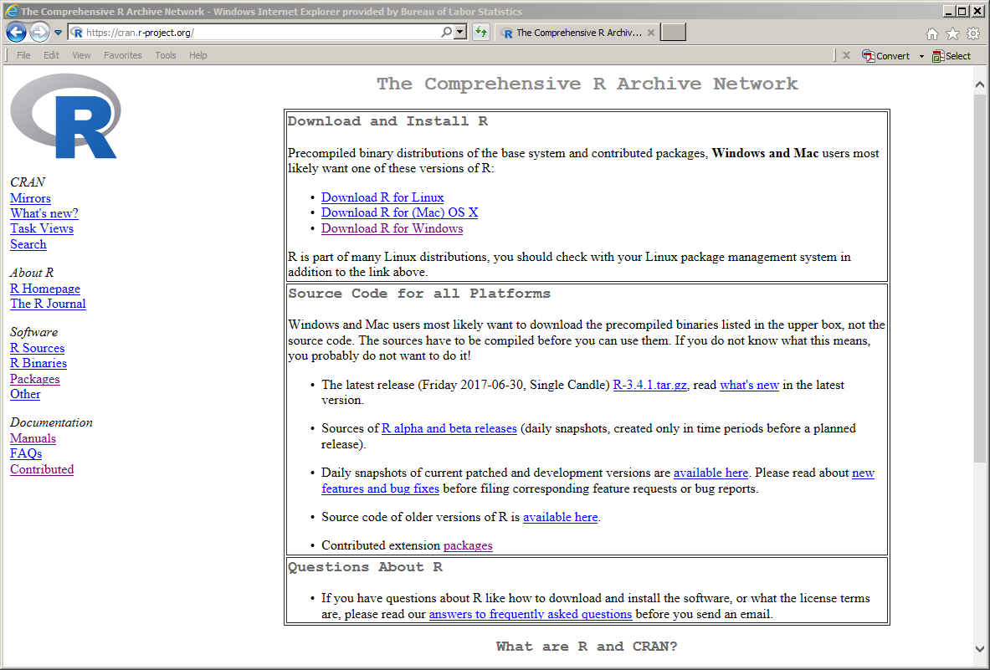
I. CRAN Site cran.r-project.org

Slide 16
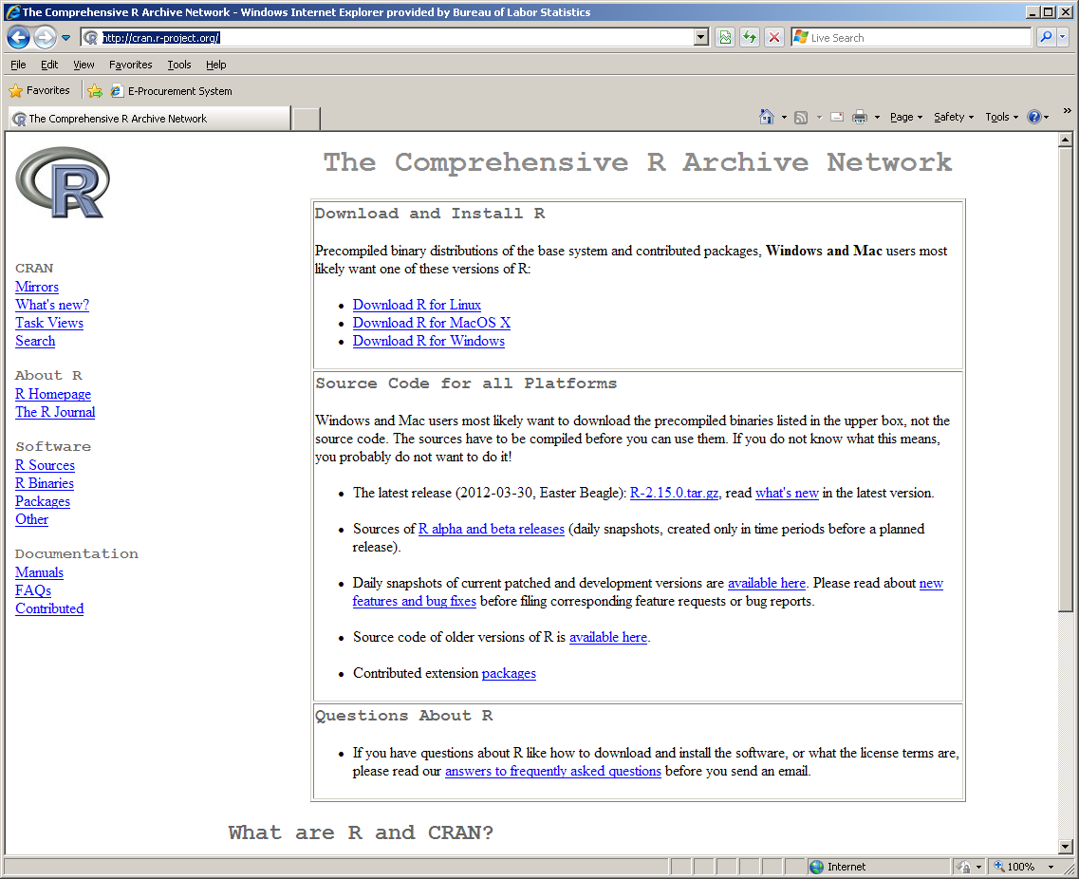
I. CRAN Site cran.r-project.org
Task Views
Download R here
Add-Ons to R
Manuals

Slide 17
I. Introduction: R Packages
Emphasis is on statistical computing, but R is used to solve problems and for research in many disciplines:
Signal and image processing
Data mining
Analysis of text
Finance and econometrics
Chemistry and Physics
Environment
Optimization
Biology and pharmaceutical
Social Science
Survey Methods

Slide 18
I. Introduction: R Packages
An R Package is a group of functions that have a common objective or emphasis.
R Packages are add-ons (or toolboxes) that users write.
Extends the capabilities of R.
They are available for free download from the CRAN site.
Some are on github and other sources.
These usually implement the latest state-of-the-art research.
We will practice loading and installing packages later.

Slide 19
I. Introduction: Task Views
There are a LOT of R packages – over 11,300 on CRAN.
Some packages have been grouped together according to major areas or Task Views:
Spatial Statistics
Finance – Econometrics
Official Statistics
Social Sciences
Graphics
More
You can find the Task Views from the main CRAN site.
Each Task View contains an explanation of the R packages that are in the Task View
You can install the packages in the view – see bottom of Task View page

Slide 20
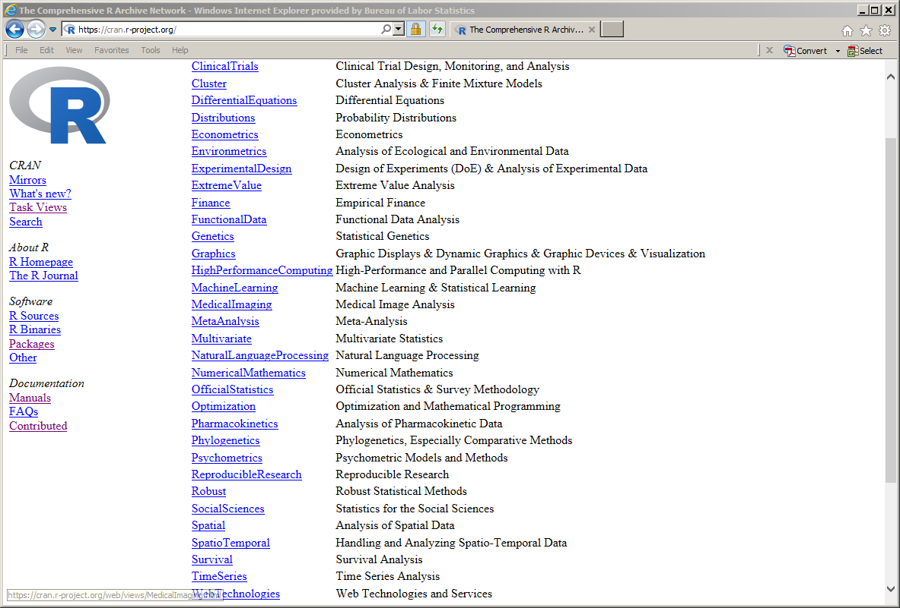
I. Introduction: Task Views

Slide 21
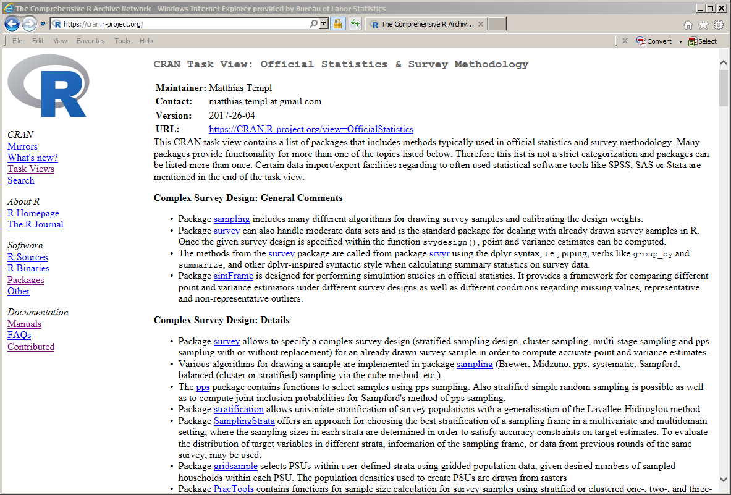
I. Introduction: Task Views
Explanation of different packages is found in the task view
Provides a nice overview.
This is the Task Views for Official Statistics & Survey Methodology

Slide 22

I. Introduction: Starting R
Start R as you would most software in MS Windows
Windows Start button… All Programs
Desktop icon or shortcut
An application appears
Graphical User Interface (GUI) window called Rgui
Called an IDE – Integrated Development Environment
Has toolbar and menus
R console window
R Studio is an alternative (and powerful) IDE

Slide 23
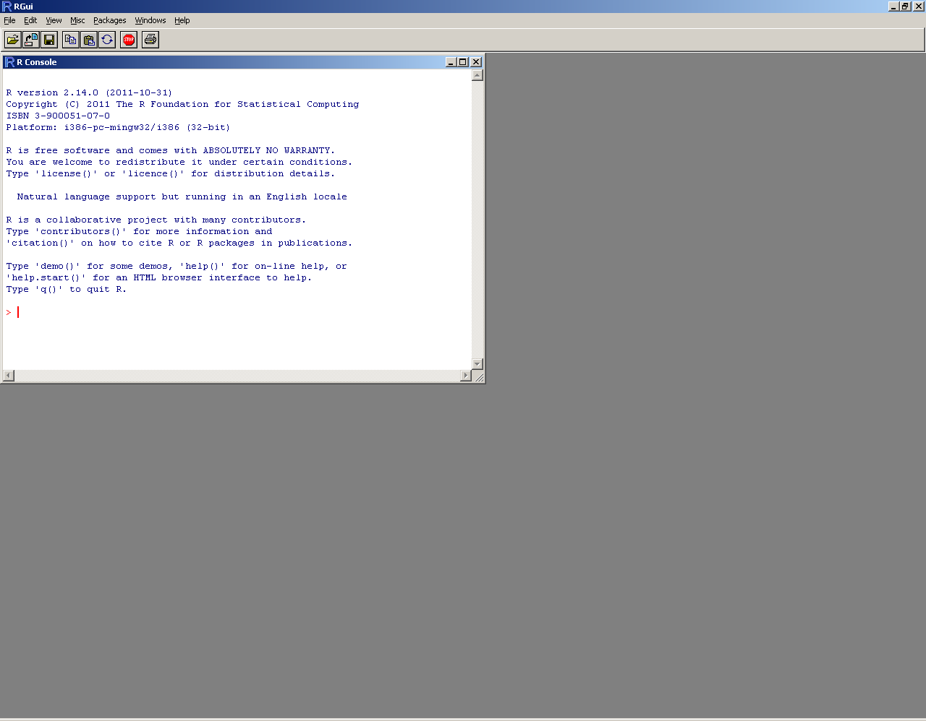
I. Introduction: Screenshot of RGUI
Toolbar & Menus
R command Window

Slide 24
I. Introduction: R Studio
R Studio is an IDE – Integrated Development Environment.
Replaces the R GUI.
R Studio is a commercial entity.
Provides open-source software for R.
R Studio IDE
R Shiny
See the cheat sheet and tutorial

Slide 25
I. Introduction: An R Session
The user types commands into the R console (or command) window
The interactions between the user and the system is called an R session.
The user provides expressions or commands for evaluation by R to
Compute things
Display results – graphics, etc.
Create data objects for future use, saving, …

Slide 26
I. Introduction: An R Session
When an R session starts:
Common (or base) R packages are loaded
Workspace (where current data lives) is empty – usually
Opens in the working directory
The contents of packages are not available until they are loaded – more on this next.
Session ends when one quits or exits R
Use the File menu to Exit
Close window – ‘x’ in upper right corner of window
Gives you the option to save the workspace (data) to load later

Slide 27
I. Introduction: Installing & Loading Packages
You must first install a package
Can be done from CRAN website
Can use Packages menu
Can be done from local .zip files
Only need to install ONCE
Next, you need to load the package
Can be done from the command line: library()
Can use the Packages menu
Has to be done EVERY session – when you want to use the package

Slide 28
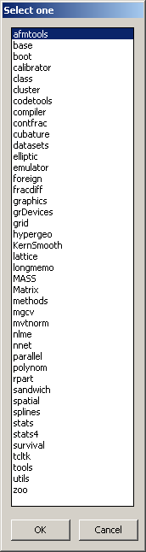
I. Introduction: Installing & Loading Packages
You can get a list of libraries or packages (these are the same thing) that you have installed by using the command library().
You can also get a list by using the Packages … Load package menu.
This pertains to RGUI.

Slide 29
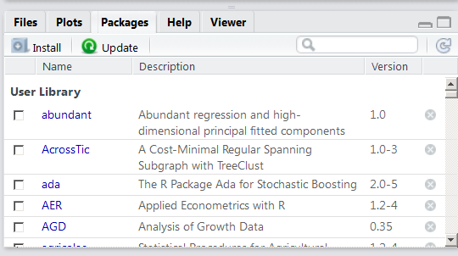
I. Introduction: Installing & Loading Packages
R Studio has similar interactive capabilities for installing and loading packages.
See Packages tab.

Slide 30
I. Introduction: Installing & Loading Packages
Try this…
Go to the Packages menu or tab.
Select Install
Select a Repository or mirror – place where the files are stored – if asked
Window should come up with a list of packages
Select to install survey
Repeat to install lattice

Slide 31
I. Introduction: Installing & Loading Packages
Now they are installed.
You must load them for each R session where you want to use them.
Try this…
Load survey using the Packages menu/tab
Load lattice using library(lattice)at the command line.

Slide 32
I. Introduction: Commands & Functions
The command line prompt appears as a >
Type in a command and hit the Enter key to make it run
Commands in R are really functions
Functions have input and output arguments
Can use the arguments or not
Depends on what you want to do

Slide 33
I. Introduction: Commands & Functions
Example…
This will list all objects in the workspace:
> ls()
[1] "adults" "adults.dsgn" "adults.wr" "ratio" "tmp"
[6] "tmp.dsgn"
Note that we called this function with no arguments.
But, we include empty parentheses.
Leaving the parentheses off will give the code for the function.
Try it – type ls at the prompt.

Slide 34
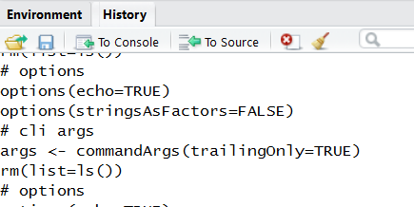
I. Introduction: Editing Commands
You can use the Up and Down arrow keys to get previous commands or expressions
You can use the Left and Right arrow keys to move along the command line and make changes
You can edit/change commands – See the Console option on the Help menu for information
This is a short-cut way to correct typos
You can copy and paste commands from a text file or the history.

Slide 35
I. Introduction: R Commands
Commands in R can be expressions or assignments
If an expression is typed into the command line, then it is evaluated, printed, and deleted
An assignment evaluates an expression and passes the value to a variable, but it is not printed to the screen
The notation for the = sign is the <-
You can print the value of the variable to the command window by typing the variable name and hit return

Slide 36
I. Introduction: Try This…
This is a simple expression or calculation:
Type this at the prompt:
2 + 2
You will get this results: [1] 4
This is the same calculation as an assignment
Type this:
x <- 2 + 2
You will get the prompt, type x at the prompt to see the value of x

Slide 37
I. Introduction: Variable Names
The x in our example is called a variable.
A variable is the name for a data object.
Variable names in R:
Are case sensitive: Data and data are different
Can be a combination of letters, numbers & periods
Cannot start with a number
Cannot use spaces

Slide 38
I. Introduction: Variable Names
More on variable names in R:
A variable name must start with a period or a letter
If it starts with a period, then the second character cannot be a digit
If possible, do not use built-in function names for variable names. This can cause problems and give strange results.

Slide 39
I. Introduction: R Punctuation
If a command is not completed when you hit the return key, then R will give a different prompt.
You will see a + sign.
You will get this until you complete the command or expression or make a syntax error.
You can get out of it by hitting the Esc key.
Commands or expressions with a pound sign (#) in front are comments and are not evaluated.

Slide 40
I. Introduction: R Punctuation
Commands are separated by
A semi-colon – usually if commands are on the same line/prompt
A newline – hit the return key
Elementary commands can be grouped into one compound expression using curly braces
This is often used in writing functions, looping, and conditional execution.
Example:
{ls(); x = 2 + 2, … }

Slide 41
I. Introduction: Getting Help
If you know the function or command name, then you can get help by typing help(functionname).
Try this… help(ls)
That should bring up a window – see next slide.
The help documentation often has examples that you can copy and paste into the R Console to execute.
Try this…
help(cov)
Then copy and paste an example to execute – scroll down to the Examples section.

Slide 42
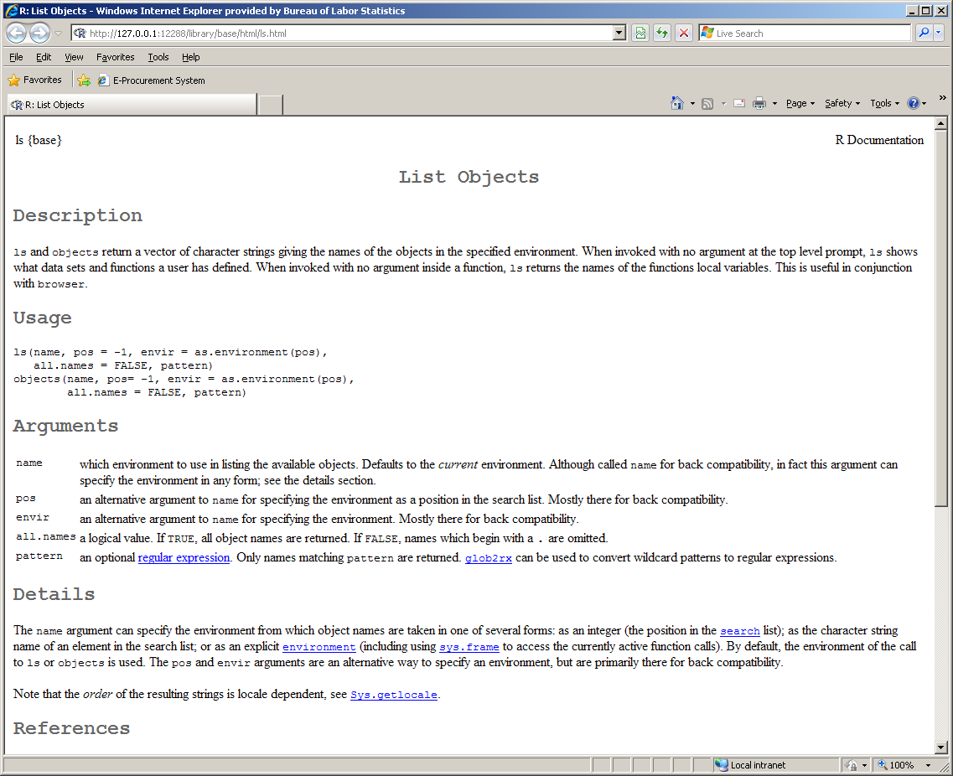
I. Introduction: Getting Help
Tells you what package it is from. In this case, it is from the base functions.
Description of arguments and defaults.
References for the function details.

Slide 43
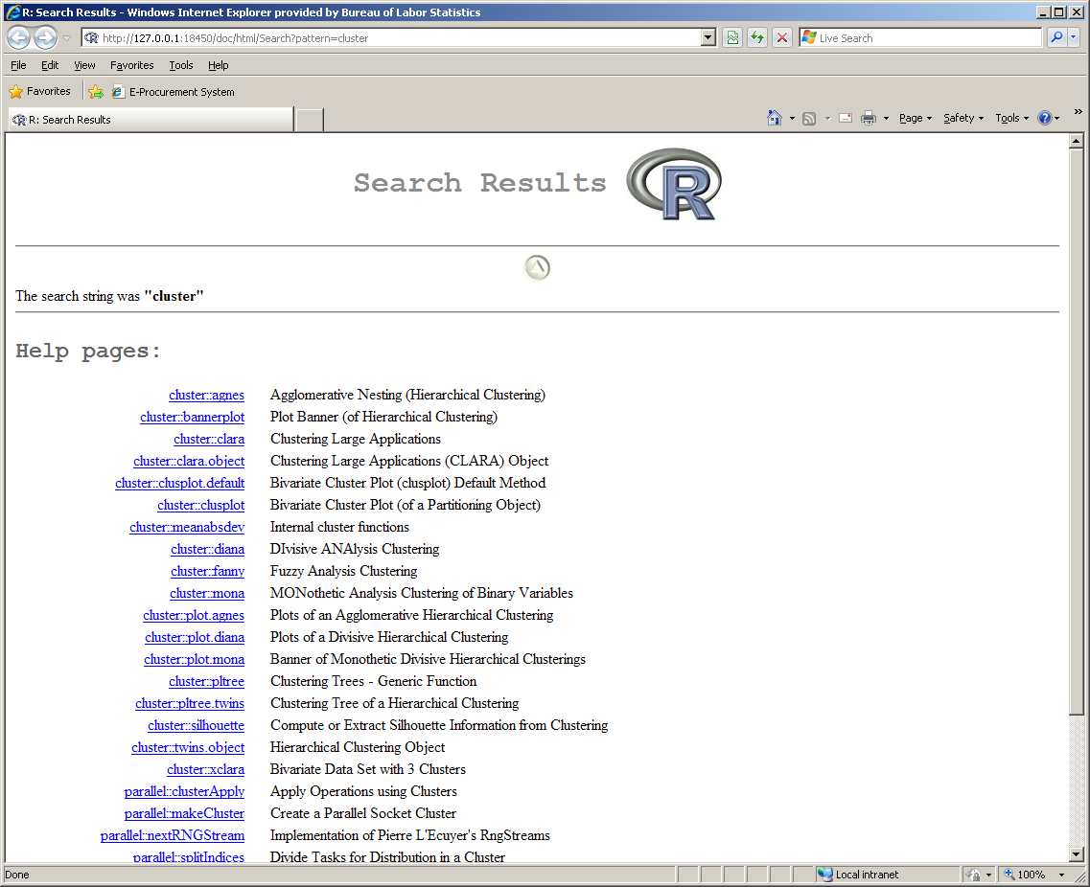
I. Introduction: Getting Help
You can search for help using help.search()
Arguments to this function are strings – words in quotes
Try this…
help.search("cluster")
Produces this window
Package name : : Function Name

Slide 44
I. Introduction: Workspace
Knowing about the R workspace, objects, variables, directories, etc. is helpful.
The objects or entities you create are called objects.
Objects can be
Variables
Arrays – vectors, matrices
Character strings – text
Functions

Slide 45
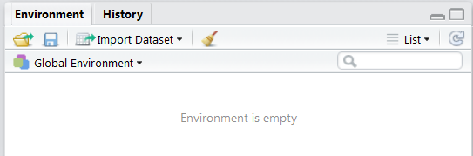
I. Introduction: Workspace
Objects are stored and accessed by variable name.
They live in the workspace for the current R session.
You can list the names of the objects in the workspace using objects() or ls() or the menu Misc … List objects
R Studio has a panel to view workspace.

Slide 46
I. Introduction: Workspace
Objects can be removed from the workspace using rm() or remove():
rm(x, data)
This removes (deletes) objects or variables called x and data.
You can also use the RGUI menu Misc … Remove all objects

Slide 47
I. Introduction: Workspace
Objects can be stored and then loaded in a future R session.
This option is offered when you quit R or you can do this using the RGUI File … Save workspace menu.
The workspace will be in a file called .Rdata in the current directory or you can give it a different name.
These workspace commands are in the Session menu of R Studio.

Slide 48
I. Introduction: Directories
You should use a separate working directory for different projects.
Use getwd()to get the current directory
Use setwd("pathname")to change to that directory
Example:
setwd("C:\\wmartinez\\Rproject")
setwd("C://wmartinez/Rproject")
This can be done via menus, too:
Session menu in R Studio
File menu in RGUI

Slide 49
I. Introduction: Editors in R
We are not going to cover writing programs or functions in R – where editors become important.
There is an R editor in RGUI – invoked via the menu: File… New Script
There is a really good editor in R Studio.
You can also use MS Notepad.
Write code, commands
Copy and paste to the console

Slide 50
Data – Inputs & Outputs

Slide 51
II. Data – Inputs & Outputs
In this Section, we will explore options for data I/O (inputs and outputs):
Learn how to read data from files
Import/export with other software
Use data from R packages
Export data
We will learn about the actual data (object) types in the next section.

Slide 52
II. Data – I/O: Data From Files
The easiest way to get data into R is from a text file.
The basic function for reading in data (assumes data is in a table form – rows and columns) is:
read.table()
Let’s look at the help for this function:
help(read.table)
The help gives information on column headers (or titles) and type of separator (tab, comma, etc.).
Reads a data file that is in a table form:
Rows are observations (points or cases)
Columns are variables (fields or characteristics)

Slide 53
II. Data – I/O: Data From Files
There are some other useful related functions for reading in table-like data files.
The function read.csv() is for comma separated files.
Most statistical software programs and databases will export or record data in this type of format.
Microsoft Excel will read and write files in this format.
The function read.delim()is for files with other separators, such as TAB or space.
See the help on these functions for arguments to give information about column/row labels, etc.

Slide 54
II. Data – I/O: Data From Files
See the R Data Import/Export manual on the CRAN website for more information on data I/O.
You can access this from the Help … Manuals (in PDF) menu.
In R Studio… go to the Help… R Help menu.
Let’s look at that now…

Slide 55
II. Data – I/O: Other Software
There are some functions that can be used to connect with other software packages.
Options for importing/exporting are (requires the foreign package):
Minitab portable worksheet: read.mtp()
SAS Transport format: read.export()
SPSS save and export: read.spss()
Stata .dta files: read.dta()
See haven package for robust data I/O.

Slide 56
II. Data – I/O: Exporting Data
The basic function for exporting data to a file is the write() function.
This function writes out a table to a text file.
The function write.table()adds row and/or column labels to the file.

Slide 57
II. Data – I/O: .Rdata
What we just discussed is mostly used to get data from R that will then be used in other software, like Excel.
Remember that you can save data in a special file called .Rdata.
Saves more than one object – saves the workspace.
Use the menu to save the data
Can load the workspace using the menu
Uses the save() function – with optional arguments specifying a list of objects to save.
The data can be read back into R using the load() function.

Slide 58
II. Data – I/O: Data Sets in R
Most R packages come with data sets that you can use to practice or for examples.
To list all data sets in a package use data() to list all available data sets.
Depends on what is loaded.
The data should be available once the packages are loaded.
Try this…
data() to see your available data sets
The following shows the data in the lattice package
data(package = "lattice")

Slide 59
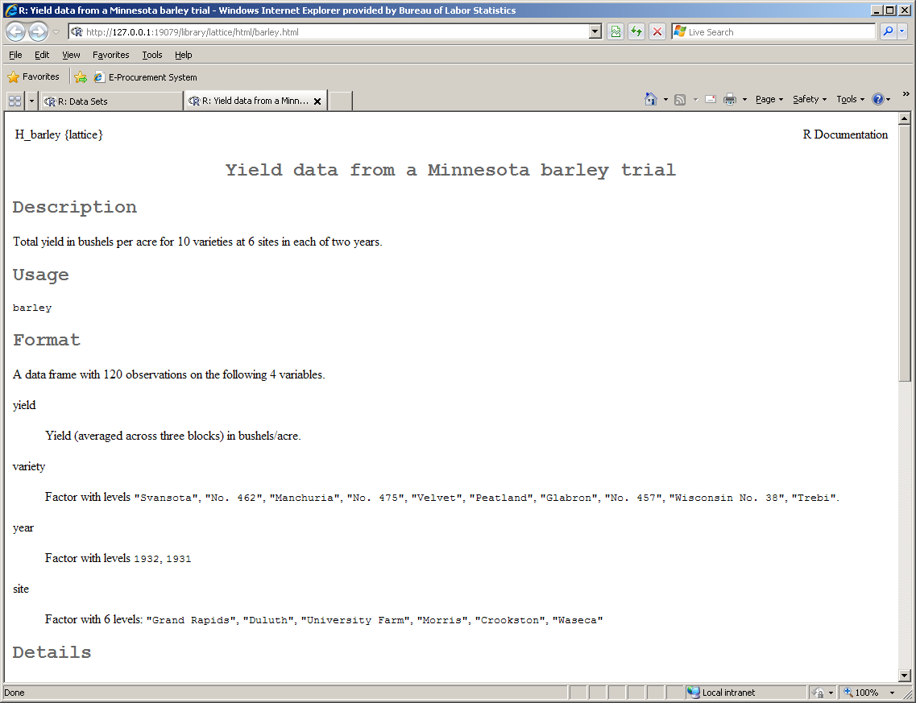
II. Data – I/O: Getting Data Out of R
You can get information on the data sets using the help function.
Try this …
# Load the package
library(lattice)
help(barley)
You will get a help file.
Note that the name of the package is at the top.

Slide 60
II. Data – I/O: Data Sets in R
A useful function to understand the contents and structure of a data object is the summary() function.
This produces different results, depending on the type of object or variable.
You can also type the name of the data and the contents will appear in the command window.
Try this…
summary(barley)
Now try this…
barley

Slide 61
II. Data – I/O: Data Sets in R
> summary(barley)
yield variety year site
Min. :14.43 Svansota :12 1932:60 Grand Rapids :20
1st Qu.:26.88 No. 462 :12 1931:60 Duluth :20
Median :32.87 Manchuria:12 University Farm:20
Mean :34.42 No. 475 :12 Morris :20
3rd Qu.:41.40 Velvet :12 Crookston :20
Max. :65.77 Peatland :12 Waseca :20
(Other) :48
>

Slide 62
II. Data – I/O: Data Sets in R
> barley
yield variety year site
1 27.00000 Manchuria 1931 University Farm
2 48.86667 Manchuria 1931 Waseca
3 27.43334 Manchuria 1931 Morris
4 39.93333 Manchuria 1931 Crookston
5 32.96667 Manchuria 1931 Grand Rapids
6 28.96667 Manchuria 1931 Duluth
7 43.06666 Glabron 1931 University Farm
8 55.20000 Glabron 1931 Waseca
9 28.76667 Glabron 1931 Morris
10 38.13333 Glabron 1931 Crookston
29.13333 Glabron 1931 Grand Rapids
…

Slide 63
II. Data – I/O: Data Sets in R
Some other useful functions to understand the data and object in the workspace are:
dimnames(): Provides the names of the observations (or cases) and the variables
dim(): Provides the number of rows and columns
Try this …
dimnames(barley)
dim(barley)
head(barley) # First ?? rows
tail(barley) # Last ?? rows

Slide 64
II. Data – I/O: Data Sets in R
> dimnames(barley)
[[1]]
[1] "1" "2" "3" "4" "5" "6" "7" "8" "9" "10" "11" "12"
[13] "13" "14" "15" "16" "17" "18" "19" "20" "21" "22" "23" "24"
[25] "25" "26" "27" "28" "29" "30" "31" "32" "33" "34" "35" "36"
[37] "37" "38" "39" "40" "41" "42" "43" "44" "45" "46" "47" "48"
[49] "49" "50" "51" "52" "53" "54" "55" "56" "57" "58" "59" "60"
[61] "61" "62" "63" "64" "65" "66" "67" "68" "69" "70" "71" "72"
[73] "73" "74" "75" "76" "77" "78" "79" "80" "81" "82" "83" "84"
[85] "85" "86" "87" "88" "89" "90" "91" "92" "93" "94" "95" "96"
[97] "97" "98" "99" "100" "101" "102" "103" "104" "105" "106" "107" "108"
[109] "109" "110" "111" "112" "113" "114" "115" "116" "117" "118" "119" "120"
[[2]]
[1] "yield" "variety" "year" "site"
> dim(barley) # Number of rows and columns in barley data
[1] 120 4
>

Slide 65
Data Objects in R

Slide 66
III. Data Objects in R
In this Section, we will cover:
Data objects in R
Vectors
Matrices
Data frames
Lists
R as an object-oriented language
We will cover specific objects in greater detail later.

Slide 67
III. Data Objects
The basic types of data objects in R are:
Vectors – single rows or columns of data
Matrices – tables with rows and columns
Data frames – special tables
Lists – more structured tables
A data object has a variable name and content (the data values).
For example, barley is the variable name for a data frame object that contains values for the yield based on year and type.

Slide 68
III. Data Objects
Data objects in R also have characteristics or attributes associated with them, depending on object type and class.
Class – more on this later
Dimensions – number of rows and columns
Labels – for rows and columns
More …
Type ?attributes to look at the documentation
Try this example, copy/paste from the help…
x <- cbind(a = 1:3, pi = pi)
# simple matrix w/ dimnames
attributes(x)

Slide 69
III. Data Objects
Results …
> attributes(barley)
$names
[1] "yield" "variety" "year" "site"
$row.names
[1] "1" "2" "3" "4" "5" "6" "7" "8" "9" "10" "11" "12"
[13] "13" "14" "15" "16" "17" "18" "19" "20" "21" "22" "23" "24"
[25] "25" "26" "27" "28" "29" "30" "31" "32" "33" "34" "35" "36"
[37] "37" "38" "39" "40" "41" "42" "43" "44" "45" "46" "47" "48"
[49] "49" "50" "51" "52" "53" "54" "55" "56" "57" "58" "59" "60"
[61] "61" "62" "63" "64" "65" "66" "67" "68" "69" "70" "71" "72"
[73] "73" "74" "75" "76" "77" "78" "79" "80" "81" "82" "83" "84"
[85] "85" "86" "87" "88" "89" "90" "91" "92" "93" "94" "95" "96"
[97] "97" "98" "99" "100" "101" "102" "103" "104" "105" "106" "107" "108"
[109] "109" "110" "111" "112" "113" "114" "115" "116" "117" "118" "119" "120"
$class
[1] "data.frame"

Slide 70
III. Data Objects
The attributes and content type are important in analysis.
For example, a variable that takes a value of the set of {1, 2, 3} could be interpreted as
Integers – say the count of some entity
Categorical – coding of something like {Dem, Rep, Ind}
The analysis will likely be different.

Slide 71
III. Data Objects
A vector object (more later) has two intrinsic attributes: mode and length.
The mode is the type of elements contained in the object.
There are 4 main modes: numeric, character, complex, and logical.
Other modes exist, but they do not represent data (e.g., function or expression)
The length is the number of elements in the object.
To get information on these attributes, use the functions mode and length.

Slide 72
III. Data Modes
The four main types of data that are stored in objects can be – numeric, logical, complex, or characters.
Logical – values represented as TRUE/FALSE or T/F
Numeric – numbers as integers or single/double precision numeric values
Complex – imaginary, sqrt(-1)
Character – text or strings

Slide 73
III. Data Objects: Arrays
An array is a general term for a collection of data.
An array has k dimensions:
Scalar – just a single number: k = 0
Vector – single row or column: k = 1
Matrix – table: k = 2
Multi-dimensional array: k > 2
An array is a collection of data elements indexed by multiple (k) subscripts.
You need to specify the k indices to access an element in an array.
For example, you need to specify the row and column to get the data from a cell in a table.

Slide 74
III. Data Objects: Vectors
A vector is a collection of numbers, characters, etc.
It is the atomic (or fundamental) data object in R.
To create a vector, you can use the function c() to combine values into a collection:
Try this…
x <- c(10.4, 5.6, 21.7)
x
Other methods for generating vectors are available and will be covered later in the course.
Note that entries in the vector have to be of the same data type.

Slide 75
III. Data Objects: Factors
A factor is a vector object used to specify a discrete classification or grouping of the components of other vectors of the same length.
Thus, a factor is a vector of categorical data that can be numeric or characters.
For example,
A vector might contain the heights of people (whole inches) as integers.
We might create a factor vector to go along with the heights that contains the same number of entries, where each entry specifies the gender (e.g., M/F or 1/2)
All entries in a factor object have to be of the same mode or type.

Slide 76
III. Data Objects: Factors
Say we have the following vector representing the political affiliation of 5 people; try this...
> pa <- c("D","R","R","L","D")
> mode(pa)
As you can see, this is a character vector.
We can convert to categories for factors using factor().
Try this...
> pac <- factor(pa)
> mode(pac)
What mode is it now?

Slide 77
III. Data Objects: Matrices
A matrix has k = 2 dimensions, which are the rows and columns.
A data entry or value can be accessed using two index values – one for the row and one for the column.
All entries in a matrix have to be of the same data type.
For example, all entries must be numbers.
This is also true for general arrays with k > 2 dimensions.

Slide 78
III. Data Objects: Data Frames
A data frame is a special type of an array with k = 2 dimensions.
Each row represents an observation or data point.
Each column represents a variable or characteristic
Columns or variables can be different data types.
You can attach column and row labels to the data frame object.
We saw this with the barley data…
$names
[1] "yield" "variety" "year" "site"

Slide 79
III. Data Objects: Lists
A list object is even more general.
Thus, it is very versatile.
You could think of a list as type of ‘database’
Components of lists can be vectors, matrices, lists, frames, etc.
The components (entries in the list) and their elements (actual data) do not have to be of the same data type.

Slide 80
III. Data Objects in R
Object | Data Types | Several Types Possible?
Vector – single row or column | Numeric, character, complex or logical | NO
Factor – usually a vector | Numeric or character | NO
Matrix – table with rows and columns | Numeric, character, complex or logical | NO
Array – more than 2 dimensions | Numeric, character, complex or logical | NO
Data Frame – special table | Numeric, character, complex or logical | YES
List | Numeric, character, complex or logical | YES

Slide 81
III. Data Objects: Object-Oriented Language
Object-oriented programming is a style of computer programming.
R follows this general approach and the concepts of object-oriented programming.
It is important to understand the basic idea of object-oriented programming, so you can use R.
Two central concepts of object-oriented programming are:
Classes
Methods

Slide 82
III. Data Objects: Object-Oriented Language
The GOOD:
Functions (plot, summary, print) work like one would want for the object type
The BAD:
Functions do not work like we want unless we have the right object as the argument
The UGLY:
Packages have their own object definitions

Slide 83
III. Data Objects: Object-Oriented Language
Some useful functions to deal with object-oriented aspects of R:
class()
as.factor
as.matrix
as.list
as. …
There are many as.* functions – see the help on the base package.
These coerce the argument to be of the specified class
Can be used to temporarily convert an object to another class
Companion is.* functions can be used to find out (TRUE or FALSE) whether something is of a certain class

Slide 84
III. Data Objects: Object-Oriented Language
A class defines the type of object.
Some examples of object classes in R:
Matrix
List
Data frame
Clusters or groups
Classification trees
Spatial (geographic) data
Many, many more
A data object we create in R is an instance of some class.

Slide 85
III. Data Objects: Object-Oriented Language
The class is a characteristic of the object.
Use class(varname) to find the class of the object or variable.
Try this… What is the class for these objects?
pa
pac

Slide 86
III. Data Objects: Object-Oriented Language
Computations or processing on objects are done via the methods.
Methods are functions that are written for a particular object class, for example…
plot(X)
summary(X)
The appropriate result is obtained depending on the class of the variable X.
The user does not need to worry about the right type of plot or summary. R produces the right output for the object, based on its class.

Slide 87
III. Data Objects: Object-Oriented Language
Try this… Get the class of some data sets:
class(volcano) # matrix
class(singer) # data frame
class(UKDriverDeaths) # ts – time series
class(UCBAdmissions) # table
class(eurodist) # dist - distance
class(state.center) # list
class(state.region) # factor

Slide 88
III. Data Objects: Object-Oriented Language
Now, let’s see how the same function will produce different results based on the type of object.
Try this…
Apply the plot function to each of the data sets on the previous slide.
For example, plot(volcano), plot(singer), etc.
Try this…
Apply the summary function to each of the data sets on the previous slide.
For example, summary(volcano), summary(singer), etc.

Slide 89
Data Manipulation (Vectors)

Slide 90
IV. Data Manipulation
In this section, we will look at simple operations on vectors, to include:
Generating a vector sequence
Arithmetic on vectors and matrices
Logical operators
Special values
Indexing vectors and matrices

Slide 91
IV. Data Manipulation – Review
An expression or command in R can be of many forms.
We will look at simple arithmetic expressions using vectors.
Recall that…
If an expression is typed into the command line, then it is evaluated, printed, and discarded:
> 2 + 2
[1] 4
Assigning the expression to a variable, stores the result in that variable, but the result is not shown. Type the variable name to see the value(s).
> x = 2 + 2
> x
[1] 4

Slide 92
IV. Data Manipulation: Generating a Sequence
You can generate vectors that have a regular sequence of values.
This is useful in programming your own functions in R, e.g. loops.
We use the colon (:) operator for this.
For example, 1:5 will generate a vector of values 1 through 5.
These produce the same vectors:
> x <- c(1,2,3,4,5)
> y = 1:5

Slide 93
IV. Data Manipulation: Generating a Sequence
Put the higher number first to get a decreasing sequence:
> d <- 5:1
> d
[1] 5 4 3 2 1
For more options and control over your sequence of values, use seq(start,end).
There are additional arguments for the step size and more.
See ?seq for information on options.

Slide 94
IV. Data Manipulation: Generating a Sequence
The colon operator has highest priority in an expression.
This can have some unexpected consequences and can give incorrect results.
Try this…
> # Same as (1:5) - 1
> 1:5-1
[1] 0 1 2 3 4
The above first generated a sequence of 1 to 5 and then subtracted 1 from each element.
What does this do?
> 1:(5-1)

Slide 95
IV. Data Manipulation: Vector Arithmetic
Vectors (and matrices) can be used in arithmetic expressions.
The operations work element-by-element, as the default.
Vectors do not need to be the same length.
The result is the length of the longest vector.
Shorter vectors are recycled or copies until they match the length of the longest vector.
The basic arithmetic operators are available:
+, -, *, /, ^

Slide 96
IV. Data Manipulation: Vector Functions
Note that these are used on the entire vector.
Some useful functions for vectors are:
Find the maximum value: max(x)
Find the minimum value: min(x)
Add all the values: sum(x)
Find the average: mean(x)
Calculate the square root: sqrt(x)
Get the number of elements: length(x)
Find the sine or cosine: sin(x), cos(x)

Slide 97
IV. Data Manipulation: Vector Functions
More useful functions for vectors are:
Find logarithms using any base: log(x)
Find the inverse log: exp(x)
Find the range – min and max: range(x)
Find the product of the elements: prod(x)
Find the variance: var(x)
Sorting functions are available:
sort()
order()
sort.list()

Slide 98
IV. Data Manipulation: Logical Vectors
A vector can contain logical values.
The elements of a logical vector can be TRUE, FALSE, and NA.
The values TRUE and FALSE can be abbreviated to T and F, but it is not recommended.
Elements T and F are variables that are set to TRUE and FALSE, so they can be over-written.
The marker NA means ‘not available’
Logical vectors can be coerced into numeric vectors when they are used in ordinary arithmetic, in which case, TRUE = 1 and FALSE = 0.

Slide 99
IV. Data Manipulation: Vectors as Sets
There are some useful functions for working with vectors as sets.
These are
Union: union(x, y)
Intersection: intersect(x, y)
Set difference: setdiff(x, y)
Set equality: setequal(x, y)
These operations discard duplicated values.

Slide 100
IV. Data Manipulation: Vectors as Sets
Example...
> x <- c(sort(sample(1:20, 9)), NA)
> y <- c(sort(sample(3:23, 7)), NA)
> x
[1] 1 4 5 7 8 11 12 16 17 NA
> y
[1] 4 6 8 9 17 18 19 NA
> union(x,y)
[1] 1 4 5 7 8 11 12 16 17 NA 6 9 18 19
> intersect(x, y)
[1] 4 8 17 NA
> setdiff(x, y)
[1] 1 5 7 11 12 16
> setequal(x, y)
[1] FALSE

Slide 101
IV. Data Manipulation: Logical Operators
Logical operators are:
Less than: <, <=
Greater than: >, >=
Exact equality: ==
Inequality: !=
If c1 and c2 are logical expressions, then
The expression c1 & c2 is the intersection
The expression c1 | c2 is the union
The expression !c1 is the negation of c1

Slide 102
IV. Data Manipulation: Logical Functions
There are several functions in R that start with is – mostly of the form is.*.
Some examples:
is.logical, is.numeric, is.vector
is.real, is.complex
is.nan, is.finite, is.na
isTrue, isSymmetric
There is a function called all.equal() that compares two objects for near equality.
The function identical() tests exact equality.

Slide 103
IV. Data Manipulation: Special Values
Some components may not be known, e.g., not observed, not a valid numeric value, etc.
The value NA can take the place of missing values.
Operations on NA result in an NA.
The function is.na(z) produces a logical vector with the same length as z, where each element evaluates to TRUE if the corresponding element of z is NA.
Cannot use the expression z == NA for the same.

Slide 104
IV. Data Manipulation: Special Values
Cannot use the expression z == NA for the same.
Try this…
> z <- c(1:3, NA)
> is.na(z)
[1] FALSE FALSE FALSE TRUE
> z == NA
[1] NA NA NA NA

Slide 105
IV. Data Manipulation: Special Values
Two other special values in R correspond to infinity and not-a-number.
You can get infinity (Inf) when dividing by zero.
Try this…
1/0
You can also get a result of not-a-number (NaN) or is undefined in this manner:
Try this…
0/0

Slide 106
IV. Data Manipulation: Character Vectors
Character vectors are used in many places in R.
Plot titles and labels
Names of factors
File names and directories
They are represented by a sequence of characters enclosed in single or double quotes.
Character vectors are displayed in the window in double quotes and sometimes without quotes.

Slide 107
IV. Data Manipulation: Character Vectors
The backslash "\" is an escape character.
Use "\\" to print the backslash
Use "\n" for newline
Use "\t" for tab
Use "\b" for backspace
You can concatenate character vectors using the c() function.
The paste() function concatenates vectors.
This is good for creating patterned labels.

Slide 108
IV. Data Manipulation: Indexing
Sometimes we want to extract or operate on a subset of elements in a vector.
We can access specific elements by enclosing the index numbers in square brackets after the variable name.
Note that the first element of a vector is element 1.
Because this is a vector – with dimension 1 – we only need to provide 1 index or address.
> x <- c(1,2,3)
> # Display the second element of vector x.
> x[2]
[1] 2

Slide 109
IV. Data Manipulation: Indexing
An indexed expression can appear on the receiving part of an assignment statement.
In this case, the operation is performed on those elements only.
> x <- c(1, 0/0, 3)
> x
[1] 1 NaN 3
> x[is.na(x)] = 0
> # That replaces the NaN element
> # with a zero
> x
[1] 1 0 3

Slide 110
IV. Data Manipulation: Indexing
The part inside the brackets is the index vector (or list of addresses), which can be of several types.
Logical vector – TRUE or FALSE:
> x <- c(-3,3,-4,5)
> x[x > 0] # positive values
[1] 3 5
Positive index:
> # Get values in location 1 & 3
> x[c(1,3)]
[1] -3 -4

Slide 111
IV. Data Manipulation: Indexing
Negative index:
> # Everything EXCEPT locations 1 & 3
> x[-c(1,3)]
[1] 3 5
Character index:
> fruit <- c(5,10,1,20) # Vector of data
> names(fruit)=c("orng","ban","app","pch") # names
> fruit[c("app","orng")]
app orng
1 5
> # Extracted apples and oranges

Slide 112
IV. Data Manipulation: Extracting Subsets
There is a generic function called subset().
This can be used to extract subsets of vectors, matrices or data frames.
It returns an object similar to the argument with
Selected elements for a vector
Selected rows and columns for a matrix or data frame
A related function is split().
This divides the data in a vector into groups defined by one of the arguments.
The function unsplit() reverses this.

Slide 113
Matrices and Arrays

Slide 114
V. Arrays: A Matrix
Recall that matrices and arrays are a collection of data that are indexed with multiple subscripts.
In R, this is mostly matrices (k-D arrays) and higher-dimensional arrays.
Vectors can be an array if it has a dimension vector in its dim attribute:
Try this…
> x <- 1:10 # set up vector
> class(x) # Class is a vector of integers
[1] "integer"
> dim(x) <- c(1,length(x)) # Set the dim attribute
> dim(x) # What do you get?
> class(x) # What is the class now?

Slide 115
V. Arrays: Generating a Matrix
The function matrix() can be used to create a matrix object.
The function has the general form:
matrix(data_vector, nrow, ncol)
Different arguments are available, and not all are required.
You can build a matrix using vectors and/or other matrices.
There are 2 functions for this: rbind and cbind
The function cbind() connects other objects as columns.
The function rbind() connects them as rows.

Slide 116
V. Arrays: Generating a Matrix
For example, create two vectors:
> x = 1:4
> y = 5:8
Bind as rows:
> rbind(x,y)
[,1] [,2] [,3] [,4]
x 1 2 3 4
y 5 6 7 8
Bind as columns:
> cbind(x,y)
x y
[1,] 1 5
[2,] 2 6
[3,] 3 7
[4,] 4 8

Slide 117
V. Arrays: Generating an Array
You can use the function array() to create a more general array object.
The function has the general form:
array(data_vector, dim_vector)
Try this example…
> X <- array(1:20, dim = c(4,5)) # Create a matrix (2-D array)
> X
[,1] [,2] [,3] [,4] [,5]
[1,] 1 5 9 13 17
[2,] 2 6 10 14 18
[3,] 3 7 11 15 19
[4,] 4 8 12 16 20

Slide 118
V. Arrays: Uses
Some uses of array() are the following.
To get an array of all zeros:
array(0, dim_vector)
To get an array of all ones:
array(1, dim_vector)
And so forth…

Slide 119
V. Arrays: Arithmetic
Arrays and matrices can be used in arithmetic expressions.
The operations work element-by-element in the arrays.
The basic operations available are addition, subtraction, multiplication, division, and powers (exponents)
Use this notation to get a linear algebra multiplication for vectors and matrices:
X%*%Y # X and Y are matrices

Slide 120
V. Arrays: Arithmetic
Try these examples …
Create two 3 by 2 matrices.
X = matrix(1:4,3,2)
Y = matrix(6:10,3,2)
Add: X + Y
Multiply: X*Y
Subtract: X – Y
Square each element of Y: Y^2

Slide 121
V. Arrays: Functions
Some important functions for use with matrices are:
Find the number of rows: nrow(X)
Find the number of columns: ncol(X)
Transpose a matrix: t(X)
Find the dimensions (# rows & # cols): dim(X)
Find the matrix inverse: solve()
Create a diagonal matrix or extract the diagonal: diag()

Slide 122
V. Arrays: Functions
To solve the linear equations Ax = b for x, you can use the function solve(A,b).
The function solve(A) can be used to find the inverse of A.
We can find the eigenvalues and eigenvectors of a matrix using:
eig <- eigen(S)
The variable eig is a list (discussed in next section)
To extract the vectors use: eig$vec
To extract the eigenvalues use: eig$values

Slide 123
V. Arrays: Functions
To perform a least-squares fit, we can use the function lsfit(X,y).
The matrix of observed predictors is given by X.
The vector of responses is given by y.
It provides the least squares estimate of b in the model: y = Xb + e
It returns a list that includes the estimated coefficients (b), the residuals, and more.
We will see a different function for this later in the course.

Slide 124
V. Arrays: Indexing
Specific data elements in arrays and matrices can be accessed by specifying the required number of indexes.
Arrays – need k indexes
Matrices – need two indexes
Recall that with vectors, we can access specific data elements by enclosing the index numbers in square brackets after the variable name.
> x = c(1, 2, 3)
> x[2] # Get the second element of vector x
[1] 2

Slide 125
V. Arrays: Indexing
Matrices work the same way.
However, you need to use two indexes – one for the row and one for the column.
> x = 1:4
> y = 5:8
> X = rbind(x,y)
> X[2,3] # 2nd row, 3rd col.
y
7
> X[2,3] <- 0
> X
[,1] [,2] [,3] [,4]
x 1 2 3 4
y 5 6 0 8

Slide 126
V. Arrays: Indexing
You can access entire rows and columns of a matrix as shown here.
> X[,1] # Column 1
x y
1 5
> X[2,] # Row 2
[1] 5 6 0 8
You can get a column from a data frame as shown here – uses the $ sign.
Try this…
> summary(barley)
> barley$yield

Slide 127
V. Arrays: Indexing
Try this…
Generate a matrix with N(0,1) values:
Z = matrix(rnorm(12),3,4)
Extract the first row.
Extract the first and third rows.
Change the negative values to 0.
Extract the even numbered columns.

Slide 128
Lists and Data Frames

Slide 129
VI. Lists & Frames: Lists
In R, a list is an object that is a collection of other objects.
The objects in a list are called components.
The components in a list do not have to be of the same type or mode.
They can be
Numeric
Logical
Character
Matrix, array, lists, data frames
This makes them very flexible.

Slide 130
VI. Lists & Frames: An Example
Here is a simple example of creating a list.
Do not type in the ‘+’ sign – is a continuation prompt.
> Rteach <- list(name = "Wendy",
+ degrees = c("BS", "MS", "PhD"),
+ numchild = 4)
> Rteach
$name
[1] "Wendy“
$degrees
[1] "BS" "MS" "PhD“
$numchild
[1] 4
> class(Rteach) # What is the class?

Slide 131
VI. Lists & Frames: Accessing Lists
The components in a list are ordered.
So, they are numbered and can be accessed via an index, as we did with vectors and arrays.
> length(Rteach) # Rteach has 3 components
[1] 3
> Rteach[[2]]
[1] "BS" "MS" "PhD"
We can also access the individual elements of a component.
> Rteach[[2]][3]
[1] "PhD"

Slide 132
VI. Lists & Frames: Accessing Lists
The use of single and double brackets is different.
Try this…
> x <- Rteach[1] # First sublist or component
> class(x)
[1] "list"
> y <- Rteach[[1]] # First object in list
> class(y)
[1] "character"
> y
[1] "Wendy"

Slide 133
VI. Lists & Frames: Accessing Lists
If components have names, then you can refer to them or access them using this syntax:
Lstname$component_name
Lstname[[“component_name”]]
It should be noted that enough letters to uniquely determine the component name can be used.
Rteach$na could be used to access Rteach$name
Rteach$nu could be used to access Rteach$numchild

Slide 134
VI. Lists & Frames: Constructing Lists
Lists can be constructed by putting together existing objects.
Use the function list() to do this.
The general syntax is
LST <- list(nme1 = obj1, … nme_n = obj_n)
We saw this used before.
The names can be left out, in which case the components are accessed by numbers and in order of their inclusion in the list object.

Slide 135
VI. Lists & Frames: Constructing Lists
Lists can be extended or modified by using the index values, as one would a vector.
LST[4] <- list(data = DAT)
We can concatenate lists together using the c() function.
In this case, the arguments are lists.
This results in a list object.
LST.AB <- c(list.A, list.B)

Slide 136
VI. Lists & Frames: Data Frames
A data frame is a list that has a class designated as “data frame.”
A data frame can be thought of as a matrix (or table) with columns possibly having different modes and attributes.
The conditions that need to be met for a data frame are:
Components of columns must be vectors, factors, numeric matrices, lists or other data frames
Numeric vectors, logicals, and factors are used as is.
Character vectors become factors.
Vector structures appearing as variables must have the same length.

Slide 137
VI. Lists & Frames: Data Frames
Data frames are one of the most-common objects for data.
They are a familiar form for statisticians – as a data matrix.
Data frames may be displayed in matrix form.
Its rows and columns can be extracted using matrix indexing.
The columns (or components) can be accessed using the $ notation.
Advantages:
Matrix-like structure – columns are variables and rows are observations.
Columns can be different data types
Can access the columns using names, if available, making it easier to use

Slide 138
VI. Lists & Frames: Data Frame Construction
Data frames can be constructed using the function data.frame().
It is similar to the construction of a list.
The arguments are of the form
name = object
A list with components that fulfill the conditions for a data frame can be coerced into one of that type or class using as.data.frame().
The read.table() function produces a data frame.

Slide 139
Probability Distributions

Slide 140
Overview
R has functions for handling probability distributions:
Evaluate probability density function
Evaluate cumulative distribution function
Evaluate the quantile function: given q, the smallest x such that
Generate random variables
Useful for examining distribution of data

Slide 141
Some probability distributions (Rname)
Beta(beta) | Gamma(gamma) | Normal(norm)
Binomial(binom) | Geometric(geom) | Poisson(pois)
Cauchy(cauchy) | Hypergeometric (hyper) | Student’s t(t)
Chi-squared(chisq) | Log-normal(lnorm) | Uniform(unif)
Exponential(exp) | Logistic(logis) | Weibull(weibull)
F(f) | Negative binomial (nbinom) | Wilcoxin(wilcox)

Slide 142
Probability distributions in R
In general, one attaches a different prefix to the distribution function name to accomplish different things.
dname() ‘d’ corresponds to density function
pname() ‘p’ corresponds to CDF
qname() ‘q’ corresponds to quantile function
rname() ‘r’ generates random variables

Slide 143
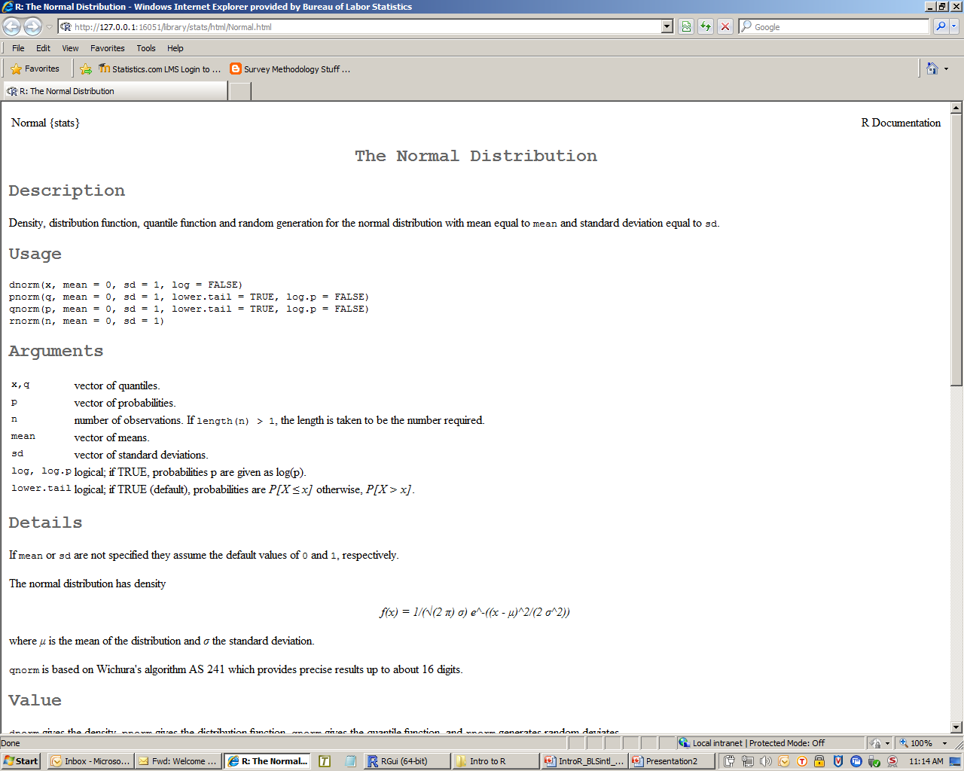
help(rnorm)

Slide 144
Examples
Evaluate the standard normal pdf at 3 points:
> dnorm(c(-4, 0, 4), mean = 0, sd = 1)
0.0001338302 0.3989422804 0.0001338302
Evaluate the standard normal CDF at 0:
> pnorm(0)
[1] 0.5
Evaluate the 0.50 quantile of the standard normal:
> qnorm(0.5)
[1] 0
Evaluate the 0.95 quantile of the standard normal:
> qnorm(0.95)
[1] 1.644854

Slide 145
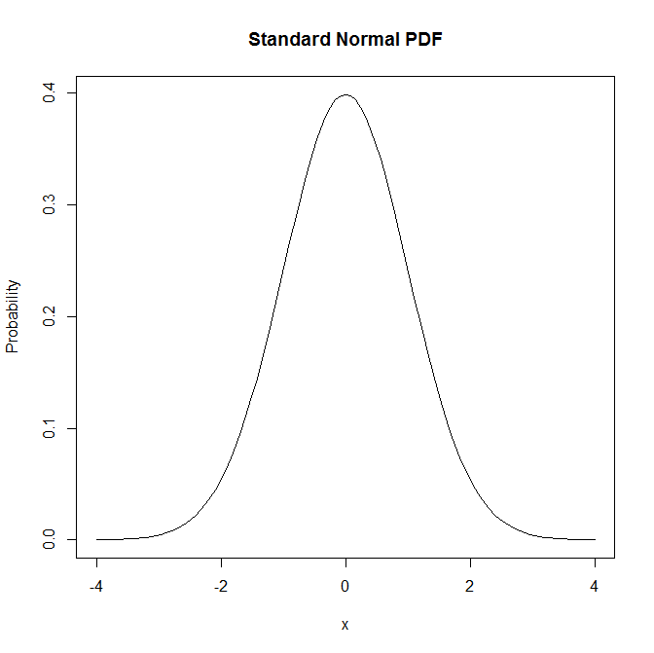
Graphing density functions
> plot(function(x) dnorm(x, mean = 0, sd = 1), -4, 4, main = "Standard Normal PDF", ylab = " ", xlab = " ")

Slide 146
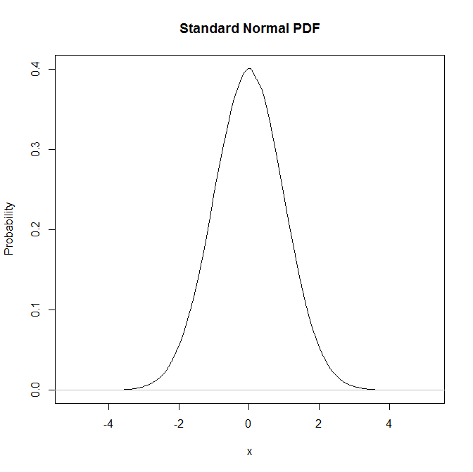
Graphing density functions (2)
> plot(density(rnorm(1000000, 0 , 1)), main = "Standard Normal PDF", ylab = "Probability", xlab = "x")

Slide 147
Generating random numbers
The ability to generate random numbers from a given distribution is very important in many applications
Modeling and simulation
Monte Carlo methods for hypothesis testing
Bootstrap methods
Disclaimer: these are really pseudo-random numbers

Slide 148
Notes about the seed
Algorithms for generating random numbers depend on a starting point called the seed
By default, a new seed is created when a seed is needed in R
Thus, different sessions result in different simulation results (based on different sequences of random numbers)

Slide 149
Generating random numbers
It is sometimes useful to start generating random numbers at a specified starting point
You can set the seed using the function set.seed()
Example:
> runif(3)
[1] 0.6000461 0.4969139 0.2509717
> runif(3)
[1] 0.8794610 0.6947965 0.2330450
> set.seed(527)
> runif(3)
[1] 0.1759273 0.4705125 0.4378114
> set.seed(527)
> runif(3)
[1] 0.1759273 0.4705125 0.4378114

Slide 150
Visualization
There are several functions in R for looking at distributions of univariate data
Summaries of appropriate numbers are
summary(): Results depend on type of object
fivenum(): Tukey’s 5 number summary used for boxplots
Minimum
Lower hinge
Median
Upper hinge
Maximum

Slide 151
Visualization
Example: use the Old Faithful data that comes with R
> class(faithful) ##get object type
[1] "data.frame"
> faithful[1:2,] ##print first two records
eruptions waiting
1 3.6 79
2 1.8 54
> summary(faithful$eruptions)
Min. 1st Qu. Median Mean 3rd Qu. Max.
1.600 2.163 4.000 3.488 4.454 5.100
> fivenum(faithful$waiting)
[1] 43 58 76 82 96

Slide 152
Visualization
There are several high-level plotting functions (more on this in a later section) for viewing distributions
These are:
Stem and leaf plot (not discussed): stem()
Histogram and density: hist(), density()
Empirical CDF (included in stats package): ecdf()
Quantile plots: qqnorm(), qqplot()
Boxplots: boxplot()
Frequency table: table()

Slide 153
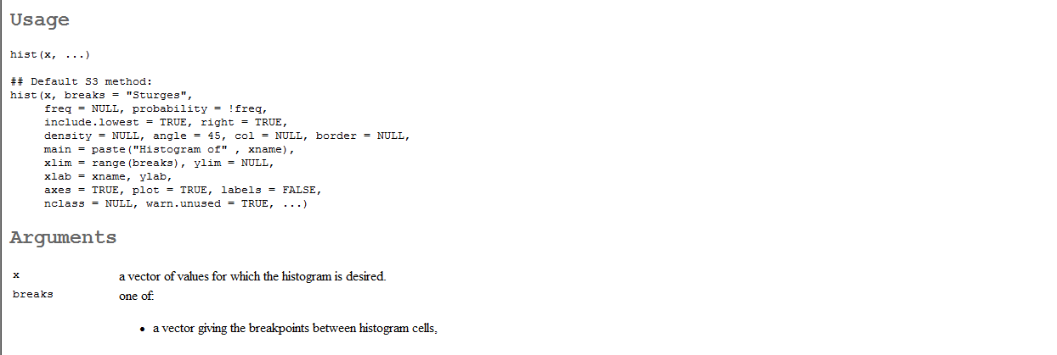
Histogram
In R, a histogram consists of a bin (or bar) for each class – default is to use equal-width bins
Bin height is proportional to the frequency for the class
There are several arguments that allow control over the histogram and what it conveys >help(hist)

Slide 154
Histogram
There is an argument breaks that can be a vector of breakpoints, the number of bins, and more
Changing this (e.g., the number of bins) can provide different information about the distribution

Slide 155
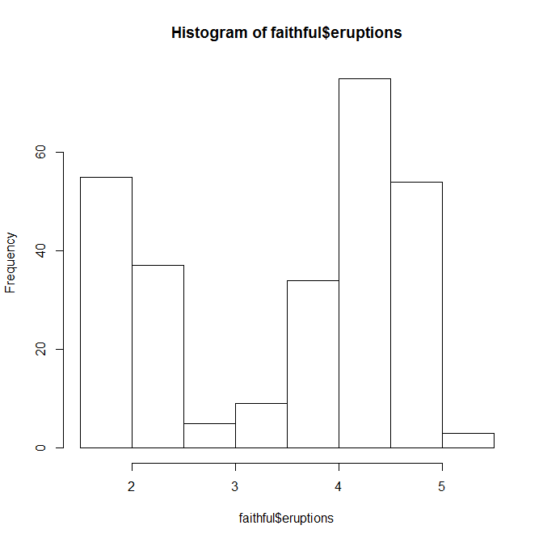
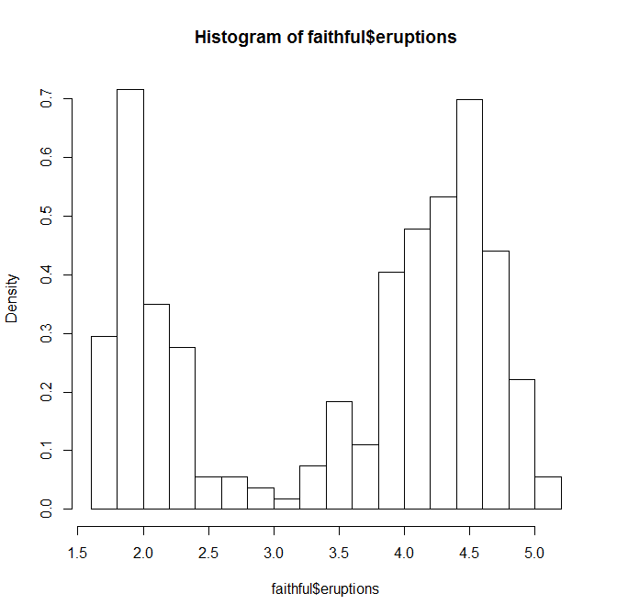
Histogram: Example
> ##Use default number of bins
> hist(faithful$eruptions)
> ##Make bins smaller
> hist(faithful$eruptions, breaks = 20, prob = T)

Slide 156
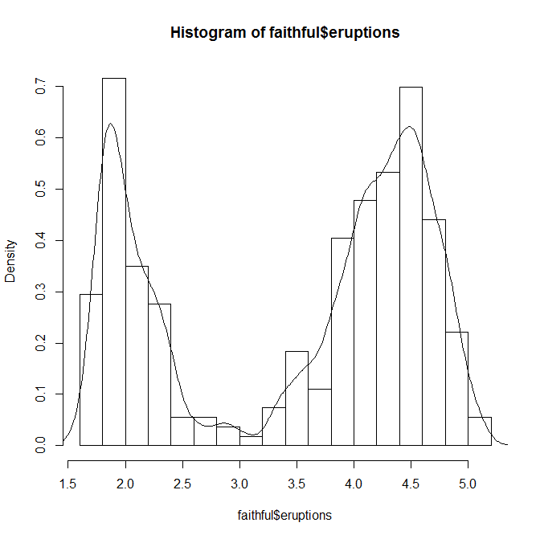
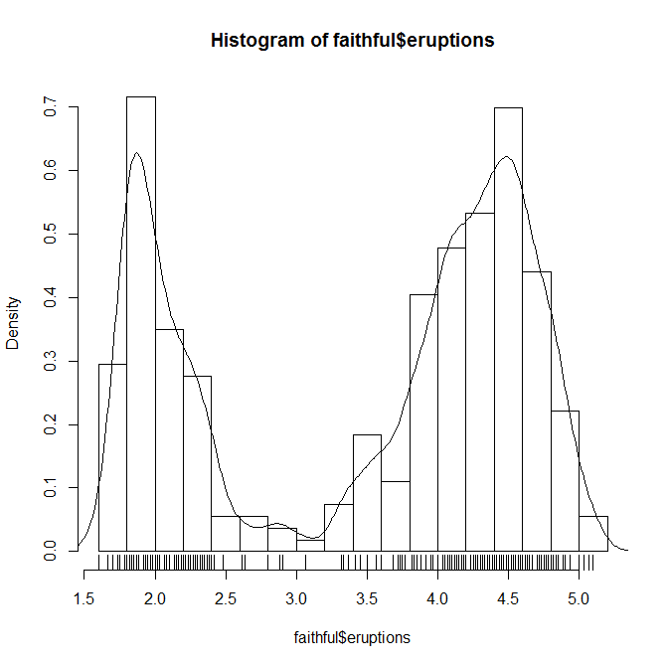
Histogram: Example
> ##Add a plot of the density
> lines(density(faithful$eruptions, bw = 0.1))
> ##Add the actual data in a 1-D scatterplot
> rug(faithful$eruptions)

Slide 157
Empirical CDF
The empirical cumulative distribution function (ecdf), Fn, is a step function with jumps at i/n at observed data values
Here, i is the number of tied observations at that value and n is the number of points
For observations x=(x1,x2,…,xn), Fn(t) is the fraction of observations less than or equal to t

Slide 158
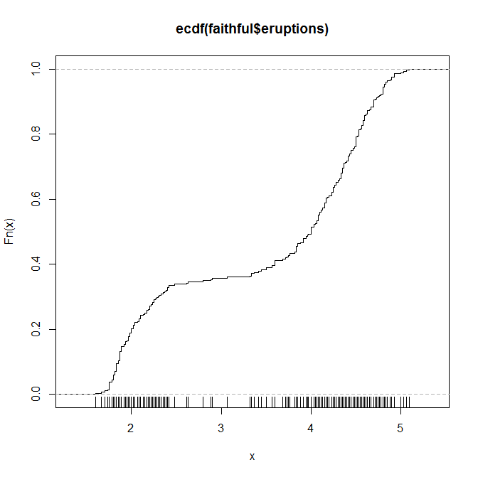
Empirical CDF: Example
> plot(ecdf(faithful$eruptions), do.points = F, verticals = T)
> rug(faithful$eruptions)

Slide 159
Q-Q Plots
Quantile-quantile plots can be used to
Compare the distributions between two data sets
Compare the distribution of the data to a theoretical one
Plotting the quantiles of one distribution against the other
These are essentially a scatterplot of the
Ordered data values of each distribution
Ordered data values versus the theoretical quantiles

Slide 160
Q-Q Plots (2)
If the distributions are the ‘same’ then the points should fall on a line
R has three relevant functions for Q-Q plots
To compare against a normal distribution use qqnorm()
To add a line to the plot (going through the first and third quartiles) use qqline()
To compare two data sets use qqplot()

Slide 161
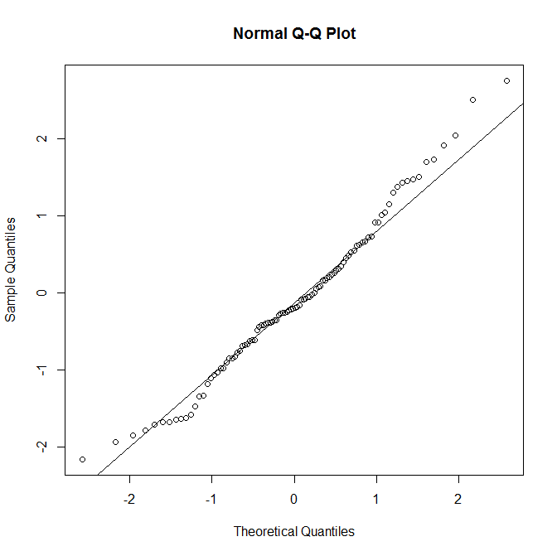
Q-Q Plots: Example
> x <- rnorm(100) ##Generate normal RVs
> qqnorm(x) ##Do a qq plot
> qqline(x) ##Add the line through the data

Slide 162
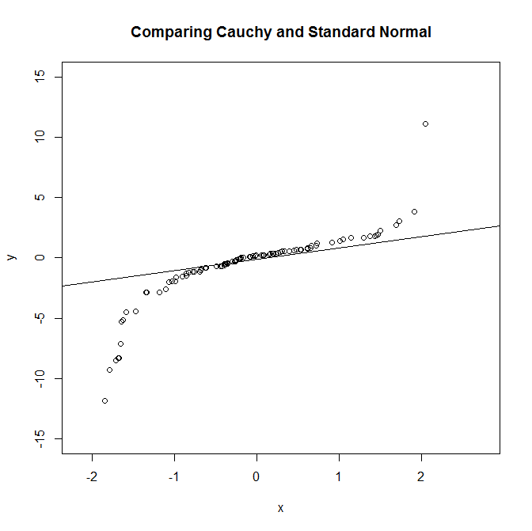
Q-Q Plots: Example (2)
> y <- rcauchy(100) ##Generate some other RVs
> qqplot(x,y, ylim=c(-15,15), main = "Comparing Cauchy and Standard Normal")
> qqline(x) ##Add the line

Slide 163
Boxplots
Boxplots (or box-and-whisker plots) provide a useful summary of the data
One can see
How the data are distributed (e.g., symmetric, skewed)
Potential outliers
Quartiles, maximum and minimum values
One can also do a side-by-side comparison of two data sets

Slide 164
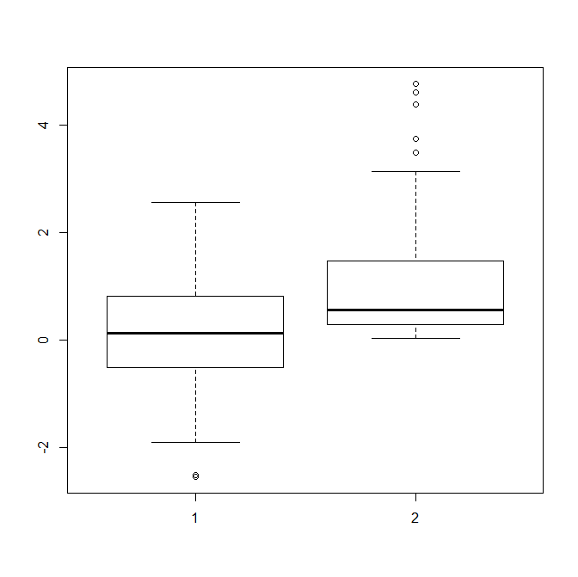
Boxplots: Example
> x <- rnorm(100) ##Generate normal RVs
> y <- rexp(100) ##Generate exponential RVs
> boxplot(x,y) ##Construct boxplots

Slide 165
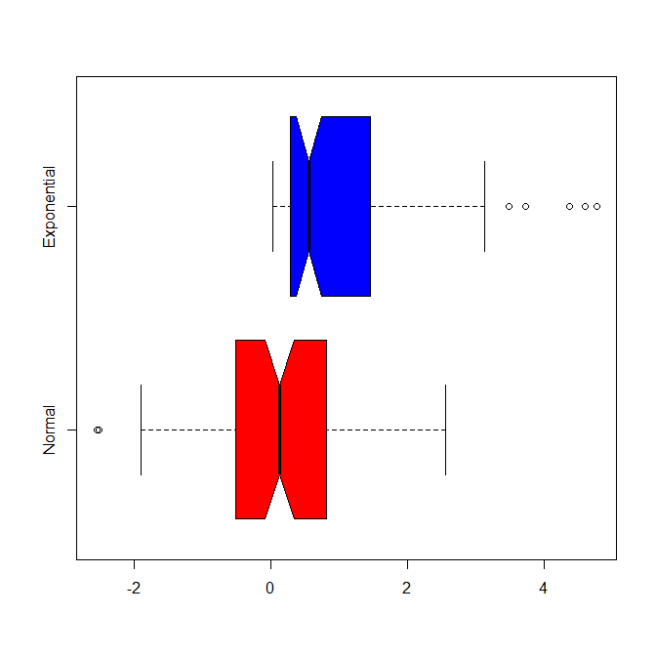
Boxplots: Example (2)
> ##Modify boxplot options
> boxplot(x,y, notch = T, horizontal = T, names=c("Normal", "Exponential"), col=c("red", "blue"))

Slide 166
Basic Models

Slide 167
Overview
Many functions in R require formulas that relate variables
We will also call this formula a model
These could be the subject of more advanced courses in R (e.g., generalized linear models, generalized additive models, etc.)
We cover the basics here because they arise where one least expects them (e.g., boxplots)

Slide 168
Overview (2)
Models in R use a schematic or symbolic notation
Gives terms in the model in a shorthand form
The basic format of the model is , which in R is: response ~ f(predictors)
For a linear model, this might be
resp ~ op_1 term_1 op_2 term_2…
resp is a vector or a matrix defining the response variables

Slide 169
Overview (3)
op_i is an operator
Plus sign (+) implies inclusion of a term
Minus sign (-) implies exclusion of a term
term_i is either
Vector, matrix expression, or 1
Factor
Formula expression consisting of factors, vectors, or matrices
Intercept is included by default

Slide 170
Examples
Let x and y be numeric variables
Simple linear regression of y on x
y ~ x ##Implicit intercept term
y ~ 1 + x ##Explicit intercept term
Simple linear regression w/o intercept
y ~ 0 + x
y ~ -1 + x
y ~ x - 1

Slide 171
Examples (2)
Multiple regression of transformed y on x1 and x2 with intercept
log(y) ~ x1 + x2
Polynomial (quadratic) regression of y on x
y ~ poly(x,2) #Orthogonal polynomials
y ~ 1 + x + I(x^2) #Explicit powers
More multiple regression
y ~ x1 + x2 + x3

Slide 172
Examples (3)
One of the previous models included explicit powers of x:
y ~ 1 + x + I(x^2)
Note that the function I() means to insulate the model inside
In this case, all operators inside I() have their usual arithmetic meaning and the corresponding term(s) appear in the model matrix

Slide 173
Functions
There are several functions available for fitting models
A simple one to fit ordinary linear models is lm()
The general syntax is
fitted.model <- lm(formula, data = data.frame)
The default is ordinary least squares, but one can use an argument for weights

Slide 174
Functions (2)
There are several functions for extracting information about the fitted model
Given an obj output from lm(), some of these are:
Extract the coefficients: coef(obj)
Produce plots: plot(obj)
Make predictions: predict(obj, newdata=ndat)
Get residuals: resid(obj)
Get fitted values: fitted(obj)
Print the object: print(obj)
Print summary of the analysis: summary(obj)

Slide 175
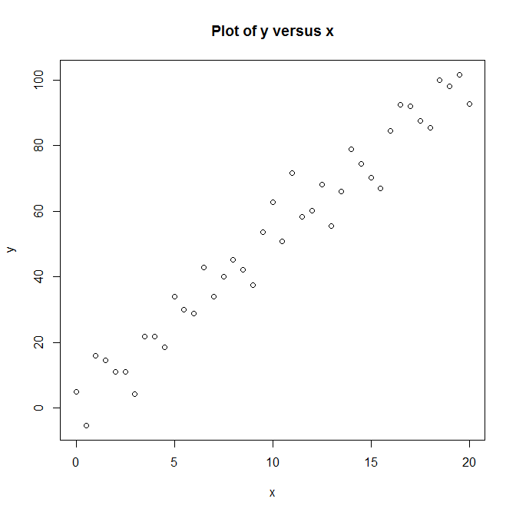
Linear model: Example
> x <- seq(0, 20, 0.5)
> y <- 2.3 + 5*x + rnorm(41, 0, 8)
> # Plot the data
> plot(x,y, main = 'Plot of y versus x')

Slide 176
Linear model: Example (2)
Fit a straight line to the data
> data1 <- data.frame(x,y) #1st get data into data frame
> y.fit1 <- lm(y ~ x, data1) #Fit model
Print the model
> print(y.fit1)
Call:
lm(formula = y ~ x, data = data1)
Coefficients:
(Intercept) x
2.211 4.963

Slide 177
Linear model: Example (3)
Get summary of analysis
> summary(y.fit1)
Call:
lm(formula = y ~ x, data = data1)
Residuals:
Min 1Q Median 3Q Max
-12.7123 -3.5253 0.1908 4.1806 14.9090
Coefficients:
Estimate Std. Error t value Pr(>|t|)
(Intercept) 2.2113 2.0251 1.092 0.282
x 4.9629 0.1743 28.475 <2e-16 ***
---
Signif. codes: 0 ‘***’ 0.001 ‘**’ 0.01 ‘*’ 0.05 ‘.’ 0.1 ‘ ’ 1
Residual standard error: 6.602 on 39 degrees of freedom
Multiple R-squared: 0.9541, Adjusted R-squared: 0.9529
F-statistic: 810.8 on 1 and 39 DF, p-value: < 2.2e-16

Slide 178
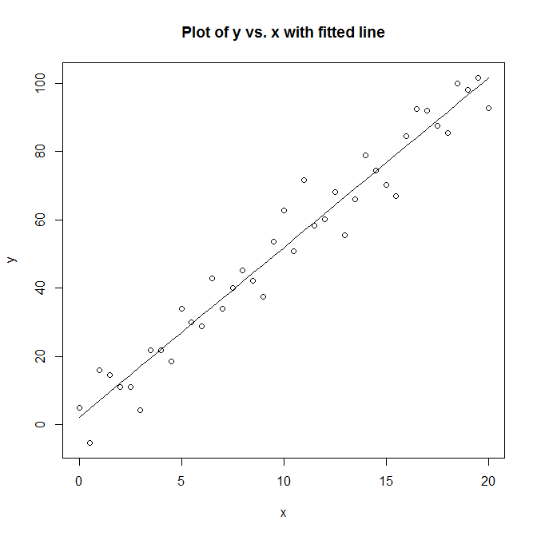
Linear model: Example (4)
Get the fitted values and plot the fitted line
> yhat1 <- fitted(y.fit1)
> plot(x,y, main="Plot of y vs. x with fitted line")
> lines(x, yhat1)

Slide 179
glm() function
A useful function to fit generalized linear models (GLMs) is glm()
GLMs differ in two ways from simple linear models:
Allow for more general form of expression for the expectation
Allow various types of non-normal error terms
Logistic regression models are perhaps the most widely used GLM

Slide 180
glm() function (2)
The general syntax is
fitted.model <-
glm(formula, family = …, data = data.frame)
Where family = …
binomial(link = "logit")
gaussian(link = "identity")
Gamma(link = "inverse")
inverse.gaussian(link = "1/mu^2")
poisson(link = "log")
quasi(link = "identity", variance = "constant")
quasibinomial(link = "logit")
quasipoisson(link = "log")

Slide 181
Graphics in R

Slide 182
Overview
We have already seen some examples of graphics in R
The ability to visualize data, results, etc. is very important in data analysis
R has a lot of options for graphics and visualization
Graphics facilities can be used interactively or in batch modes

Slide 183
Overview (2)
Graphics in R are associated with a graphics device driver
A graphics device driver is started when R is opened in MS Windows
A new, additional graphics device can be started in R GUI with the function windows()
Once the device driver is running, then plotting commands can be used to produce plots

Slide 184
Basic concepts
Plotting functions are divided into 3 groups
High-level: creates a new plot (default)
Low-level: adds more to existing plot
Interactive: interactively add/extract information to/from an existing plot
We will primarily discuss graphics included with base R
Other good graphics packages exist: lattice, ggplot2,…

Slide 185
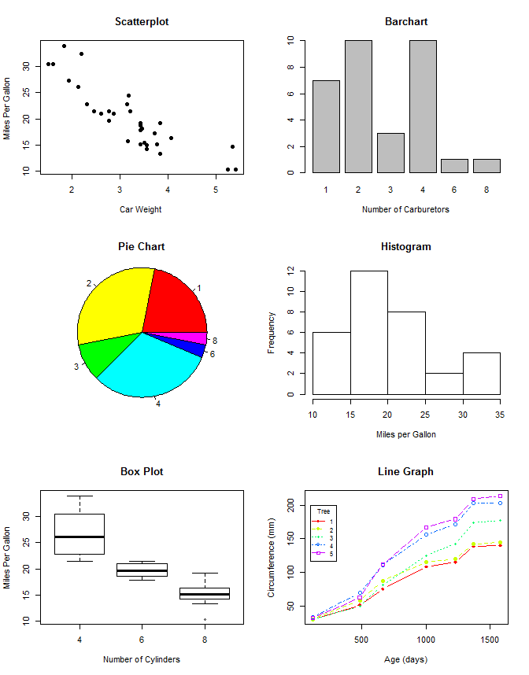
base graphics
Graphics system that was originally developed for R
Very powerful set of graphics
Code is in the graphics package, which is loaded by default R is started

Slide 186
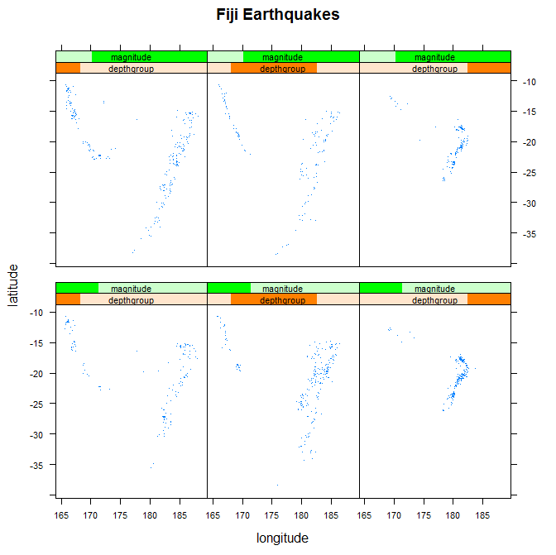
lattice graphics
Implements trellis style graphics – framework for the visualization of multivariable databases
lattice package needs to be loaded before use
Compared to base, lattice functions provide greater control over specification of graphical output

Slide 187
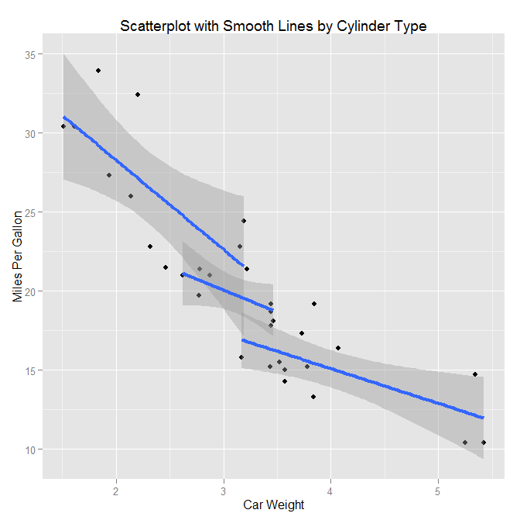
ggplot2 graphics
High-level graphics system
Powerful model of graphics that make it easy to produce complex multi-layered graphics
Based on the grammar of graphics which tries to take the good parts of base and lattice graphics
ggplot2 package needs to be loaded before use

Slide 188
Which package to use?
Dependent on comfort and skill levels with R and on what you want to accomplish
Simple graphs can easily be produced in base
Motivation for lattice graphics was to provide support for the production of graphical displays similar to those produced by the Trellis graphics package in the S-Plus system
These sorts of plots are difficult to produce using the base R graphics functions
Greatest flexibility lies with ggplot2

Slide 189
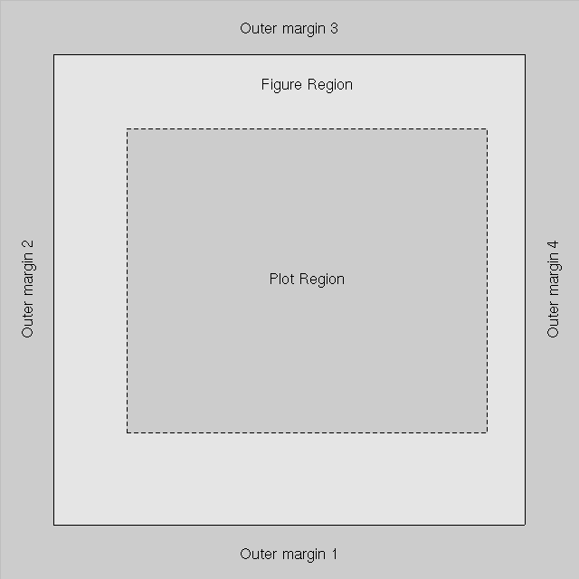
Basic concepts (2)
A graphics window consists of:
Plot region
Figure region
Outer margins
Low-level functions can be used to change them (e.g., col, lty, mfrow, pch)

Slide 190
High-level functions
High-level functions will generate a complete plot of the data passed as arguments
Axes, labels, and titles might be generated by default
High-level plots always start a new plot, erasing the current plot

Slide 191
plot()
Main high-level graphics function
Generic function (think object-oriented)
The type of plot that results depends on the type or class of the first argument
This is very important and can be frustrating!

Slide 192
plot()(2)
Given vectors x and y, then plot(x,y) produces a scatter plot of points
If x is a numeric vector, then plot(x) produces a plot of the values in x versus their index
If f is a factor object, then plot(f) produces a bar plot

Slide 193
More high-level functions
Compare distributions: qqnorm(), qqline(), qqplot()
Histograms: hist()
Boxplots: boxplot()
Dotchart: dotchart()
Image: image()
Contour: contour()
Perspective or surface: persp()
Scatterplot matrix: pairs()

Slide 194
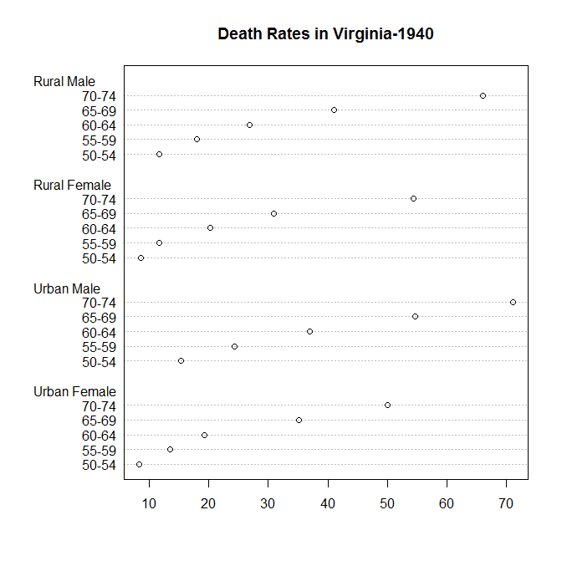
Example: dotchart()
A dotchart is a nice way of visualizing data along a common axis
> dotchart(VADeaths, main = "Death Rates in Virginia-1940")

Slide 195
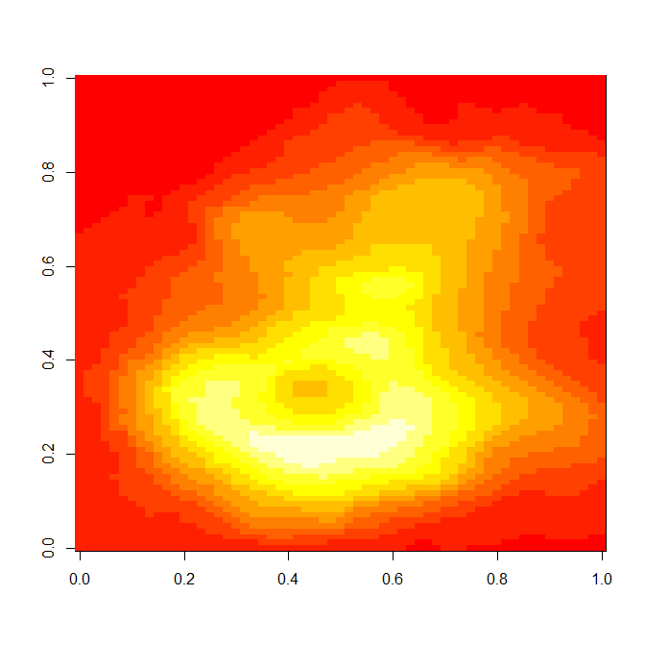
Example: image()
Essentially plots 3 variables: x, y, z
Image plot draws a grid of rectangles using colors to represent values of z
#transpose volcano data set
>image(t(volcano)[ncol(volcano):1,])

Slide 196
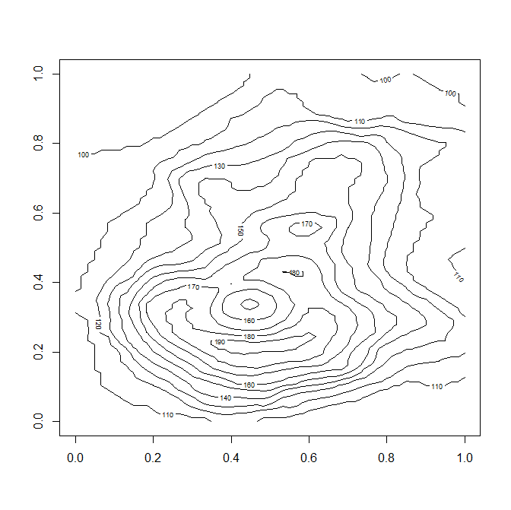
Example: contour()
Construct a contour plot of the same volcano data
Contour plots show a surface in 2-D by plotting contour lines that correspond to constant values of the surface represented by z
Similar to contours in maps
contour(t(volcano)[ncol(volcano):1,])

Slide 197
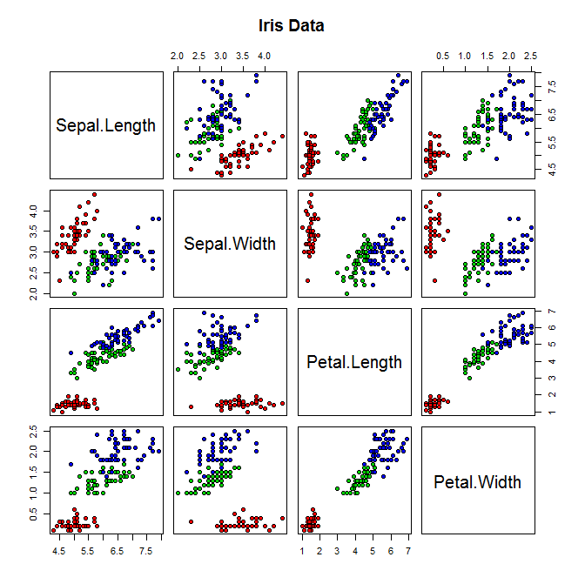
Example: pairs()
A good way to visualize higher-dimensional data is via a scatterplot matrix
It shows all pairwise scatterplots
> pairs(iris[1:4], main = "Iris Data", pch = 21, bg = c("red", "green3", "blue")[unclass(iris$Species)])

Slide 198
Low-level functions
The high-level functions can probably accomplish most of what you need
There will likely be cases where you need to do more to create the type of plot you need
Low-level functions can be used to add information to your current plot:
Lines
Points
Axes
Text

Slide 199
Examples: Low-level functions
Add points: points(x,y)
Add connected line: lines(x,y)
Add text to a plot at points x, y: text(x,y,labels)
Add straight line with slope b and intercept a: abline(a,b)
Draw a polygon with vertices given in x and y: polygon(x,y)
Add a legend: legend()
Add a title: title()
Add an axis to the specified side: axis()

Slide 200
Example: lines(), title() , and legend()
> ##USE Orange data and SET UP THE PLOT
plot(range(Orange$age), range(Orange$circumference), type="n", xlab="Age (days)", ylab="Circumference (mm)" )
> ntrees <- 5
> colors <- rainbow(ntrees) ##Create vector of n colors.
> linetype <- c(1:ntrees)
> plotchar <- seq(18,18+ntrees,1)
>
> ##ADD LINES
for (i in 1:ntrees) {
tree <- subset(Orange, Tree==i)
lines(tree$age, tree$circumference, type="b", lwd=1.5, lty=linetype[i], col=colors[i], pch=plotchar[i]) }
>
> ##ADD TITLE TO GRAPH
> title("Line Graph")
>
> ##ADD A LEGEND
> legend(100, 200, 1:ntrees, cex=0.8, col=colors, pch=plotchar, lty=linetype, title="Tree")

Slide 201
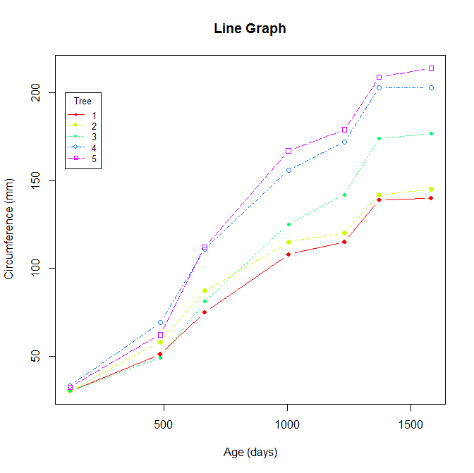
Example: lines(), title() , and legend() (2)

Slide 202
Interactive functions
R has some functions to enable users to obtain or to add information to a plot
Uses a mouse
Simplest is locator(n, type)
Waits for the user to select n locations using the left mouse button
type argument will plot something at that location
locator function without arguments returns the locations of the points

Slide 203
Interactive functions (2)
Another useful function is identify()
Reads the position of the graphics point when the mouse button is pressed
Searches for the coordinates of the closest point
The index of the point is returned
Depending on the argument(s), it can plot the labels of nearby points

Slide 204
Graphics parameters
One can change many things about the plot using the functions discussed
However, there is even more control by changing the graphics parameters
Possible to control
Line style
Colors
Figure arrangement
Text
More…

Slide 205
Graphics parameters (2)
Each active graphics device has a list of graphics parameters
Each comes with a default set
Graphics parameters can be changed
Permanently: affects all graphics functions that go to the current device
Temporarily: affects a single graphics function call

Slide 206
Permanent changes
Permanently change the graphics parameters using the par() function
Like changing the default for the current device
Recommendation:
save the original parameters,
make changes,
then restore

Slide 207
Permanent changes (2)
par() without any arguments returns a list of all graphics parameters and their values
par() with named arguments, sets the values of the named graphics parameters, and returns the original values
Example: changing the line type: par(lty = 2)
One could use an alternative restoration of graphics parameters
> op <- par(lty = 2) ##Change default line type
## do lots of plotting…
> par(op) ##Reset to original values

Slide 208
Temporary changes
Temporary changes can be made by passing arguments to graphics functions
These are named arguments:
name = value
Has the same effect as passing it to the par() function but only last for the duration of the function call
Does not change default value

Slide 209
Saving a graph
Variety of ways of saving your graphs
Depends on operating system, use of graph, and connection (local vs. remotely)
Function | Output to
pdf("mygraph.pdf") | pdf file
win.metafile("mygraph.wmf") | windows metafile
png("mygraph.png") | png file
jpeg("mygraph.jpg") | jpeg file
bmp("mygraph.bmp") | bmp file
postscript("mygraph.ps") | postscript file

Slide 210
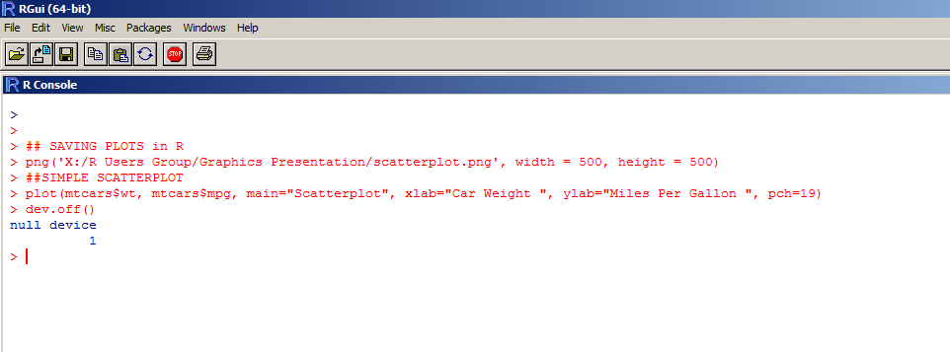
Example: Saving to a .png file

Slide 211
Loops and Conditionals

Slide 212
Overview
This information is probably most useful when writing functions
We won’t cover writing functions here, but there might be times when you need to use these concepts in your data analysis (recall line graph example)
R can be thought of as a meta-computer language so it has the ‘usual’ control flow instructions
Loops: for, repeat, while
Conditional execution: if, else, ifelse

Slide 213
Grouping expressions
Recall that R uses expressions
An expression is anything that can be evaluated
e.g., an assignment is an expression whose result is the value assigned
y <- x^2
y == x^2
Commands or expressions may be grouped together and enclosed in curly braces:
{expr_1;…;expr_n}
These might be on several lines

Slide 214
Grouping expressions (2)
The value of the group of expressions is the result of the last expression that was evaluated
The group is also an expression, so it could be included in a large expression

Slide 215
Control statements – if
The standard conditional construction uses the if statement
Usual syntax: if(expr_1) expr_2 else expr_3
expr_1 must result in a logical value
If expr_1 is true, then expr_2 is evaluated and returned
If expr_1 is false, then expr_3 is evaluated and returned
The if returns the value of expression evaluated, or NULL if none was

Slide 216
Control statements – ifelse
There is a vector version of the if statement: ifelse()
General syntax: ifelse(cond, a, b)
Value returned is a vector with the same length as the longest vector argument
The result has element a[i] if cond[i] is true, otherwise it has element b[i]
> x <-c(-3:3)
> sqrt(ifelse(x >= 0, x, NA))
[1] NA NA NA 0.000000 1.000000 1.414214 1.732051

Slide 217
Operators
The operators && (‘and’) || (‘or’) are often used as part of the conditions in control statements
&& and || are used with scalars and the result is a length-one logical vector
& and | apply to vectors – element-by-element
> x <- 1:5
> y <- -2:1
> (any(x == 0) || any(y == 0))
[1] TRUE

Slide 218
Control loops
There are several options for looping through objects and expressions
Keep in mind that most functions will operate on arrays without looping through elements
Looping can be computationally inefficient
Basic looping functions are:
for(var in seq) expr
repeat expr
while(cond) expr
next
break

Slide 219
Control loops – for
for loop syntax: for(varname in expr_1) expr_2
varname is the loop variable
expr_1 is a vector expression, which is usually a sequence like 1:100
expr_2 is
Usually a grouped expression (series of expressions enclosed by curly braces)
Written in terms of the varname loop variable
Repeatedly evaluated as varname ranges through the values in expr_1

Slide 220
Example: for loop
Looping through the variable i five times
Each time it prints out 1 through the current value of the looping variable, i
> for(i in 1:5) print(1:i)
[1] 1
[1] 1 2
[1] 1 2 3
[1] 1 2 3 4
[1] 1 2 3 4 5

Slide 221
Example 2: for loop
Looping through the rows of a matrix and filling them with values from a standard normal distribution
> X <- matrix(0, 10, 3)
> for(i in 1:10){ X[i,] <- rnorm(3)}
> X
[,1] [,2] [,3]
[1,] -0.07388040 1.84535382 -2.5774763
[2,] -0.59473642 -1.69582456 0.2534664
[3,] -0.67143521 0.50949246 0.8689156
[4,] 0.44415625 0.34779348 -1.2704805
[5,] 1.08309825 0.60598823 -0.1416968
[6,] -0.46960384 -1.61402207 0.2575123
[7,] -0.05551708 -0.77079558 0.8457465
[8,] 0.02020369 -0.43118594 1.0028279
[9,] -0.40478290 0.03146126 0.3530466
[10,] -0.32987606 -1.22765247 0.4674851

Slide 222
Control loops – repeat
General syntax: repeat expr
It continues to evaluate expr until a break terminates the loop
next is used to discontinue a cycle and skip to the next one
This type of loop is not used very often

Slide 223
Control loops – while
A while loop is a little safer than repeat
General syntax: while(cond) expr
This will keep evaluating expr while the condition is true
There is a danger of infinite loops with the while statement

Slide 224
Example: while loop
Printing out the numbers 1 to i (from before)
> i <- 1 #Initialize the looping var
> while(i <= 5){ print(1:i); i <- i + 1}
[1] 1
[1] 1 2
[1] 1 2 3
[1] 1 2 3 4
[1] 1 2 3 4 5
Note: We had to initialize and increment the looping variable

Slide 225
Resources

Slide 226
Resources: Online
The main website for R is:
http://cran.r-project.org/
You can find another R (graphical) interface at
http://www.sciviews.org/
R News – an online journal for R
http://journal.r-project.org/
The Journal of Statistical Software – online and free
http://www.jstatsoft.org/

Slide 227
Wendy L. Martinez Director, Mathematical Statistics Research Center Office of Survey Methods Research 202-691-7400 martinez.wendy@bls.gov

