Slide 1
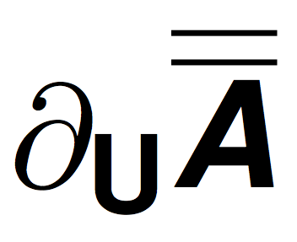
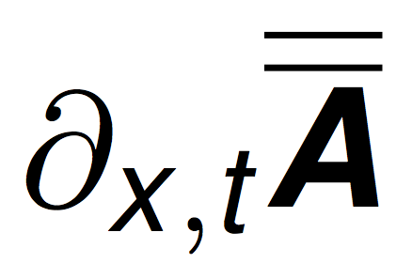
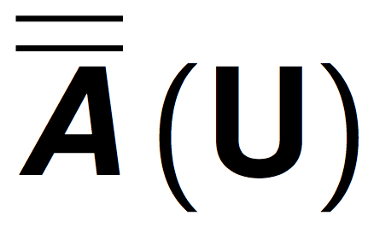
?
= 0
= 0
/
?
only?
= 0
= 0
/
Yes
No
Linear with constant coefficients
Linear with variable coefficients
Quasi-linear
Non linear

