Slide 2
Zero AI, only mathematics
The “pillow” library creates a template of all 26 letters using a font file
The “opencv” library compares each letter on the grid to the template and chooses the letter with closest match
  registration.py – find the board
  warp_py – warp the board so that it’s a perfect square
  grid.py – identifies the grid and separates each letter
  classify.py – compares each letter to pillow template and chooses letter
pipeline.py creates the debugging pictures

Slide 3
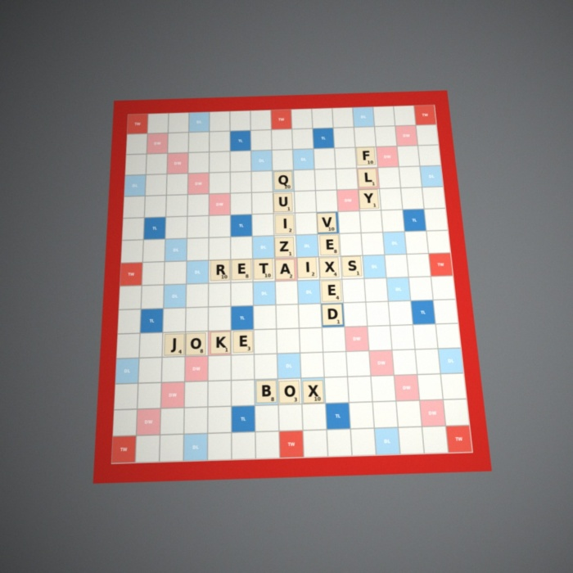
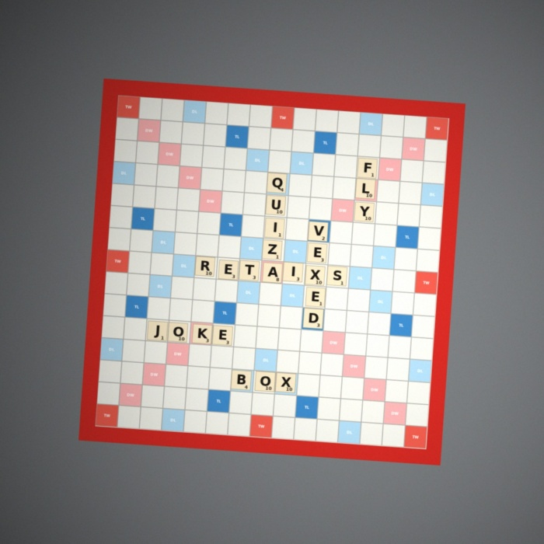
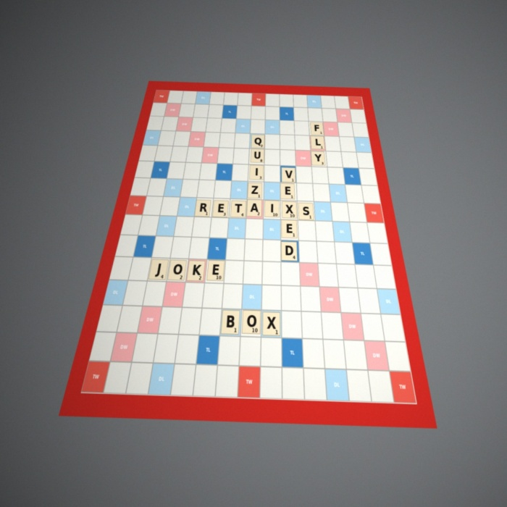
make_fake_boards

Slide 4
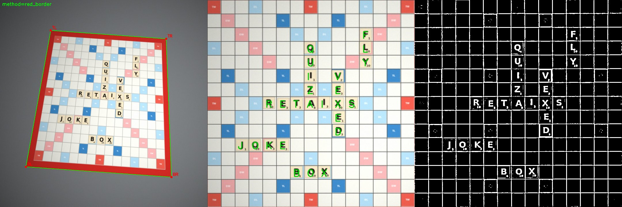

Slide 5
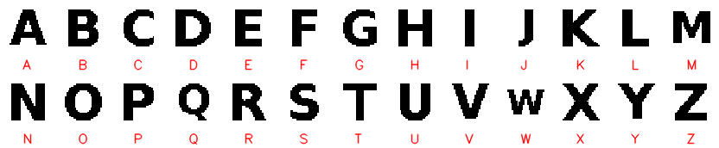
In training images, tiles were always cream colored, so the model recognizes tiles only if they are cream. (saturation less than 105)
Board always had a red border, so it would search for that
Tiles were of a specific font:

Slide 6
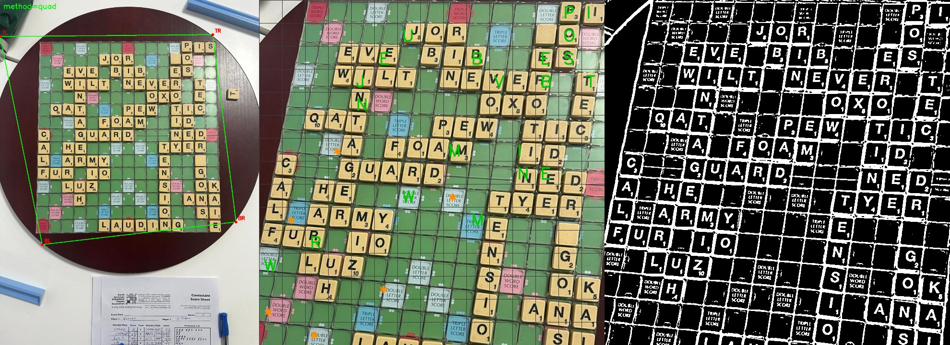
Board not red, face not white, couldn’t find accurately

Slide 7
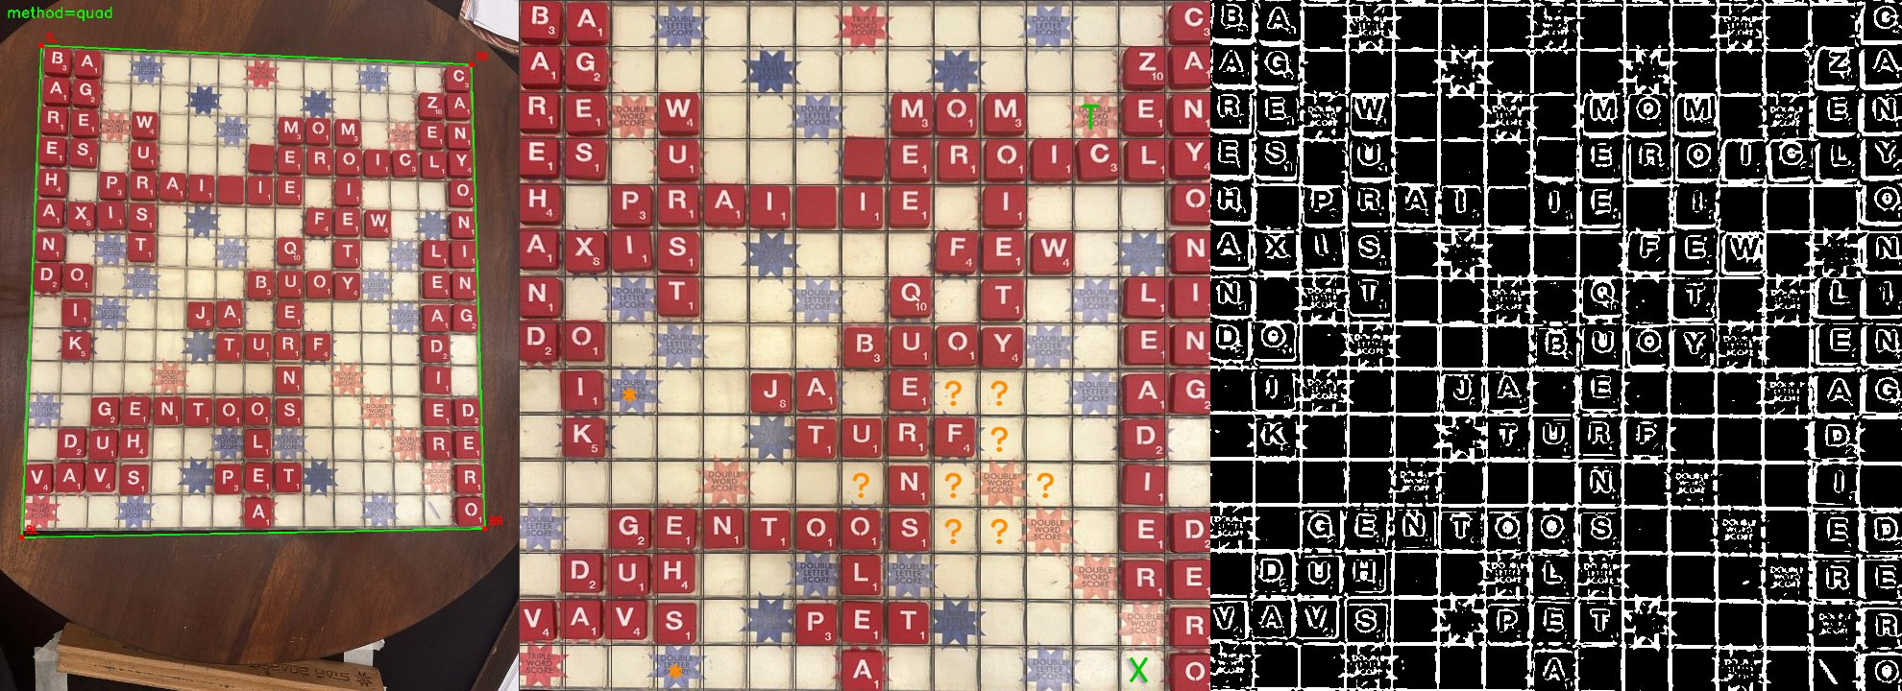
Tiles are red, not cream

Slide 8
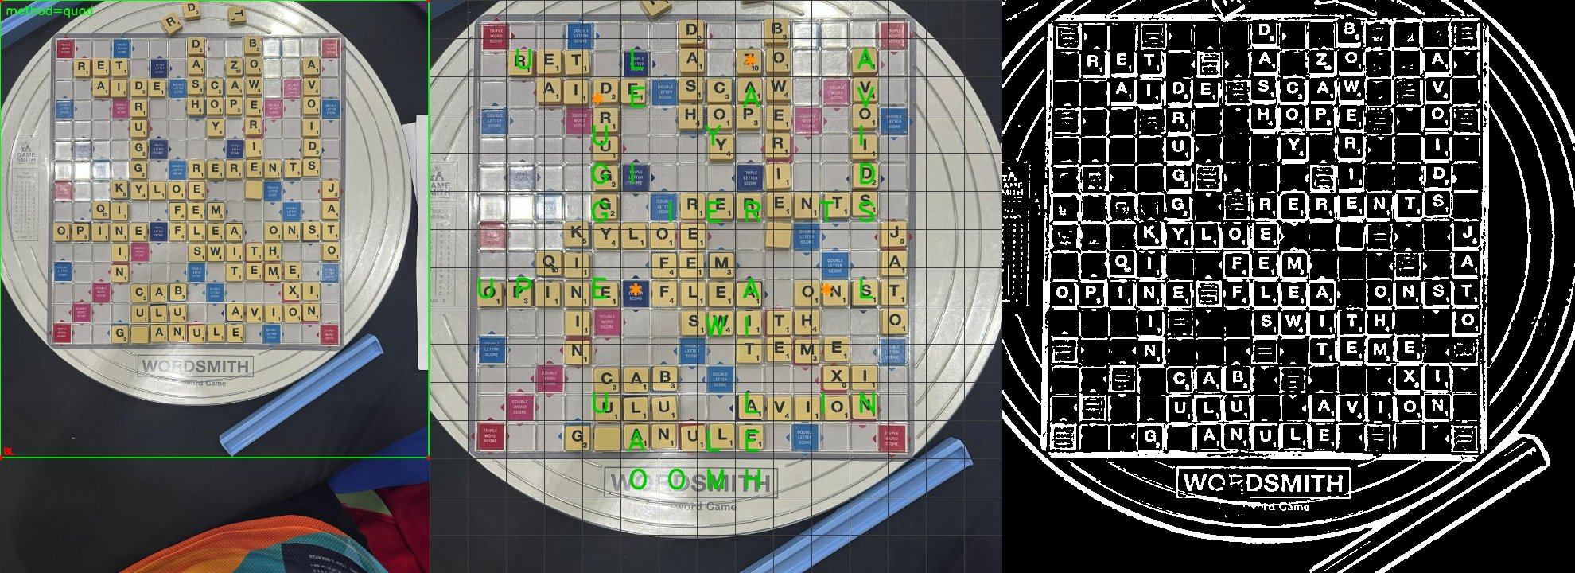
Board same color as board face, analyze everything

Slide 9
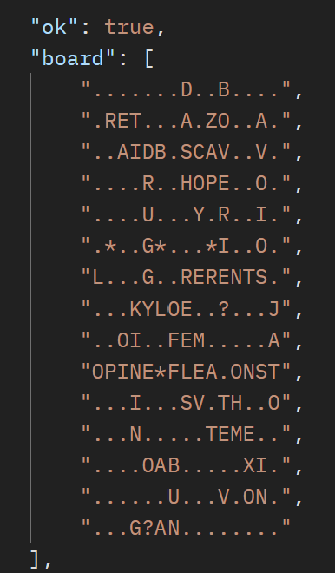
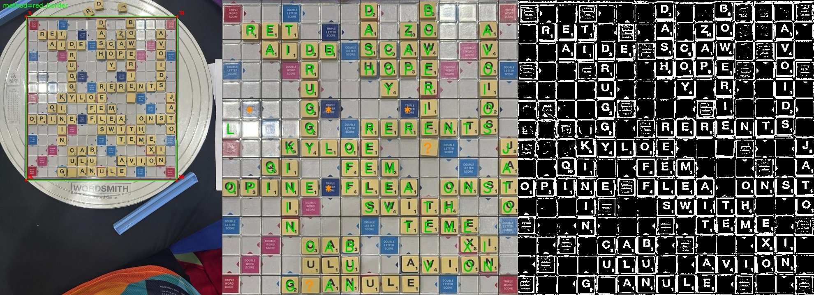
Red border added via paint, white face, cream tiles, identifies most of the letters

