Slide 1
Layered Network Architecture

Slide 2
What is Layering?
A technique to organize a network system into a succession of logically distinct entities, such that the service provided by one entity is
solely based on the services provided by the previous (lower level) entity.

Slide 3
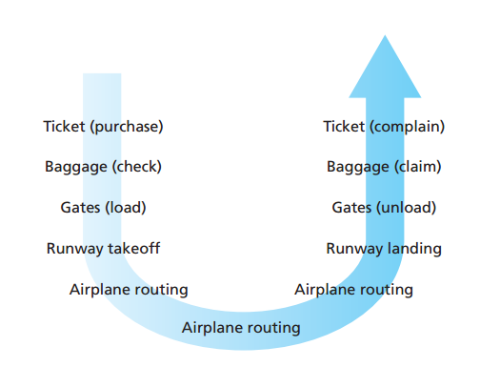

Slide 4
Why Layering Approach
Solving all the problems at once is difficult.
It’s a good idea to divide problems or functions into several sets in
such a way that:
• problems or functions in a same set are tightly coupled
• the inter-dependence between problems or functions in different
sets is minimized
Address the problem sets separately.

Slide 5
The OSI Reference Model
OSI Reference Model – an internationally standardised network architecture.
An abstract representation of an ideal network protocol stack; not used in real networks.
OSI = Open Systems Interconnection.
Specified in ISO 7498-1.
Model has 7 layers.

Slide 6
Internet Protocols vs OSI
Application
Application
7
Presentation
5
6
Session
5
TCP
Transport
4
4
3
IP
Network
3
Network Interface
2
Data Link
2
Hardware
Physical
1
1

Slide 7
The OSI Model
Layer 7
Application Layer
Layer 6
Presentation Layer
Layer 5
Session Layer
Layer 4
Transport Layer
Layer 3
Network Layer
Layer 2
Data Link Layer
Layer 1
Physical Layer

Slide 8
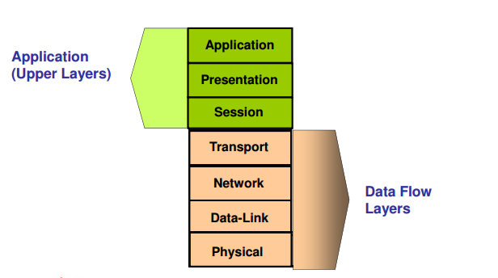

Slide 9
Lower/Upper Layers
Layers 1-4 often referred to as lower layers.
Layers 5-7 are the upper layers.
Lower layers relate more closely to the communications technology.
Layers 1 – 3 manage the communications subnet.
  the entire set of communications nodes required to manage massages between a pair of machines.
Layers 4 – 7 are true ‘end-to-end’ protocols.
Upper layers relate to application.

Slide 10
Layer 7: Application Layer
Home to wide variety of protocols for specific user needs,
e.g.:
virtual terminal service, file transfer, electronic mail, directory services.
Provides Applications with access to network services.
Notes:
Directory services : It is a shared information infrastructure for locating, managing, administering and organizing everyday items and network resources, which can include volumes, folders, files, printers, users, groups, devices, telephone numbers and other objects
VT : a virtual terminal (VT) is an application service that: Allows hostterminals on a multi-user network to interact with other hosts regardless of terminaltype and characteristics

Slide 11
Layer 6: Presentation Layer
Concerned with representation of transmitted data.
Deals with different data representations.
  ASCII or EBCDIC,
Also deals with data compression.
Determines the format used to exchange data among networked computers.

Slide 12
Layer 5: Session Layer
Allows establishment of sessions between machines, e.g. to
  allow remote logins
  provide file transfer service.
Responsible for:
  dialogue control
    which entity sends when with half-duplex communications.
  token management
    E.g. control which entity can perform an operation on shared data.
  synchronisation
    E.g. insertion of checkpoints in large data transfers.

Slide 13
Allows two applications to establish, use and disconnect a connection between them called a session. Provides for name recognition and additional functions like security, which are needed to allow applications to communicate over the network.

Slide 14
Layer 4: Transport Layer
Basic function is to take data from Session Layer, split it up into smaller units, and ensure that the units arrive correctly.
Concerned with efficient provision of service.
The Transport Layer also determines the ‘type of service’ to provide to the Session Layer.

Slide 15
Ensures that data is delivered error free, in sequence and with no loss, duplications or corruption.
This layer also repackages data by assembling long messages into lots of smaller messages for sending, and repackaging the smaller messages into the original larger message at the receiving end.

Slide 16
Layer 3: Network Layer
Key responsibility is control of routing in the subnet.
Routing can be based on:
  static tables,
  determined at start of session,
  highly dynamic (varying for each packet depending on network load).
Also responsible for congestion control and usage monitoring.

Slide 17
Network Layer
This is responsible for addressing messages and data so they are sent to the correct destination, and for translating logical addresses and names (like a machine name FLAME) into physical addresses. This layer is also responsible for finding a path through the network to the destination computer.

Slide 18
Layer 2: Data Link Layer
Provides reliable, error-free service on top of raw Layer 1 service.
Breaks data into frames. Requires creation of frame boundaries.
Frames used to manage errors via acknowledgements and selective frame retransmission.

Slide 19
This layer takes the data frames or messages from the Network Layer and provides for their actual transmission. At the receiving computer, this layer
- receives the incoming data and sends it to the network layer for handling.
The Data-Link Layer also provides error-free delivery of data between the two computers by using the physical layer.
It does this by packaging the data from the Network Layer into a frame, which includes error detection information.
At the receiving computer, the
Data-Link Layer reads the incoming frame, and generates its own error detection
information based on the received frames data. After receiving the entire frame, it then compares its error detection value with that of the incoming frames, and if they match,
- the frame has been received correctly.

Slide 20
Layer 1: Physical Layer
Concerned with bit transmission over physical channel.
Issues include:
  definition of 0/1,
  whether channel simplex/duplex,
  connector design.
Mechanical, electrical, procedural matters.

Slide 21
Controls the transmission of the actual data onto the network cable. It defines the electrical signals, line states and encoding of the data and the connector types used.
An example is 10BaseT.
Notes:
10BASE-T, one of several physical media specified in the IEEE 802.3 standard for Ethernet local area networks (LANs), is ordinary telephone twisted pair wire. ... The "BASE" refers to baseband signalling, which means that only Ethernet signals are carried on the medium.

Slide 22
TCP / IP Model
Transmission Control Protocol/Internet Protocol, is a suite of communication protocols used to interconnect network devices on the internet.

Slide 23
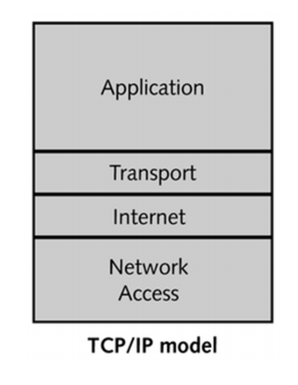

Slide 24
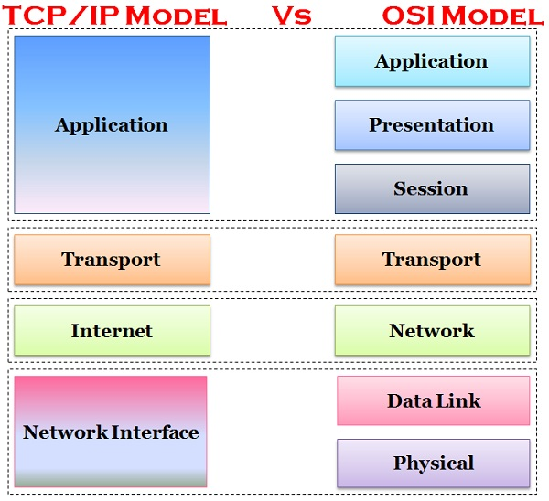

Slide 25
