Slide 2
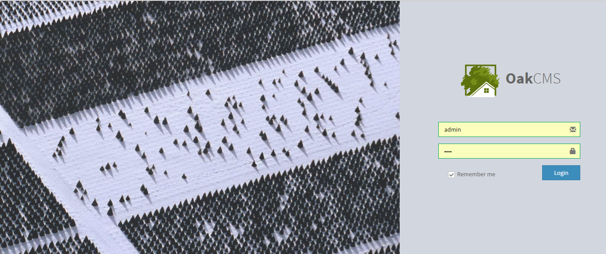
1. Main provisions
Oak CMS is Content Management System which is developed using Yii 2.0 framework
Content management system (CMS - Content Management System) is a software that allows to manage the content and the structure of the site.

Slide 3
1. Main provisions
Features of Yii Framework
Yii Framework is equipped with a great documentation that allows developers to easily implement projects of any complexity.
Yii system is flexible and Yii websites are fast, elegant and stylish.
The Yii caching system greatly improves page loading speed.
On the Yii sites you can easily create AJAX components thanks to the integrated library jQuery
Yii theme integrations can easily help to change the design
CMS, which are developed using Yii, allow to create websites of any complexity and types from small business sites and blogs to news portals, large online stores and corporate websites.
YII Framework developers have done everything to make your site 100% safe.
Yii — Yii is a high-performance, component-based structure-the PHP framework for rapidly developing large-scale Web applications. It allows to apply the concept of maximum code reuse and significantly accelerates the process of web development. Name Yii (pronounced as Yee or [ji:]) means easy, efficient and extensible.

Slide 4
2. Short review of OakCMS
OakCMS сontent management system performes a variety of functions required and sufficient for the management of different types of sites:
Small business website
Blogs
News portals
Online stores
Corporate websites
Social Networks
OakCMS has a number of advantages, among which are:
Ease and flexibility of management
Support of language versions (also possible to install an automatic translator)
A good caching system, which in its turn increases the speed of loading pages
Supports php7
High level of security
All images are downloaded to a separate subdomain (storage. sitename.com), allowing to increase the speed of loading pages
Admin Panel is adaptive and it is located on a separate subdomain (admin sitename.com.), allowing to increase the protection of the site
Safety and performance - framework protection is one of the top three in the world, the resource is divided into three parts, frontend - it's what the user has access to, backend –it’s a part that can be accessed only by the administrator of the site and storage it’s a part that stores generally available files.
All these parts are located on different domains that first of all creates complexity for hacking attempts, besides all these parts can be located on separate servers, accordingly hacking will be practically impossible, what in its turn, can be used for ultra-large loads on the resource.

Slide 5
3. Standard Features of Admin Panel
Basic settings
turning on / off indexing
filling meta tags
specifying of the mail settings and database of administrator
cache management (clearing the cache)
event and error log
The content
CMS allows to create / delete / publish / remove from the publications and hierarchically organize site page;
CMS automatically creates convenient means of navigating the site (links, menus, site map, "bread crumbs");
CMS fills the site pages with content blocks of different types (text, image, list, table, links, galleries (photo / video), widgets, etc.).
Media galleries
CMS allows you to implement a photo / video galleries of any complexity and design (sliders, galleries, playlists, widgets of news and content etc.)

Slide 6
3. Standard Features of Admin Panel
Users
registration / creation / deleting users and administrators of the site
Feedback
CMS allows you to process and store any number of feedback requests (forms of callback, messages, request etc.)
Reviews / comments
CMS allows to implement systems of reviews / comments on the site, processing and management of data requests
Menu / categories
CMS allows to create a menu / categories of articles / categories of goods of any nesting and manage them from admin panel
SEO application
CMS in its structure has a control component of the meta tags for the site in which you can add a unique tags to the rights pages manually
It is also possible to implement an automatic generation system of meta tags for the different sections per sample.

Slide 7
4. Features of realization of site on OakCMS
Creating the sites on OakCMS the task is to make the site as easy and convenient as possible in management.
All necessary tasks to be performed by the admin panel are approved in the specification in order to meet 100% customer's requirements.
From the realized applications for OakCMS
For online stores (import / export of goods, categories of products / prices / buyers / producers, integration with 1C, the choice of currency, 1-click purchasing, filters / sorting of goods)
For small business sites, corporate sites (reviews, comments and various forms of feedback, news widgets, media galleries)
Below are screenshots of the admin panel of the site operating on OakCMS (online store):

Slide 8
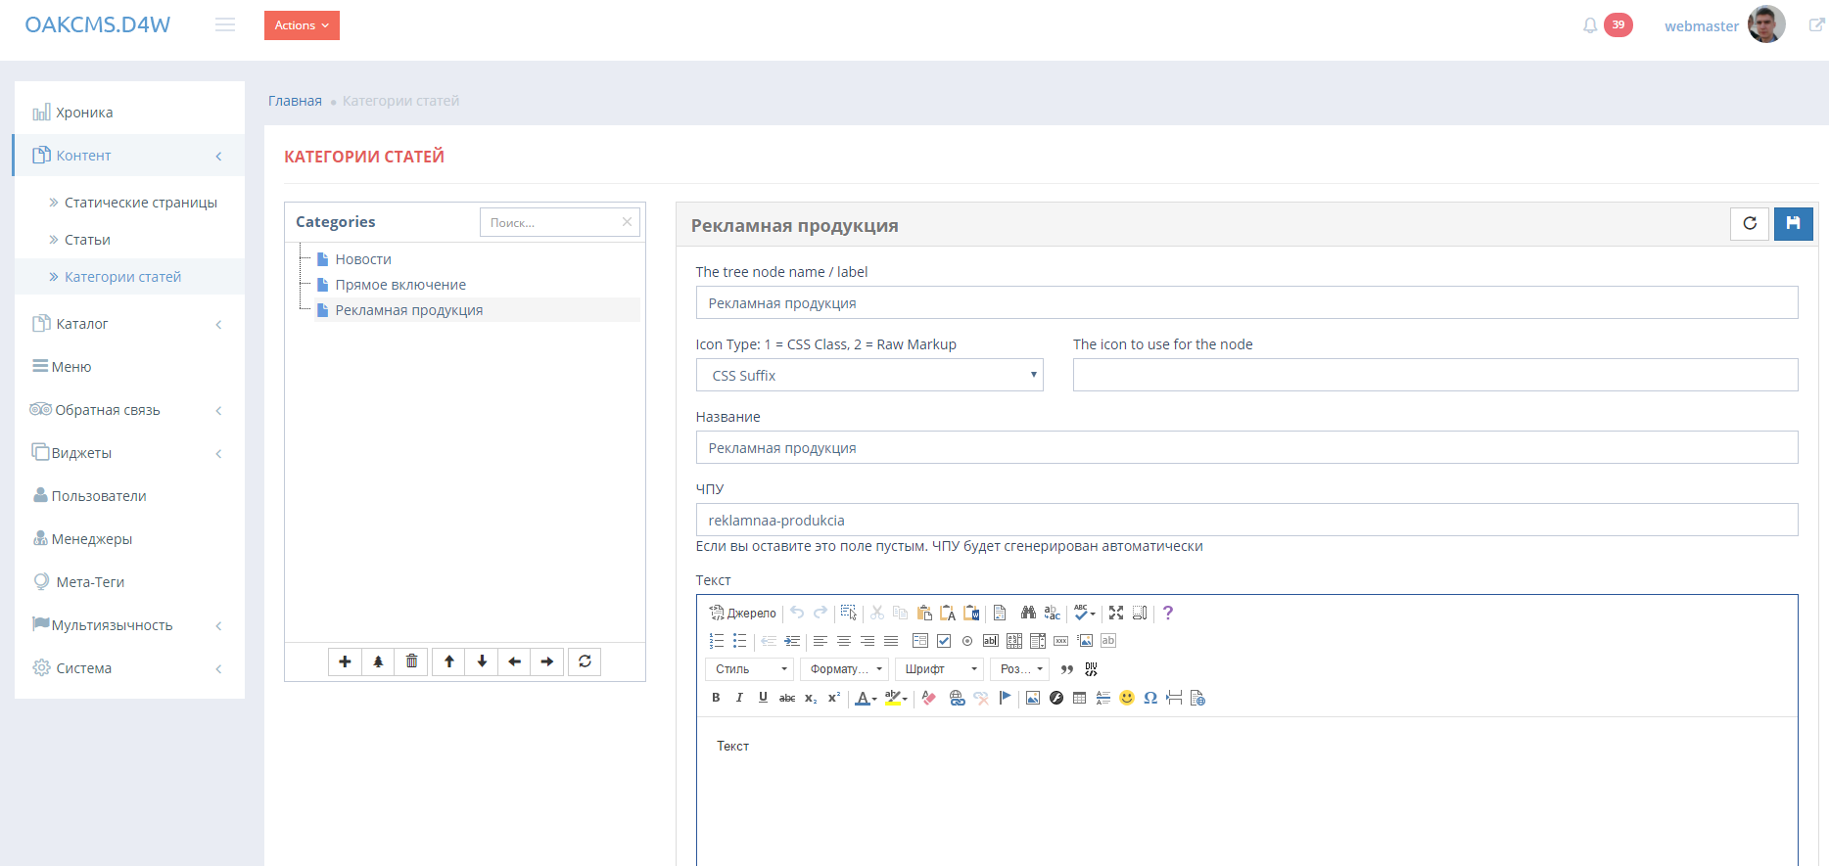
5. Adding categories of articles / chapters

Slide 9
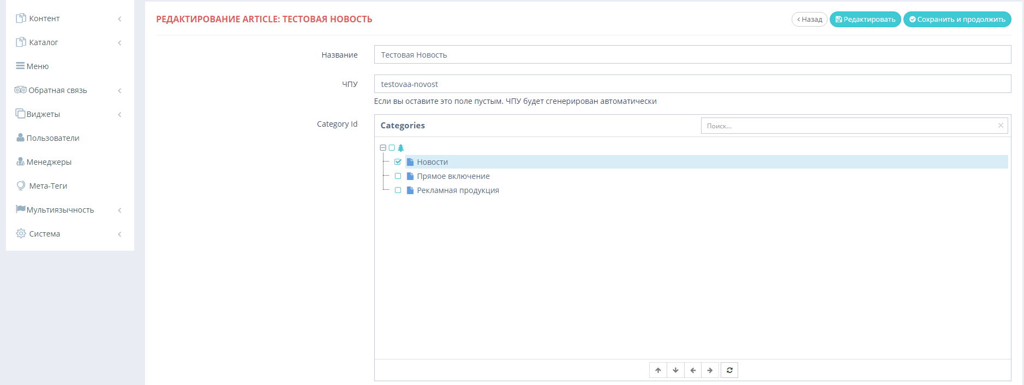
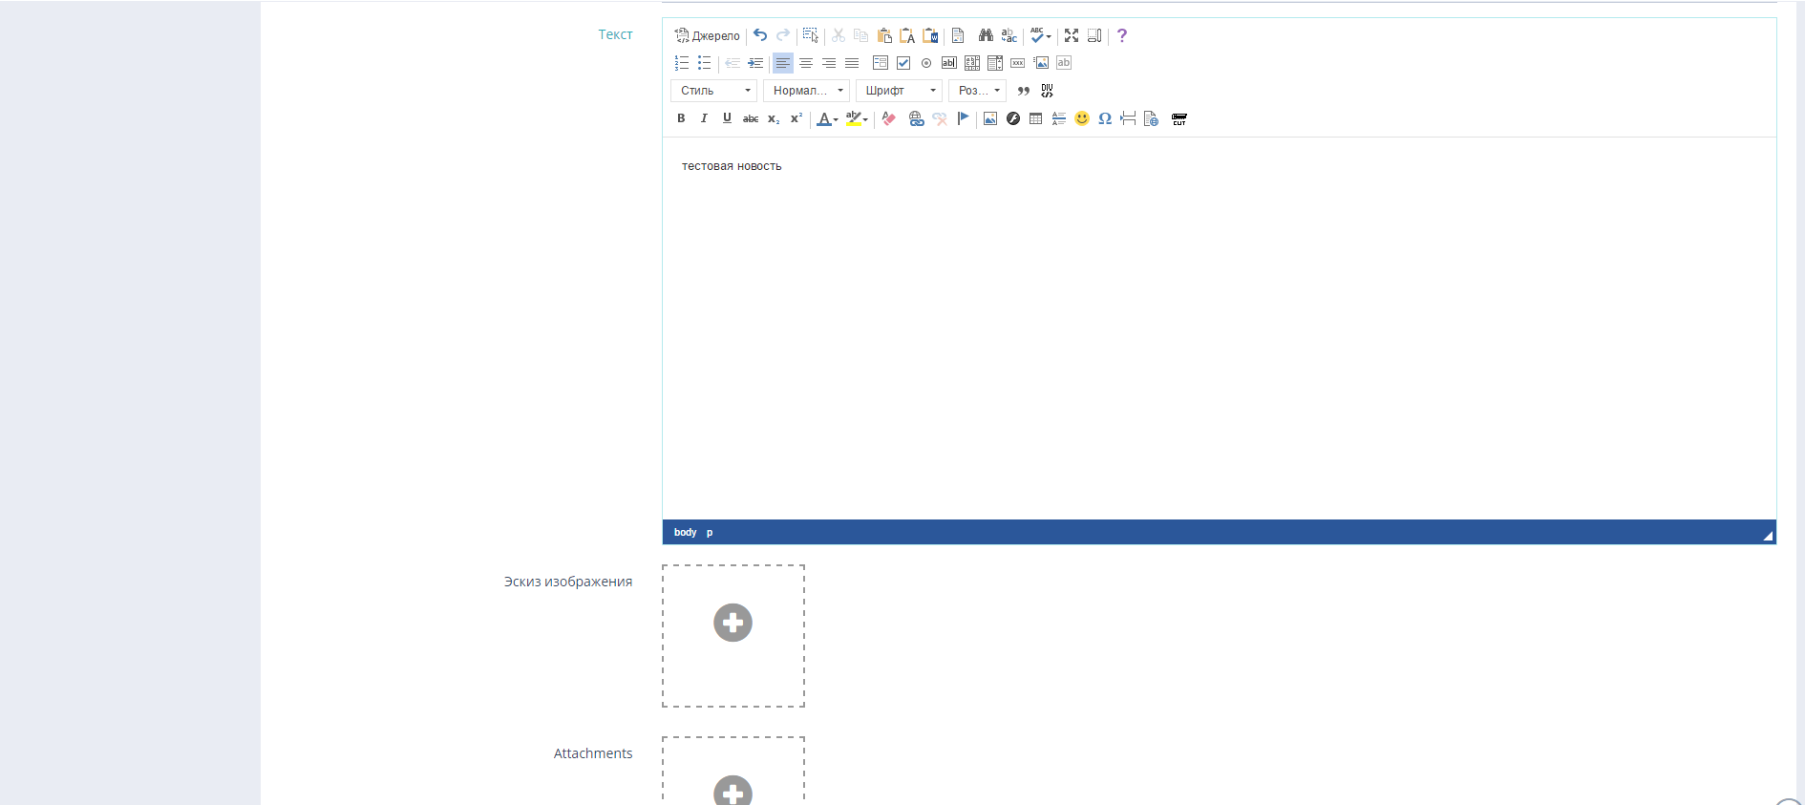
6. Creating text material

Slide 10
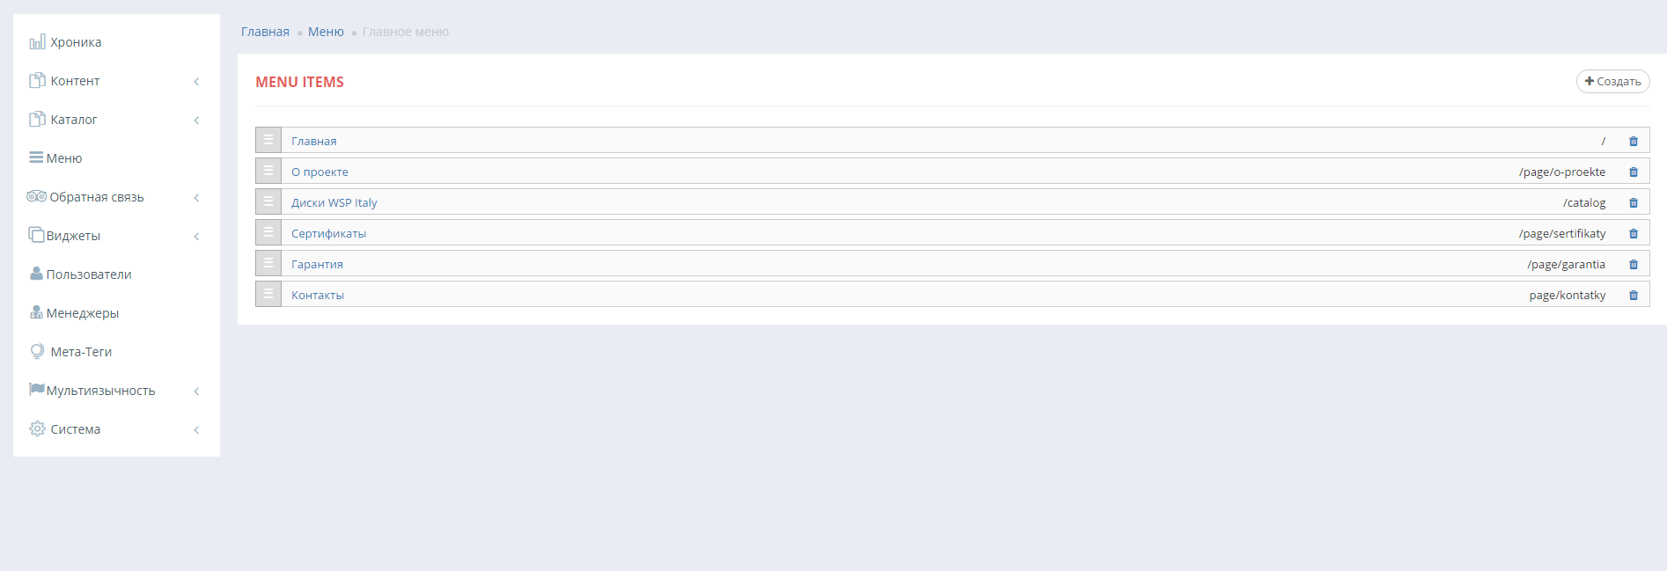
7. Menu Control

Slide 11
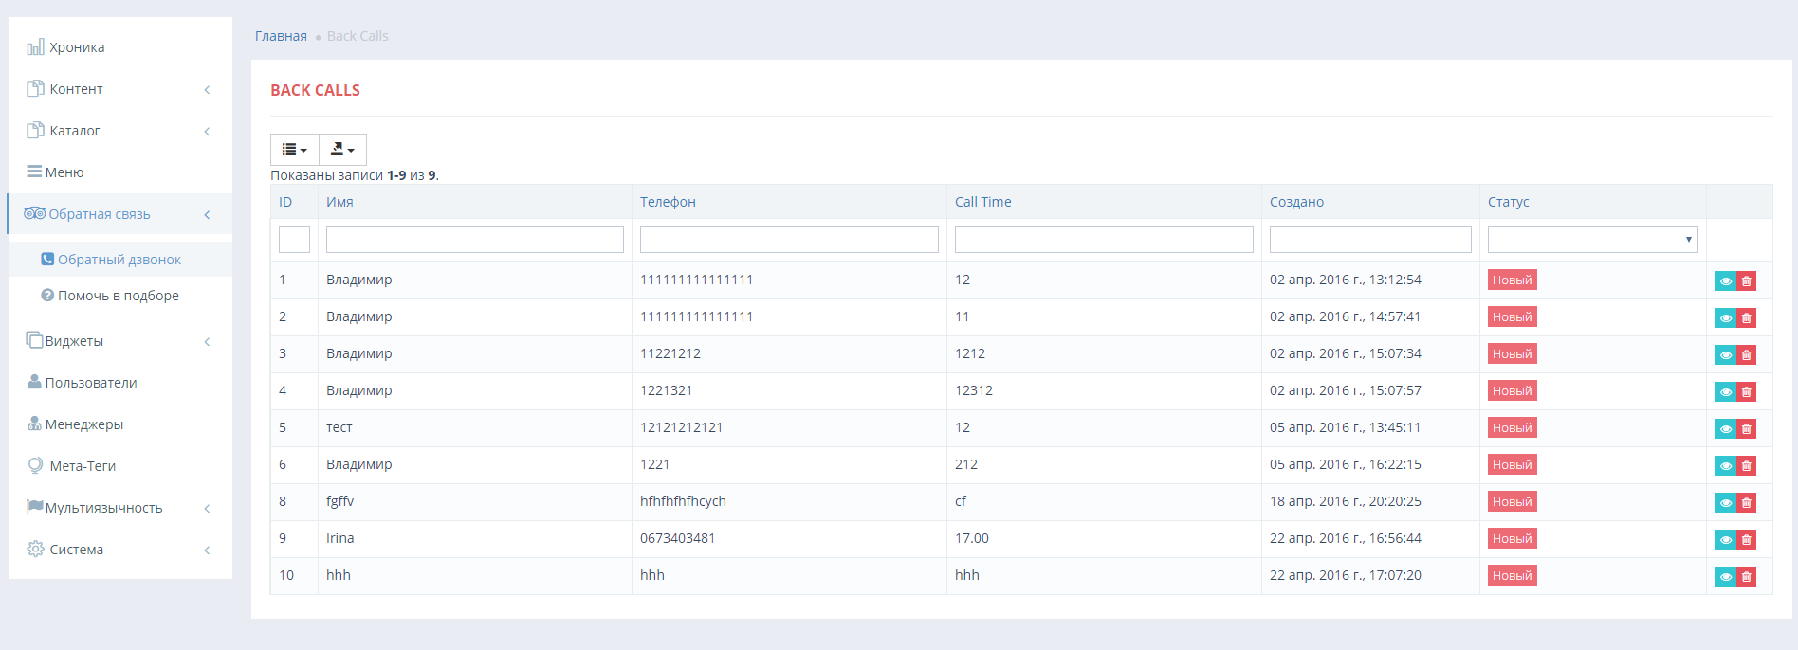
8. Manage feedback

