Slide 1
21 Stream Ershov Ilia
https://github.com/IliaErshov1/DiProj
https://github.com/IliaErshov1/Infra

Slide 2
Diploma task
Variant 2. Using API https://affiliate.itunes.apple.com/resources/documentation/itunes-store-web-service-search-api/
get all data about “The Beatles" and store it into your DB: kind, collectionName, trackName, collectionPrice, trackPrice, primaryGenreName, trackCount, trackNumber, releaseDate. Output the data by collectionName (the collectionName is set) in form of a table and sort them by releaseDate in ascending order.

Slide 3






Infrastructure
Container registry
Storage account
Kubernetes
Frontend, Backend (Golang)
MySQL flexible server

Slide 4






CI/CD Infrastructure process
Main.tf
TF State File
Container registry
Kubernetes
GitHub
Artifacts
Storage
CI
CD
MySQL flexible server
Virtual machine scale set

Slide 5




CI/CD Application process
Docker Hub
Kubernetes
Docker image
build
Docker image
push
Deploy
deployk8s.yml
App Pod
Dev
App Pod
Prod
GitHub
Azure DevOps
Azure
registry
CI
CD
MySQL

Slide 6
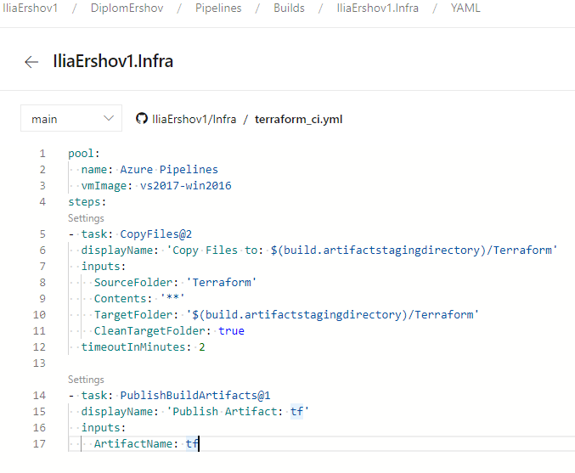
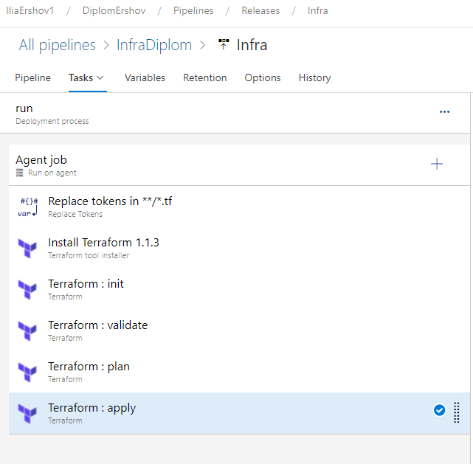
CI/CD Infrastructure deployment

Slide 7
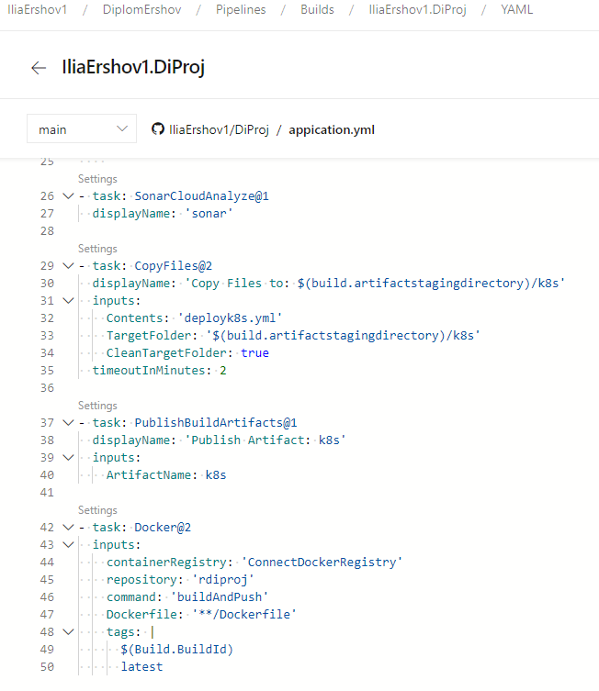
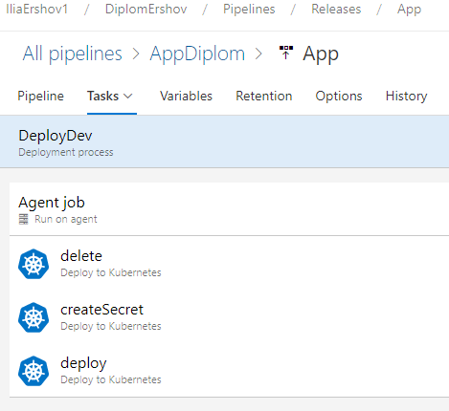
CI/CD Application deployment

Slide 8
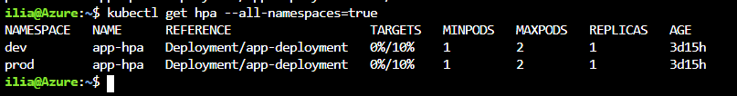
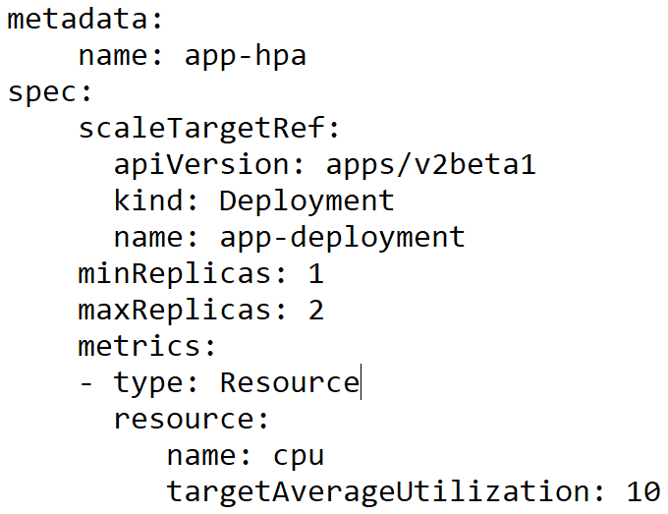
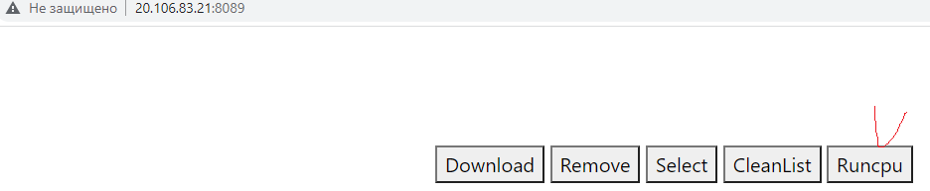
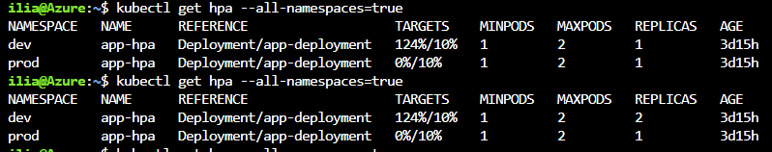
Pod Autoscaling

Slide 9
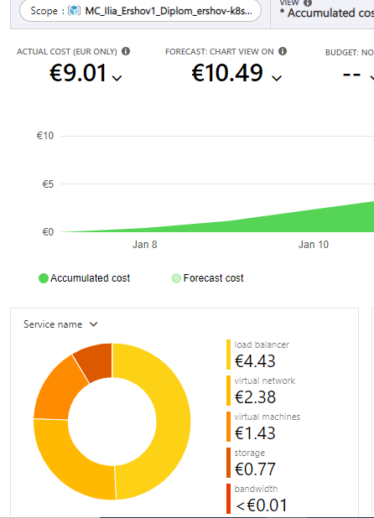
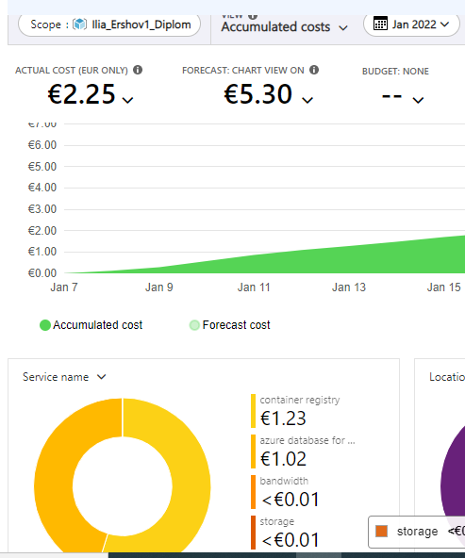
Cost analysis

Slide 10
Спасибо за Внимание

