Slide 1


Electroencephalogram data processing :
Intrinsic motivation and decision-making in
Patients with Parkinson’s syndrome

Slide 2
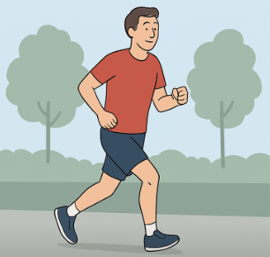
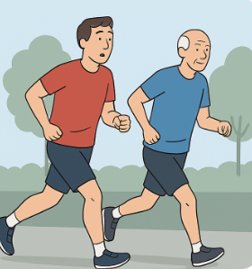
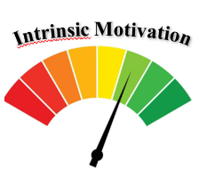
Effort modulated by social comparison
Leisurely jog, alone ...
Moderate effort .
Increasing effort following implicit comparison.

Slide 3

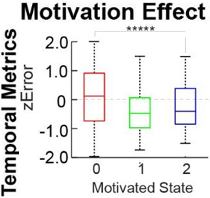
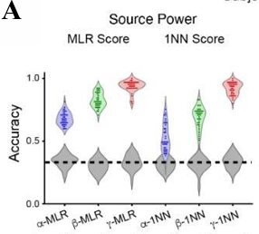
Context & Prior Work
Social pressure especially competition can boost attention and effort [1][2]
Social hierarchy represented in prefrontal cortex, insula, angular gyrus
Prior study by Ignasi Cos and Matthieu Gilson in healthy participants [4]:
Virtual partner created a sense of hierarchy
EEG revealed changes in beta (15–32 Hz) and gamma (40–80 Hz) bands
Machine learning (Logistic regression, MLR) classified motivational states with up to 95% accuracy
Behavioural effect of the motivated state on the End- point Error [4].
All Sources Space EEG Analyses [4].
[1] DiMenichi & Tricomi, Front. Psychol., 2015 [2] Garcia et al., Perspect. Psychol. Sci., 2013 [4] Cos et al., Research Square, 2021

Slide 4


Main objectives of the Study
Technical Objective
To develop an improved EEG analysis pipeline for patients with Parkinson’s disease, providing better spatial accuracy and inter-subject anatomical alignement. This can be reused on healthy patients.
Scientific Objective
To explore whether social motivation can enhance motor performance in a patient with Parkinson’s disease. And replicate the study for healthy patients.

Slide 5
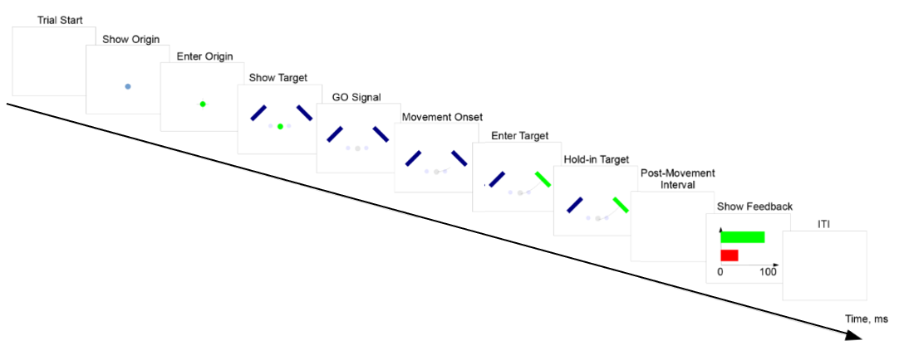
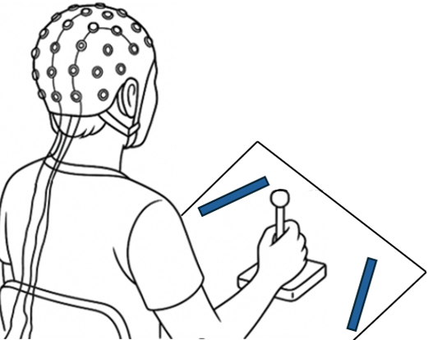
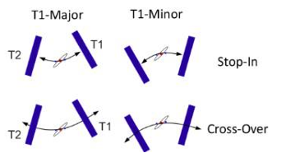
Precision reaching task
Timeline of a typical trial [4]
Geometrical arrangements (T1-Major/T1-Minor) and control configurations (STOP- IN/CROSS-OVER). [4]
[4] Cos et al., Research Square, 2021

Slide 6

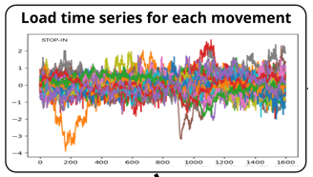
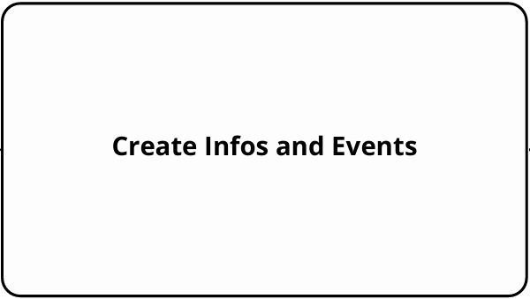
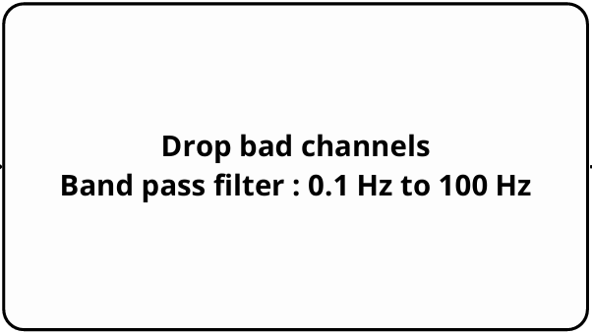
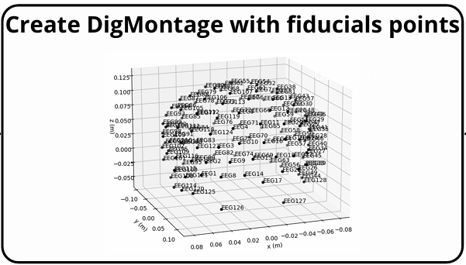
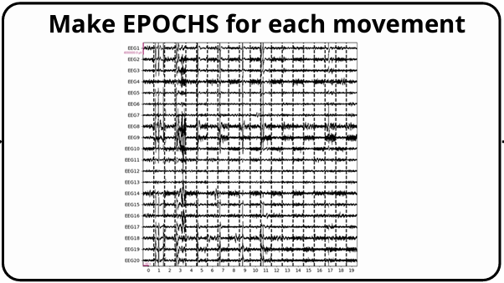
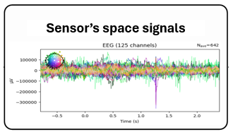
Pipeline to extract the Signals
Part 1 : Classic MNE formating and cleaning sensors’s signals

Slide 7
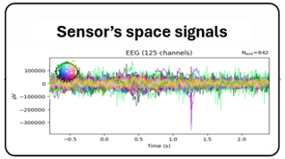
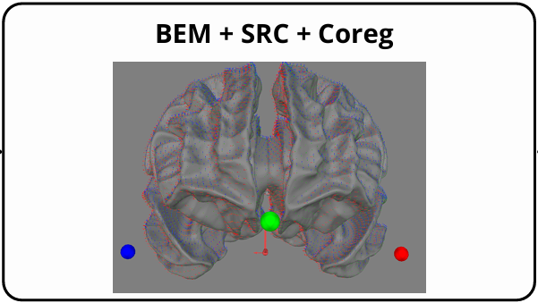
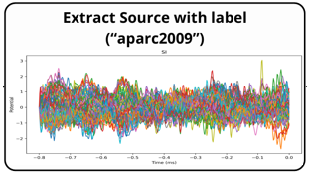
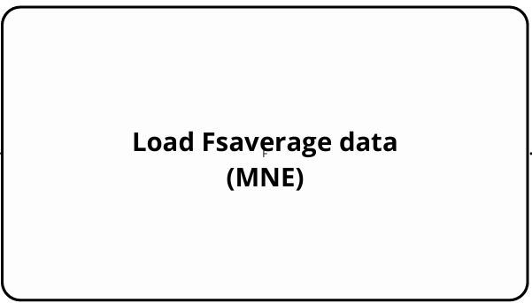
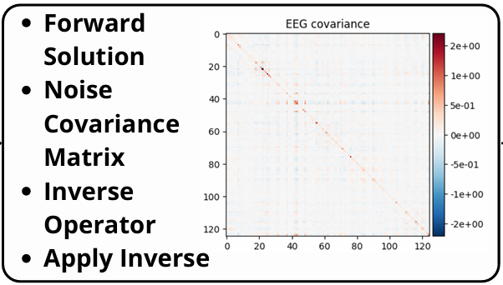
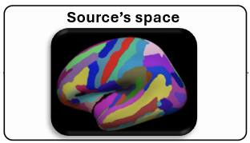
Pipeline to extract the Signals
Part 2 : Source’s space with atlas

Slide 8
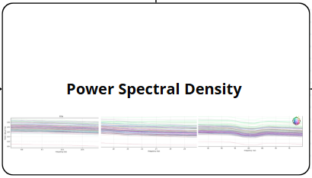
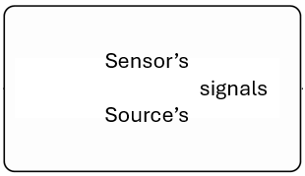
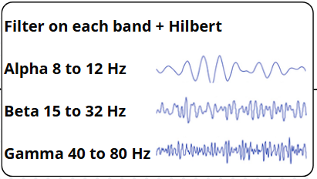
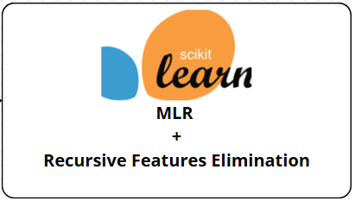
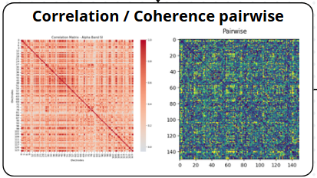
Pipeline to decoding the Signals

Slide 9
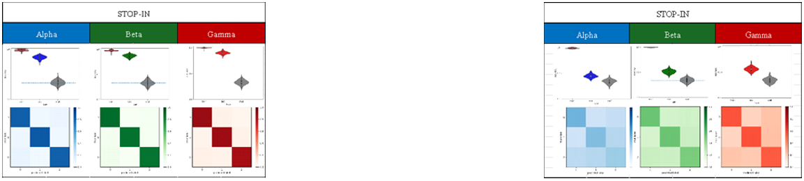
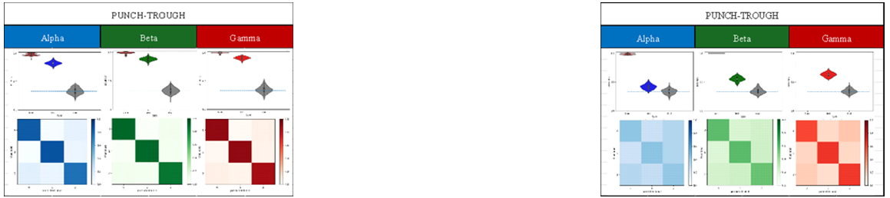
Results :
Biomarkers Sensor’s space
MLR decoding on Power
VS
MLR decoding on Correlation
Gamma > Beta > Alpha
Gamma band most predictive of motivational state
Similar accuracy for each movement
Lower overall performance in correlation

Slide 10
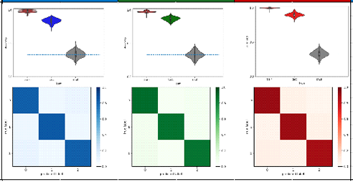
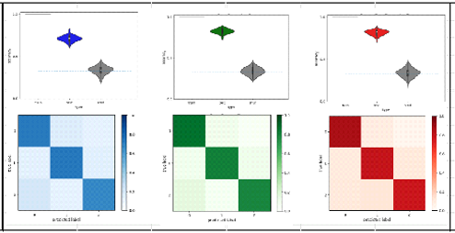
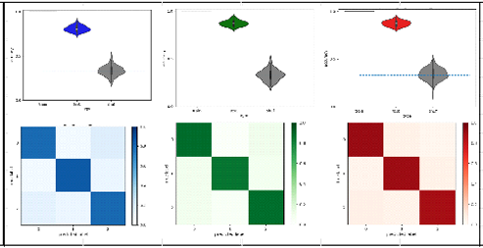
Results :
Biomarkers Sensor’s space
Stop-In on Power
MLR
kNN
RF
MLR and RF better accuracy than kNN
Using MLR because linear analysis and simpler than RF

Slide 11
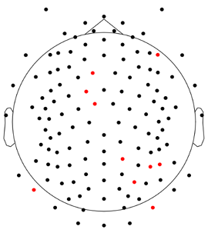
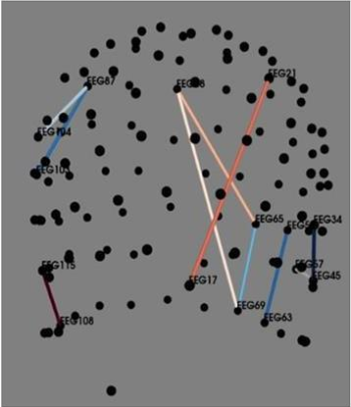
Results :
Biomarkers Sensor’s space
Making RFE on Gamma band
Central and posterior regions
Notable pairs : EEG68 – EEG17
Motor control (frontal/parietal areas)
Attention networks (temporal regions)
Visiomotor integration
Sensorimotor planning for fluid motion
The spatial distribution of the most significant electrodes with the top-performing electrodes highlighted in red.
Functional connectivity patterns between the most informative electrode pairs

Slide 12
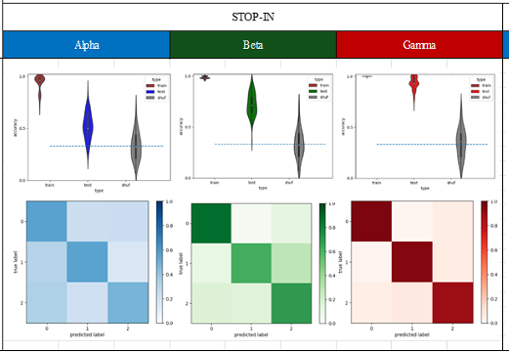
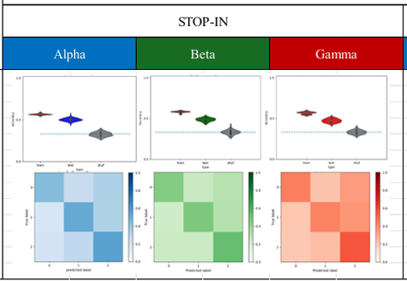
Results :
Biomarkers Source’s space
MLR decoding on Power
MLR decoding on Coherency
VS
Gamma > Beta > Alpha
Gamma band highly informative for motivational decoding
Power of source better than correlation like in sensor’s space
More variability in source’s space

Slide 13
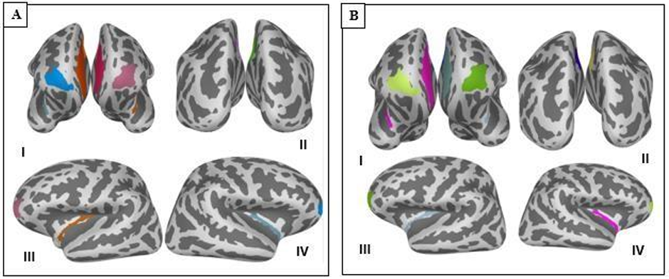
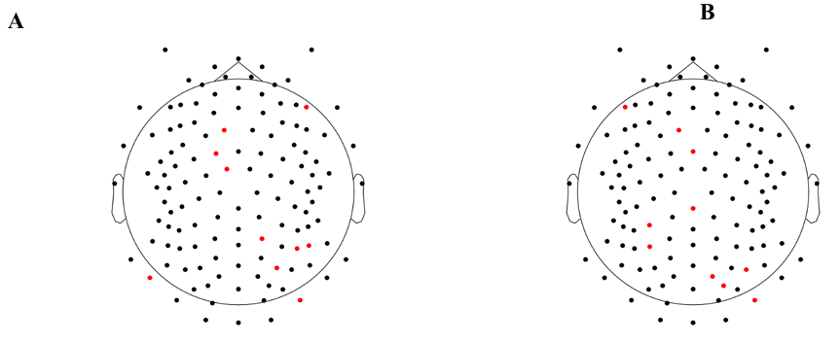
Results :
Biomarkers Source’s space
Motor & premotor control = cingulate cortex
High-level motivation modulation = frontmarginal gyrus
Sensory-integration & awareness = insula girus
Ten ROIs for each movement. A:STOP-IN. B:PUNCH-TROUGH
Higher spatial precision
Closer to neural sources
Anatomically meaningful analysis
The spatial distribution of the most significant electrodes with the top-performing electrodes highlighted in red. A : STOP-IN. B:PUNCH-TROUGH

Slide 14




Results Summary
New MNE-Python pipeline with source reconstruction improves spatial accuracy, reaching up to 90% accuracy in detecting motivation states.
We obtained promising results, and the next step is to align the outcomes from Parkinson’s patients with those from healthy controls to find a new biomarker.
Implicit social motivation triggers distinct beta/gamma EEG patterns in Parkinson’s, as healthy patients.
Aims to advance understanding and develop tageted therapies for motivation and motor engagement in Parkinson’s.

Slide 15



Discussion, Limitations & Perspectives
Key Findings & Methodological Advances
Our pipeline improved spatial accuracy over ICA [4].
Single-trial classification in sensor space was effective and replicable.
Beta (15–32 Hz) and gamma (40–80 Hz) activity observed during motivated action without external rewards [9].
Study Limitations
Trials were grouped in sets of 10 due to memory/computational constraints.
Protocol limited to fast-frequency bands; slower frequencies should be explored.
Focused on a specific motivational form, future work should consider broader motivational contexts.
Future Directions & Applications
Apply to larger, more diverse clinical populations.
Investigate brain connectivity (Granger Causality [37], Transfer Entropy [38]).
Combine EEG with fMRI[40]; explore non-invasive stimulation (TMS [41], Tdcs [42]).
[4] Cos et al., Research Square, 2021
[9] Le Heron et al.,Neuropsychologia, 2018 [37] Seth et al., J Neurosci, 2015 [38] Ursino et al., Front Comput Neurosci, 2020 [40] Chang & Chen, Curr Opin Biomed Eng, 2021 [41] Institut du Cerveau, s.d. [42] Gharib et al., L’Information Psychiatrique, 2016

