Slide 1
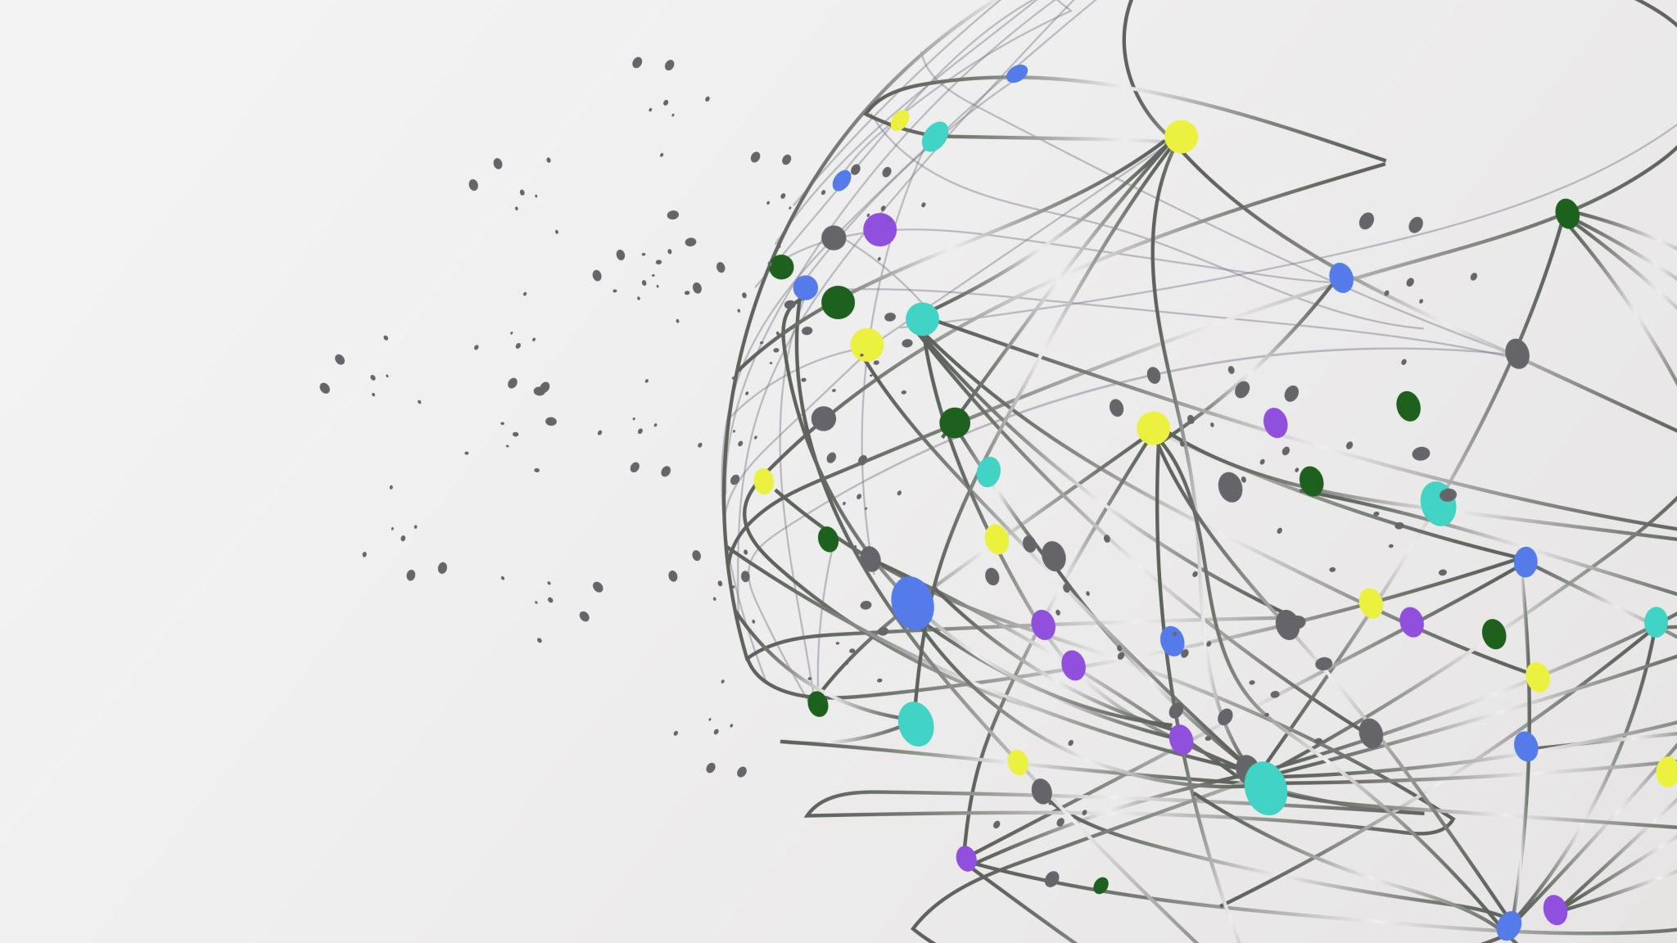
FAIRyTale
Give your data a happily-ever-after
By: Florencia Altschuler, Illiana Sandoval, Jamie Rios & Annika Andersson

Slide 2
Open Science – What is this sorcery?
Replication crisis:
Low reproducibility rates
the Reproducibility Project replicated 100 psychology studies and found only 36 % showed the original effect (Open Science Collaboration, 2015).
Selective reporting and p–hacking
Publication bias - positive findings are far likelier to reach print, skewing the evidence base
And a whole lot more..
This has resulted in the needs of:
Openly accessible scripts, data and analyses from published experiments
Online repositories like OSF, Zenodo, Figshare etc.
Preregistrations of what is to be studied, how & the expected results
Guiding conventions on how to make data accessible, readable, reproducible & understandable
Open Science Collaboration. (2015). Estimating the reproducibility of psychological science. Science, 349(6251), https://doi.org/10.1126/science.aac4716

Slide 3
Current issues of Open Science..
TIME CONSUMING
Unstructured repositories
Missing information for replication & reproducibility
Lack of following guidelines

Slide 4
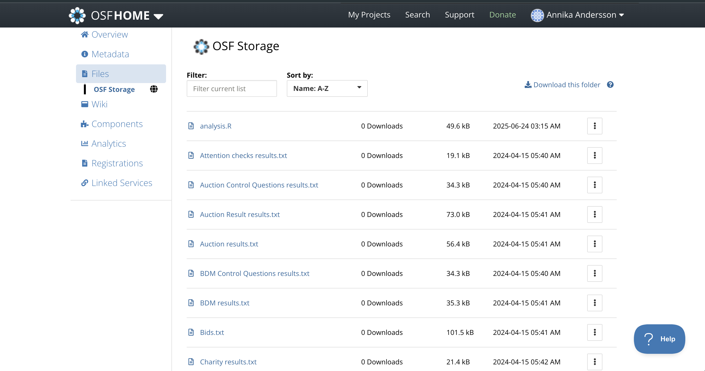
Example of an unstructured repository on OSF

Slide 5
Findable, Accessible, Interoperable & Reusable - FAIR guiding principles (simplified)
Findable (F):
Give every dataset a permanent ID Add a clear description Put that ID inside the description List the dataset in a searchable place
Accessible (A):
Make it downloadable through a standard, open link Allow login if needed Keep the description online even if the data disappear
Interoperable (I):
Use common, machine-readable formats and vocabularies Link to related datasets in a standard way
Reusable (R):
Provide rich, detailed metadata Add a clear reuse license Record who made it and how (provenance) Follow your field’s standards

Slide 6
What is the solution?

Slide 7

FAIR Archive Infrastructure for Research,
It’s Your Template for Accessible & Linked Evidence

Slide 8
Creates a local repository
Upload files with necessary information, data, scripts, results and metadata
Check and verify the repository making sure what’s included and not
Upload it to official repository (OSF, Zenodo etc)

Slide 9
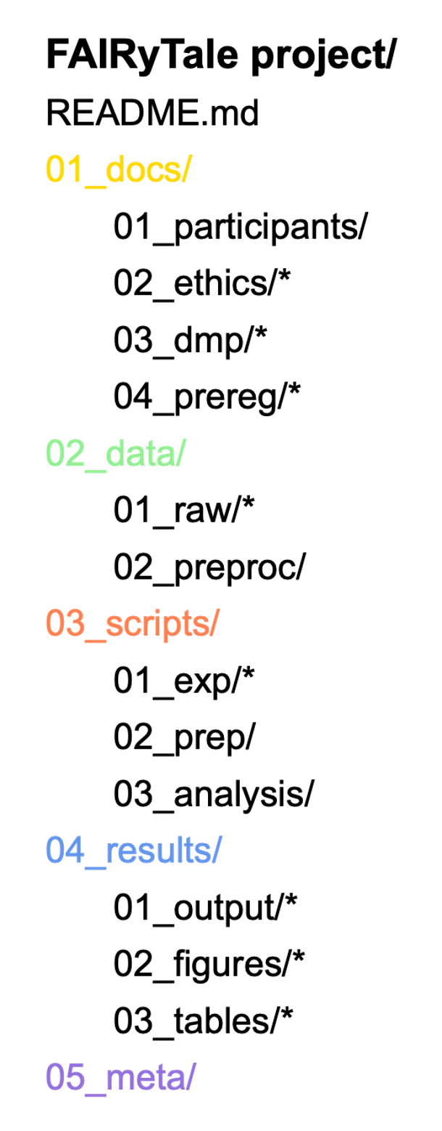





Repository structure
* Optional

Slide 10
