Slide 1

FAIRyTale
Give your data a happily-ever-after
By: Florencia Altschuler, Illiana Sandoval, Jamie Rios & Annika Andersson

Slide 2
What is the problem?
Data & Metadata sharing = TIME CONSUMING
Unstructured repositories
Missing information for replication & reproducibility
Not according to the FAIR guiding principles

Slide 3
Findable, Accessible, Interoperable & Reusable - FAIR guiding principles (simplified)
Findable (F):
Give every dataset a permanent ID Add a clear description Put that ID inside the description List the dataset in a searchable place
Accessible (A):
Make it downloadable through a standard, open link Allow login if needed Keep the description online even if the data disappear
Interoperable (I):
Use common, machine-readable formats and vocabularies Link to related datasets in a standard way
Reusable (R):
Provide rich, detailed metadata Add a clear reuse license Record who made it and how (provenance) Follow your field’s standards

Slide 4
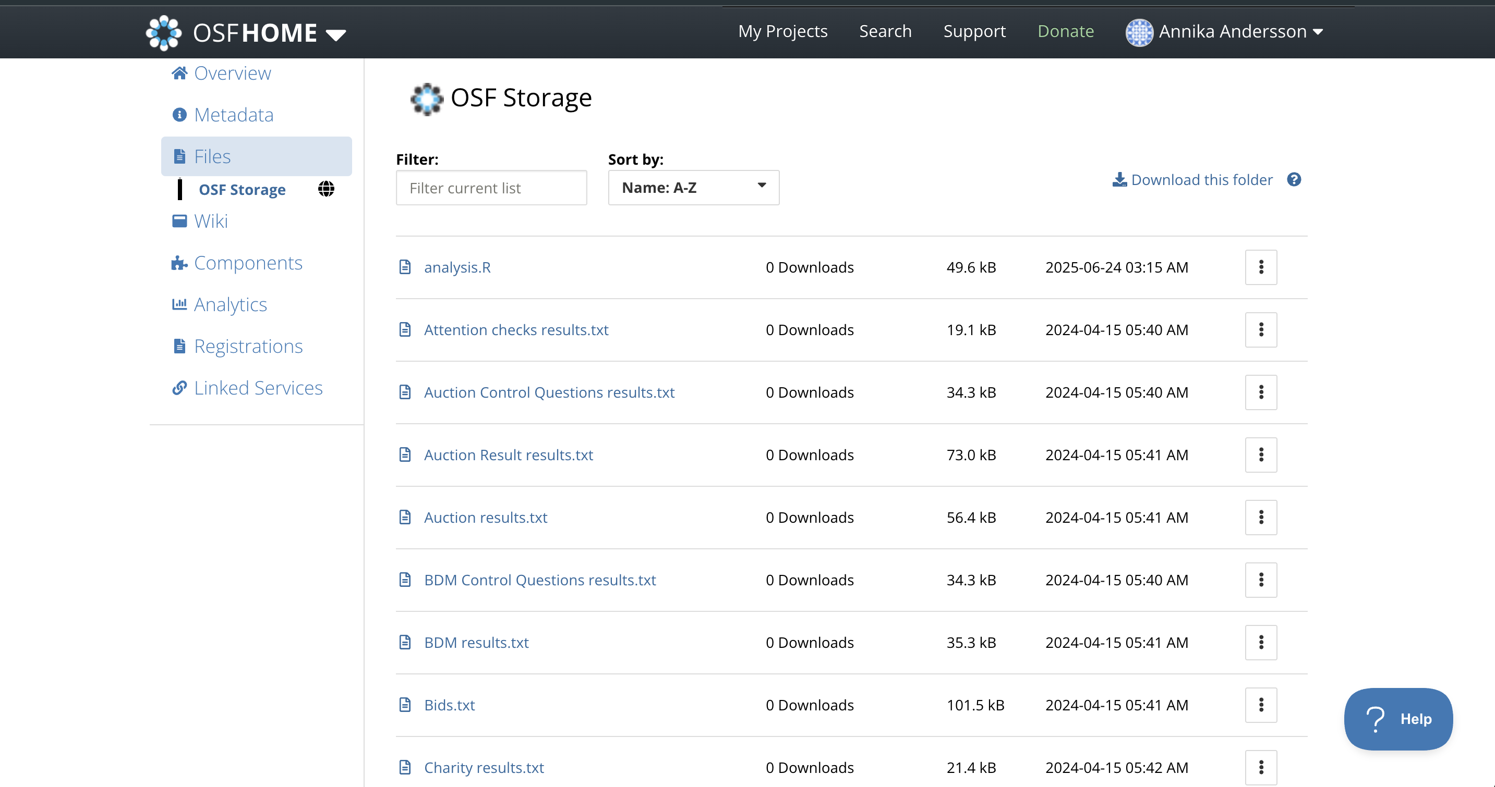
Example of an unstructured repository on OSF

Slide 5

What is the solution?
FAIRyTale! (of course)
Creates a local repository
Automatically structured and organized
Upload files with necessary information, data, scripts, results and metadata
Upload it to official repository (OSF, Zenodo etc)

Slide 6
Repository structure

Slide 7
