Slide 1
The Minimum Linear Arrangement Problem
Γεώργιος Καλλίτσης
Ηλιάνα-Μαρία Ξύγκου
Department of Electrical and Computer Engineering
National Technical University of Athens
11/04/22

Slide 2
Outline
Definition of the problem
Existing accurate algorithms
Heuristics
Experimental evaluation of heuristics

Slide 3

Definition
Given a graph G(V,E) where E and V are the sets of edges and vertices respectively, a permutation π is defined as
π: V -->{1,2,...,n}.
The Minimum Linear Arrangement problem requires to find the permutation π s.t. the below objective function is minimized:
Applications: VLSI design, biology, graph drawing…

Slide 4
It has been proven that the problem in its general form is NP-complete.
So are we done?
No!
In some cases (small graphs, complete graphs, complete bipartite graphs, rooted or undirected trees), there exist algorithms running in polynomial time (maybe with some constraints in the output too).

Slide 5
Categorization of graphs input
Small graphs
Undirected trees
Rooted trees

Slide 6
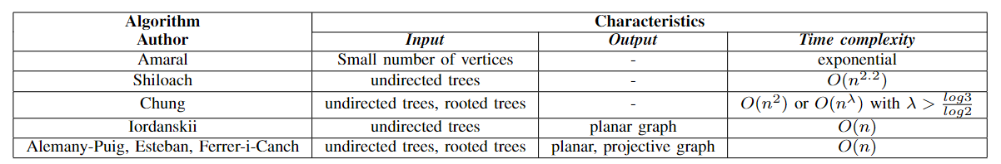
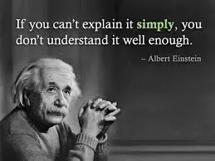
Summary of existing accurate algorithms

Slide 7
Approximation techniques (heuristics)
Spectral sequencing
Random layout
Normal layout
Successive Augmentation
Local Search
Hillclimbing
Spreading metrics
…

Slide 8

Spectral sequencing
Proposed by Juvan and applied as follows:
Compute matrices A(G), D(G) and subsequently the Laplacian matrix L(G).
Find the Laplacian eigenvalues and sort them in increasing order, λ₁ ≤ λ₂ ≤ ... ≤ λ_{n}.
Compute the eigenvector x⁽²⁾ (Fiedler vector) which corresponds to the second smallest laplacian eigenvalue λ₂.
Determine labeling ψ^{e} s.t. :
If x⁽²⁾_{u} ≤ x⁽²⁾_{v} then ψ^{e}(u) ≤ ψ^{e}(v)
Lower bound achieved:

Slide 9
Local Search
Generalized method for solving many combinatorial problems.
Trying to find out local minimal (or maximal) by performing local changes.
Need to specify the set of feasible solutions, the objective function and the concept of “neighborhood”.
Simple, comprehensive and most times effective family of algorithms.

Slide 10
Implementation of Local Search in MLA
Set of feasible solutions: the set of all permutations of size n (n!).
Objective function: we saw that before,
Neighborhood ??

Slide 11
Definition of the term “neighborhood”
Definition 1: two layouts are neighbors if one can move from
one to another by flipping the labels of any pair of nodes in
the graph (version 2).
Definition 2: Two layouts are neighbors if one can move from
one to another by flipping the labels of two adjacent nodes in the graph (version 2b).
Definition 3: Two layouts are neighbors if one can move from
one to another by rotating the labels of any triplet of nodes in the graph (version 3).

Slide 12

But even if we specify the term of neighborhood, which will be the appropriate stopping criterion?

Slide 13
Experimental evaluation of heuristics
Implemented approximation techniques: Normal layout, Random layout, Spectral Sequencing, Local Search (3 definitions of neighborhood).
Python (Anaconda and Spyder)
Use of Linear Arrangement Library (LAL) (Llu ́ıs Alemany-Puig, Juan Luis Esteban and Ramon Ferrer-i-Cancho) which uses the Algorithms of Chung and Shiloach.
Comparison of results according to the quality of solution and execution time …

Slide 14
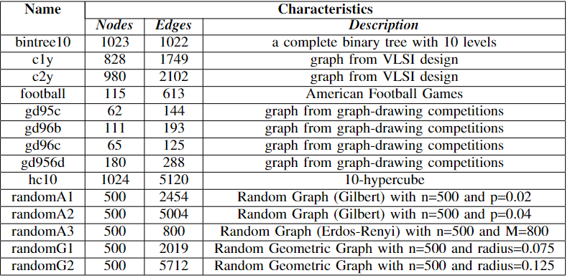
Input graphs of experiments
Use of properly processed real-life graphs provided by Jordi Petit and randomly generated graphs.

Slide 15
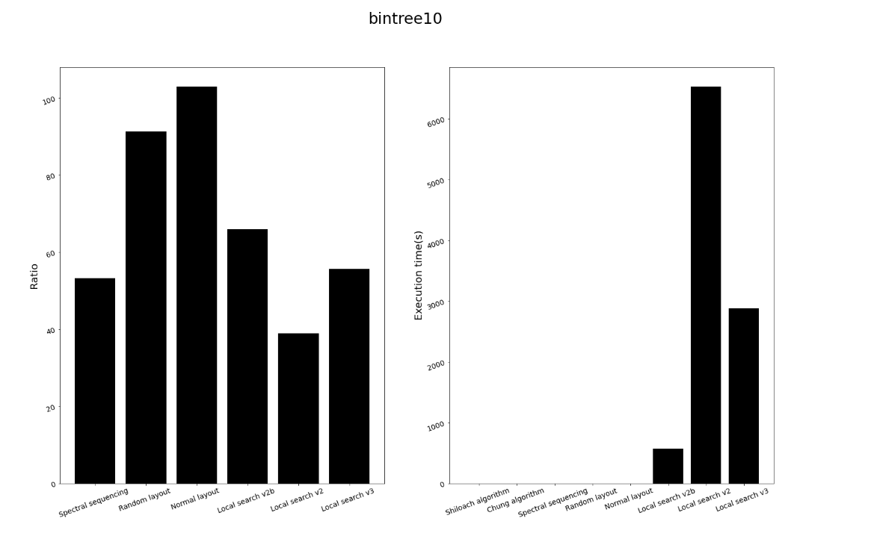
Evaluation of Heuristics: an example

Slide 16
Conclusion
Expected bad performance of Normal and Random Layout.
Very satisfying time and quality performance of Spectral Sequencing (but inappropriate heuristic for large graphs because of computational power - huge use of memory).
The great interest: Local Search parameters…

Slide 17

Conclusion (cont.)
Local Search: what to choose?
It seems that the definition 1 (version 2) gives the best results referring to the approximation ratio among the 3 neighborhoods…
but with max_iterations close to 3000-4000!
With smaller stopping criterion, Local Search behaves worse even than Spectral Sequencing!
With max_iterations in the range 5000-10000, Local Search v2 approaches the optimal solution…
but it runs for hours even for graphs with 500-1000 nodes!

Slide 18

So what to choose?
Tradeoff between approximation ratio and execution time.

Slide 19

How close are we to optimality?
Local Search is a randomized family of algorithms.
It depends on the selection of the initial permutation.
Could we choose a “close enough” initial permutation so as to save time…?
and our computer too!

Slide 20

Questions?

Slide 21
Thank you for your attention!
References:
Amaral, A.R.S. ,“A mixed 0-1 linear programming formulation for the exact solution of the minimum linear arrangement problem”, Optim Lett 3, 513–520, 2009.
Y. Shiloach, “A minimum linear arrangement algorithm for undirected trees”, SIAM J. Cam, 8, 15-32, 1979.
Esteban J L and Ferrer-i-Cancho R, “A correction on Shiloach’s algorithm for minimum linear arrangement of trees”, SIAM J. Comput., 46, 1146–51, 2015.
F.R.K. Chung, “An optimal linear arrangements of trees”, Computers & Mathematics with Applications,10,43-60, 1984.
M.A.Iordanskii, “Minimal numberings of the vertices of trees”, Dokl. Akad. Nauk SSSR, 218, 2, 272-275, 1974.
Llu ́ıs Alemany-Puig, Juan Luis Esteban, Ramon Ferrer-i-Cancho, “Minimum projective linearizations of trees in linear time”, Information Processing Letters, Volume 174, 2022.
M. Juvan, B. Mohar, “Optimal linear labelings and eigenvalues of graphs”, Discr. Appl. Math. 36, 1992.
Jordi Petit, “Experiments on the minimum linear arrangement problem”. ACM J. Exp. Algorithmics 8, Article 2.3, 2003.
Rao, S., Richa, A.W. “New approximation techniques for some linear ordering problems”. SIAM J. Comput. 34(2), 388–404, 2004.
Feige, Uriel & Lee, James, “An improved approximation ratio for the minimum linear arrangement problem”, Information Processing Letter, 101, 26-29, 2007.

