Slide 1
Bio-embeddings construction from microarray gene expression datasets using deep neural networks
Κατασκευή βιο-αναπαραστάσεων από σύνολα δεδομένων μικροσυστοιχιών γονιδιακών εκφράσεων με χρήση βαθιών νευρωνικών δικτύων
Elias Georgoulis Physics Department UoC
Supervisor : Dr. Pantazis IACM-FORTH

Slide 2
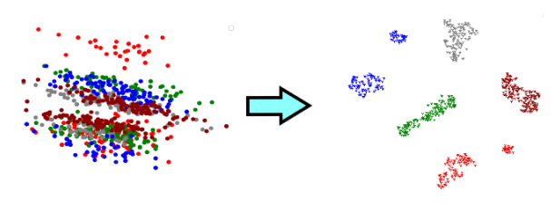
The consept
Construction of a low dimensional latent space of features for gene expression, biological data, where different studies are distinctly separated from each other.
Inspiration
Latent Feature Representations for Human Gen Expression Data Improve Phenotypic Predictions
Speaker Conditional WaveRNN: Towards Universal Neural Vocoder for Unseen Speaker and Recording Conditions

Slide 3
Problem specificities and characteristics
Biological data: Gene expression is the process by which genetic instructions control the various cell mechanisms through the synthesis of proteins and other gene products.
Gene expression data :
By nature high-dimensional (microarray samples have about 55000 features)
Datasets typically have low sample size
Results might not be reproducible across different studies due
to the specificities of each study
Gene overrepresentation in microarray datasets

Slide 4
Applications
Batch effect removal for enabling translation from study to study.
Measure different studies similarities/closeness.
Building of a global, low-dimensional representation for
gene expression data that would be able to generalize on newly, unseen studies.
Ease the biological interpretation of transcriptomics data for biologists.
Batch effect on biological data: non-biological factors in an experiment cause changes in the data produced by the experiment

Slide 5
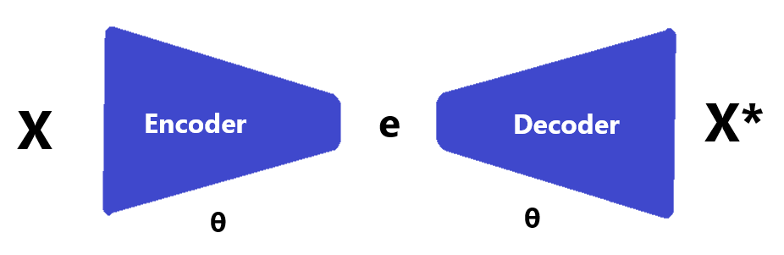
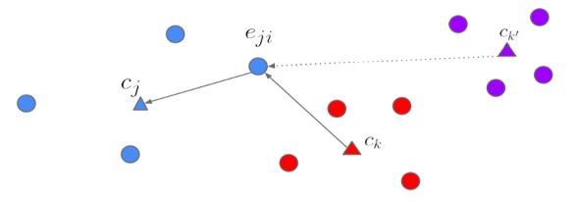
Problem statement and proposal
The goal is to push the embedding of each sample towards the centroid of its study and away of the centroids of other studies on the feature latent space. We also want to reconstruct the reduced samples.
For that reason:
Autoencoder neural network
+ +
Generalised end to end (GE2E) loss function

Slide 6
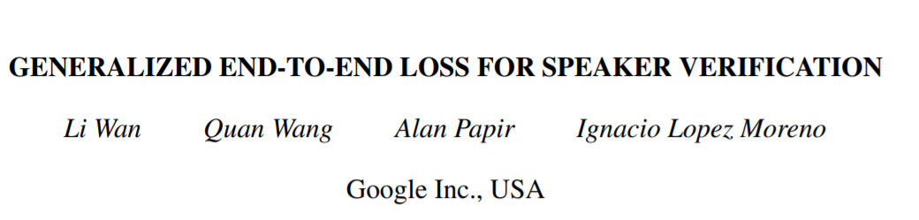




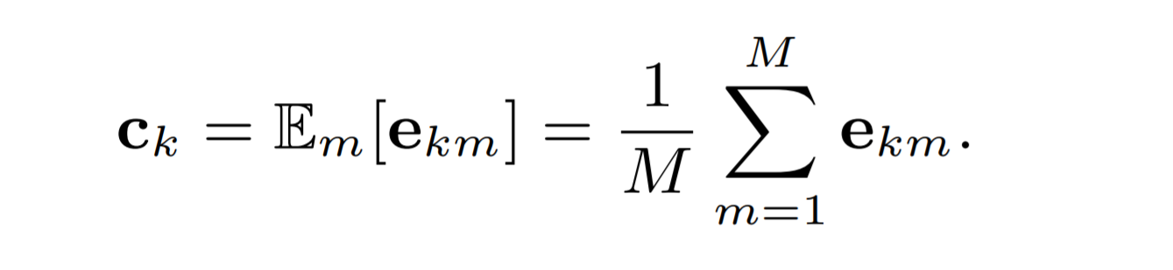
GE2E loss function
For NxM samples where N is the number of studies and M the number of samples of each study, Xji represents the ith sample of the jth study.
The output of the neural network application on the xji sample is denoted as where w represents all parameters of the neural network.
Each sample's embedding vector , is defined as the L2 normalization of the network output:
(1)
The centroid of the embedding vectors from the kth study is defined as:
(2)

Slide 7



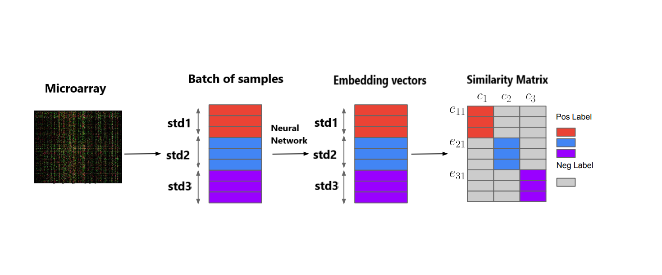
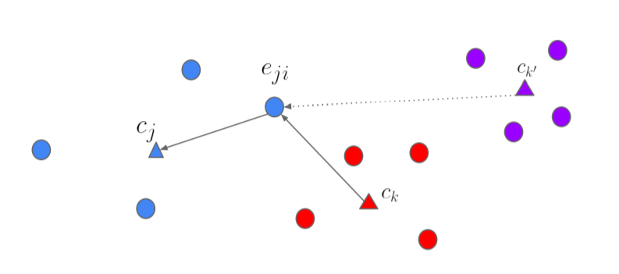
Similarity Matrix
The similarity matrix Sji,k is defined as the scaled cosine similarities between each embedding vector to all centroids :
(3)

Slide 8
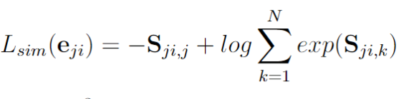


Total loss
We put a softmax on for k = 1, . . , N that makes the output equal to 1 if k = j, otherwise makes the output equal to 0. Thus, the loss on each embedding vector eji could be defined as:
(4)
The reconstruction error for each sample is defined as:
(5)
Finally the total loss is:
(6)

Slide 9
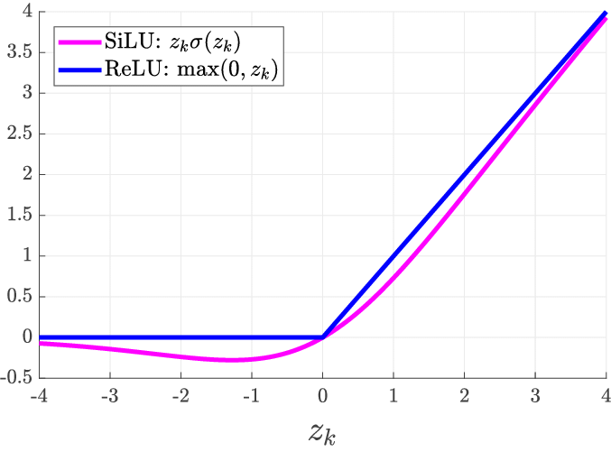
Model characteristics
Constructed using PyTorch library
3 layer autoencoder :
layer_1= 2048 output size
layer_2= 1024
layer_3= 256 (embeddings size)
Activation Function: ReLU and SiLU (swish) on final layer
Dropouts
Optimizer: AdamW
Loss criterion: MSE for the reconstruction loss and Cross entropy loss for the similarity loss

Slide 10
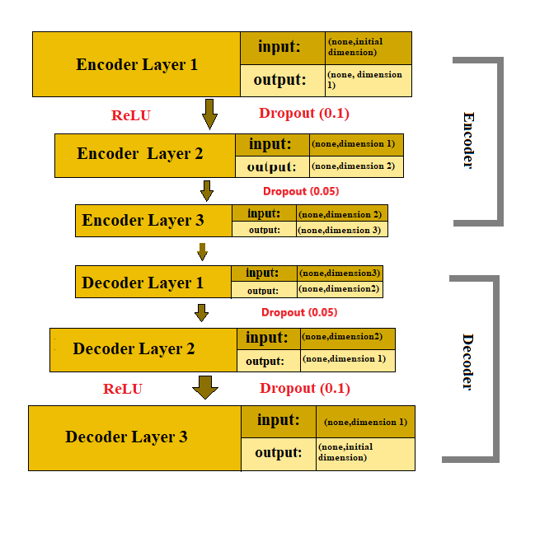
Network's summary graph
SiLU

Slide 11
Synthetic data
First, we tested the method on synthetic datasets that emulate microarray datasets.
Characteristics:
k = inner dimension
p = final dimension
cl = number of classes
w = percentage of control samples
a = noise coefficient

Slide 12
Method implementation on synthetic data
The implementation of the method on the synthetic data was successful, confirmed by multiple tests.
Example parameter values:
5 datasets of (200,200,300,300,500) samples
k = inner dimension = 50
p = final dimension = 1000
cl = number of classes = 2
a = noise coefficient = 0.001

Slide 13
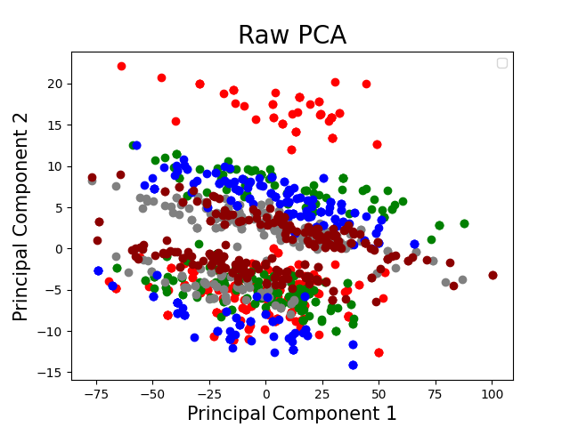
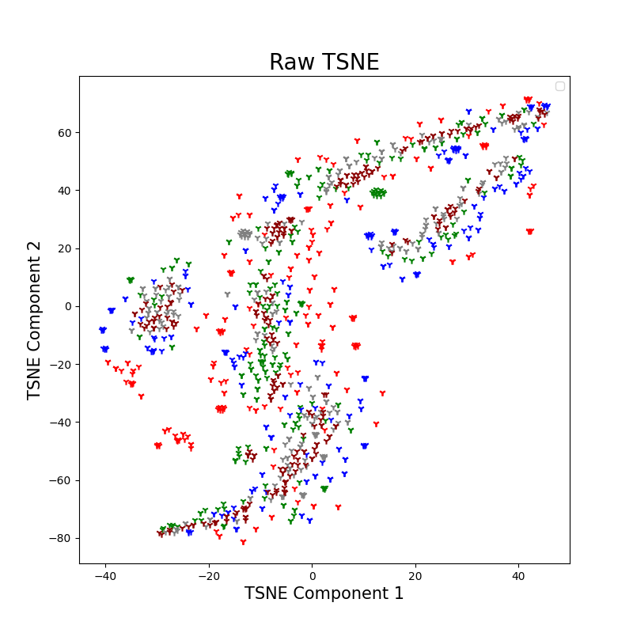
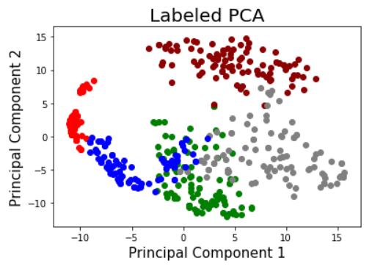
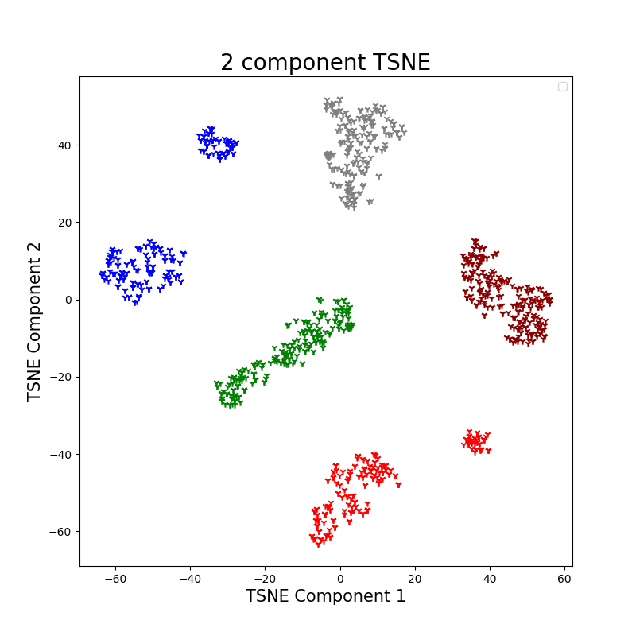
Synthetic example results
Raw data
PCA-TSNE
representations
Results after method's implementation
The accuracy of the knn algorithm on the test set improved from 32.3 % that was before the method implementation to 86.1 % using the created embeddings which is a 166.6 % improvement.

Slide 14
Method implementation on real microarray data
Microarray data:
In this work, we used datasets created with the GPL570 platform.
Every sample taken using this platform, is an one dimensional array that consists of 45675 gene expression values.
In order to make our data usable but also keep the useful biological information, we perform an initial reduction on the data’s dimension using Principal Component Analysis.
The data that are used to validate our results (test set) were not part of the principal components calculation.

Slide 15
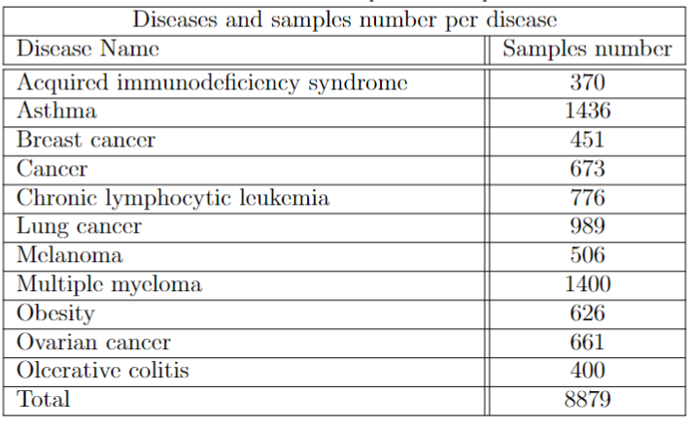
Multiple studies per disease-dataset example
In this example, for the model training 12 datasets have been used. Every datasets contains samples from multiple studies on a given disease.

Slide 16
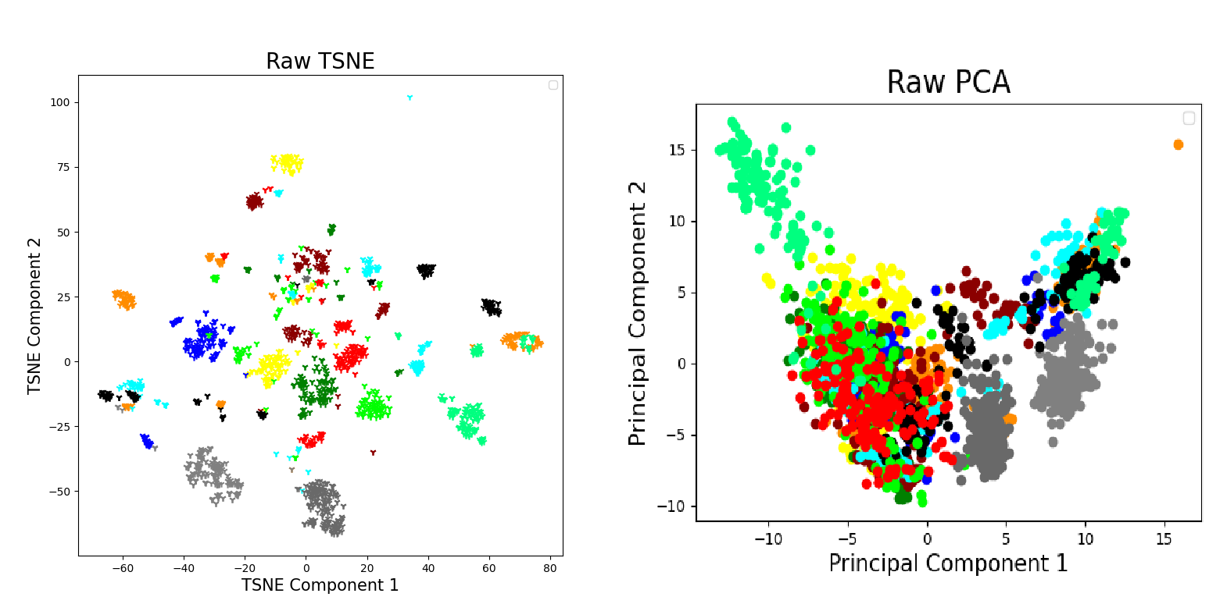
Two-dimensional representations of the data

Slide 17
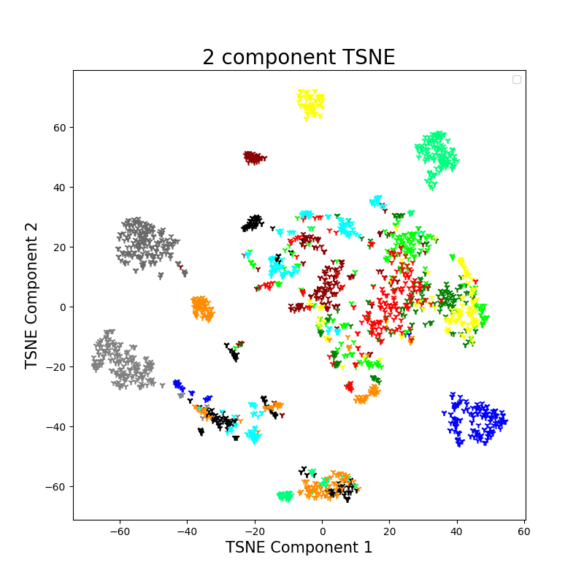
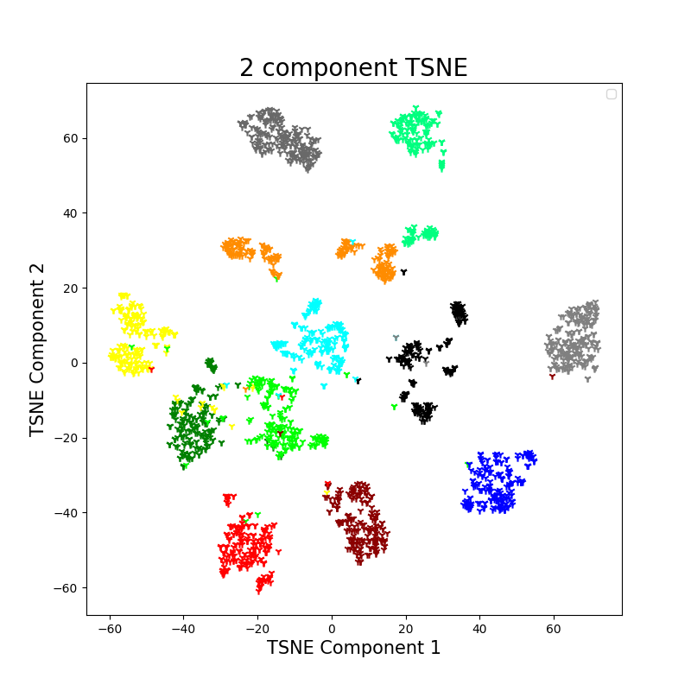
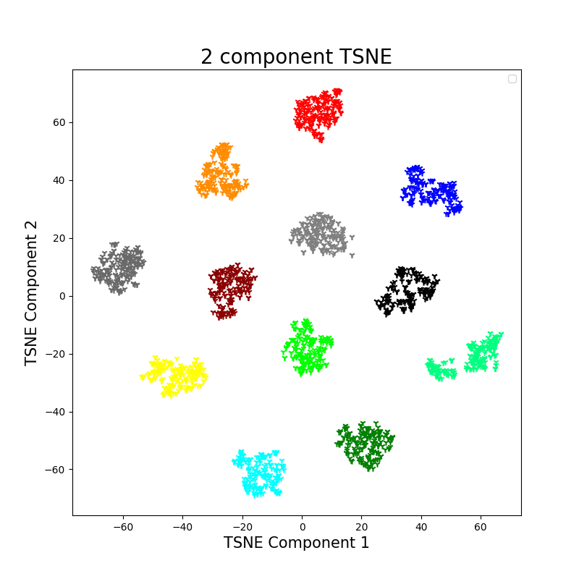
Two dimensional representation of the embeddings space after different number of training epochs

Slide 18
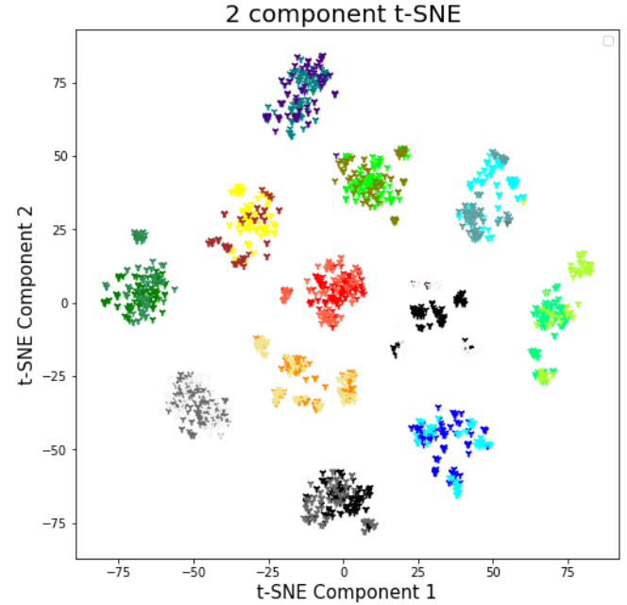
t-SNE two-dimensional representation of the embeddings space both for samples from the training set as long as the test set
The accuracy of the knn algorithm on the test set improved from 62.0 % to 98.2 % using the created embeddings, which is a 58.4 % improvement.

Slide 19
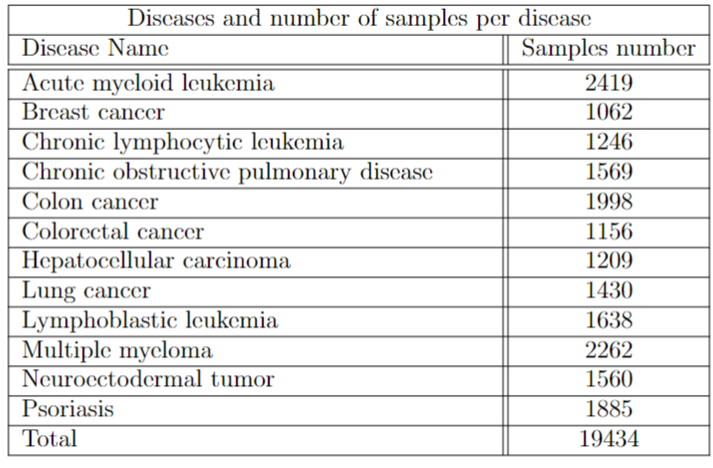
Large scale experiment
A total of 120 studies with more than 19000 samples were downloaded by the BioDataome database. From every of the 12 different diseases, 10 studies with at least 60 samples were picked randomly from the database.

Slide 20
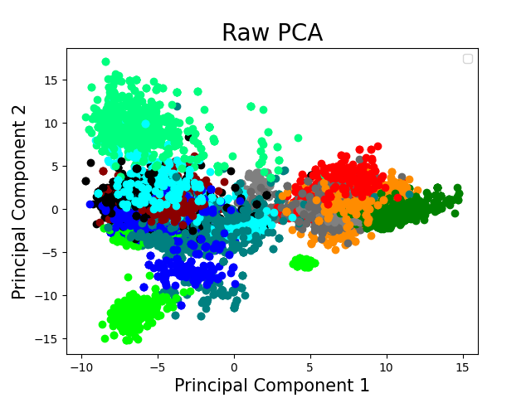
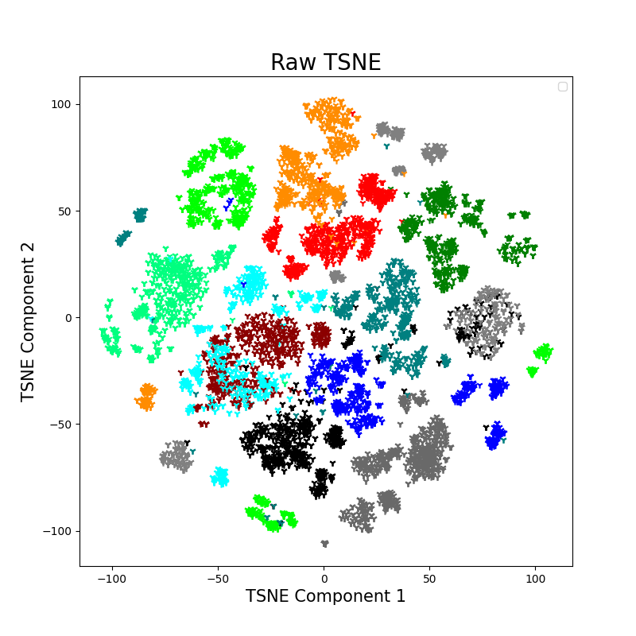
Two-dimensional representations of the data

Slide 21
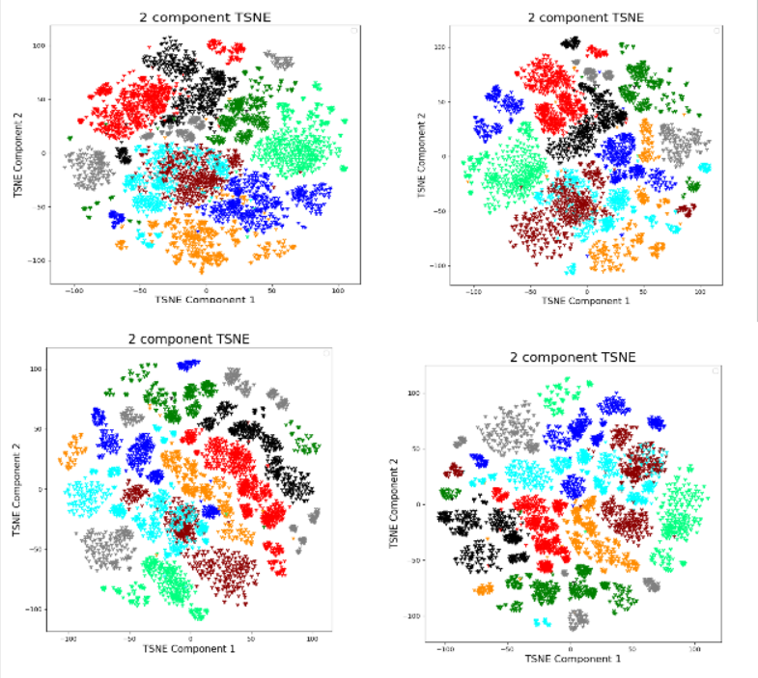
Two dimensional representation of the embeddings space after different number of training epochs

Slide 22
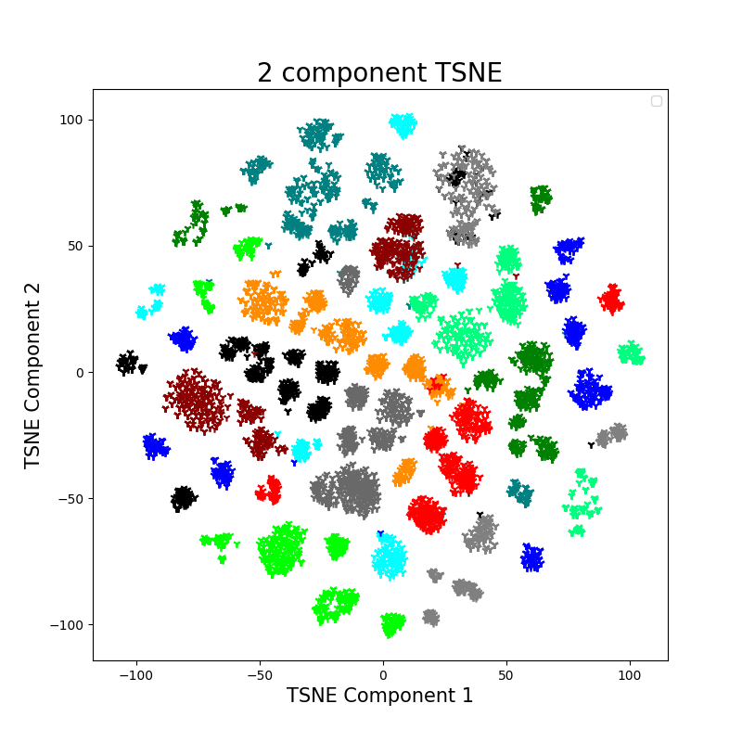
Two dimensional representation of the data before and after the method implementation

Slide 23
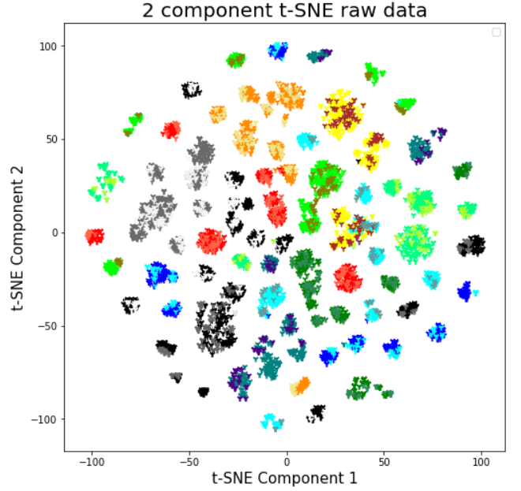
t-SNE two-dimensional representation of the embeddings space both for samples from the training set as long as the test set
The classification accuracy of the knn algorithm on the test set, in terms of the disease that the samples came from, increased from 91.7% to 96.9%, which is a 5.7% improvement.
In terms of what particular study the samples originate from, the classification accuracy increased from 54.5% to 65.3%, which is a 19.8% improvement.

Slide 24
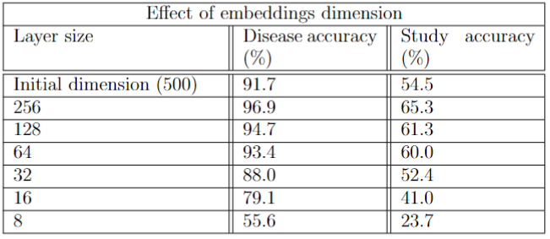
Effect of embeddings dimension on the classification accuracy of the knn algorithm

Slide 25
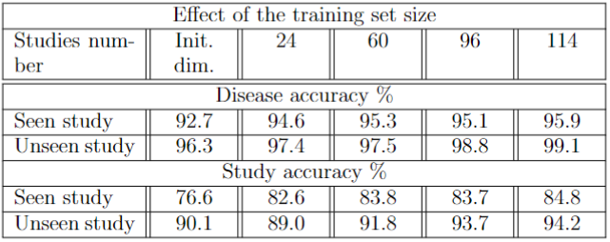
Effect of the training set size on the knn algorithm’s accuracy in both seen and unseen studies by the network

Slide 26
Summary
The implementation of the method was succesful for both synthetic and real microarray data.
The knn algorithm's classification accuracy for both seen and unseen samples and studies by the model during its training improved after the method's implementation.
We confirmed that the relative topology of the different studies and diseases, in terms of their similarity, was retained on the embeddings space.
The sanity of the visual results was confirmed after multiple tests.
The method was proven capable to generalise to large scale experiments.

