Slide 1
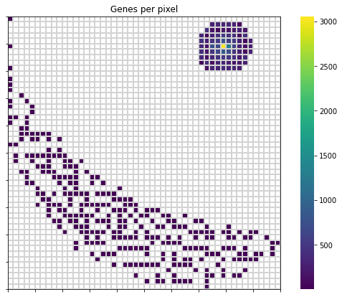
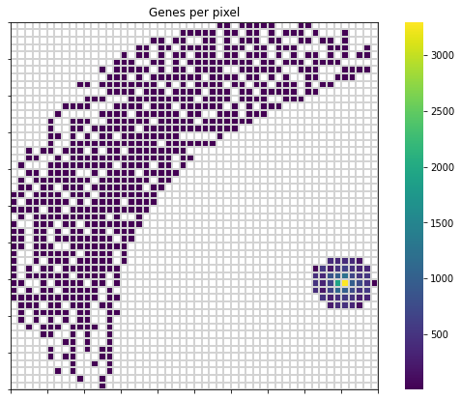
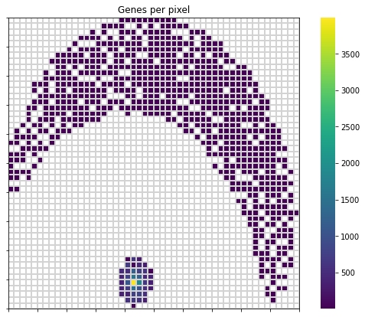
COVID19 - feature weight heatmap
Alpha (B.1.1.7-like)
Beta (B.1.351-like)
Beta (B.1.351-like)

Slide 2
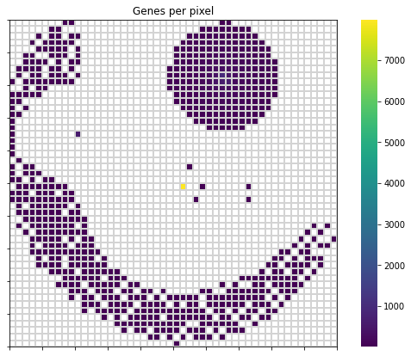
COVID19 - feature weight heatmap (mix)
Delta (B.1.617.2-like)
Delta (B.1.617.2-like)
Gamma (P.1-like)

Slide 3
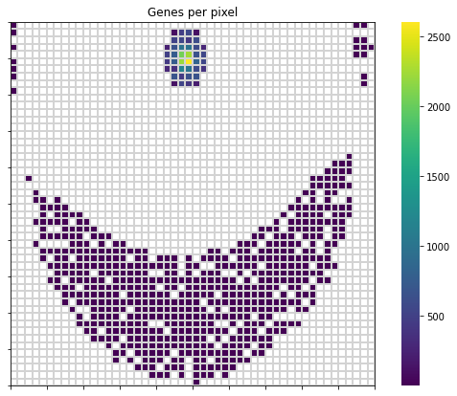
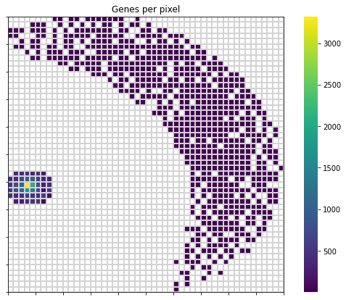
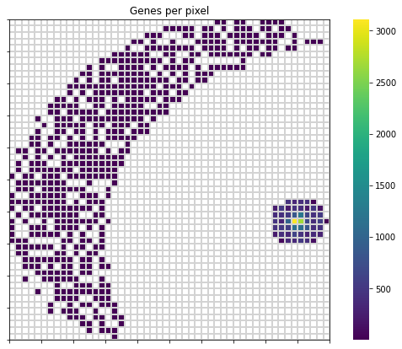
COVID19 - feature weight heatmap
Delta (B.1.617.2-like)
Delta (B.1.617.2-like)
Gamma (P.1-like)

Slide 4
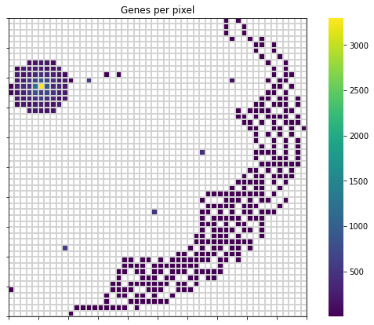
COVID19 - feature weight heatmap (mix)
Alpha (B.1.1.7-like)
Beta (B.1.351-like)
Beta (B.1.351-like)

Slide 5
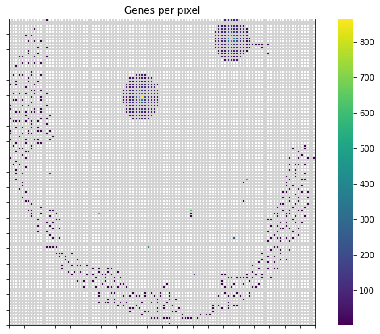
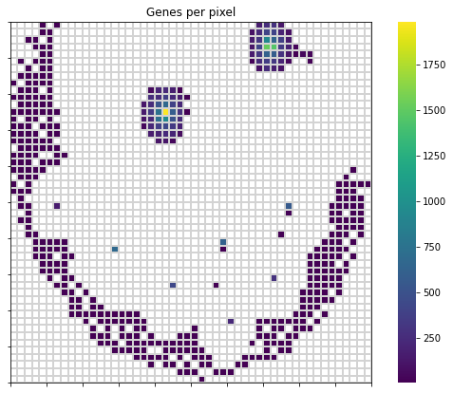
COVID19 - feature weight heatmap (mix)

Slide 6
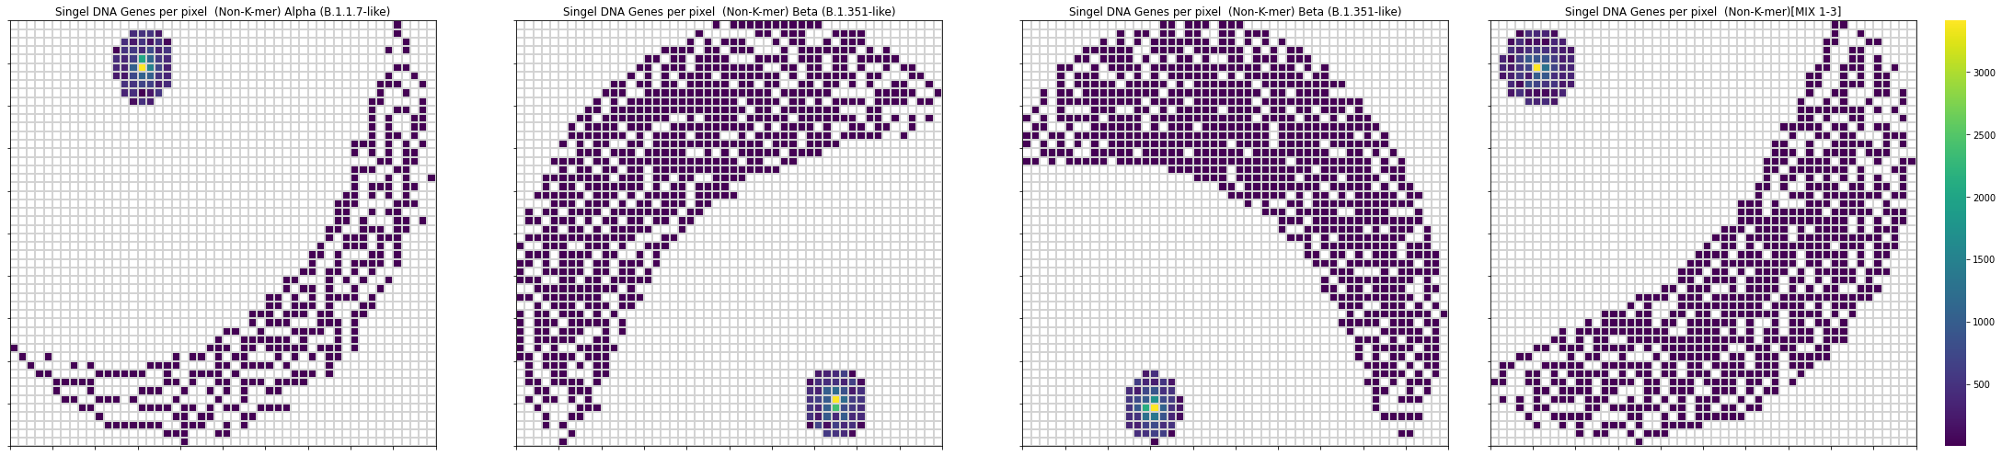
Notes:
rna to num

Slide 7
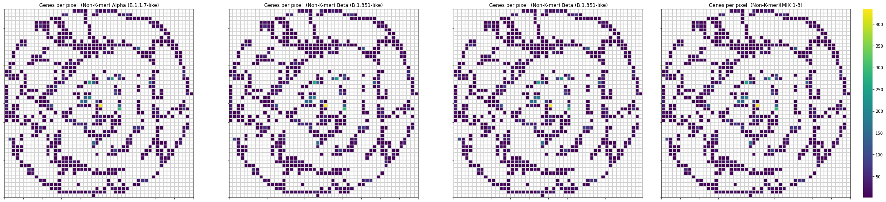

Slide 8
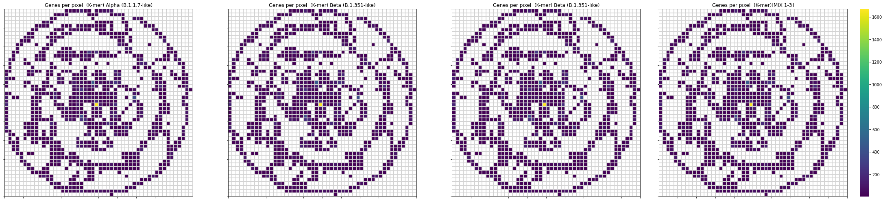

Slide 9
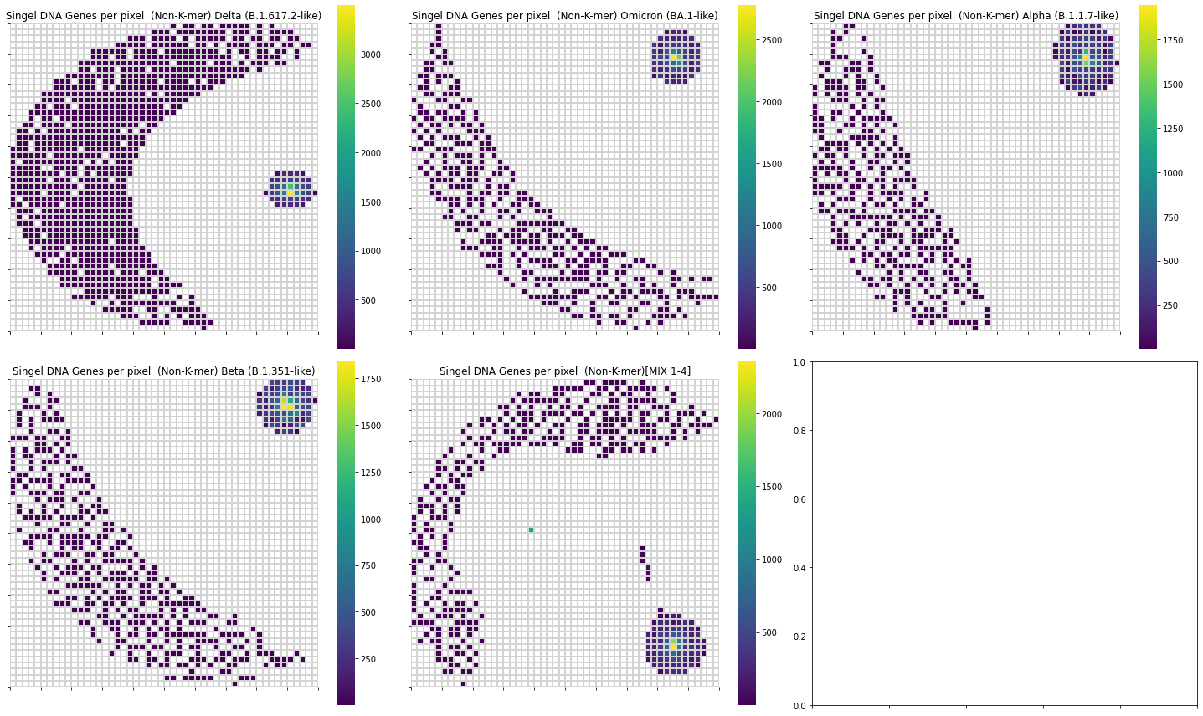
Single RNA Unit
Notes:
流程圖
不同rna deep in sight圖片
重複製作

Slide 10
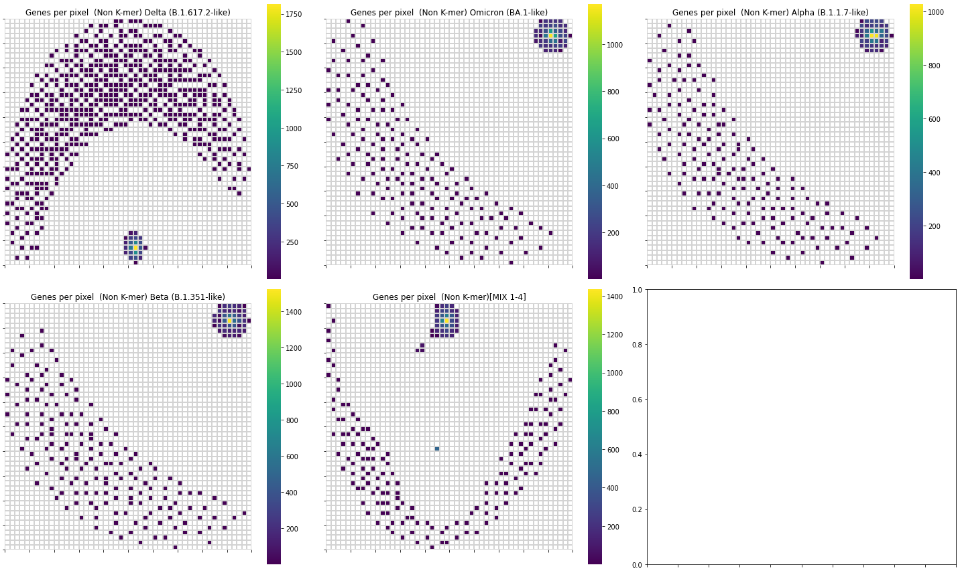
Non K-mer 3
Notes:
流程圖
不同rna deep in sight圖片

Slide 11
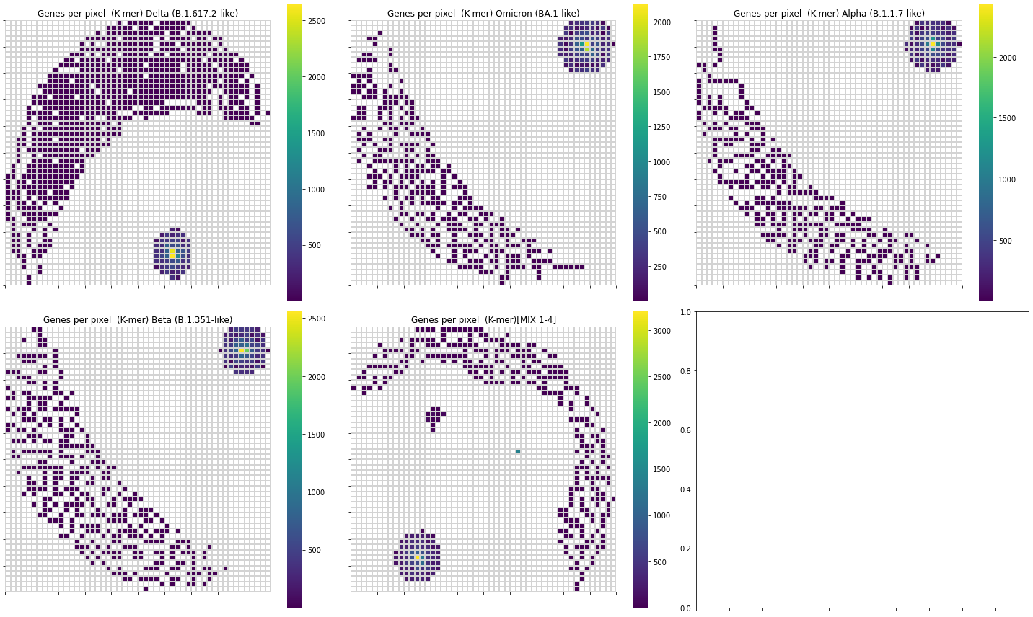
K-mer 3
Notes:
流程圖
不同rna deep in sight圖片

Slide 12
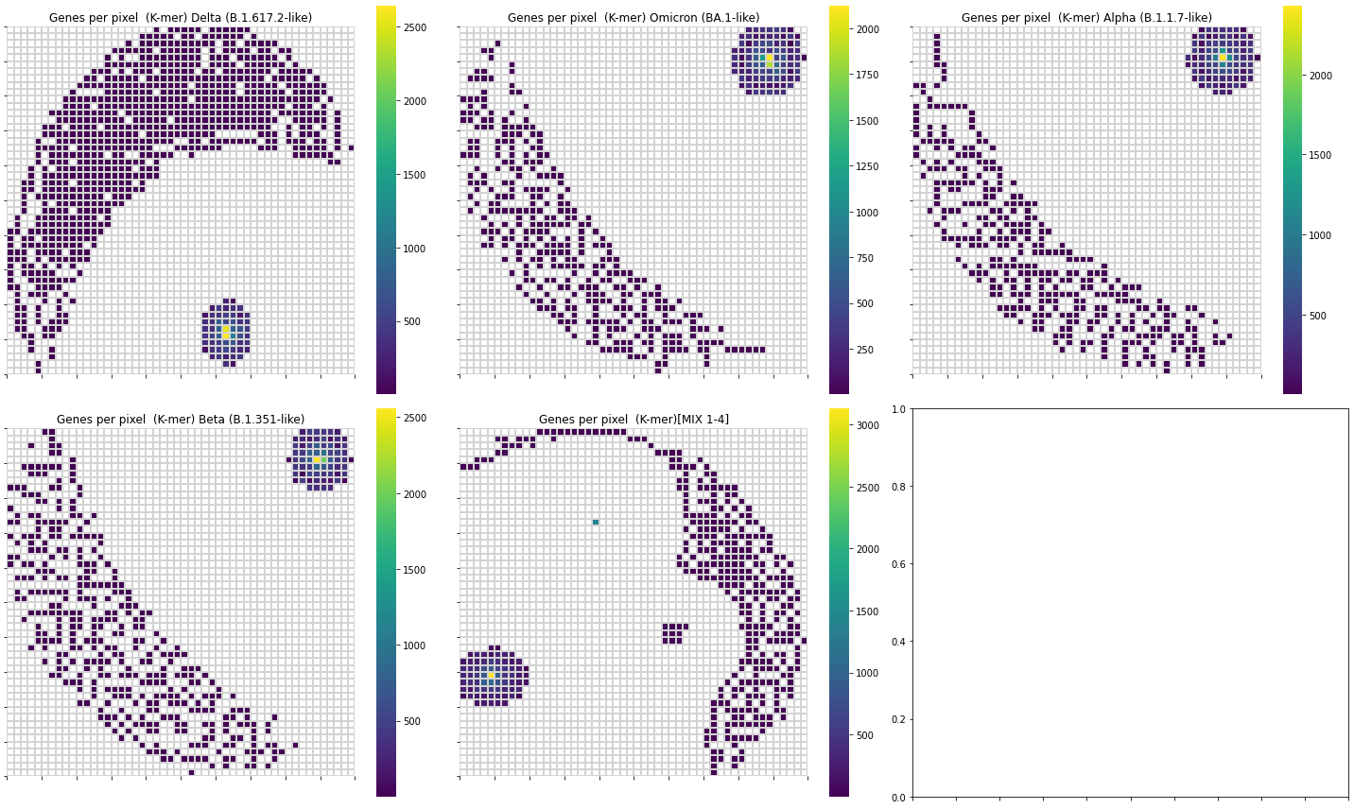
K-mer 3 - Extend Scale

Slide 13
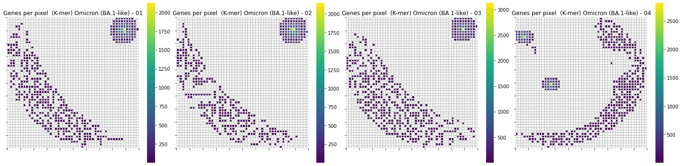
K-mer 3 - Omicron

Slide 14
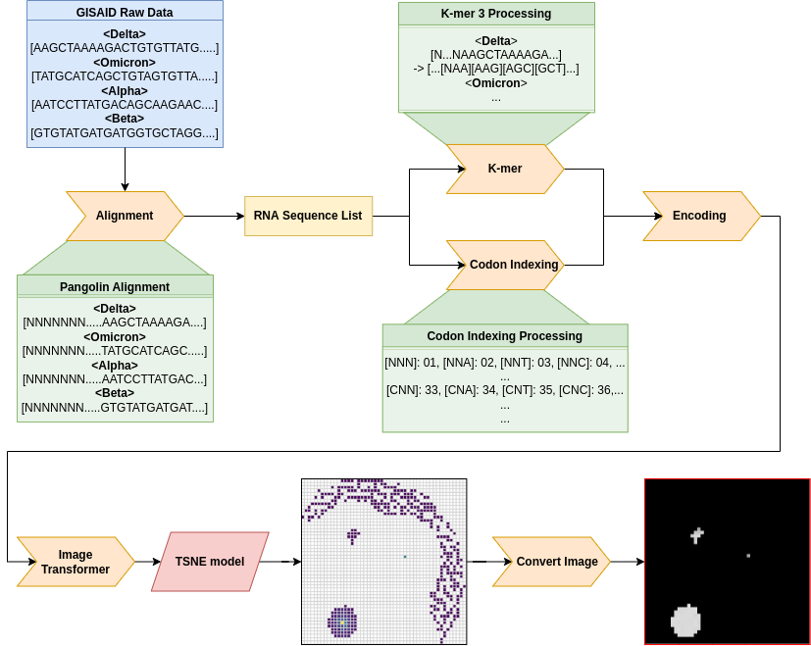
DeepInsight

Slide 15
MultiClass -
Class : Alpha, VUM(Unclear), Beta, Delta, Eta, Gamma, Iota, Lambda, Mu, None
Model | Train Accuracy | Test Accuracy
DeepInSight(k-mer3)+AlexNet | 84.33% | 84.33%
MLP(Non-k-mer3) | 91.07% | 91.17%
LSTM(Non-k-mer3) | 84.33% | 84.33%

Slide 16
k-mer 3 - pca

Slide 17
k-mer 3 - pca

