Slide 1
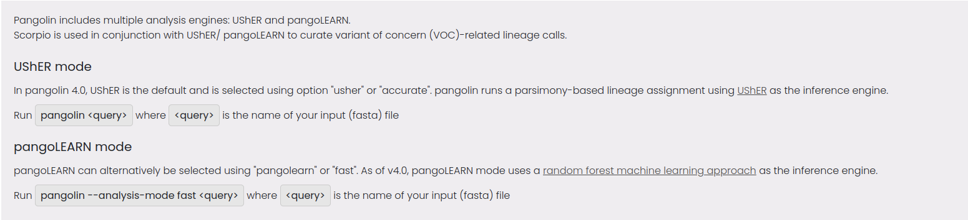
pangolin model mode

Slide 2
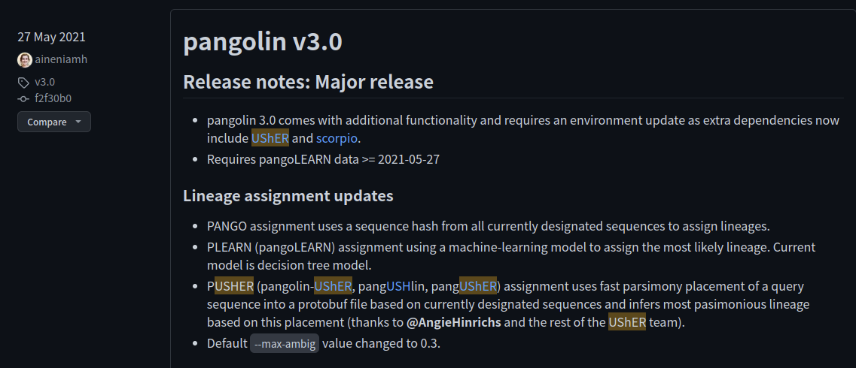
usher function

Slide 3
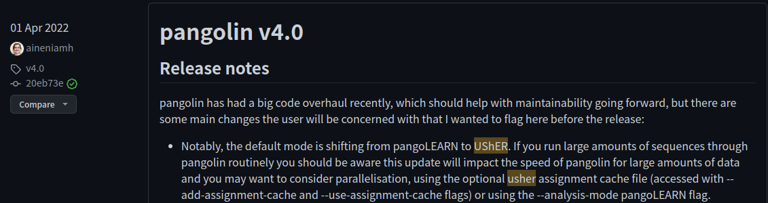
usher function

Slide 4
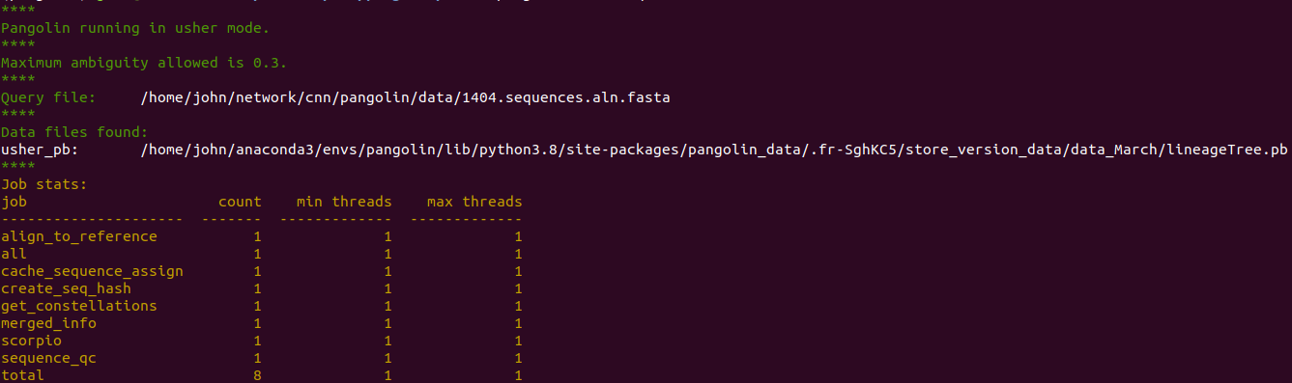
pangolin model mode - usher

Slide 5
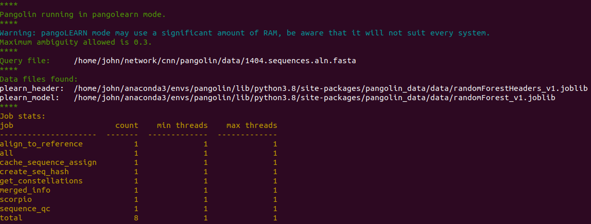
pangolin model mode - pangoLearn

Slide 6
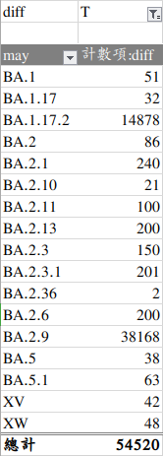
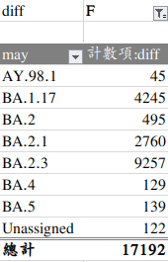
pangolearn 5月[ver.1.9] & 3月[ver.1.2.133]-part4
data shape | diff[T/F]
[71712, 29903] | [54520/17192]

Slide 7
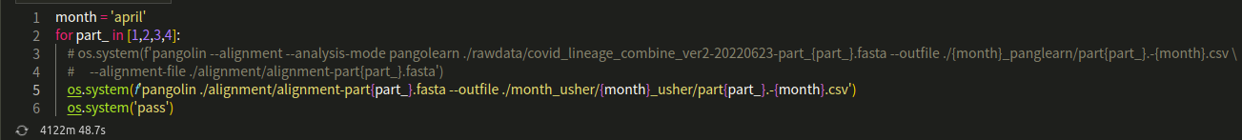
usher

Slide 8
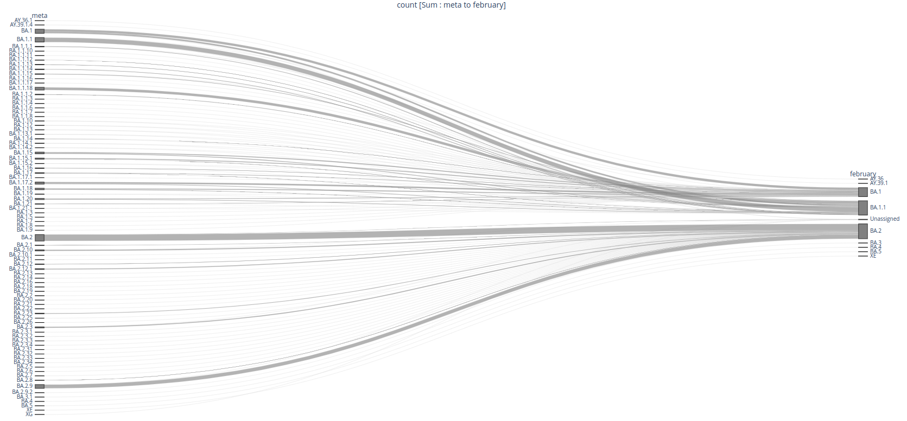
meta - february

Slide 9
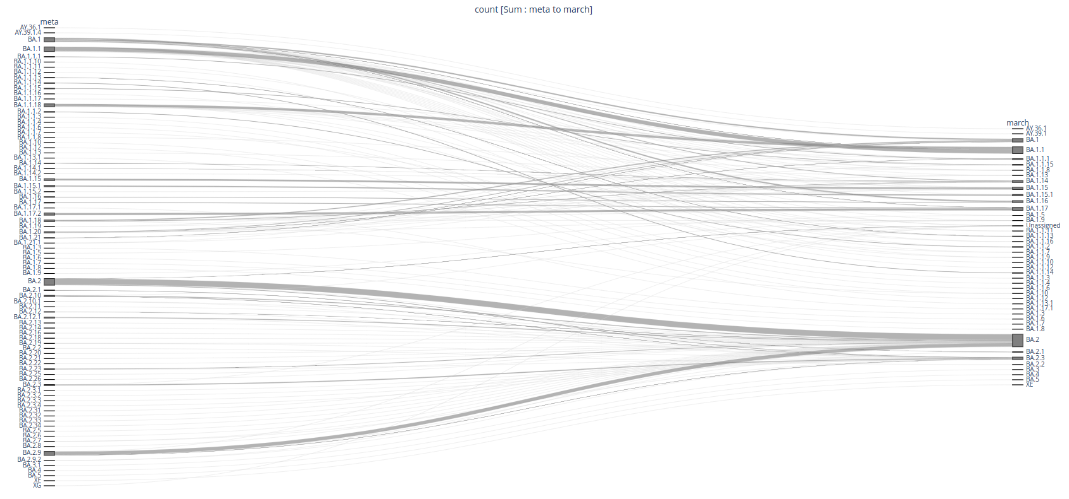
meta - march

Slide 10
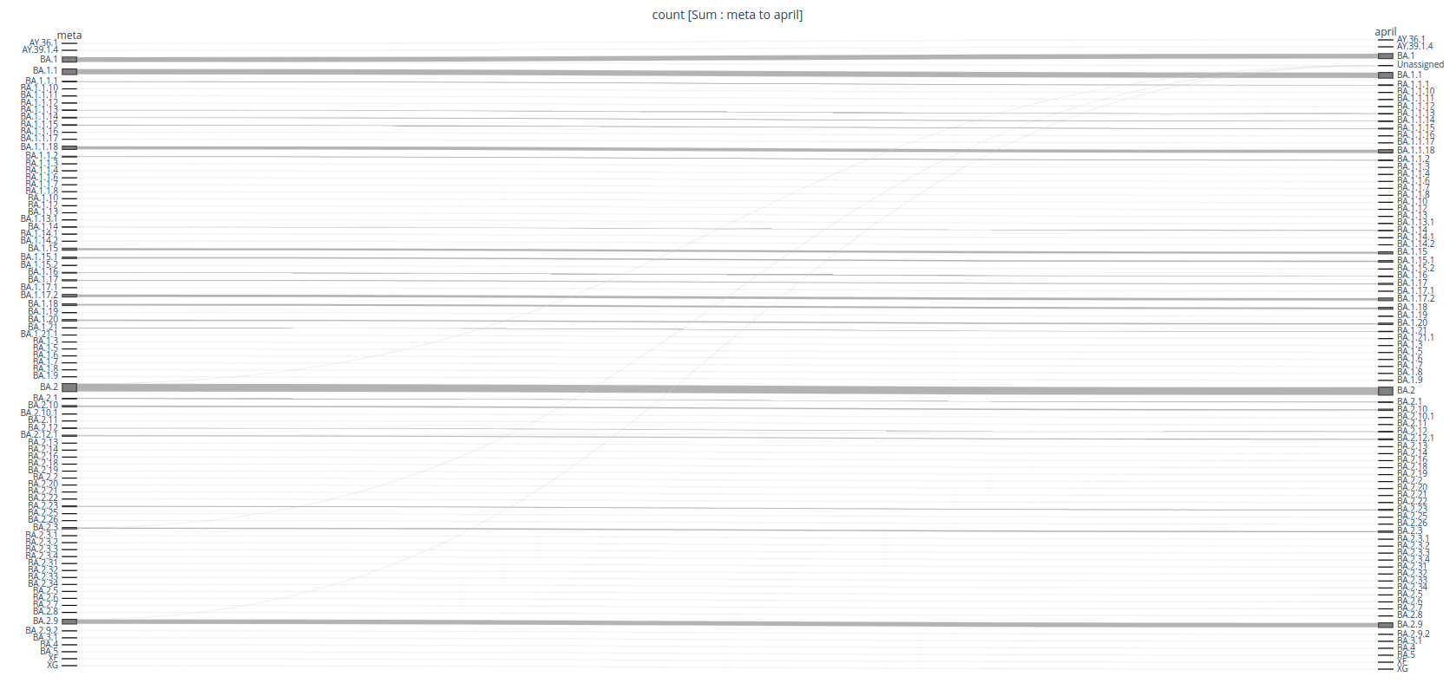
meta - april

Slide 11
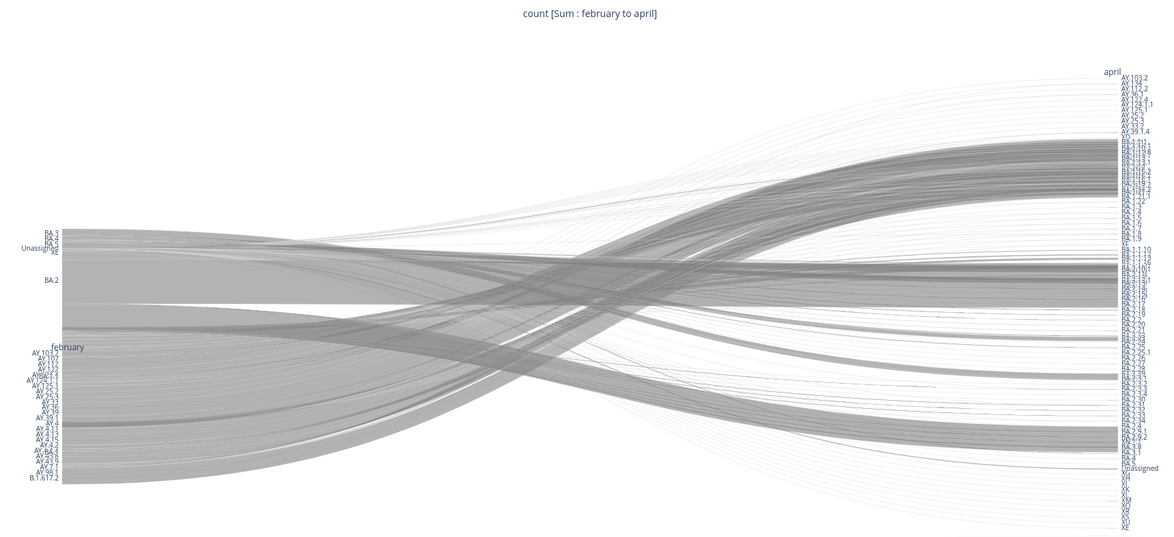
february - april

Slide 12
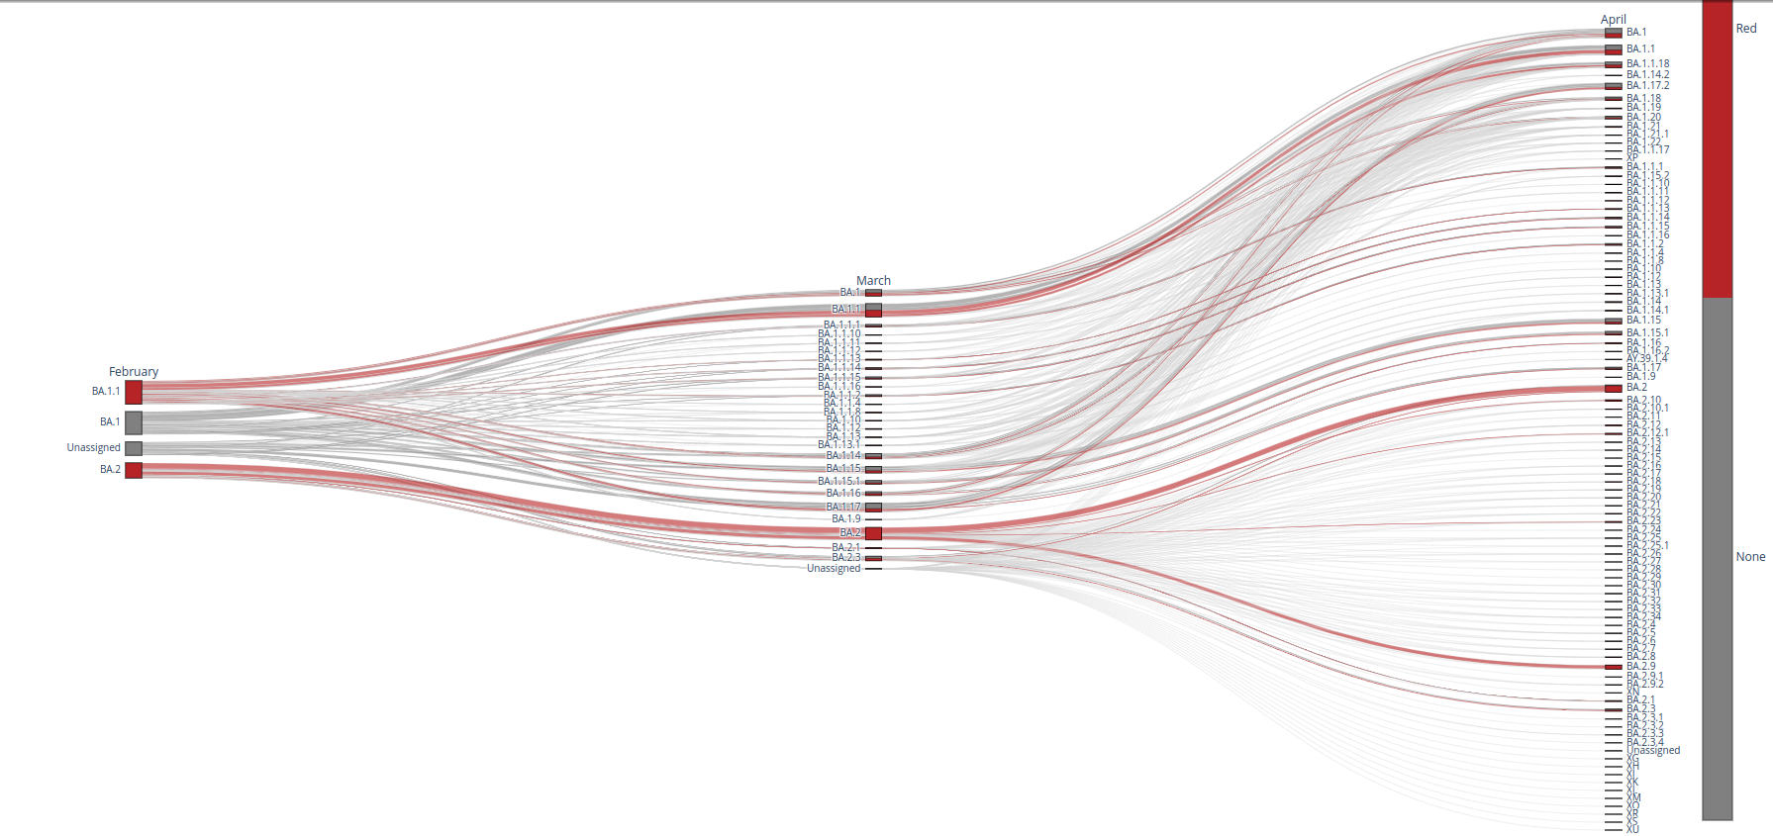
february - march - april

Slide 13
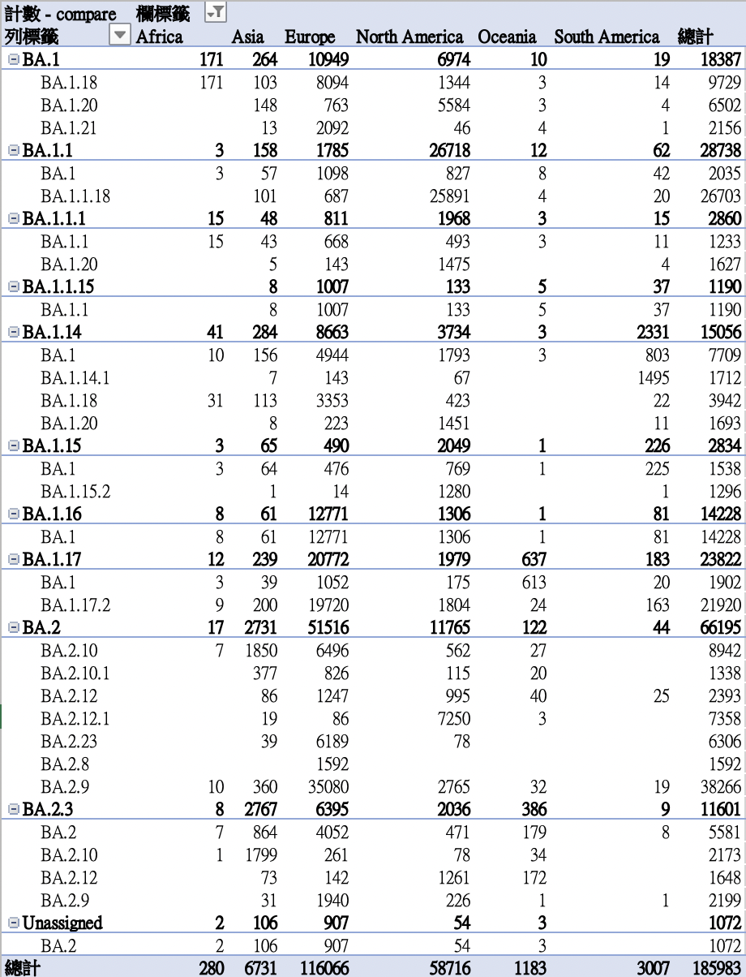
Lineage update – country compare
Lineage > 1000

