Slide 1
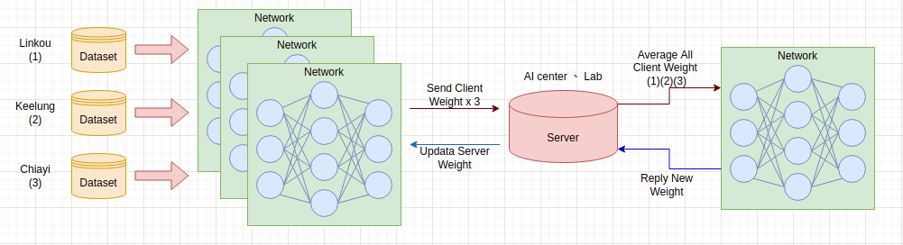
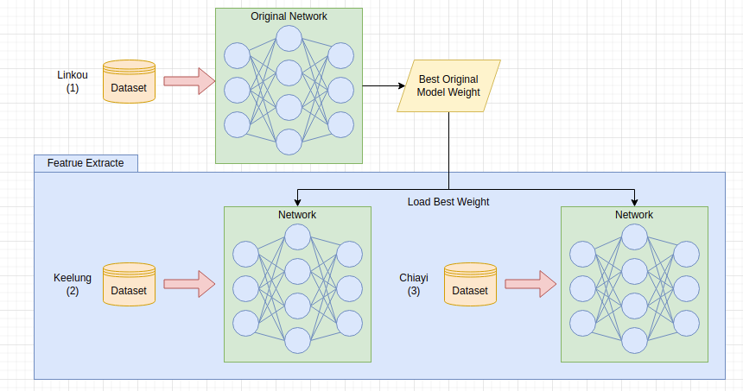
Federated Learning & Transfer Learning
Notes:
Federated vs transfer ?
baseline的結果 將原本555的wiehgts拿去驗證loc1,2,3
federated learning 加入freeze model type
average weight

Slide 2
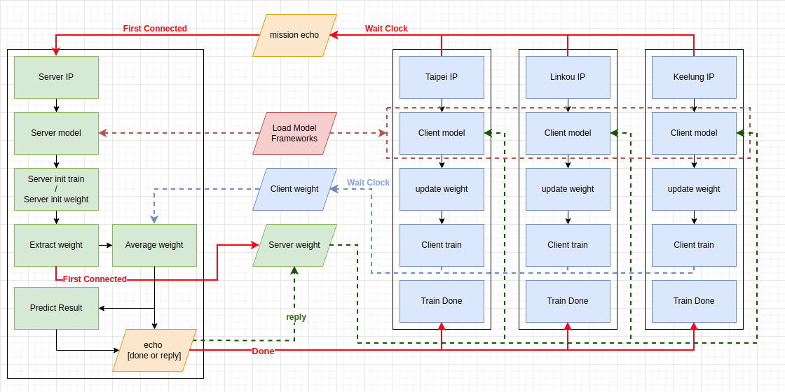
Federated Learning

Slide 3
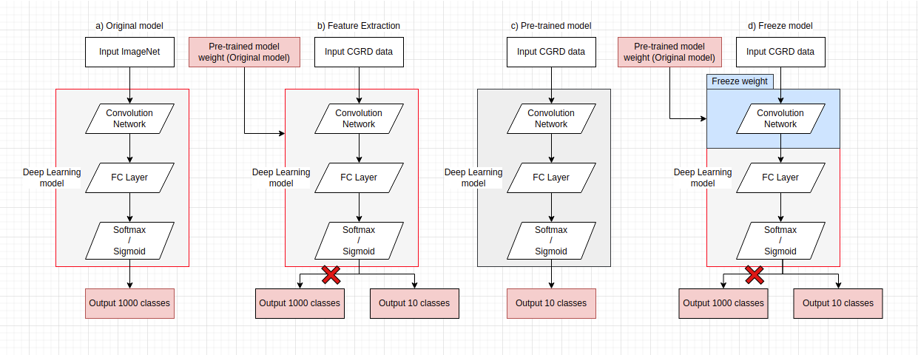
Transfer Learning

Slide 4
Sepsis - Survival&Mortality( Total ≒ 16300 )
Baseline - 514 : 41 (555)
Taipei - 1212:45 (1257)
Keelung - 1854:404 (2258)
Linkou - 10303:2491 (12794)

Slide 5
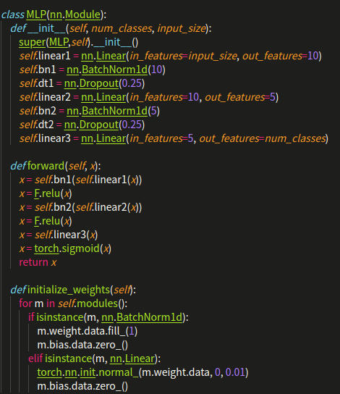
Model - MLP (Transfer & Federated)

Slide 6
BaseLine - Result
Dataset | Survival | Mortality | Train ACC | Train AUC | Test ACC | Test AUC
BaseLine - Loading 555 patient best model weight
Original | 514 patient | 41 patient | 0.9336 | 0.9062 | 0.9280 | 0.8914
Taipei | 1212 patient | 45 patient | - | - | 0.9649 | 0.7518
Keelung | 1854 patient | 404 patient | - | - | 0.8212 | 0.5769
Linkou | 10303 patient | 2491 patient | - | - | 0.8052 | 0.5606
Notes:
1.train & test none var process
2.

Slide 7
Transfer Learning (Feature Extraction) - Results
Brach | Survival(patient) | Mortality(patient) | Baseline AUC | TL Train AUC | TL Test AUC [IC]
Taipei | 1212 | 45 | 0.7518 | 0.8533 | 0.7611 [0.5135-0.9576]
Keelung | 1854 | 404 | 0.5769 | 0.8962 | 0.7056 [0.6360-0.7658]
Linkou | 10303 | 2491 | 0.5606 | 0.8295 | 0.8127 [0.7946-0.8318]

Slide 8
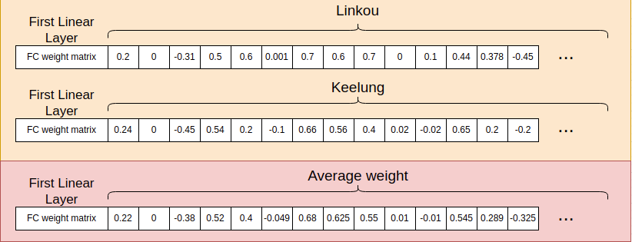
Average Weight

Slide 9
FL - 16300 Sample (Federated Learning)
Dataset | Survival | Mortality | Train ACC | Train AUC[IC] | Test ACC | Test AUC[IC]
Federated Learning - 3 LOC (Feature Extraction)
Server | 514 | 41 | 0.9976 | 0.9999 [0.990-1.000] | 0.9496 | 0.9364 [0.877-0.986]
Taipei | 1212 | 45 | 0.9639 | 0.8221 [0.750-0.890] | 0.9649 | 0.7026 [0.462-0.933]
Keelung | 1854 | 404 | 0.8600 | 0.8337 [0.808-0.859] | 0.8442 | 0.7881 [0.742-0.836]
Linkou | 10303 | 2491 | 0.8053 | 0.8209 [0.810-0.830] | 0.8052 | 0.8088 [0.791-0.826]
Federated Learning - 3 LOC (Freeze model)
Server | 514 | 41 | 0.9831 | 0.9999 [0.990-1.000] | 0.9424 | 0.7717 [0.517-0.971]
Taipei | 1212 | 45 | 0.9639 | 0.7852 [0.697-0.862] | 0.9649 | 0.7883 [0.570-0.957]
Keelung | 1854 | 404 | 0.8210 | 0.7420 [0.711-0.773] | 0.8212 | 0.7441 [0.697-0.798]
Linkou | 10303 | 2491 | 0.8185 | 0.7482 [0.735-0.761] | 0.8121 | 0.7539 [0.732-0.775]

Slide 10
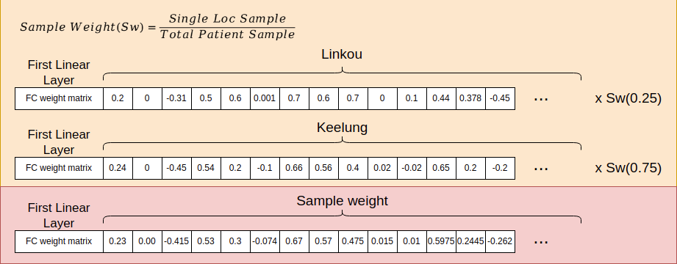
Sample Weight

Slide 11
Federated Learning - Sample Weight
Dataset | Survival | Mortality | Train ACC | Train AUC[IC] | Test ACC | Test AUC[IC]
Federated Learning - 3 LOC (Feature Extracte) [Average Weight]
Server | 514 | 41 | 0.9976 | 0.9999 [0.990-1.000] | 0.9496 | 0.9364 [0.877-0.986]
Taipei | 1212 | 45 | 0.9639 | 0.8221 [0.750-0.890] | 0.9649 | 0.7026 [0.462-0.933]
Keelung | 1854 | 404 | 0.8600 | 0.8337 [0.808-0.859] | 0.8442 | 0.7881 [0.742-0.836]
Linkou | 10303 | 2491 | 0.8053 | 0.8209 [0.810-0.830] | 0.8052 | 0.8088 [0.791-0.826]
Federated Learning - 3 LOC (Feature Extracte) [SampleWeight]
Server | 514 | 41 | 0.9254 | 0.9274 [0.868-0.946] | 0.9280 | 0.8883 [0.862-0.961]
Taipei | 1212 | 45 | 0.9639 | 0.8073 [0.723-0.881] | 0.9649 | 0.7830 [0.585-0.951]
Keelung | 1854 | 404 | 0.8210 | 0.7931 [0.767-0.826] | 0.8212 | 0.7743 [0.719-0.819]
Linkou | 10303 | 2491 | 0.8053 | 0.8206 [0.805-0.826] | 0.8052 | 0.8150 [0.794-0.831]

