Slide 1
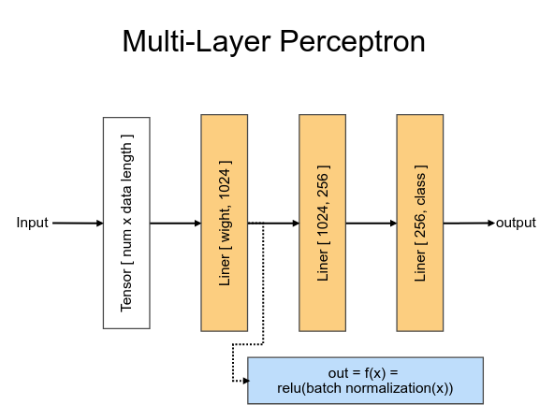
MLP Model

Slide 2
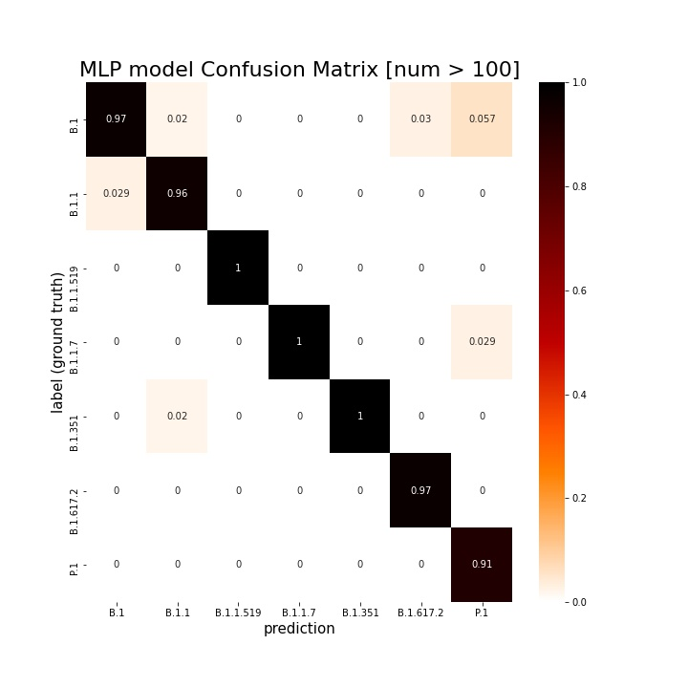
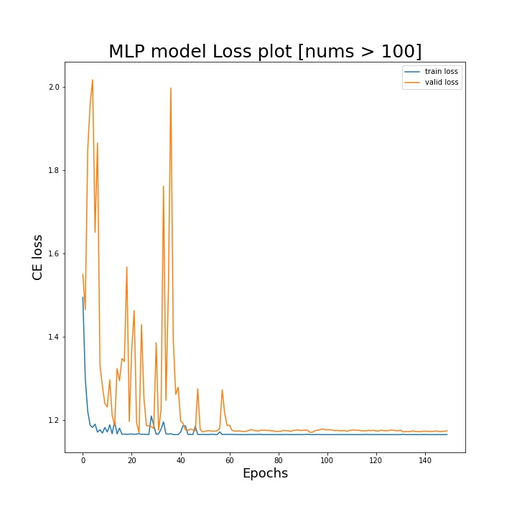
MLP SARS CoV2 - class nums sum >100

Slide 3
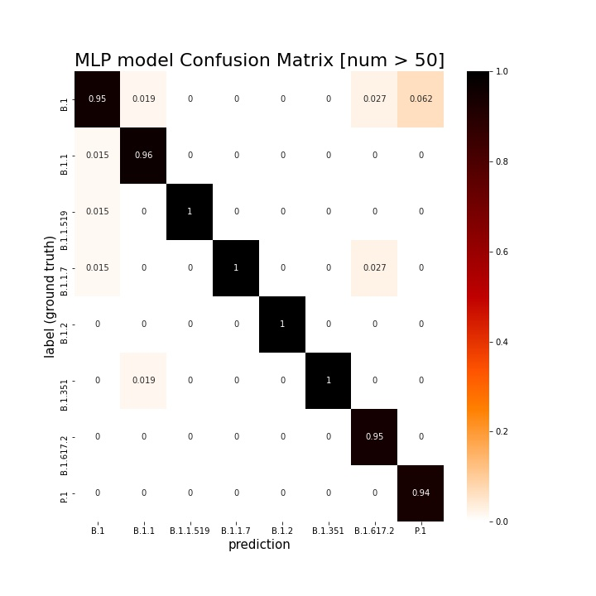
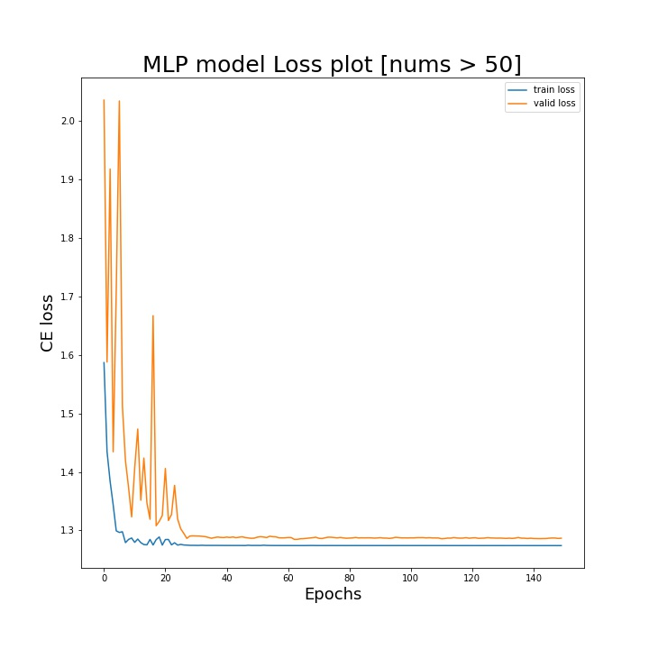
MLP SARS CoV2 - class nums sum >50

Slide 4
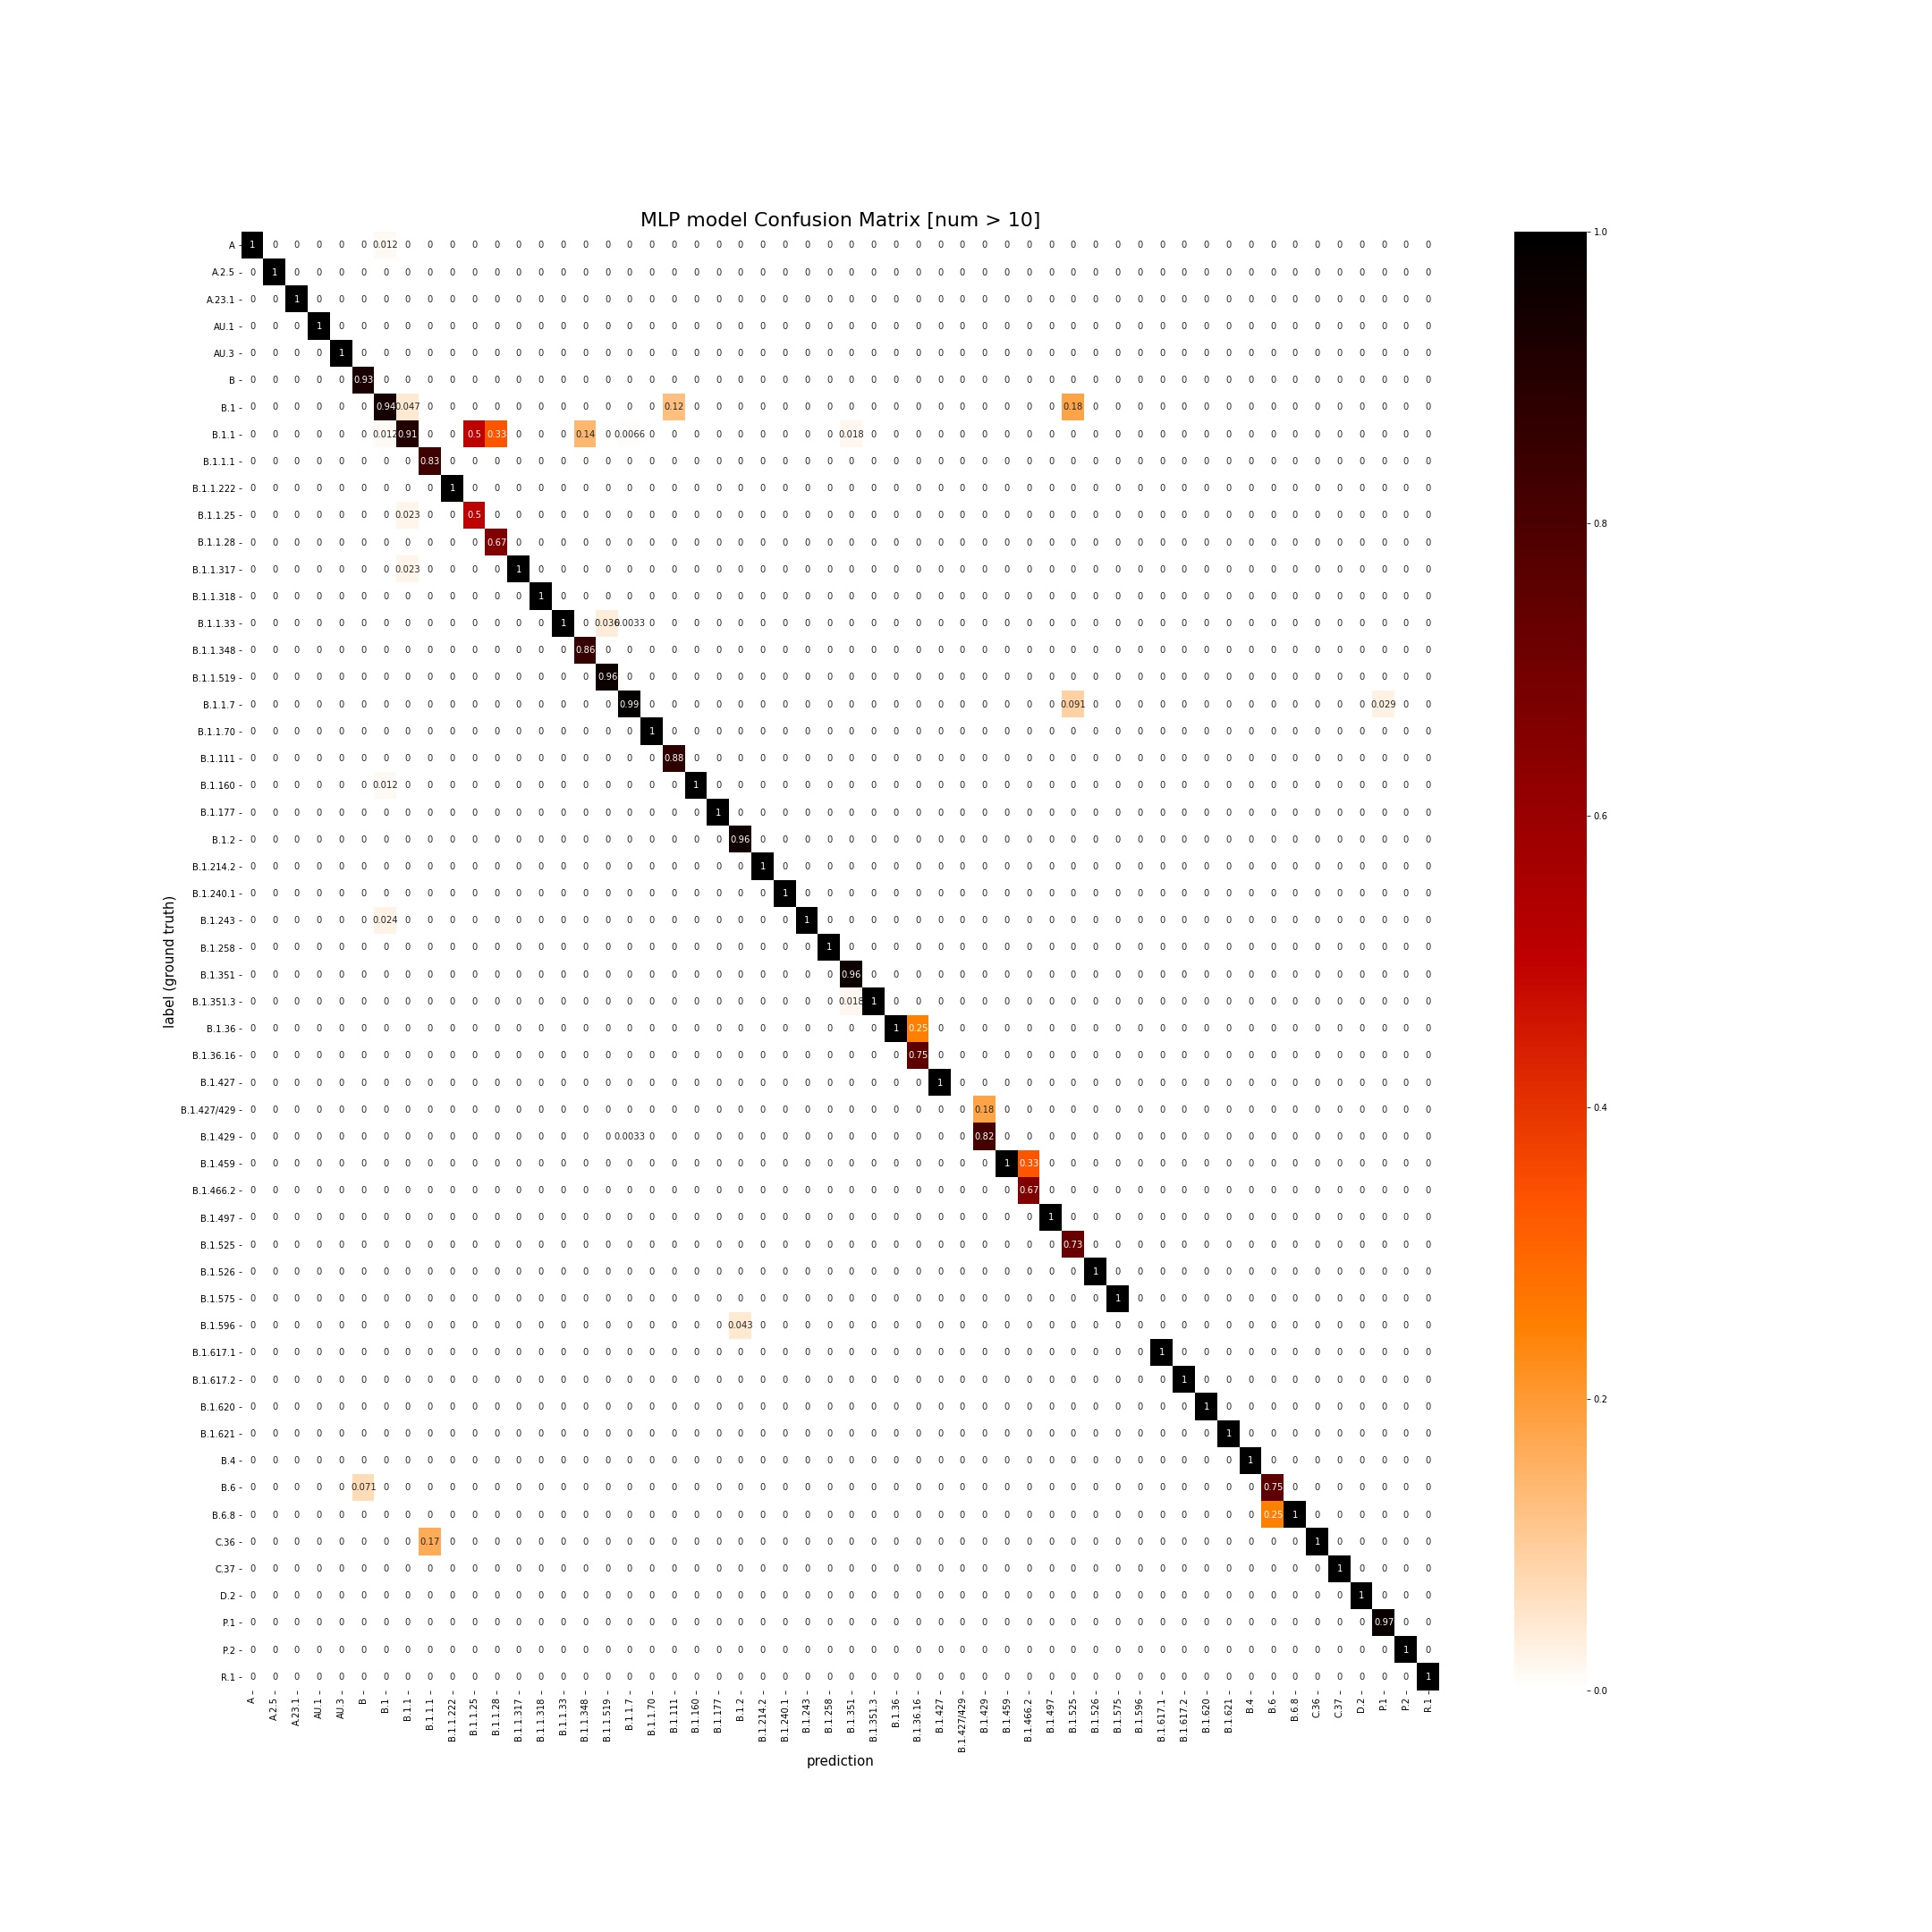
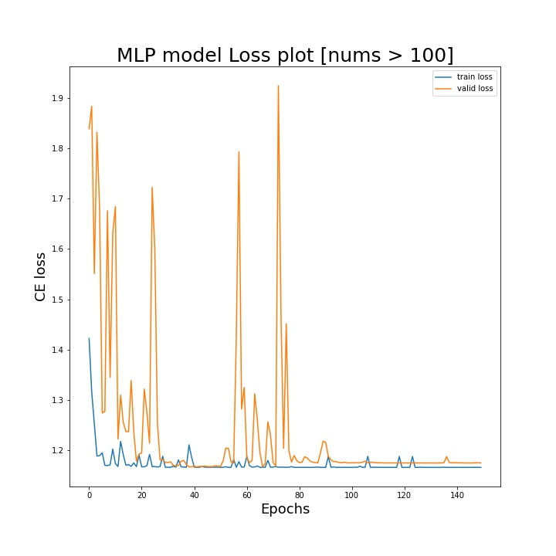
MLP SARS CoV2 - class nums sum >10

Slide 5
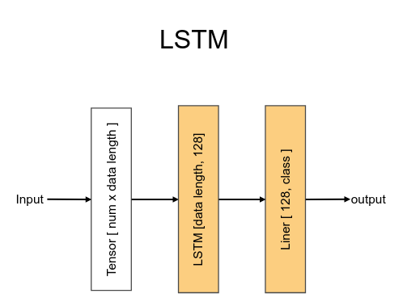
LSTM Model

Slide 6
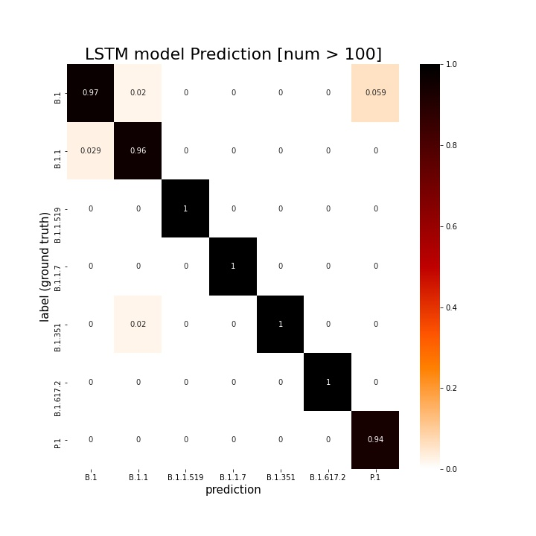
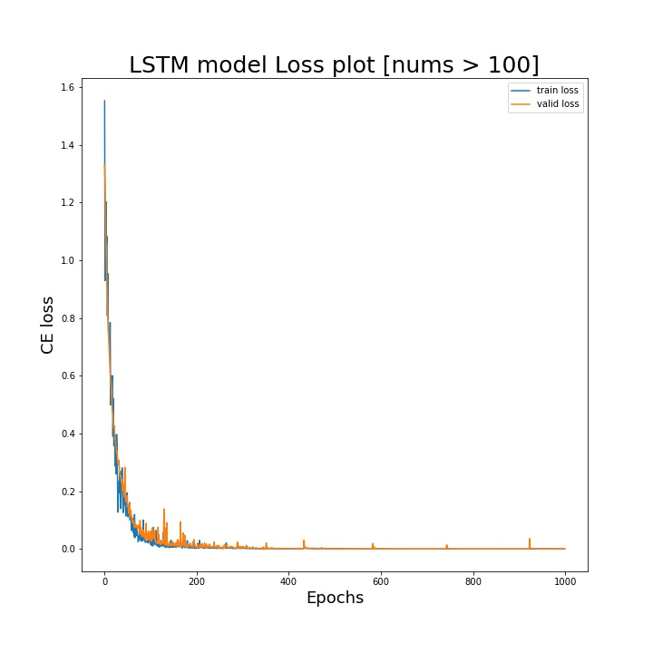
LSTM SARS CoV2 - class nums sum >100

Slide 7
 | nums>10 | nums>50 | nums>100
 | MLP
Train Accuracy(Original) | 0.996774194 | 0.996013667 | 0.995283019
Train Accuracy(Week) | 0.998790323 | 1 | 1
Valid Accuracy(Original) | 0.933814681 | 0.971039182 | 0.982332155
Valid Accuracy(Week) | 0.959085439 | 0.989761092 | 0.989399293
 | LSTM
Train Accuracy(Original) | 0.991935484 | 1 | 1
Train Accuracy(Week) | 1 | 1 | 1
Valid Accuracy(Original) | 0.924187726 | 0.98637138 | 0.987632509
Valid Accuracy(Week) | 0.959085439 | 0.991467577 | 0.989399293

Slide 8
 | nums>10 |  | nums>50 |  | nums>100
 | K - fold (LSTM)
Train Accuracy(Week) | 0.998 - 1.000 | 0.999 | 1.000 - 1.000 | 1.000 | 1.000 - 1.000 | 1.000
Valid Accuracy(Week) | 0.954 - 0.962 | 0.960 | 0.980 - 0.993 | 0.988 | 0.984 - 0.995 | 0.990

