Slide 1
NLP Report

Slide 2

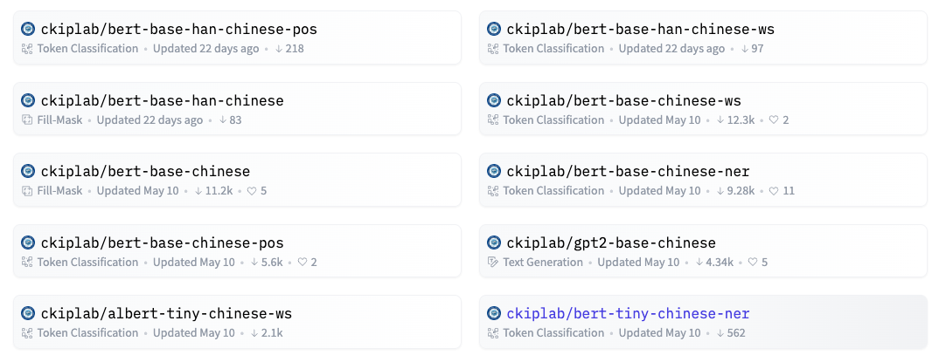
CKIP Lab

Slide 3
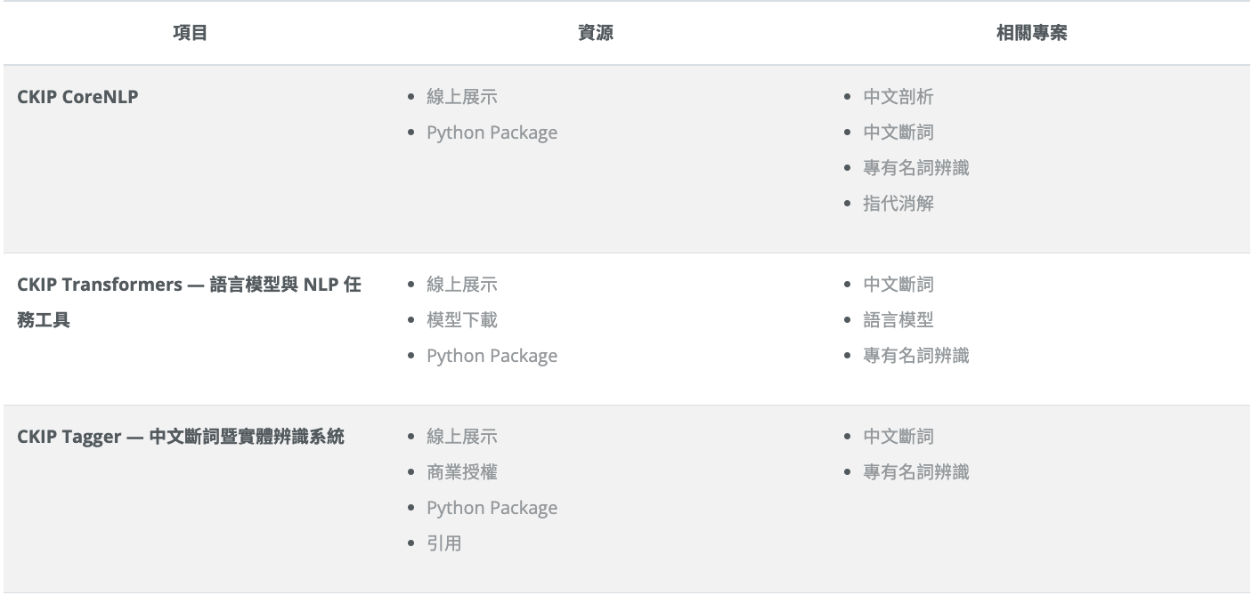
CKIP Lab

Slide 4
CKIP Lab

Slide 5
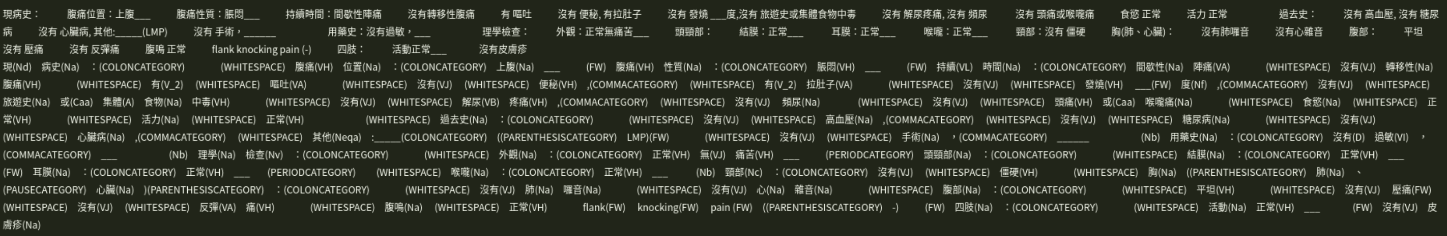
CKIP Lab

Slide 6
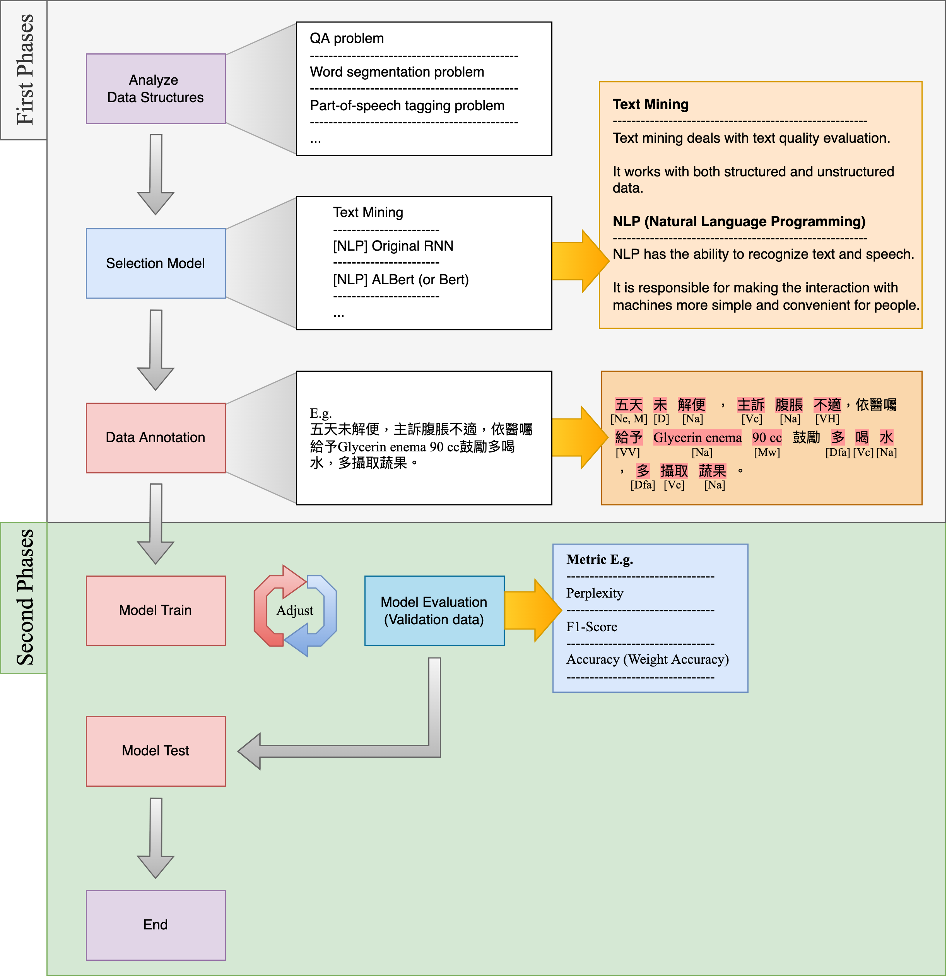
About NLP and Text Mining
Notes:
尋找中文病歷護理紀錄ＮＬＰ如何運作

Slide 7
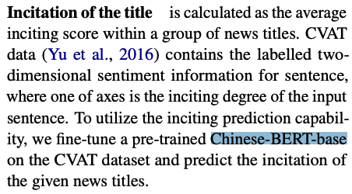

Chinese bert base

Slide 8

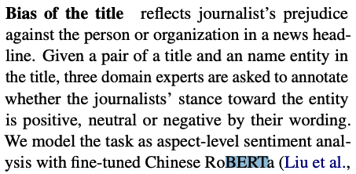
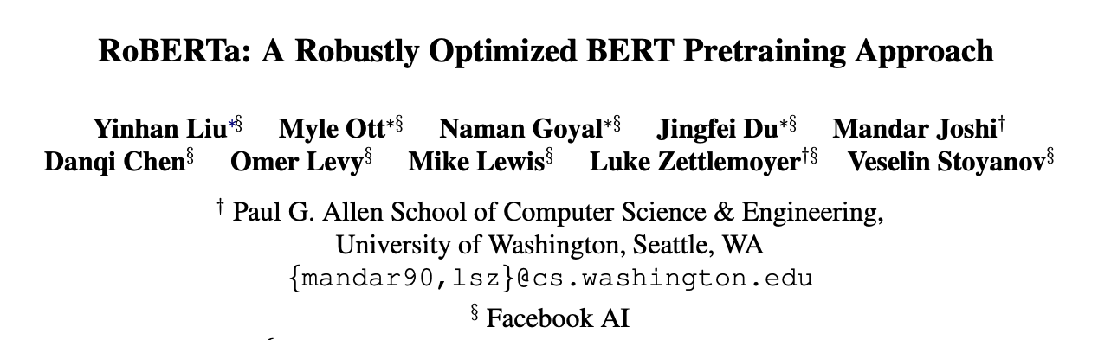
ROBERTA

Slide 9
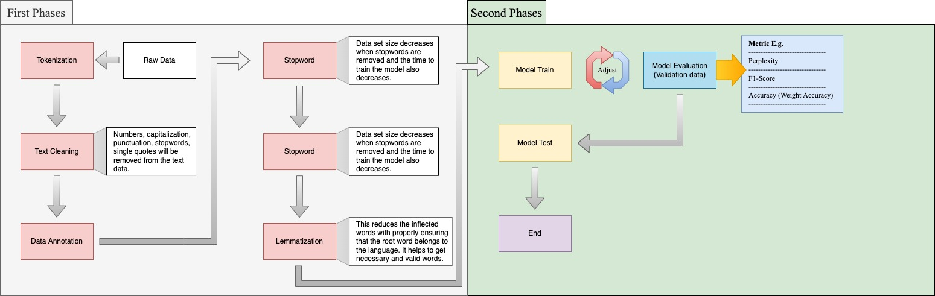
Basic Steps In Natural Language Processing Pipeline

Slide 10

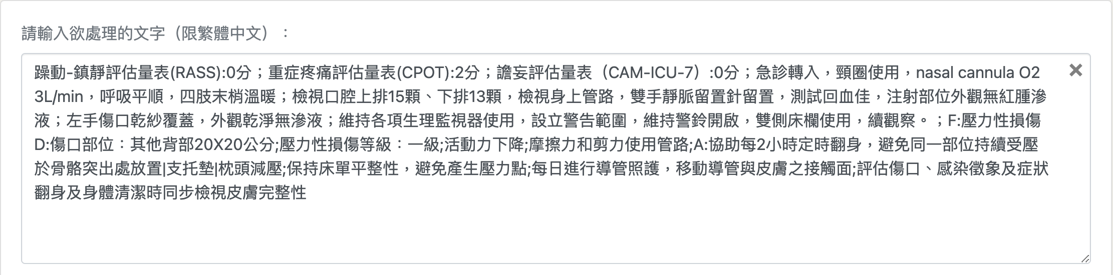
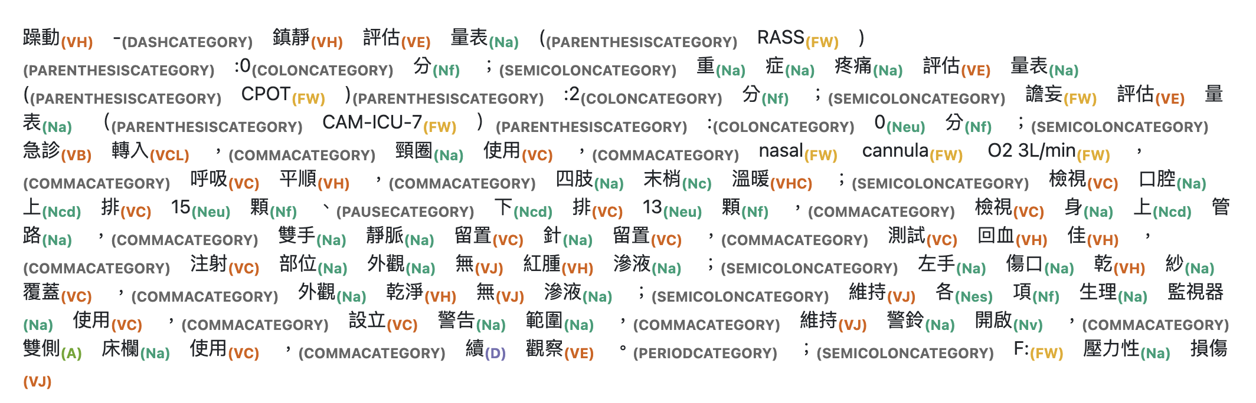
Demo – Chinese base bert 1

Slide 11
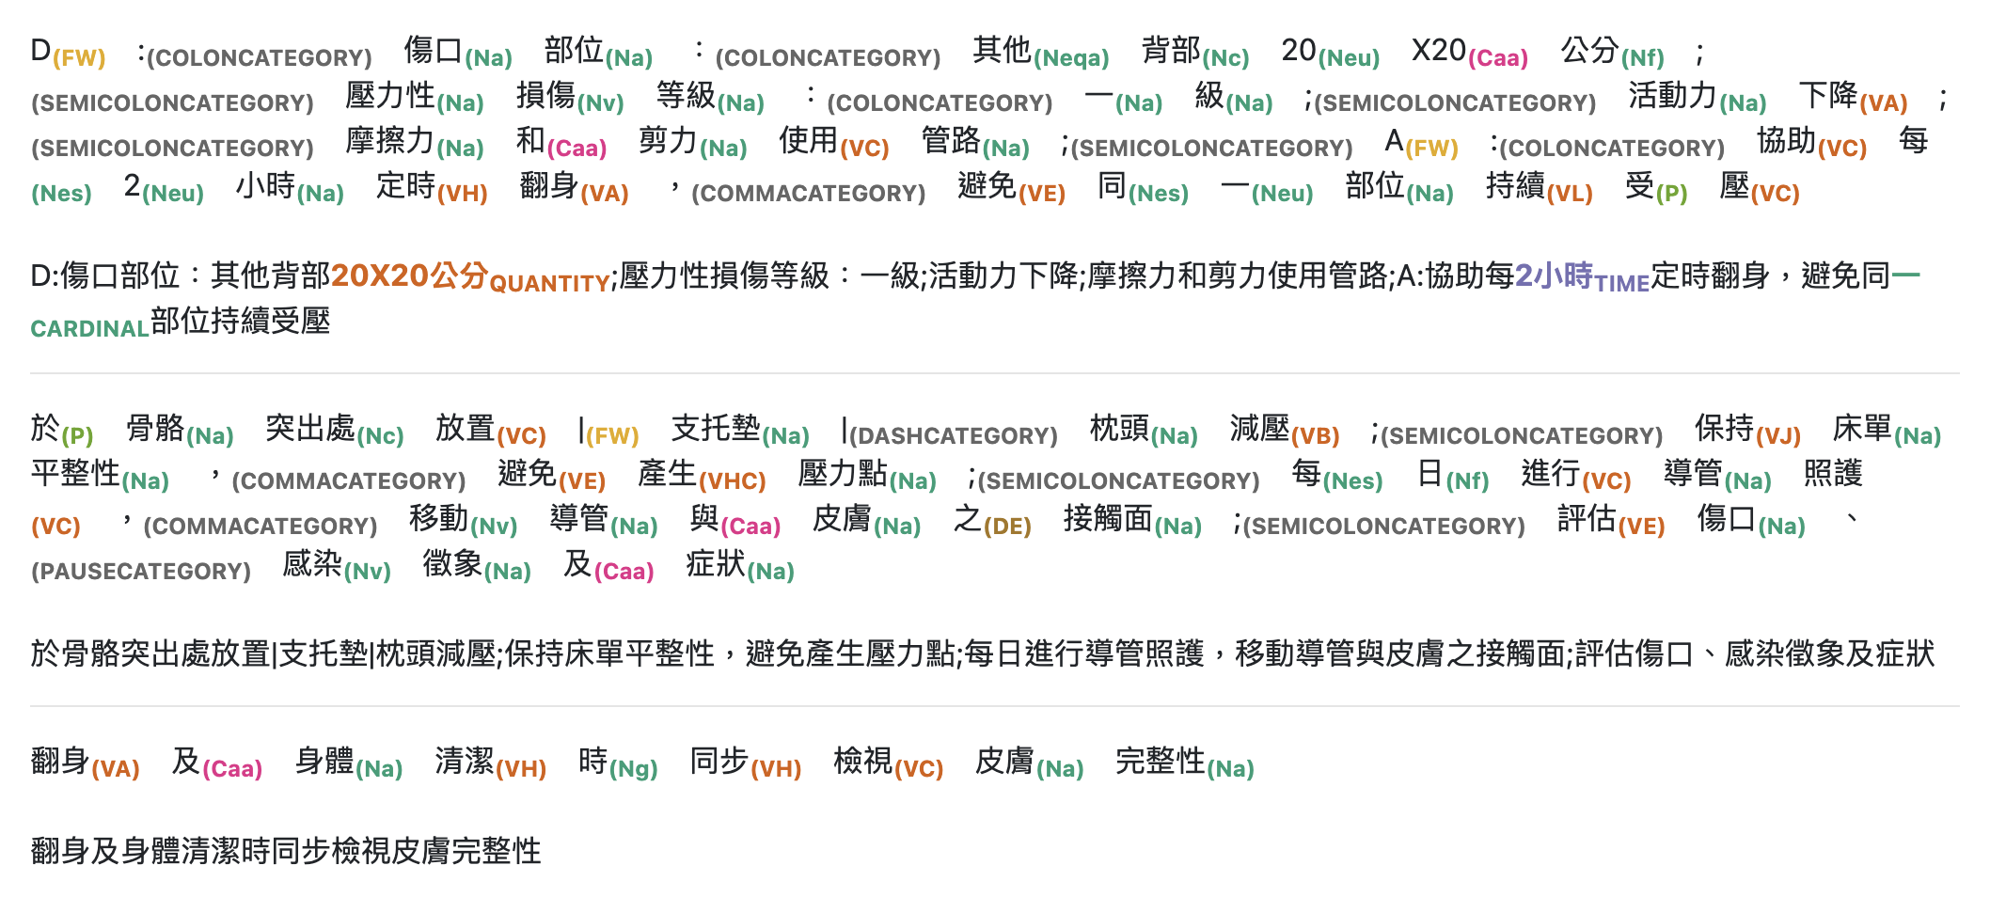
Demo – Chinese base bert 2

