Slide 1

SGD-PLUS Dischange NIHSS Predict

Slide 2
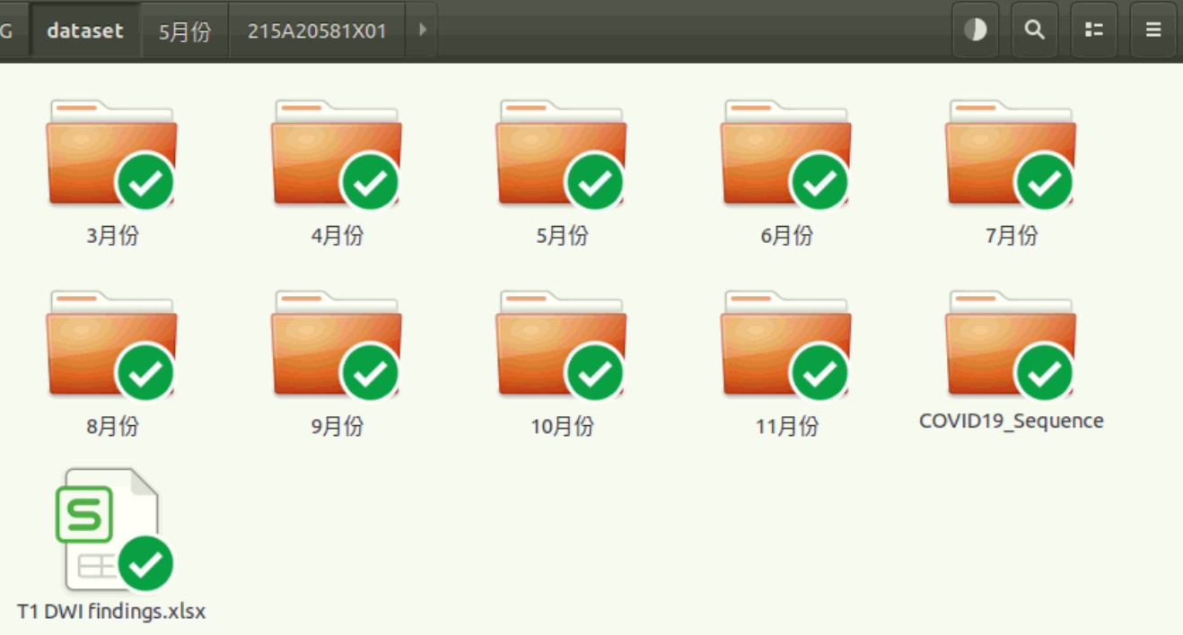
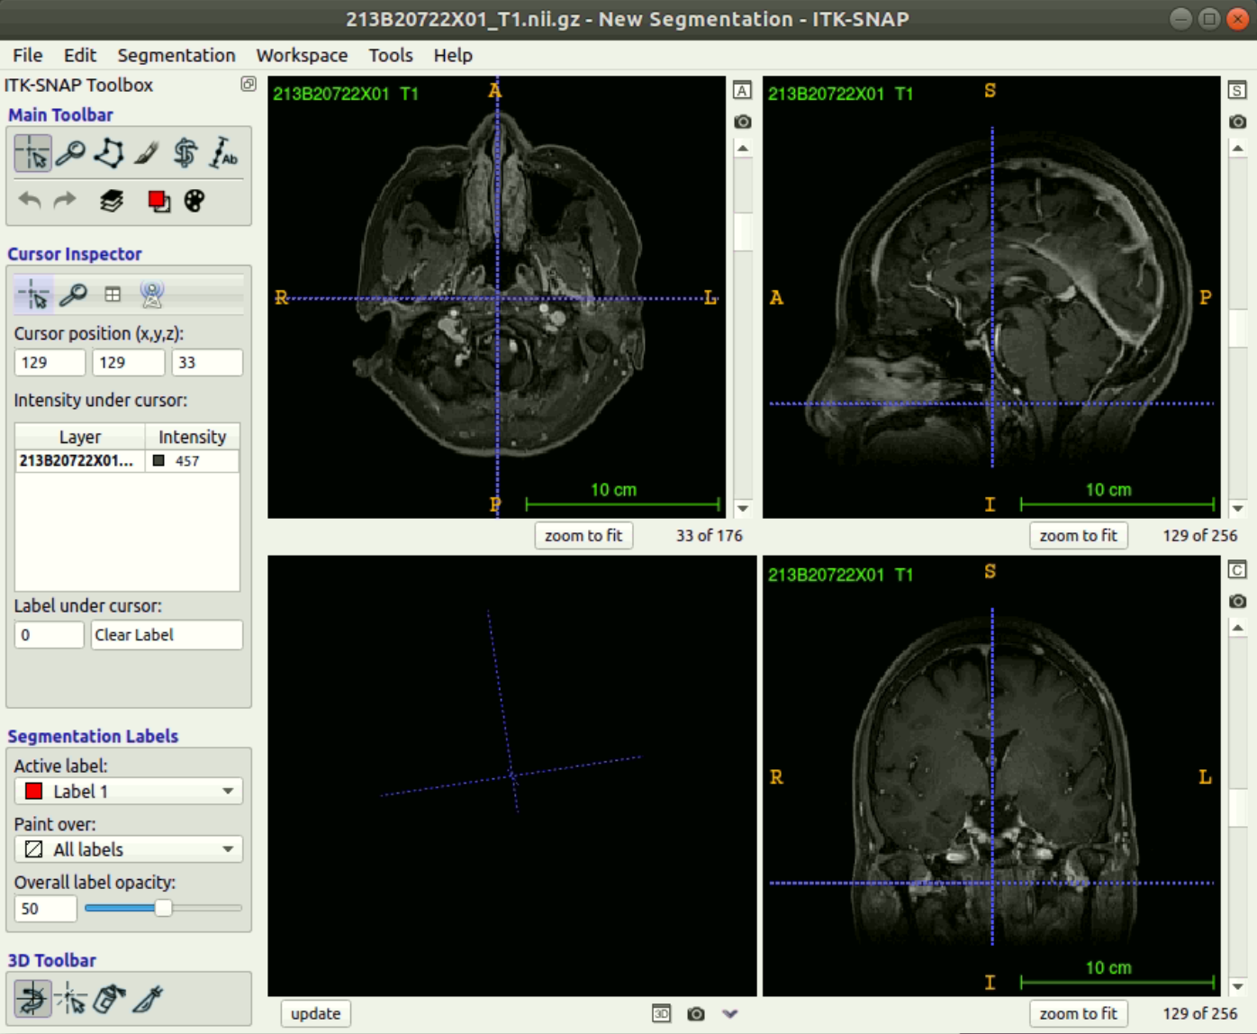
New data DWI & T1

