Slide 1
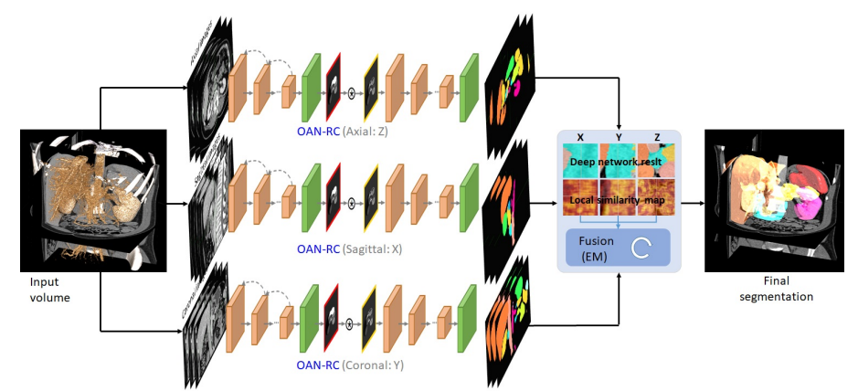
3D Multi-organ Segmentation Abdominal Multi-organ Segmentation with Organ-Attention Networks and Statistical Fusion.
2D-3D
add attenation layer or lstm make time series
Multi-Fusion Model[x, y, z] - Result by vote.

Slide 2
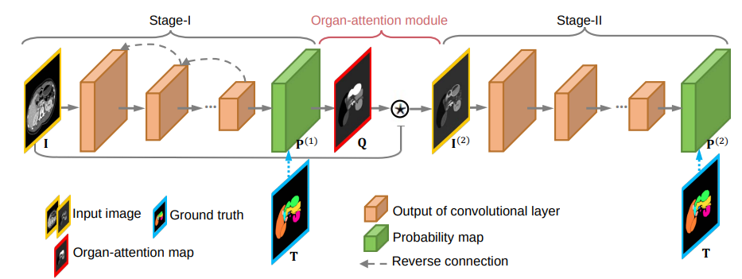
Concate attention layer

Slide 3
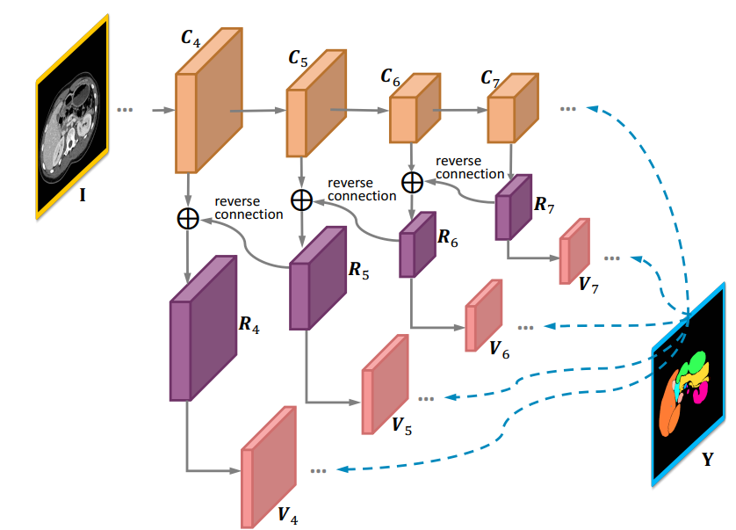
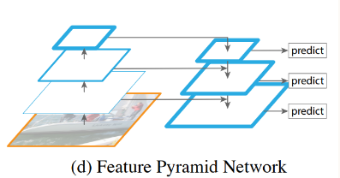
FPN ? - Feature Pyramid Networks

Slide 4
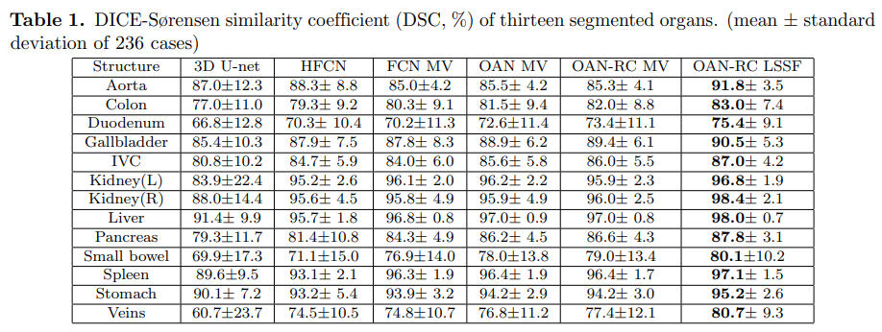
Performance

