Slide 1
UIUC datathon 2023

Slide 2
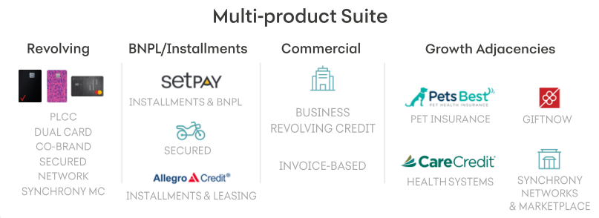

What is Synchrony?
We are a premier consumer financial services company delivering one of the industry's most complete, digitally-enabled product suites.
PUBLIC

Slide 3
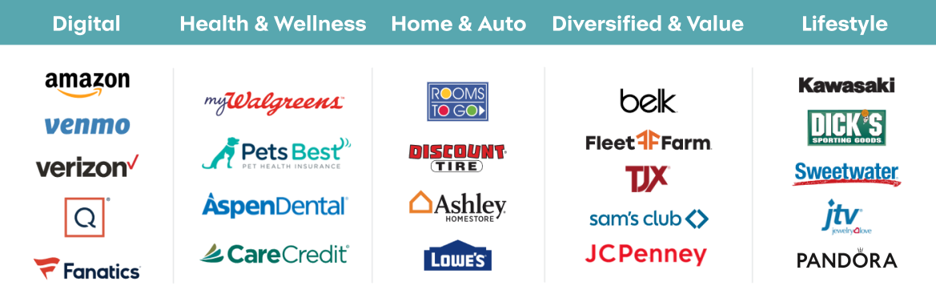
Where is Synchrony?
We have an established and diverse group of national and regional retailers, local merchants, manufacturers, buying groups, industry associations and healthcare service providers, which we refer to as our “partners.”
PUBLIC

Slide 4
Problem Statement
In the financial industry, credit charge offs are a crucial metric to measure as they directly impact the health of the institution. A charge off occurs when a customer fails to make payment and eventually is written off as a loss. With that, it is increasingly important for banks to accurately forecast their charge offs in order to make informed decisions for the future.
Based on customer and macroeconomic data, forecast an accurate number of monthly charge offs over the period of February 2020 thru January 2021.

Slide 5
Key Terms
Delinquency
A loan becomes delinquent when it does not provide the required payment by the contractual date
Charge-Off
The amount of money the bank has deemed uncollectible from a defaulted loan
Default
A loan goes into default after missing payments after a set number of days or other life events (e.g., Bankruptcy)
Probability of Default
Probability of a given customer/cohort defaulting on their credit
Marginal Probability of Default
Probability of defaulting during a period of time (conditional on not having defaulted prior to this period)
In other words, probability of default during n-th month from the perspective of today

Slide 6
Suggestions
You should provide the rationale as to why a certain model was chosen and show understanding of how different features impact the model
Your model should be tuned to fit different types of macroeconomic scenarios
Finally, a good pitch combines data, storytelling, and awareness of the business goals
We recommend Python for solving this problem. Helpful packages:
Pandas
Numpy
Scikit-Learn
Matplotlib
Stats Models
Finally, a good pitch combines data, storytelling, and awareness of the business goals

Slide 7
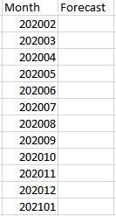
Deliverables
1. Max 7-Minute Video
2. Presentation
Sell us your recommendations and modeling approach in an elevator – why should we care and what did you learn?
Link sent in a Readme file
You will provide an overview of your unique solution to the problem including how and why it works.
3. Model Prediction Results
4. Code
Give us your model output on a CSV file containing monthly forecasts for 02/2020-01/2021.
We want to be able to replicate your results as well as understand your approach to modeling.

Slide 8
Video Submission Criteria
A 7-minute (MAXIMUM) pitch video
Can be structured however you would like to showcase approach/modeling/results
Highlight key points for data manipulation and engineering
Incorporate what you have learned during this process both technically and socially (working with a team)
Only 1 person required to be in the video
Create an unlisted YouTube video and provide link in a Readme file with submission package

Slide 9
Judging Criteria
All deliverables will be taken into consideration during judging. The following criteria will be on a 5-point scale and will be weighted equally.
ACCURACY
METHOD
PRESENTATION
Based on accuracy metric of RMSE
Accounts for the possibility of skewed data
Model fit and techniques
Explainable approach
Solution addresses given business problem
Innovative approach
Engaging presentation
Clear, thoughtful explanations
Supportive visualizations
Sandia will be awarding a prize based on best visualizations

Slide 10
Rules
All teams must submit by 8:00 AM on Sunday. No exceptions will be provided.
Any submission without all 4 deliverables will not be counted.
We are looking for clarity and ability to solve both business and data science questions together and not for flashiness of submissions. Work on what counts.
Teams can leverage any publicly available data for model creation in addition to provided data, however, understand the impact of inaccurate 3rd party data.
Teams can utilize any tools and/or libraries for this task but must provide links for those tools in their code deliverable (documentation pages)
Teams are not allowed to ask anyone outside of mentors or their own team for help. Please do your own work as this is a learning opportunity first and foremost.
Be courteous to your peers as you work.
Have fun and get to know your peers and mentors!

