Slide 1
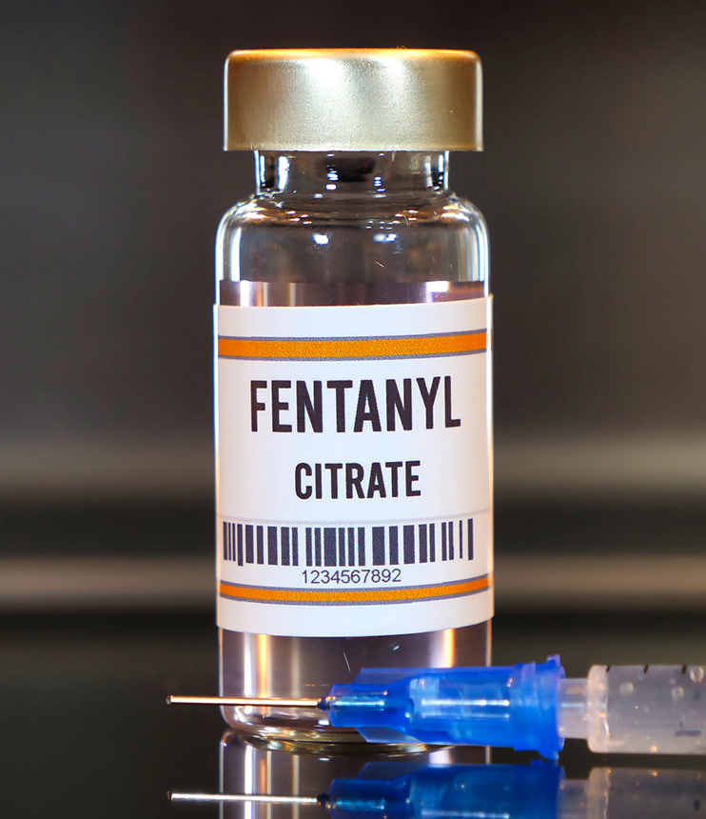
Opioid Epidemic
Presented by: Ilissa Garcia
Notes:
Line spacing + Page numbers

Slide 2
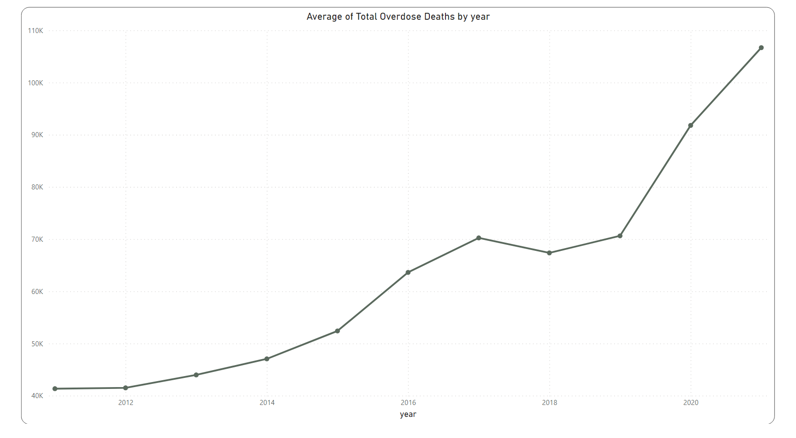
Total Overdose Deaths by Year
Notes:
Average of total overdose deaths by year from 2011 to 2021. There is a clear upward trend in the average number of deaths. Starting at around 40,000 deaths in 2011, there's a gradual increase each year, with a slight plateau around 2018. However, by 2021, the average dramatically spikes to just over 110,000 deaths. This sharp increase at the end of the graph highlights a severe escalation in this public health issue during that year.
In 2020, an average of 44 people died each day from overdoses involving opioids.
In 2021, an average of 220 people died each day from Opioids.

Slide 3
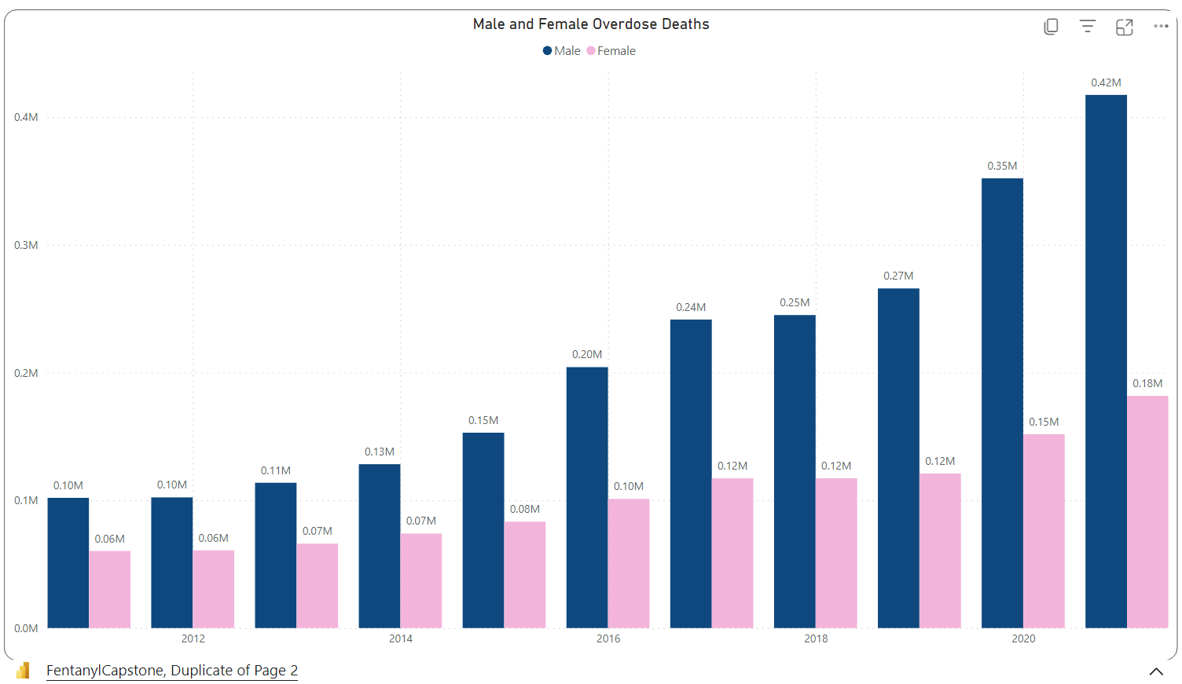
Male and Female Total Overdoses by Year
Notes:
2011-2021
The bar graph displays male and female overdose deaths from 2011 to 2020. It shows a consistent increase in overdose deaths for both genders over the years. In every year male overdose deaths outnumber female deaths. This trend of higher male fatalities continues throughout the years, with a notable jump in male overdose deaths in 2020, reaching 0.42 million, while female overdose deaths also increased but to a lesser extent, at 0.18 million.

Slide 4
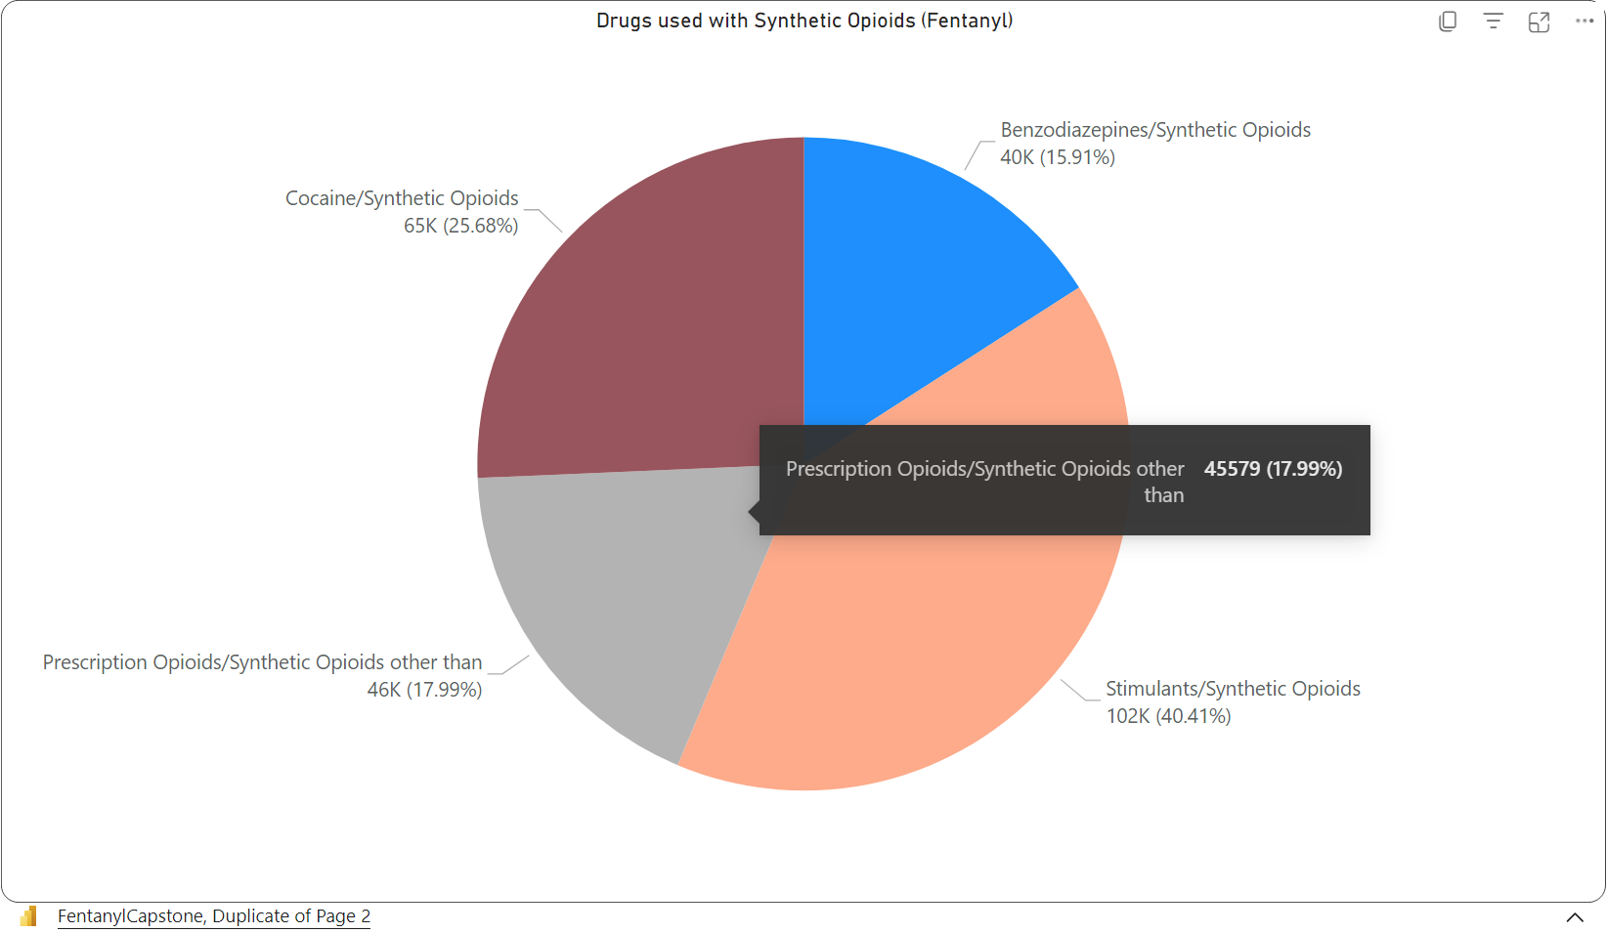
Percentage of other drugs used with Synthetic Opioids (Fentanyl)
Notes:
Pie – 2011-2021
This pie chart presents data on the use of various drugs in combination with synthetic opioids, particularly Fentanyl and the corresponding amount of overdose deaths. The largest portion of the chart shows that Stimulants are most commonly used with synthetic opioids, accounting for 40.41% of the total. Prescription Opioids combined with synthetic opioids other than Fentanyl account for 17.99% of the total. The smallest segment shows that Benzodiazepines are used with synthetic opioids which is 15.91% of the total.

Slide 5
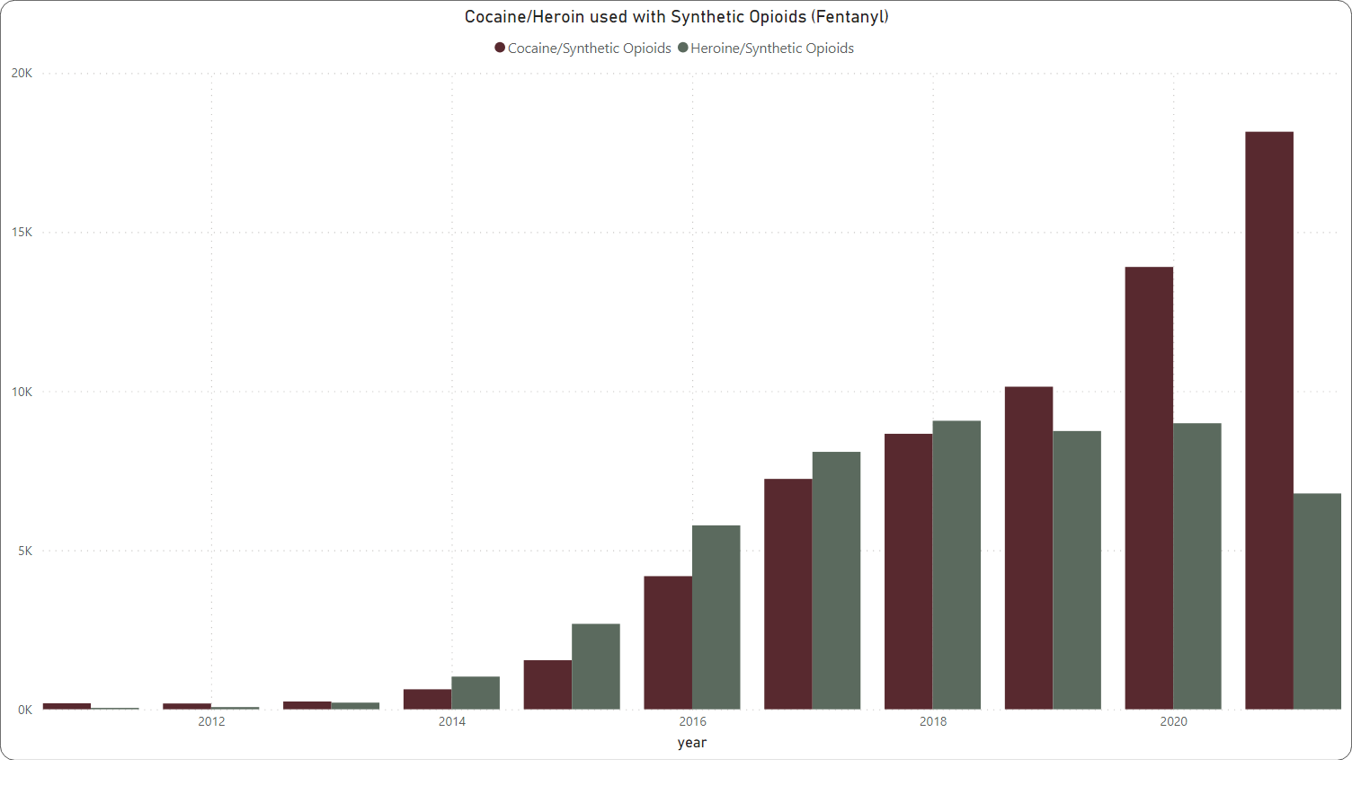
Cocaine/Heroin used with Synthetic Opioids (Fentanyl)
Notes:
This bar chart indicates the number of deaths from cocaine/heroin used with synthetic opioids (presumably Fentanyl) from 2011 to 2021. It appears that deaths from cocaine used with synthetic opioids increase over time, but not as drastically as heroin used with synthetic opioids, which shows a more significant and steady increase throughout the years.
This demonstrates that while overdose deaths from cocaine and heroin with synthetic opioids are a significant concern, they are part of a larger trend of increasing overdose fatalities.

Slide 6
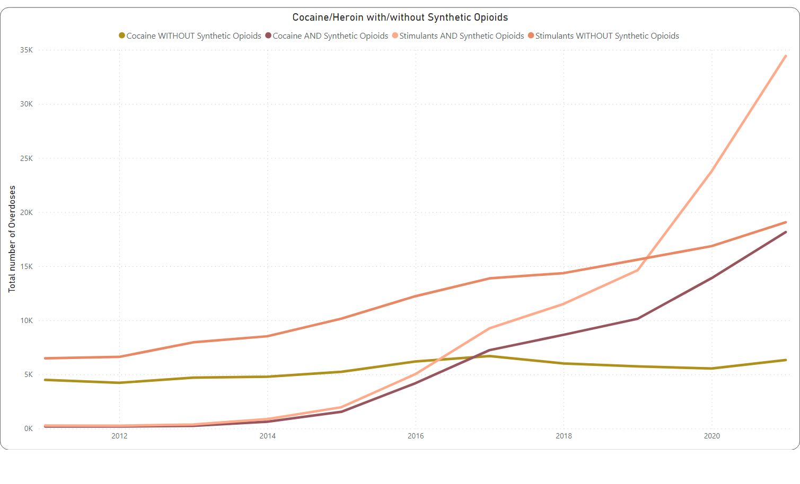
Cocaine/Heroin with/without Synthetic Opioids
Notes:
We can see that the use of cocaine and stimulants without synthetic opioids remains relatively stable and low compared to the use of these substances with synthetic opioids. Particularly, the trend for stimulants with synthetic opioids shows a drastic increase, surpassing the other categories, especially from 2016 onwards.
The last chart presented a combined view of cocaine/heroin used with synthetic opioids against the total overdose deaths, showing a direct comparison within the same category of drugs. This graph, however, breaks down the use of cocaine and stimulants with and without synthetic opioids, providing a different view of how the combination with synthetic opioids is driving the increase in overdose deaths.

Slide 7
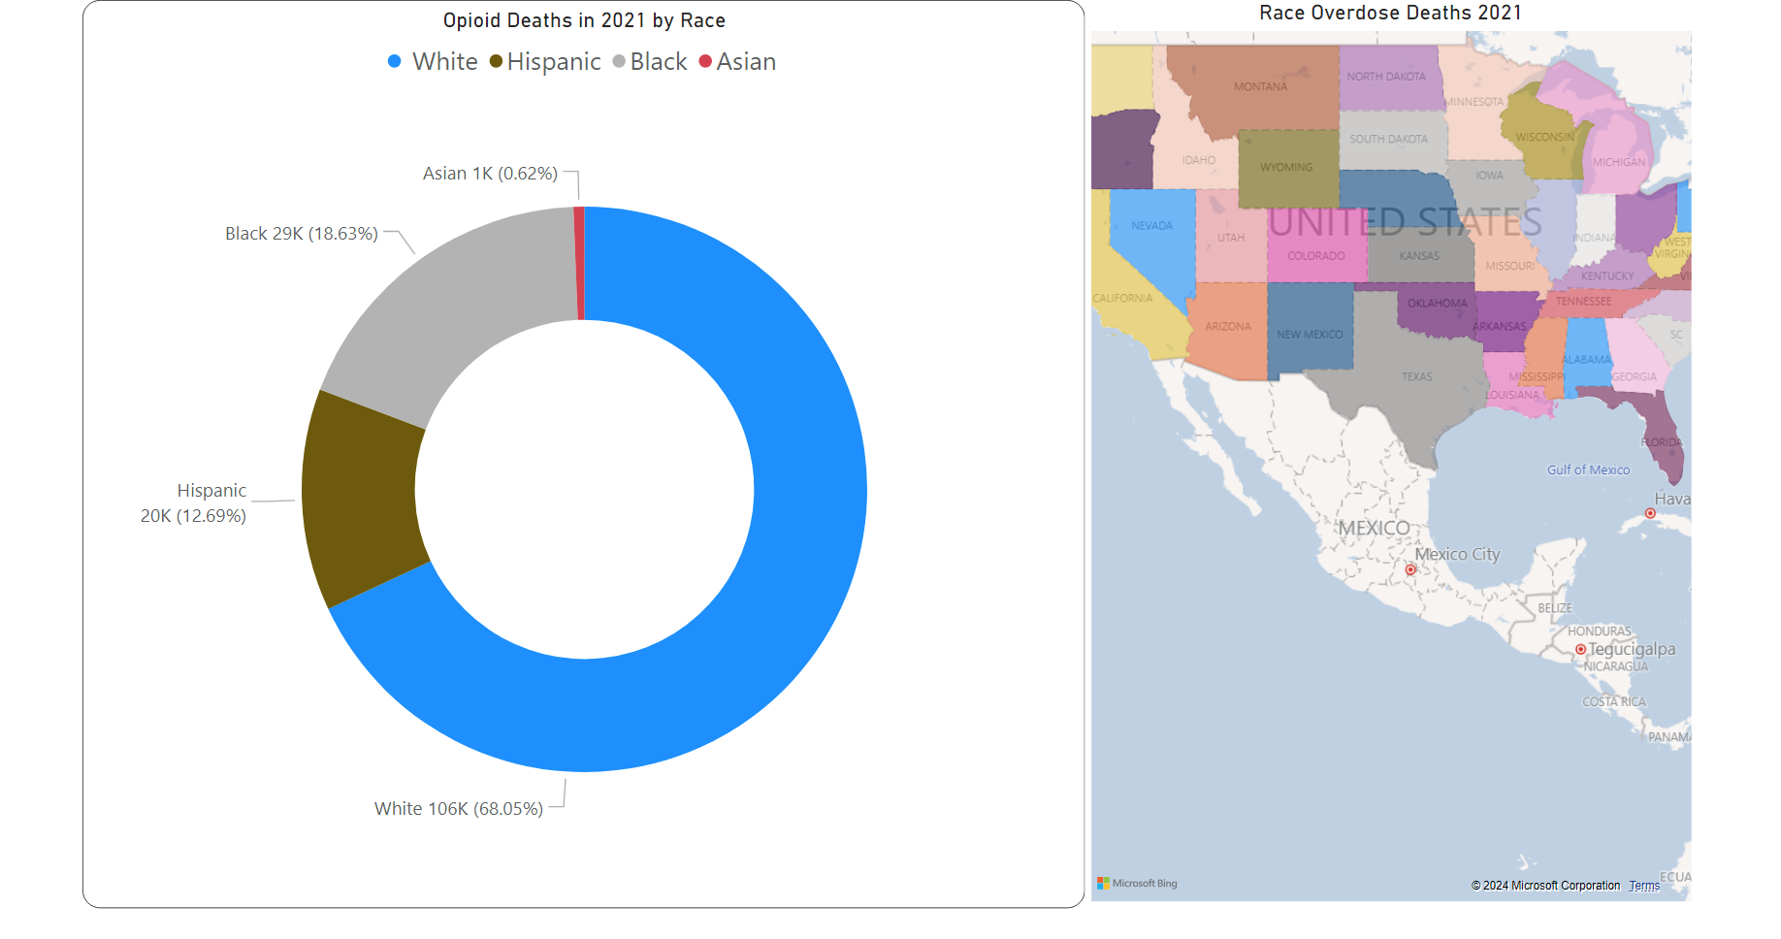
Notes:
The donut chart shows opioid-related deaths in 2021 by race. White individuals with the largest proportion, at 68.05%, followed by Black individuals at 18.63%, and Hispanic individuals, who appear to make up just over 10%. Asian individuals have the smallest share.
Currently, 71% of preventable opioid deaths occur among those ages 25 to 54, and the number of deaths among individuals 55 and older is growing rapidly.

Slide 8
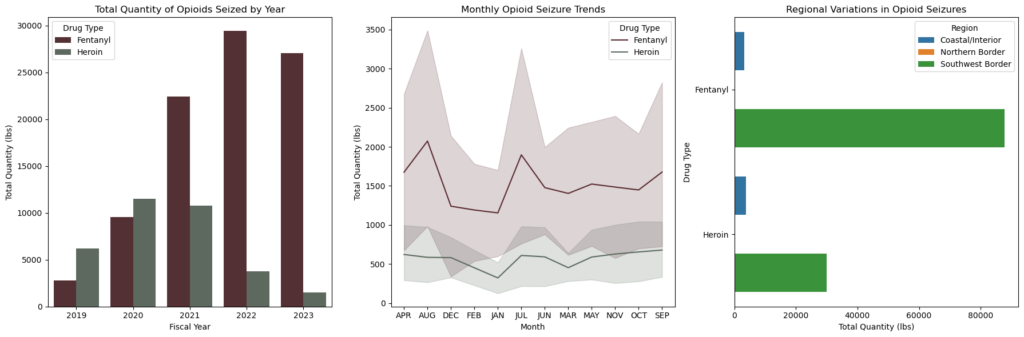



Total Quantity of Opioids Seized by Year
Regional Variations in Opioid Seizures
Coastal/Interior border
Southwest Border
Notes:
From 2020 to 2022, the amount of Fentanyl confiscated at the Mexico-U.S. border rose significantly, by 164%. In 2023 they have already seized approximately 21,846 pounds (or around 9,909 kilograms) of Fentanyl, exceeding the total amount captured in the previous year, which was about 14,104 pounds (or around 6,397 kilograms). The majority of these seizures took place in California and Arizona.

Slide 9
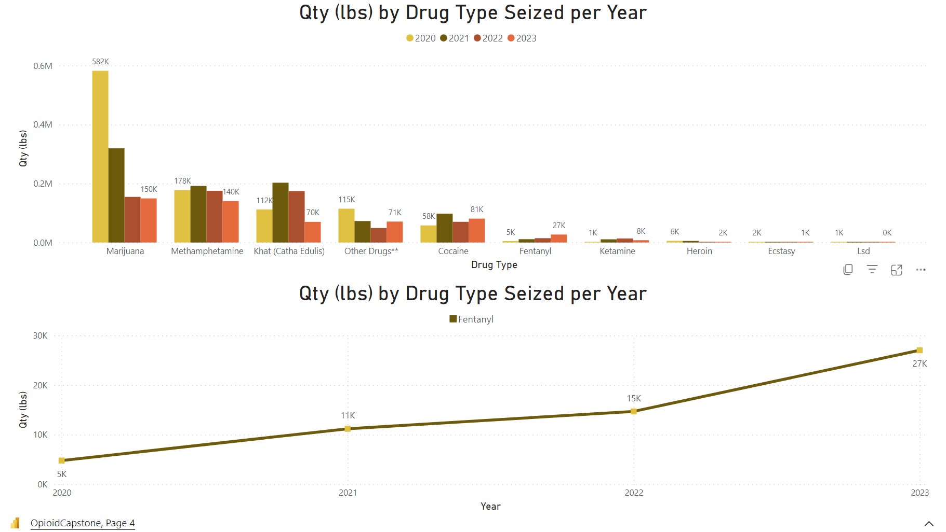
Notes:
these graphs illustrate that while marijuana and methamphetamine are the most seized drugs, the seizure of fentanyl is rapidly increasing, suggesting it is becoming a more significant part of the drug smuggling issue at the border.

Slide 10
Prescription drug monitoring programs (PDMPs)
Prescription Drug Monitoring Programs (PDMPs) are digital systems managed by state agencies.
They keep track of how controlled substances, like prescription drugs, are prescribed and given out.
Law enforcement can use them to spot illegal drug distribution or places that over-prescribe drugs.
PDMPs can reduce both the amount and number of opioid prescriptions.
States with PDMPs often see less opioid misuse and fewer hospital admissions due to opioid-related issues compared to states without PDMPs.
Experts suggest that PDMPs should be easy to use, accessible across states, open for all prescribers to register, include mandatory reporting from pharmacies, undergo regular evaluations, and be required in EDs.
Benefits
Reduced Overdose Deaths
Reduced Elicit Drug use

Slide 11

Conclusion
Notes:
In conclusion, this capstone project sheds light on critical aspects of the Opioid crisis. My analysis revealed trends of opioid-related incidents, demographic factors influencing vulnerability. These findings underscore the urgent need for comprehensive strategies and targeted interventions to combat this health crisis effectively. To mitigate its devastating impact, policymakers, law enforcement agencies, healthcare providers, and community organizations should work collaboratively.

