Slide 1
Command Line Tips CSS 475

Slide 2
A common problem
Student having trouble working on the command line. Mostly with understanding how to find files.
My suspicion is that some in the class are not as knowledgeable about how file paths work as they need to be
Let’s take a few moments to look at the subject

Slide 3
Directory Structure
One of the important concepts that Unix brought to the plate was the idea of Directories and Files.
And a file is just a stream of bites.
The idea is how organize the files on your disk ( instead of just having a big basket of all of the files )

Slide 4
Assumption
You have a laptop you will be using in this course
The laptop is either a Mac or Windows machine
Anyone not in one of these two camps?
How many of you in which camp?

Slide 5
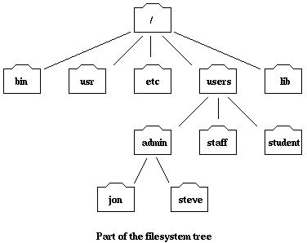
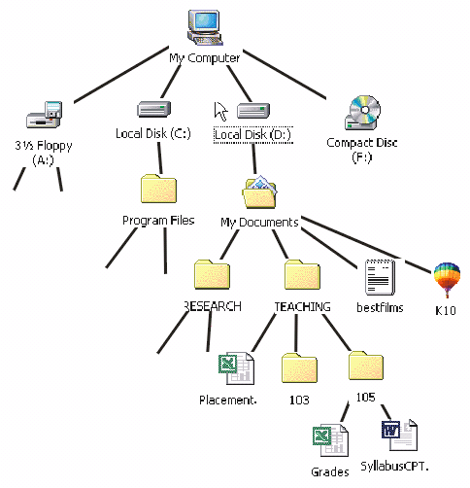
How are files on the disk organized? Logically not physically

Slide 6
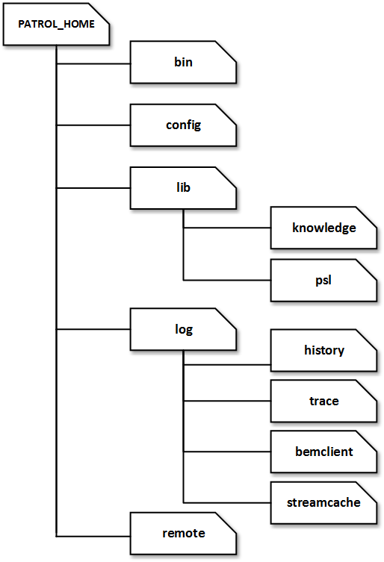
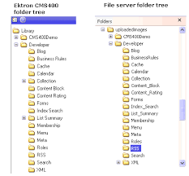
Directory Images

Slide 7
Pictures are a visual representation
They are as real as (if then else) constructs in C or C++
And a lot of ways to imagination them
Files / Folders / Directories etc.

Slide 8
Directory structures ( folders )
When you are working on the command line,
You are always in some location in the directory structure
We call this the 'working directory' or the 'current working directory'
Let's take a moment to look at how to move around in Unix and Windows.

Slide 9
Unix / Linux / ( Mac) :
Get to the command line by finding the 'Terminal' program and executing it
'pwd' ( print working directory) tells you the current directory
Unix shows a separator between directories using the forward slash character '/'
'cd' changes you to the named directory
'ls' or 'ls –l' gives you a listing of files in the current directory
Or whatever directory you name
'ls –a' ( list all) or 'ls –la' ( list long all) gives you more info.
Note the '.' and '..' directory
'cd .' leaves you in the same ( current) directory
'cd .. ' puts you up one directory.
In Unix you are working with a shell program that you can customize.
To get documentation – try
'man <command>' Where <command> Is the command of interest.

Slide 10
Windows
Get to the command line by entering 'Command Prompt' in the search bar.
Shows the current directory on the command line
Unix can do this if so configured
The directory separator is a back slash '\'
'dir' lists the contents of the current directory (or the named directory)
Long form and shows files starting with '.'
'cd' (change directory) changes to the named directory ( like Unix)
To get documentation try
'help <command> ' where <command> is the command of interest
Note that Windows has a '.' and '..' directory just like unix.
Windows also has multiple drives ( C:, D: etc) which can optionally be part of the name

Slide 11
Working on the command line
My observation
Real programmers work on the command line ( or at least can )
When you are working on the command line – what is really happening?
You are running some program ( the shell) that sits there and waits for your input.
When you hit the enter key, it will look at what you typed and do something
There are some internal commands that it will respond to.
ls, cd, echo etc under unix / linux
dir, cd, etc under Windows
Virtually anything else you type on the command line will be treated as a program to be found and to run.

Slide 12
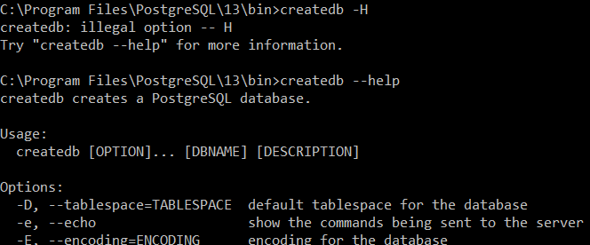
Working on the command line
When you type multiple tokens on the command line
createdb -U postgres db01
psql -U postgres db01 < /temp/db01
The shell finds the first token, and executes it – passing the rest of the arguments to the program to do with it as it will.
If you want to see what arguments are available, try passing –H or similar

Slide 13

Working on the Command Line
Sometimes the argument are options to the program
Sometimes the arguments are file names to be read.
Sometimes the arguments are redirects
psql -U postgres db01 < /temp/db01
In this case ‘psql’ is the program to execute
‘-U postres’ are options
‘db01’ is the DBNAME
‘< /temp/db01’ is a redirect. It says to send the contents of file /temp/db01 to psql as if someone typed then into the program.

Slide 14
Redirects are cool
When working at the console, you typically have:
stdin – standard input If you do nothing – stdin is what you would type to the program.
stdout – standard output. Type things to the screen for you to see
stderr – standard error. Where errors get printed. If you do nothing this goes to the screen as well.
The magic is that you can:
Redirect stdin to read from a text file
Redirect stdout to write to a text file
Redirect stderr to write to a text file.
( In unix land you can do more by piping output from one program to input of another This can be incredibly powerful as there are lots of small tools in Unix you can pipe the output from one tool to the next. )
When you are submitting homework, we will test your submission using redirects.
( So you might want to test using that methodology as well)

Slide 15
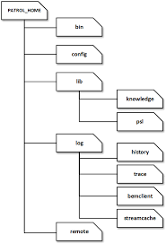
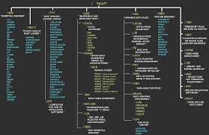
How does it find the program or data file?
When you type in a string which is not a known command to the shell. How does the shell find the program/ file?
Remember – your files on disk are organized in a hierarchy.

Slide 16
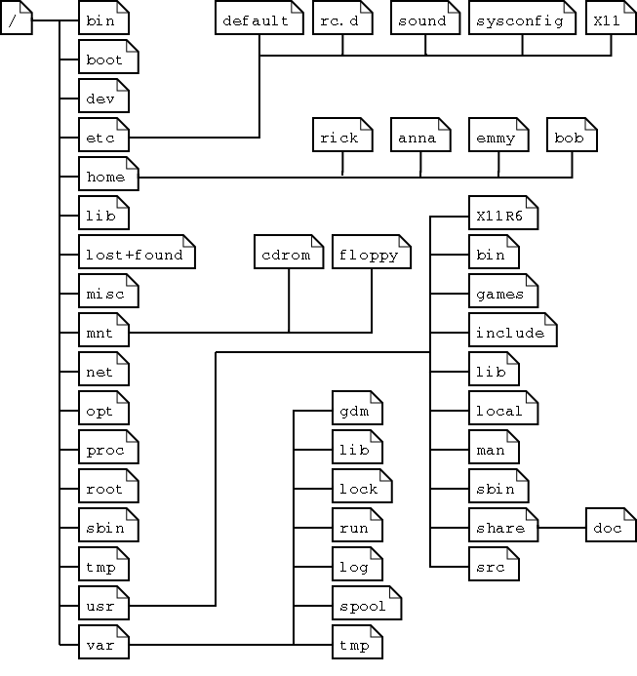
How does it find the program or data file?
The program may be hiding someplace on your hard disk
Or there may be multiple versions hiding somewhere on your hard disk
Or it may not be there at all.

Slide 17
How does it find the program or data file?
One of two choices:
Either you fully qualify the path name
Give it the name from the root directory all the way down to the file name
Or you give it a partial name from the current working directory ( usually just the file name without any directory information)
And the program ( and the command shell is just another program) uses a PATH variable to know where to search for the executable
PATH contains a list of the directories to search in the order to search them.

Slide 18
PATH
In windows my path looks like:
In windows I would start looking in my current directory for the file name
If not there I would look in
C:\Ruby26-x64\bin
C:\Users\johnc\AppData\Local\Microsoft\Widnows\Apps
Etc.
Note that each terminal shell you bring up can modify this path.

Slide 19
PATH
A unix path might look like:
./:/usr/local/bin:/usr/bin:/cygdrive/c/WINDOWS/system32:/cygdrive/c/WINDOWS:/cygdrive/c/WINDOWS/System32/Wbem:/cygdrive/c/WINDOWS/System32/WindowsPowerShell/v1.0:/cygdrive/c/WINDOWS/System32/OpenSSH:/cygdrive/c/Program Files (x86)/WinMerge
Exact same idea, except the slashes are not backwards, there is no drive designation, and the separator character is ':' not ';'
Ok – one other difference. Unix does not by default start looking in the current directory.
If you want to look in the current directory, you should put ‘./’ as the first entry in your path
Or set up an .cshrc file ( if you are running a c shell )

Slide 20
PATH
Each path entry either starts with the current directory, or from root ( or for Windows from a drive/root)
There are some special path names.
./ is the current directory
.. Is up one directory. So ../../foobar would mean look two directories up from the current directory, and then look for foobar.

Slide 21
Windows and pathnames.
UNIX introduced the slash character ‘/’ as a directory separator.
Windows when first released did not have directories, but they used ‘/’ as a switch prefix.
So when Windows added directories, they decided to use ‘\’ as a directory separator
In this time period files did not have spaces in the names.
Sometimes programs that were developed for unix ( like all your postgres programs) get confused as to the proper file separator.
If you are passing in a file name to a program using the ‘\’ and it does not work, try reversing the direction.
If you have a space in a directory name / file name – try putting the whole thing in as a quoted string.
Or just don't use spaces in file names

Slide 22
OK – Was this useful.
One finger – yes very useful. I did not know this
Two fingers – somewhat I knew some / most of it
Three fingers – I already knew all of this why are you wasting my time?

