Slide 1
Ticketing console
Computer science – First year exam
Group 2
Nikolay Dinev
Boril Milanov
Iliyan Stoev
Cosmin Gabinat
June 2015

Slide 2
Company structure
Aalbornification
Startup
Simple, functional structure
Project structure

Slide 3

Change Management
What is Change Management ?
Why it is not involved in the Project's Report ?
What if ... ?

Slide 4
Stakeholder analysis

Slide 5
Risk management

Slide 6
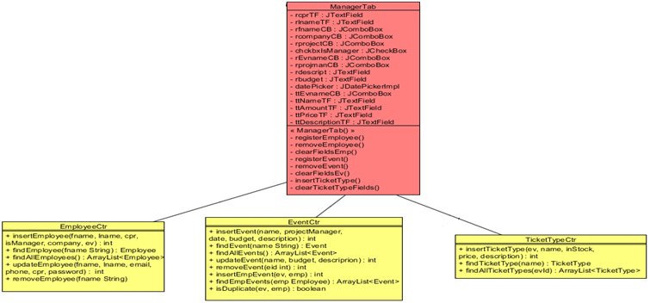
Coupling problems
Manager function
- High coupling
Alternative :
ManagerCtr

Slide 7
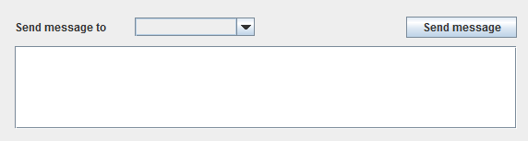
Messaging function
- new Tab ( Messaging tab )
- new Message(sender, recipient, text, date)
- getAllMessages()
- Thread
- Infinite loop
- Thread.sleep(milis)

Slide 8
DataBase Transactions
Transactions ?
Issues
Isolation Level

Slide 9
Graph - Map
What is a graph
Dijkstra’s algorithm
GUI map

Slide 10
New functionality and improvements
Receipt
Graphs
Test Classes
Concurrency
Find/Cancel booking
Tooltips
Update Employee
Database changes

