Slide 1
QR-Code based Queue Management System
Theme: Automated Queue Management System
for Branch.
Team: Py_Warriors

Slide 2
Content
Problem Statement
Proposed Idea
Introduction
How our Queue Management System works?
References

Slide 3
Problem Statement
Automated Queue Management System for Branch.
Developing Automated Queue Management System for Walk-In-Customer in the Branch with the help of latest technology like QR Codes, IoT etc. The customer should be able to scan QR code to get the ticket, which will guide the customer further by informing the counter number to serve him at the earliest. The system shall automatically re-schedule the counter to maintain FIFO order depending on customer requirements. Centralized monitoring system shall analyze the queue data, suggest the Branch to improve turnaround time and rank the branches accordingly.

Slide 4
Proposed Idea
To build an Automated Queue Management System that will display a QR-code at a branch asking the user to scan it. As the customer enters the branch, he will proceed to this display screen to scan the QR code which will redirect him to a web-portal. This management system does not raises any strict dependency related to a mobile application, simply the existing mobile QR scanner be used to follow up the process. The interface will ask the customer to enter a few important and quick details about him, for example, if we create an application for a bank, the customer may require to enter his Name, Phone Number and ‘Purpose of Visit’. As he enters all the information he will receive a unique Queue Number and minimum wait time within which the customer will be assisted by their service personnel. The same information will be sent to the customer over SMS or email. Customers will be notified one call before their turn. For example, if N605 is on the waitlist, therefore, as soon as N604 proceeds to the counter, N605 will be informed to be ready will all the required documentation to proceed to the specific counter. Moreover, an existing app of the organization with inbuilt QR-Scanner can also be used to follow the above step. This will also reduce the extra time required by the user to fill in the details.

Slide 5
Introduction: Queue Management System
Queue Management System is defined as a set of principles aimed at controlling customer flow and streamlining the queuing experience.
Queue systems have come a long way. They went from simple physical barriers to state-of-the-art digital applications. A modern, digital-based queuing solution operates on a different level than simple crowd management tools.
Queue Management System helps us to manage a large crowd in a systematic way where no human interface is needed for normal functioning
A “Queue Management System” like ours helps different organizations in managing queue in a systematic way.

Slide 6
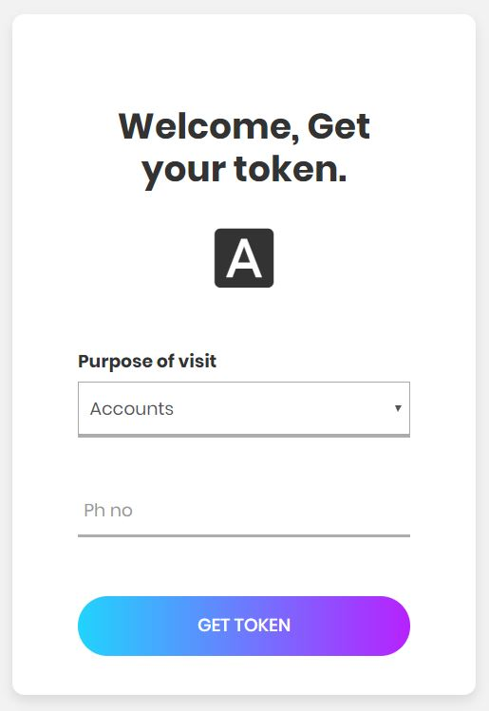
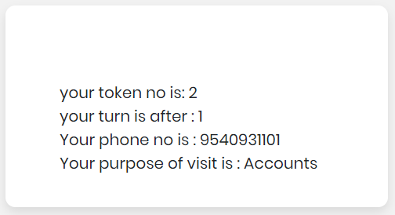
How our Queue Management System Works?
Our Queue Management System helps the user to scan a QR code which opens up a web portal for the user to provide the basic information for entering in the ongoing queue providing him/her a token number and the wait time.
As soon as the user enters his/ her information the web portal opens up a page providing him/her the token no., his/her position in the queue and the information that was entered by the user.

Slide 7
Cont. Working of the Project
Scan the QR Code: First step is that the user will scan the QR Code installed at the different branches of the organisations.
Web Portal: The user has to enter his general information like his mobile no, purpose of visit, etc.
Showing the Info.: After entering the information the web portal opens up a page providing him/her the token no., his/her position in the queue and the information that was entered by the user.

Slide 8
Tools and Technologies used
Python: An interpreted, object-oriented programming Language which helps developers to create, maintain, test different programs.
Django: Django is an open source web application framework, written in Python. A web framework is a set of components that helps you to develop websites faster and easier.

Slide 9
References
https://docs.djangoproject.com/en/2.2/
https://docs.python.org/3/

