Slide 1

Properties
Master Course
2025-03-24

Slide 2
Properties
Tasks
Start working
Repeat basics of thermodynamic properties
Use python to calculate properties
Automate calculation and prepare higher level code
Use python library to calculate properties
Analyze and visualize fluid behavior

Slide 3
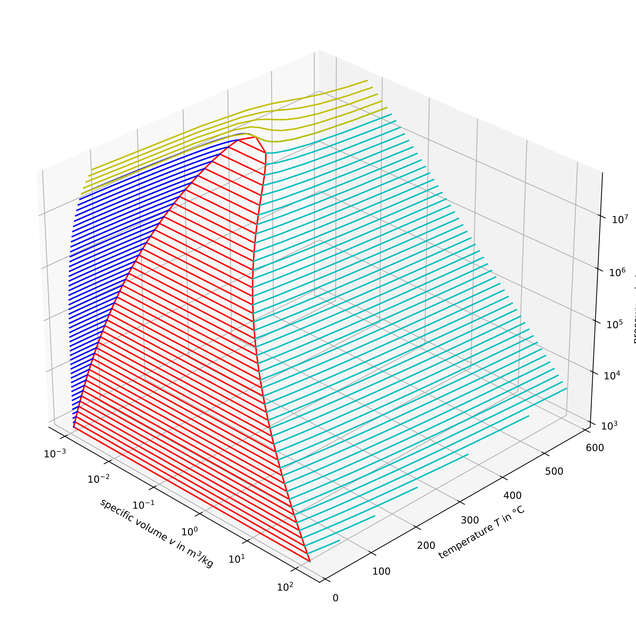
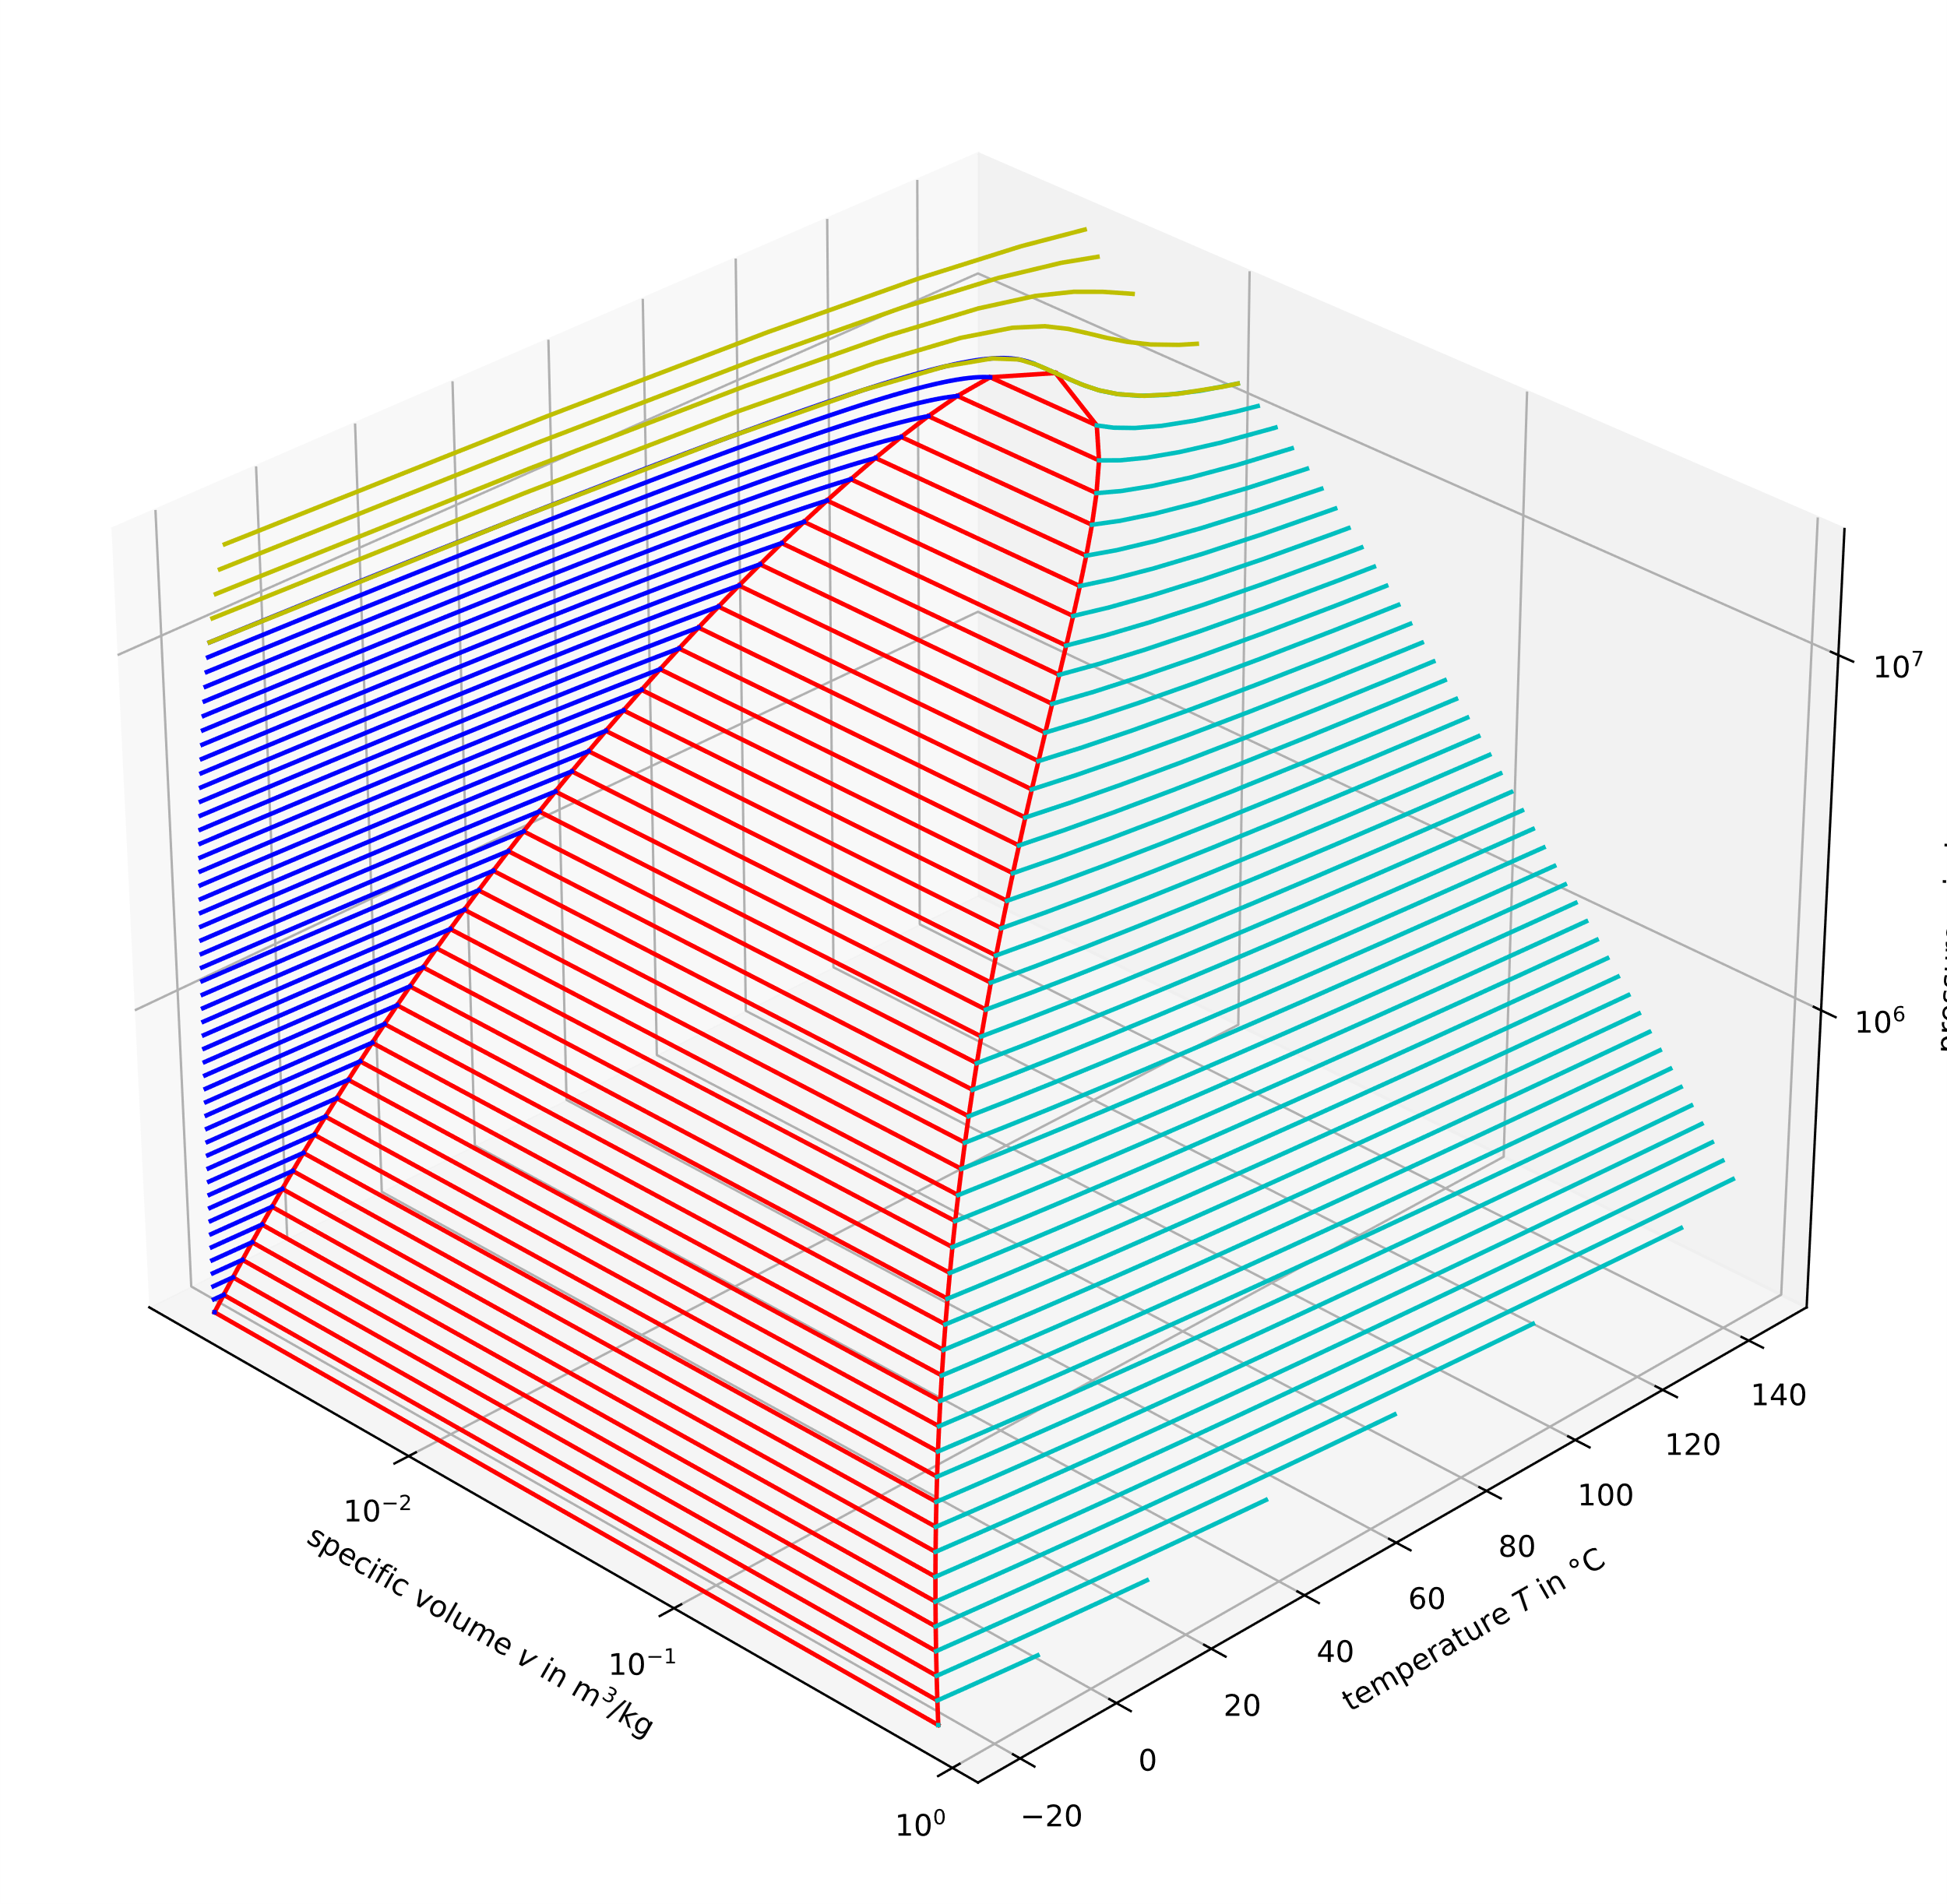
Properties
Thermal properties of real fluids
Example shows water/steam (in small: ammonia)
Volume, pressure and Temperature are related properties
Similar structure of property surfaces with different zones for condensable fluids

Slide 4
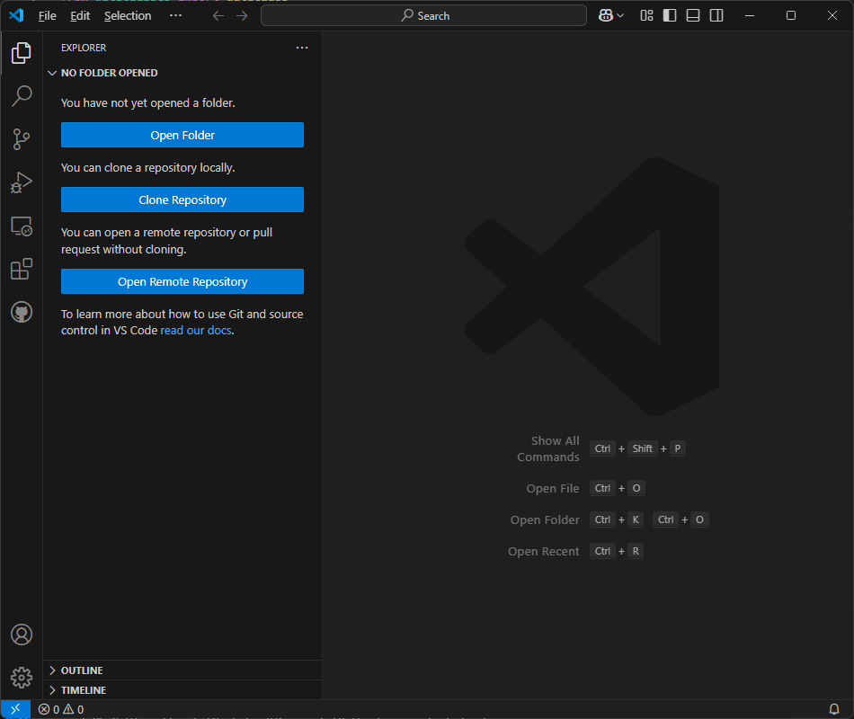
Properties
Density of air as an ideal gas for given T, p
Calculate the density of the air in this room
You may treat the air as ideal gas
Use plain python to calculate it
Once
Twice
A number of times
As a part of something bigger…

Slide 5
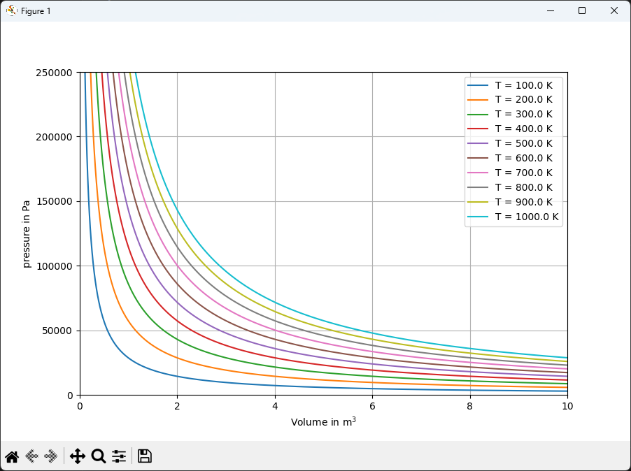
Properties
Plot a p,v diagram of air
Plotting can done using matplotlib
Processing of data can be handled using numpy
Import these libraries and use them to create a plot as seen on the right hand side

Slide 6
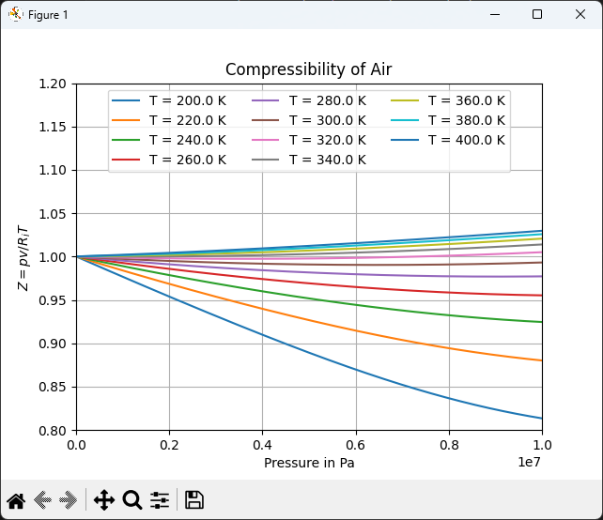
Properties
CoolProp.Coolprop and PropsSI
CoolProp is a powerful library for property calculation in all fluid phase regions
Using a simple syntax all relevant properties for a vast amount of substances can be calculated
Compare the ideal gas equation of state with real gas calculations using CoolProp

Slide 7
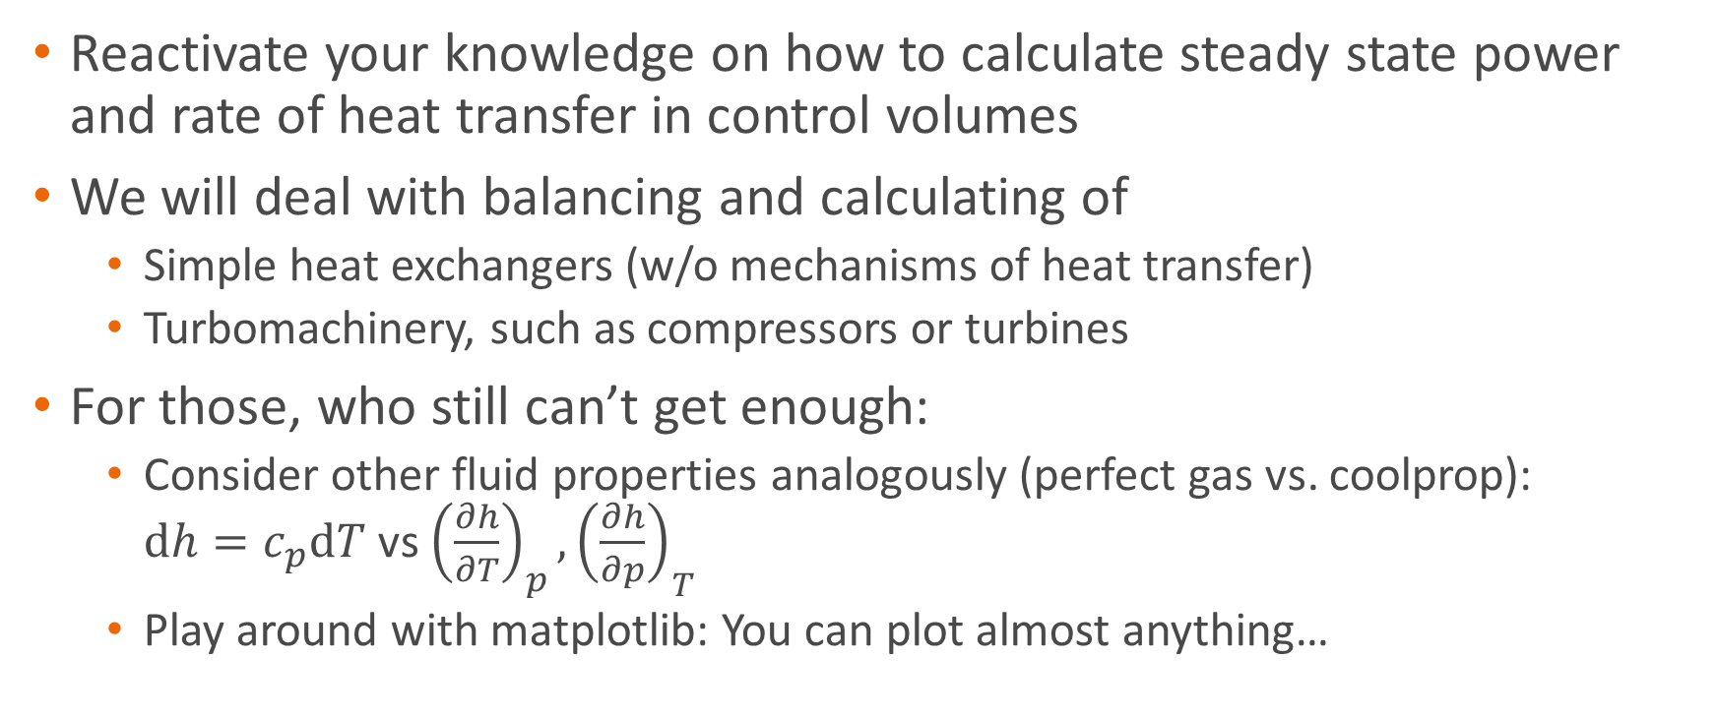
Next Time: Simple Components
Things to prepare
Reactivate your knowledge on how to calculate steady state power and rate of heat transfer in control volumes
We will deal with balancing and calculating of
Simple heat exchangers (w/o mechanisms of heat transfer)
Turbomachinery, such as compressors or turbines
For those, who still can’t get enough:
Consider other fluid properties analogously (perfect gas vs. coolprop): $dh=c_{p}dT$ vs ${\left(\frac{∂h}{∂T}\right)}_{p}, {\left(\frac{∂h}{∂p}\right)}_{T}$
Play around with matplotlib: You can plot almost anything…

