Slide 1

Single Components
Master Course
2025-03-31

Slide 2
Single Components
Tasks
Use python to perform simple component calculations
Wrap up what typical components in thermal engineering do
Heat exchanger
Compressor
Transfer analytic calculation to code
Visualize component behavior
Understand challenges and options related to numerical calculations

Slide 3
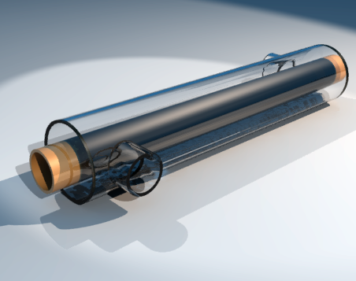
Single Components
Heat Exchanger
Let’s keep it simple:
Consider only one side of the HX
Treat fluid as ideal gas
No detailed modelling of transport
Neglect velocity and height
Collect equations and information needed to calculate the component
Code a script to calculate
Duty
Mass flow
Outlet temperature

Slide 4
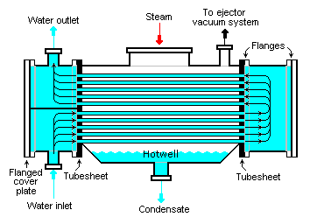
Single Components
Heat Exchangers for real media
Switch the medium to pressureless but real gas air:
Revise your set of equations
Code new scripts for duty and outlet temperature
Steam condenser
Define a flow of wet steam
Revise your set of equations
Code a script to calculate duty to condense that wet steam flow

Slide 5
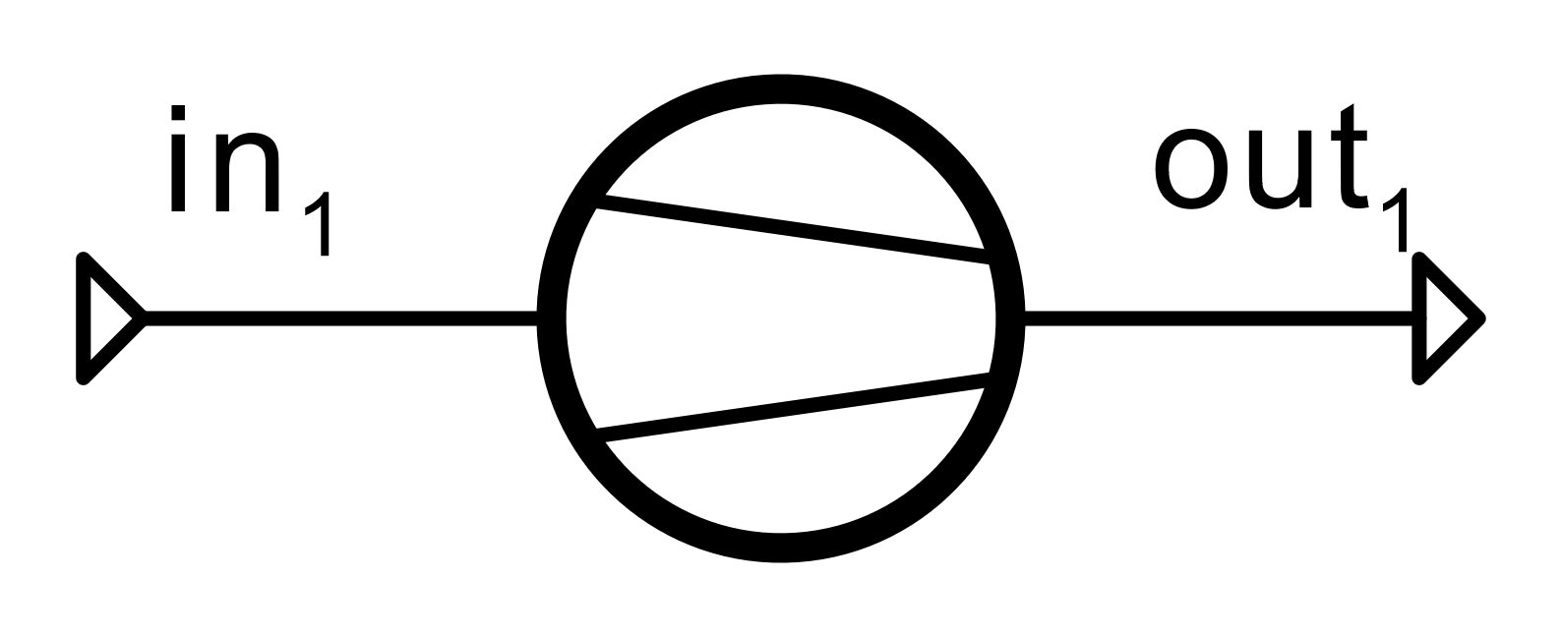
Single Components
Air Compressor
Identify a suitable set of equations
Tell component data from fluid conditions
Code a script each to calculate:
Compressor duty
Air mass flow
Plot outlet temperatures for different component data
Determine compressor pressure ratio that leads to a temperature of 300°C at the compressed air outlet

Slide 6
Next Time: Solving Strategies
Things to prepare
Try to generalize the types of equations that need to be solved
Wrap up numerical methods
Algorithms for zero search
Ways to solve sets of equations
For those, who still can’t get enough:
Consider throttles
Consider steam turbines

