Slide 1

Numerical Problem Solving
Master Course
2025-04-07

Slide 2
Numerical Problem Solving
Tasks
Use different approaches to model the compressor problem
Implement and make use of different numerical root finding algorithms
Bisectional search and Newton’s Method
Using a third party library
Transfer the single dimension root finding to multi-dimensional problems
Understand challenges and options related to numerical calculations

Slide 3
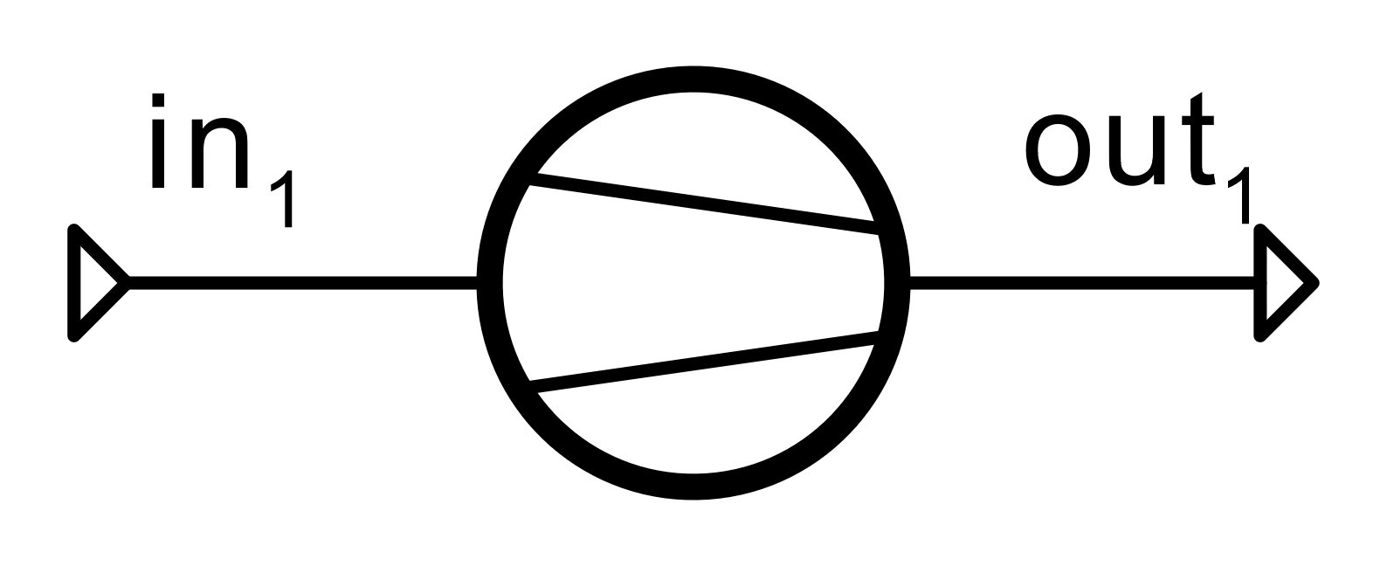
Numerical Problem Solving
Compressor example
Determine compressor pressure ratio that leads to a temperature of 300°C at the compressed air outlet numerically
Code a script, which
implement Newton’s method
Uses scipy to solve the same problem

Slide 4
Numerical Problem Solving
Compressor example
Can you reuse the same script for the following problem:
What would the value of isentropic efficiency be if the actual pressure ratio was 8?
When does reusing the same structure become challenging?

Slide 5
Numerical Problem Solving
Compressor example: Generalization
We can generalize our problem formulation to make it more flexible by solving for all equations at the same time and just swapping out the respective equations
Implement one iteration of Newton’s method for multi-dimensional problems
Write down all relevant equations of our first problem
Define the set of variables that we want to solve for
Note down the partial derivatives of all equations

Slide 6
Numerical Problem Solving
Compressor example: Generalization
Implement the iteration in a loop
What is the convergence criterion?
What issues do we encounter regarding starting value selection?
Try to swap out equations to specify
pressure ratio instead of isentropic efficiency
duty and pressure ratio instead of temperature values
volumetric flow instead of mass flow

Slide 7
Next Time: TESPy introduction
Things to prepare
Make yourself comfortable with the tespy syntax
Reimplement the different problems we have been working on as tespy models
Simple Heat Exchanger
Compressor
Two-sided Heat Exchanger
…
Have a good Easter break!

