Slide 1

Introduction to tespy
Master Course
2025-04-28

Slide 2
tespy architecture
Overview
Basics
Network
Components
Connections
How to build, parametrize and run models?
Advanced
Buses
UserDefinedEquations
Plotting of cycle and heat exchanger diagrams
To warm up your keyboards:
Update your environment (tespy and CoolProp updates were published)
pip install tespy --upgrade

Slide 3
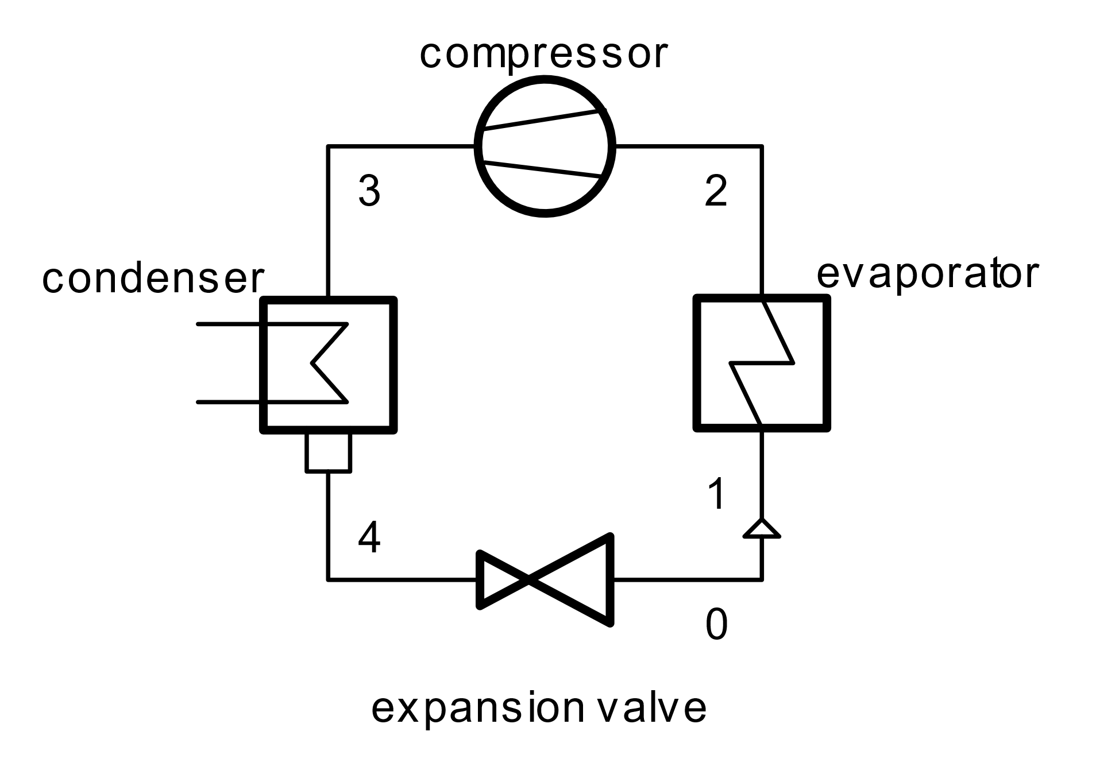
Hands-on: Simple heat pump model
Tasks
Build up a heat pump model with the following specifications
Evaporation temperature: 15 °C
Condensation temperature: 60 °C
Working fluid: R290
Compressor efficiency: 85 %
Disregard pressure drops in heat exchangers
What is the role of the cycle closer?

Slide 4
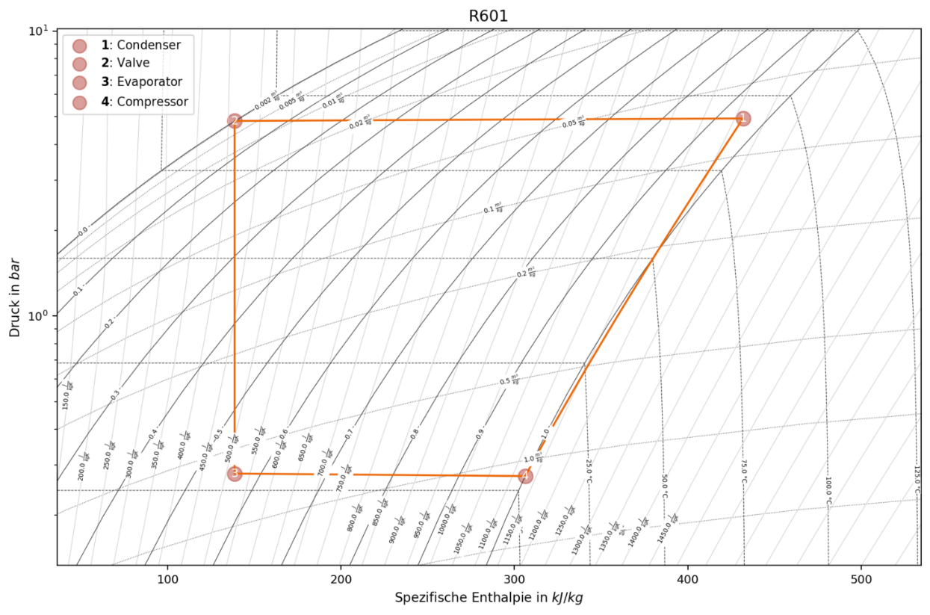
Hands-on: Results processing
Tasks
What is the COP of the heat pump?
Plot the logp-h diagram of the cycle
Show the state points
Connect them with the respective process lines
Remember thermodynamics 101: What should be noted when drawing process lines?

Slide 5
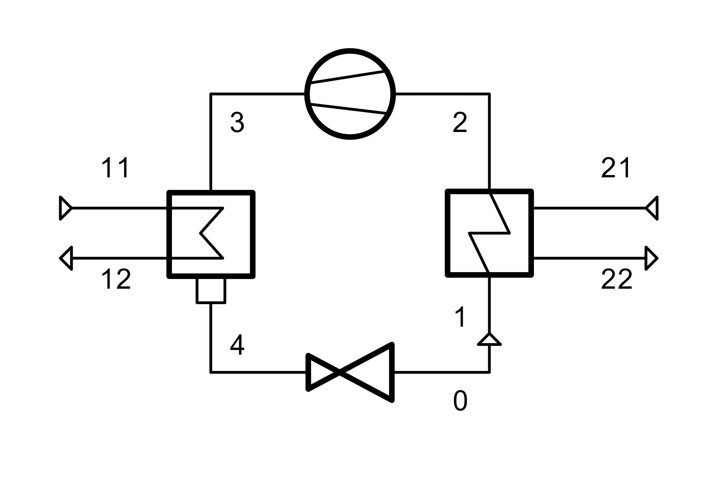
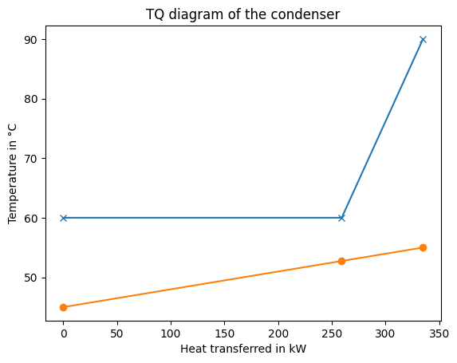
Hands-on:
Tasks
Extend the model by integrating material flow for the heat source and the heat sink
Air on heat source side
Water on heat sink side
What are reasonable assumptions for the heat exchangers?
Plot the TQ-diagram of the condenser and discuss, what issues might arise?

Slide 6
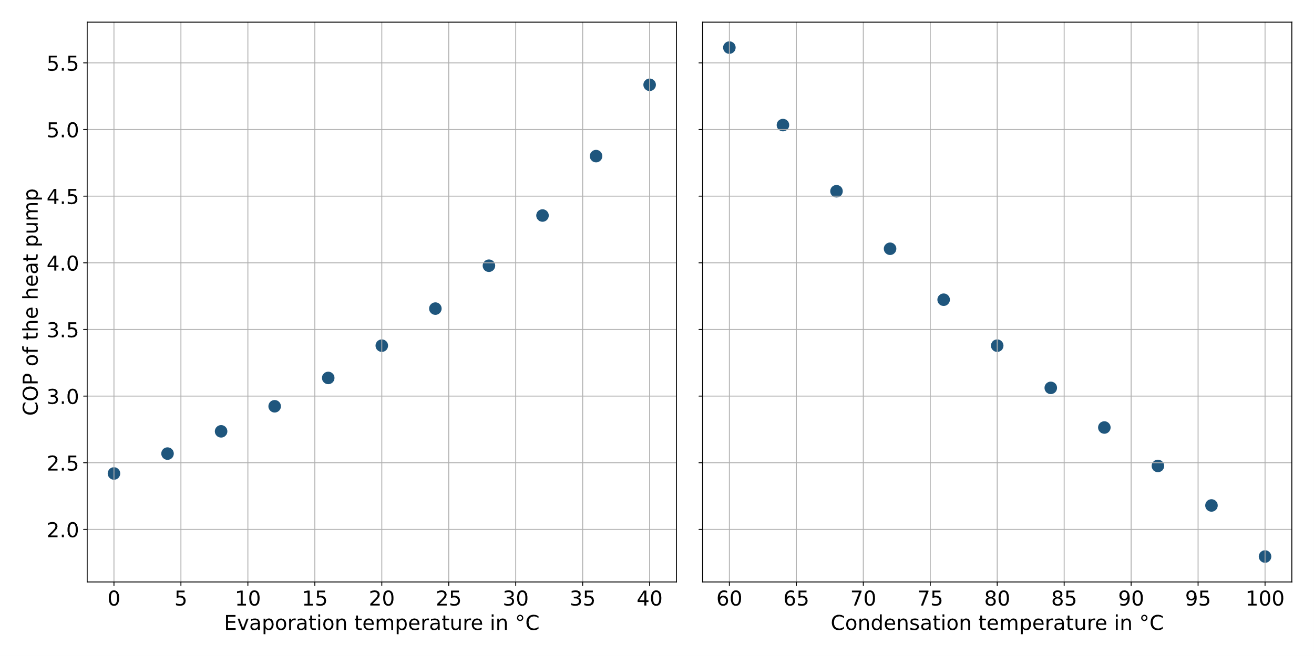
Hands-on: Heat pump model
Tasks
Run a sensitivity analysis on the COP:
As a function of ambient temperature
As function of heat sink temperature
For a variety of working fluids

Slide 7
Hands-on: Heat pump model
Tasks
At what heat sink temperature is the COP of the heat pump exactly
4
5
…
What methods other than trying manually do you recall to implement this?
Remember: This is an equation based solver!

Slide 8
Next Time: Gas turbine
Things to prepare
Repeat the concepts and syntax of tespy
What can we do, if the solver returns a linear dependency?
In what (numerical) issues did we run and how did we solve them?
How can we make use of component error messages?

