Slide 1

Cycles I: Gas Turbine
Master Course
2025-05-05

Slide 2
Cycles I: Gas Turbine
Tasks
Use TESPy for cycle performance analysis
Understand and address challenges of instable calculation setups
Learn to use new components
Combustion chamber
Turbine
(Bus)
Store information
Use starting values
Put data into csv-files
Save figures

Slide 3
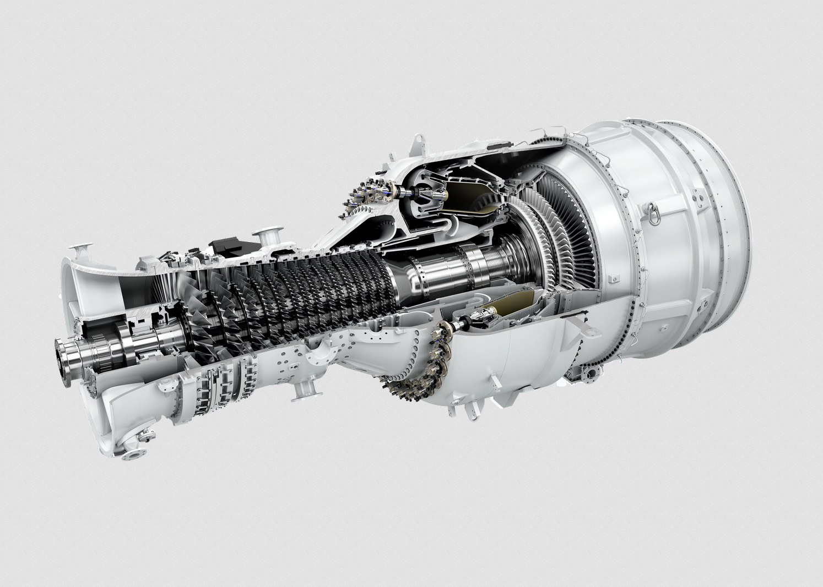
Cycles I: Gas Turbine
H₂-fired Gas Turbine‘s Combustion Chamber
Could be a backup power plant in renewable energy systems
New feature: Combustion chamber with fuel and air
First step: Set up combustor:
Combustion with given inputs
Stoichiometric combustion
Firing to a defined temperature
Explore limits of the skripts
https://www.siemens-energy.com/global/en/home/products-services/product/sgt-800.html

Slide 4
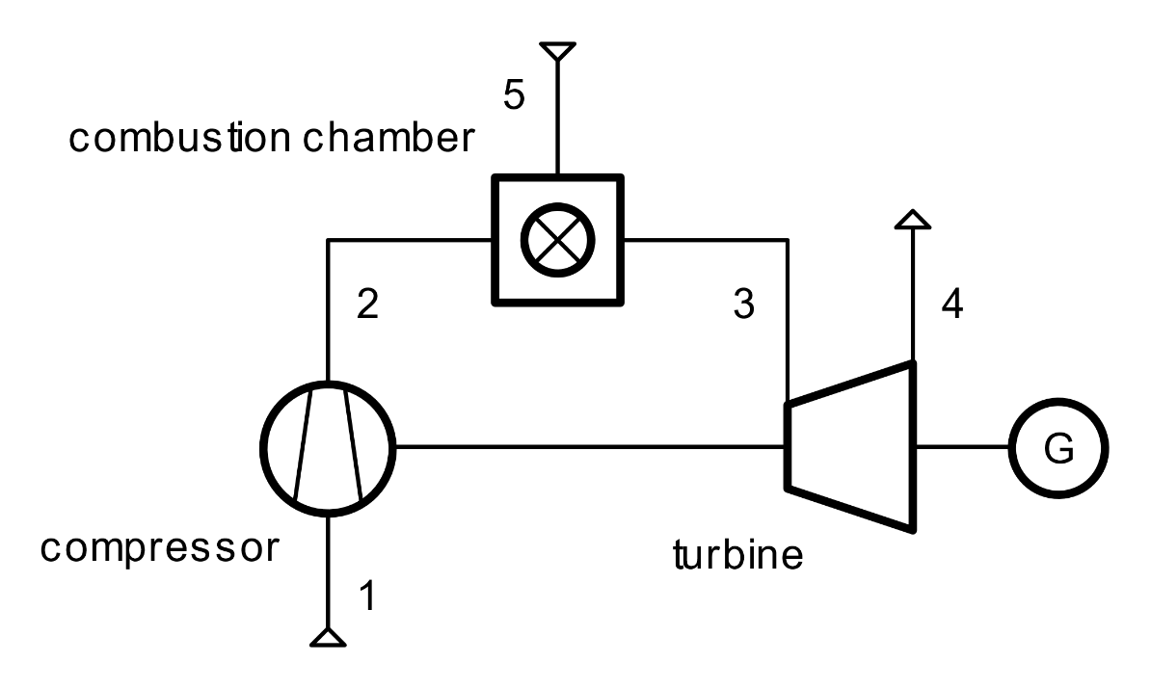
Cycles I: Gas Turbine
Gas Turbine Cycle
Set up a TESPy model for the complete GT cycle
Start with the best stable configuration of combustion
Switch to a less stable, but technically reasonable setup
Stabilize calculations if needed
Stepwise approach
Initialization dataset

Slide 5
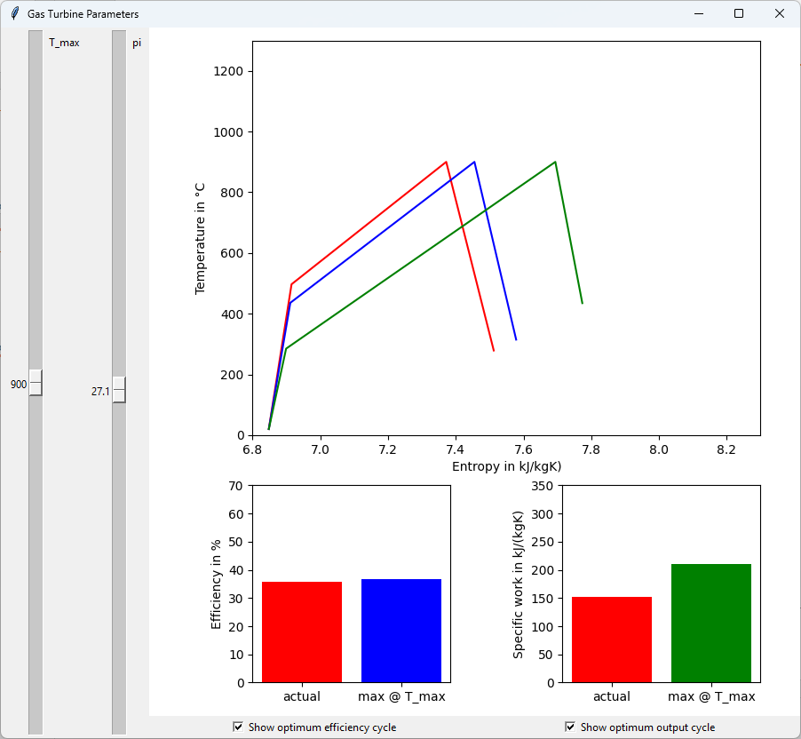
Cycles I: Gas Turbine
H₂-fired Gas Turbine Performance
Use the python file provided to explore GT performance
Code a TESPy skript to generate respective performance data
Plot and save the figures
Save performance data to file and plot from file
Discuss advantages and disadvantages of using TESPy

Slide 6
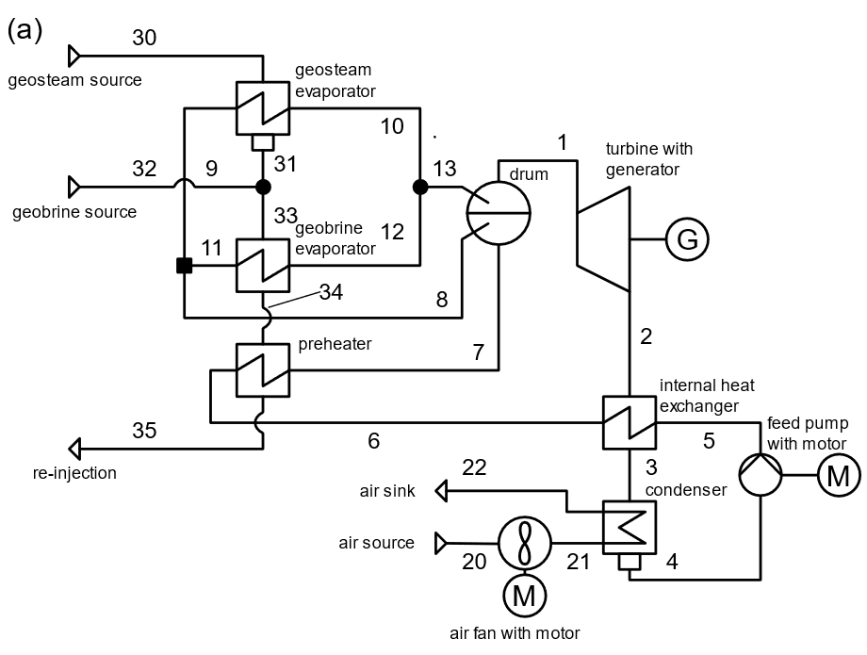
Cycles I: Gas Turbine
Next Steps
Organic Rankine Cycle (ORC)
Prepare:
Function of ORC
Typical geothermal ressources
Typical working fluids
You will learn to:
Compare different Cycles with different fluids
Work with Charts to visualize results and support discussion

