Slide 1

Thermodynamic cycles II: Organic Rankine Cycle
Master Course
2025-05-12

Slide 2
Low temperature heat utilization
Overview
Simple Cycle
Building a model
Changing fluids
Processing results
Typical working fluids
Characteristics
Plotting of fluid properties
Advanced cycle
Recuperated cycle
Parametric study
Recuperator sizing
Turbine inlet temperature

Slide 3
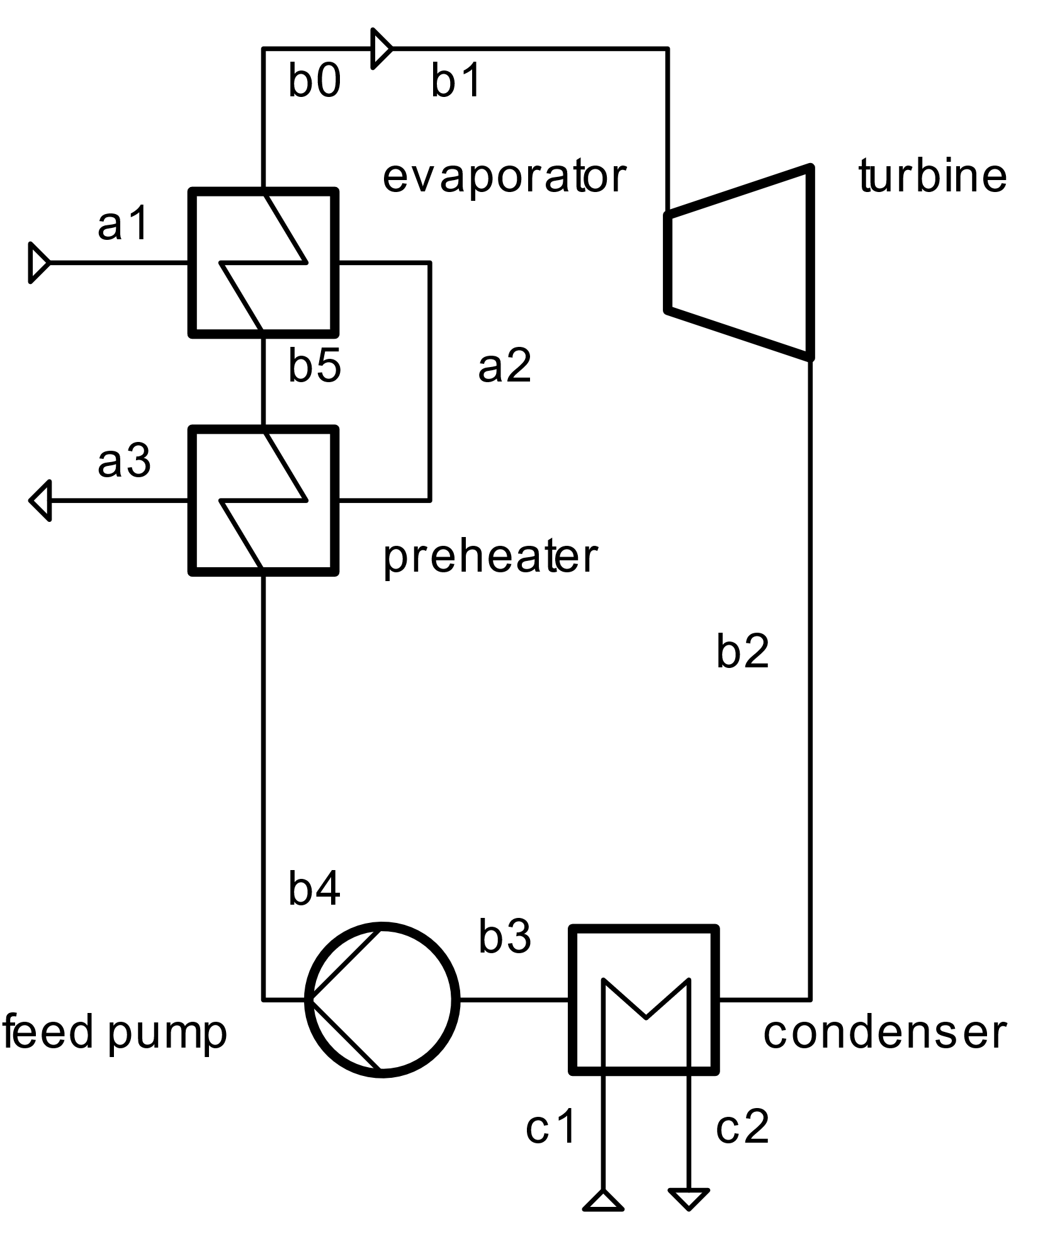
Simple ORC
Build an ORC model with the following specifications
Heat source
100 kg/s of air
Temperature: 160 °C
Pressure: 1 bar
Heat sink
Fluid: air
Temperature: 20 °C, air temperature increase: 15 K
Pressure: 1 bar
Cycle
Working fluid: water
Condenser outlet: saturated liquid
Evaporator inlet: saturated liquid
Evaporator outlet: saturated gas, 140 °C
Components
Pump efficiency: 75 %
Turbine efficiency: 85 %
Evaporator lower terminal temperature diff: 5 K
Condenser lower terminal temperature diff: 15 K
Disregard pressure drops in heat exchangers

Slide 4
Simple ORC
Tasks
Analyse the plant’s performance
Calculate the power generation
Calculate the thermal efficiency
Plot the cycle’s T-s diagram and include a plot of the saturation lines
Change the fluids
Use isopentane as working fluid
Why does the power output change in comparison with water as working fluid?
Analyse the performance
Plot the cycle’s T-s diagram
Plot the condenser’s Q-T diagram
Replace the condenser by with the MovingBoundaryHeatExchanger model
Impose a minimum pinch temperature difference of 5 K
Replace the heat source fluid with water at 10 bar

Slide 5
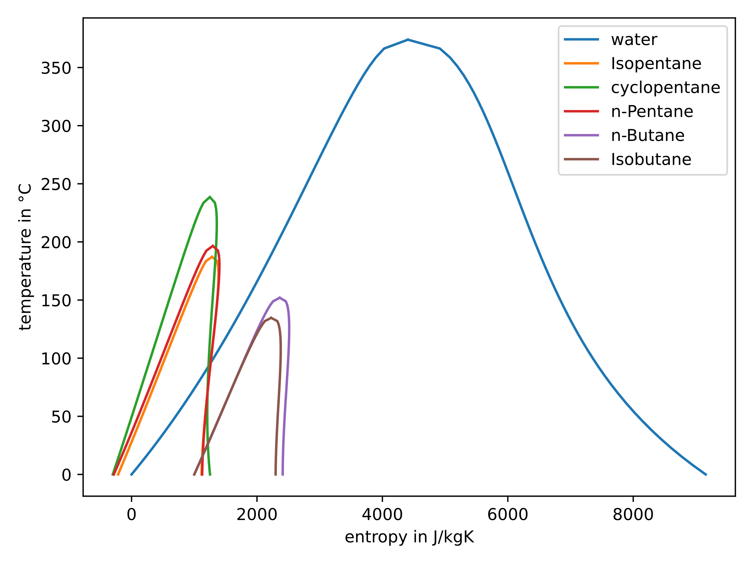
Working fluids
Tasks
Typical working fluids are, e.g.:
Isopentane
cyclopentane
Plot the T-s diagrams of these working fluids and compare it to water
What could be reasons, water is NOT typically used in low-temperature heat regimes?

Slide 6
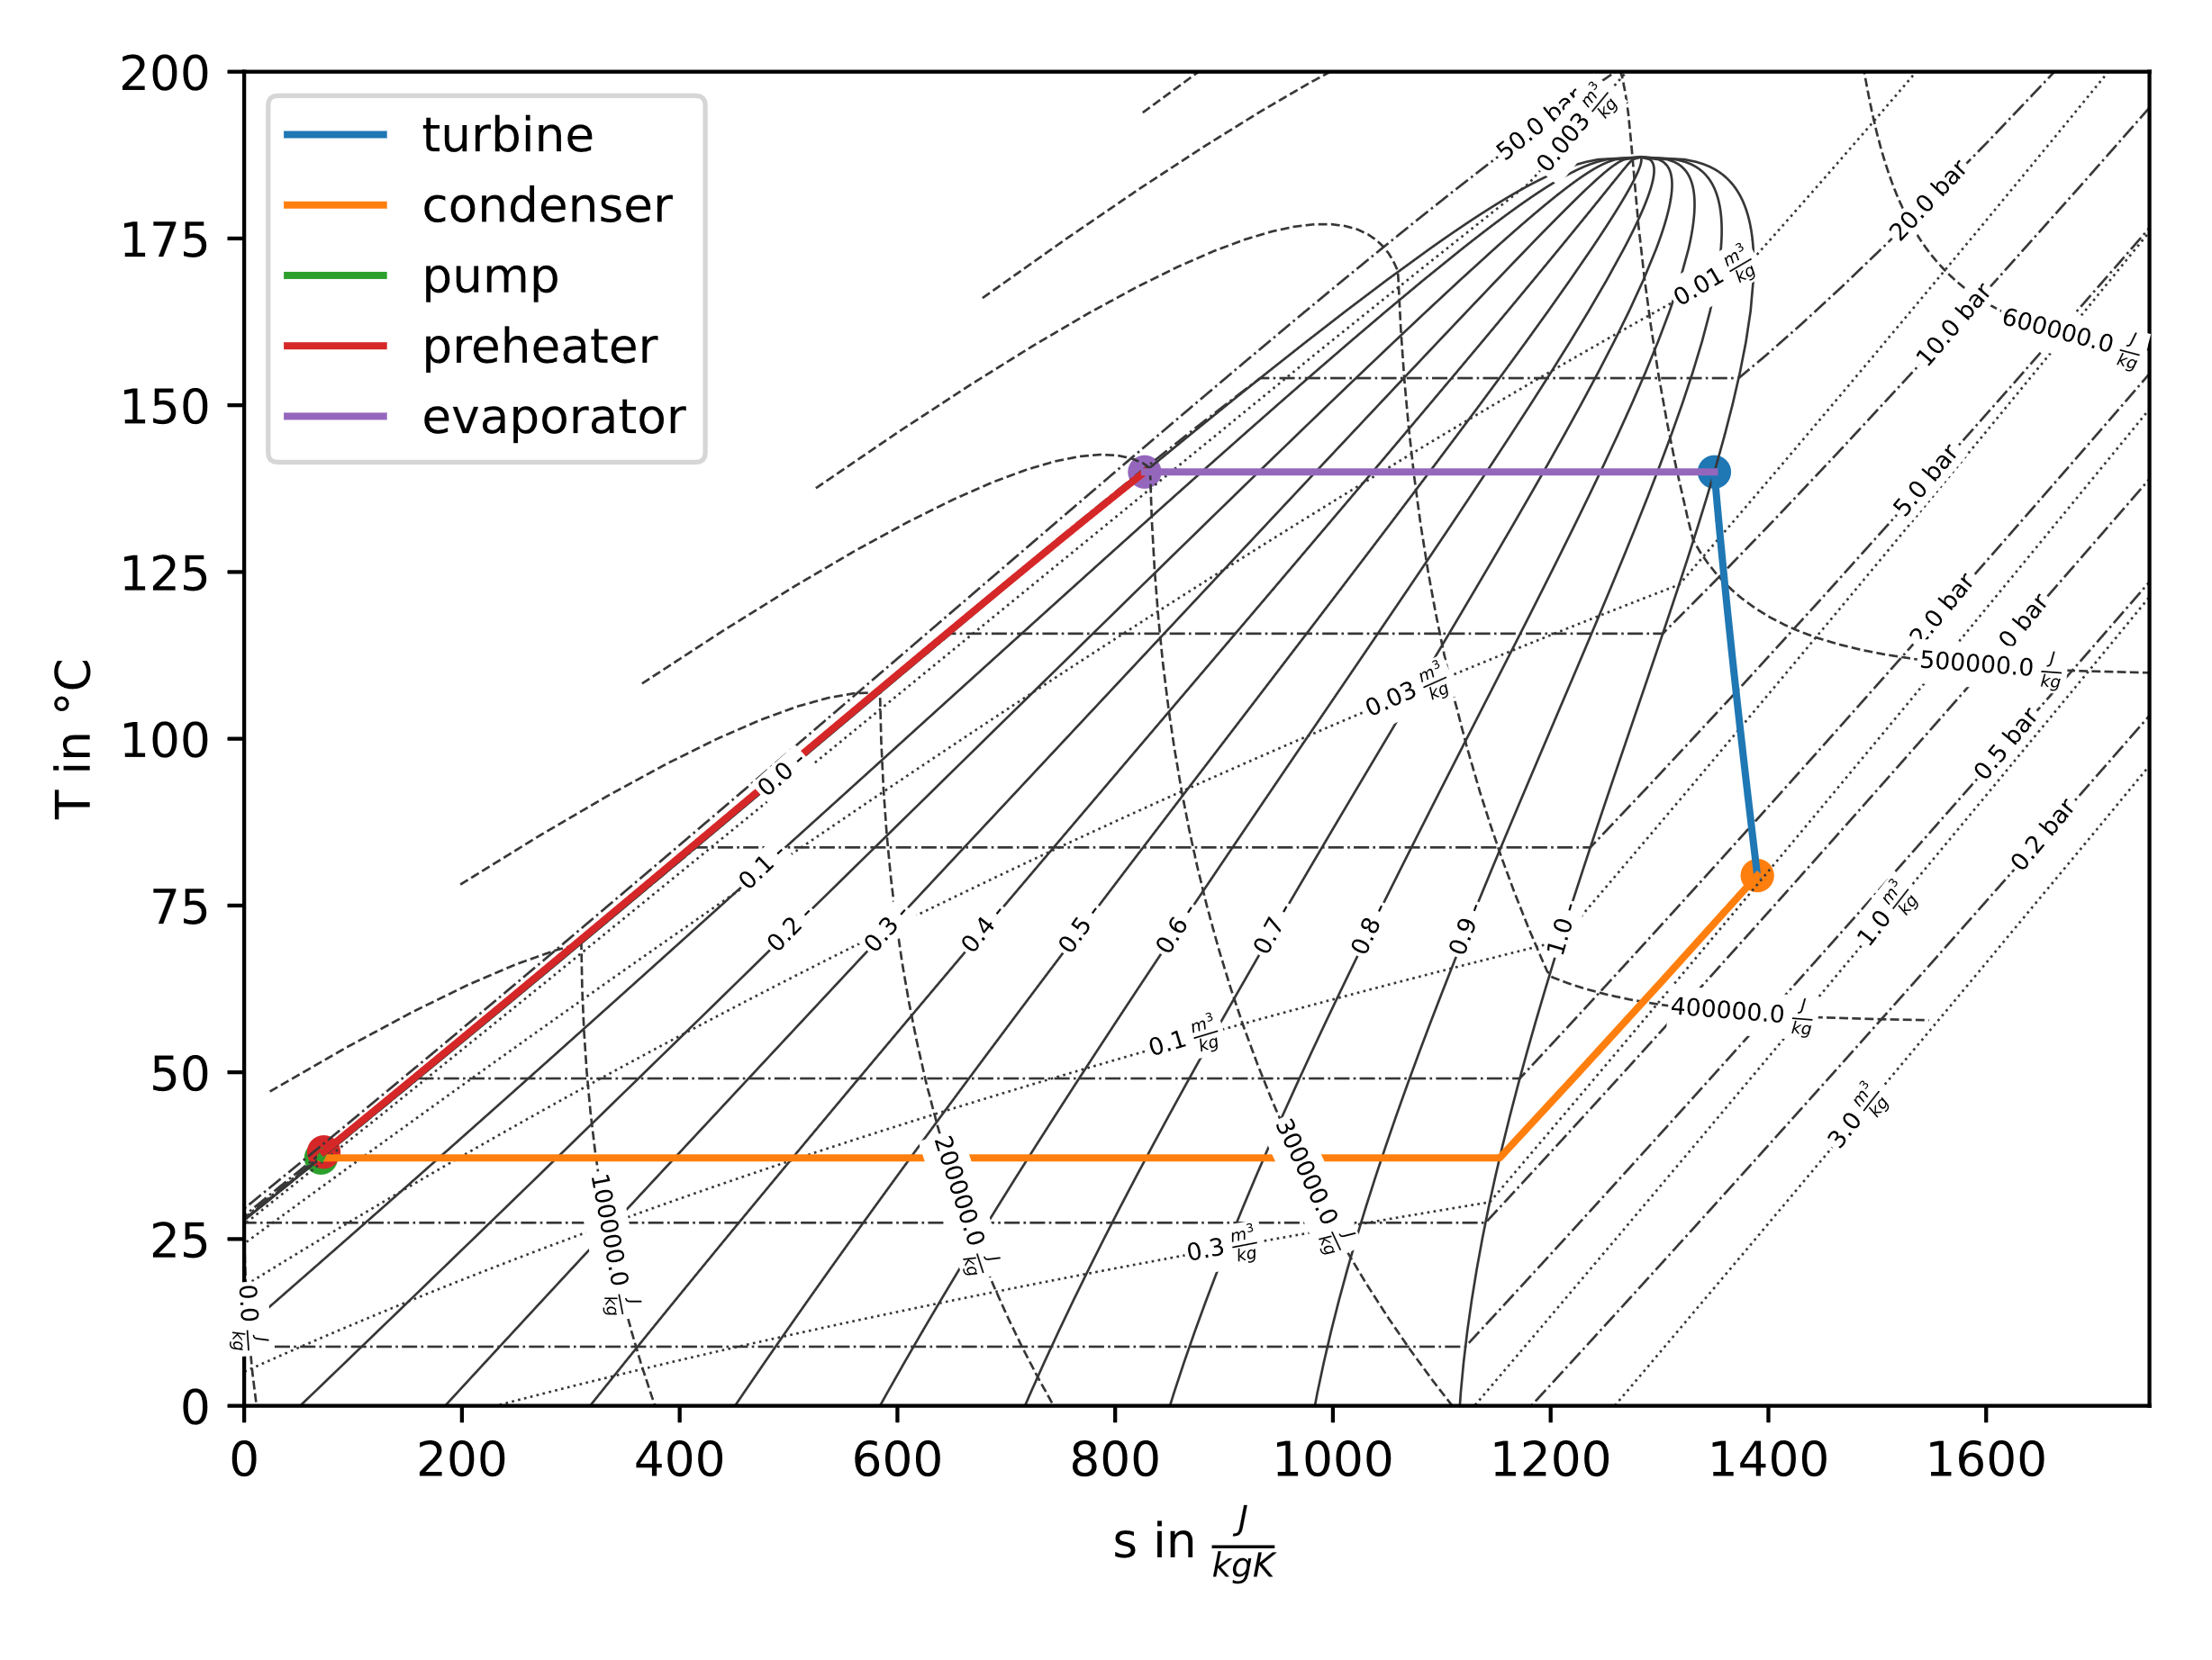
Working fluids
Tasks
Make use of the fluprodia library to create the T-s diagrams of isopentane
Include a plot of the process in it using fluprodia‘s interface for process lines

Slide 7
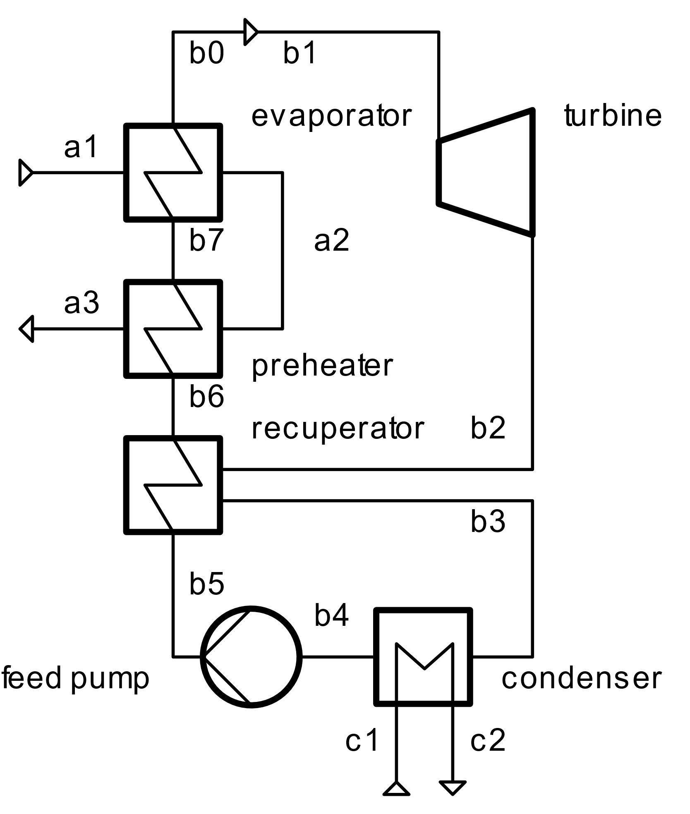
Advanced cycles
Tasks
Add an internal recuperator to your model and find a feasible solution for the problem
Impose a value of 0.5 for the heat exchanger hot side effectiveness
What does the internal heat exchanger change?
Power output?
Thermal efficiency?
…?

Slide 8
Parametric analyses
Recuperated cycle configuration analysis
How does the performance of the cycle change for different sizes of the heat exchanger?
Change the size of heat exchanger by modifying the effectiveness between 0.05 and 0.95
How does the turbine inlet temperature affect the power output?
Calculate the power output for a temperature range from 80 to 150 °C
What is the recuperator size under the following conditions
Turbine inlet temperature: 100 °C
Heat source outlet temperature: 80 °C

Slide 9
Next Time: Design/Offdesign
Things to prepare
What parameters characterize different components: Once you the actual component was manufactured, what quantity cannot change anymore? Think about
Heat Exchangers
Turbines
Pumps
Compressors

