Slide 1

Design and Offdesign performance
Master Course
2025-05-19

Slide 2
Design and Offdesign performance
Overview
Component design
What are parameters which can be selected in design?
What are parameters that are fixed once the system is in place?
Selected isoalted components
Design with absolute attributes
Design with relative attributes
Cycle analysis
Design and Offdesign performance of a gas turbine
Design and Offdesign performance of a Rankine Cycle

Slide 3
Design and Offdesign performance
Tasks
List a couple of components
Which specifications can be selected through the cycle design?
Once built, which attributes are fixed and cannot be changed anymore?

Slide 4
Design and Offdesign performance
Tasks
Consider the dimensioning of a pipe
Build a model, which identifies the diameter of a pipe that will inflict a pressure drop of 2 kPa in a stream of air.
Make a sensitivity study: How does the pressure drop in the stream of air depend on
mass flow and
pressure?

Slide 5
Design and Offdesign performance
Tasks
Consider a steam turbine
Build a model of a steam turbine with an inlet pressure of 80 bar and inlet temperature of 550 °C and an outlet pressure of 0.1 bar.
What specifications are needed to design the turbine?
Run a senstivitiy study in offdesign mode by changing the turbine mass flow:
How does the turbine inlet pressure change?
How does the turbine power output change?
How does the turbine efficiency change?

Slide 6
Design and Offdesign performance
Tasks
Consider a gas turbine compressor
Build a model of a gas turbine compressor with an inlet pressure of 1 bar, an inlet temperature of 25 °C and a pressure ratio of 10
What specifications are needed to design the compressor?
Run a sensitivity study in offdesign mode by applying a compressor map
Try to identify, how compressor maps can be read? What attributes does the compressor map control?
How do pressure ration and efficiency change when changing volumetric flow?
How does the compressor inlet temperature affect the compressor performance?

Slide 7
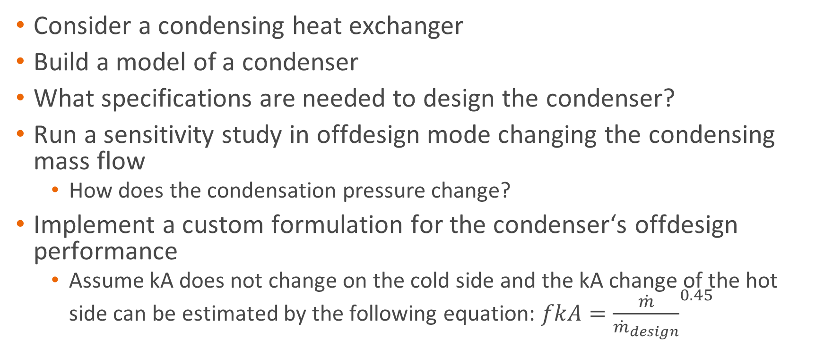
Design and Offdesign performance
Tasks
Consider a condensing heat exchanger
Build a model of a condenser
What specifications are needed to design the condenser?
Run a sensitivity study in offdesign mode changing the condensing mass flow
How does the condensation pressure change?
Implement a custom formulation for the condenser‘s offdesign performance
Assume kA does not change on the cold side and the kA change of the hot side can be estimated by the following equation: $fkA={\frac{\dot{m}}{{\dot{m}}_{design}}}^{0.45}$

Slide 8
Design and Offdesign performance
Tasks
Build a complete gas turbine model and study the effects of change in overall power generation on
Required air and fuel mass flow
Thermal efficiency
Turbine inlet temperature
Turbine outlet temperature

Slide 9
Design and Offdesign performance
Tasks
Build a complete rankine cycle model and study the effects of change in overall power generation on
Required steam mass flow
Condensation pressure
Turbine inlet pressure
Thermal efficiency

Slide 10
Next Time: Cycles III
Things to prepare

