Slide 1

Cycles III: CHP
Master Course
2025-05-26

Slide 2
Cycles III
Content
Combined Heat and Power Generation
New Components
Build up cycles and change configuration stepwise
Explore complex part load behaviour

Slide 3
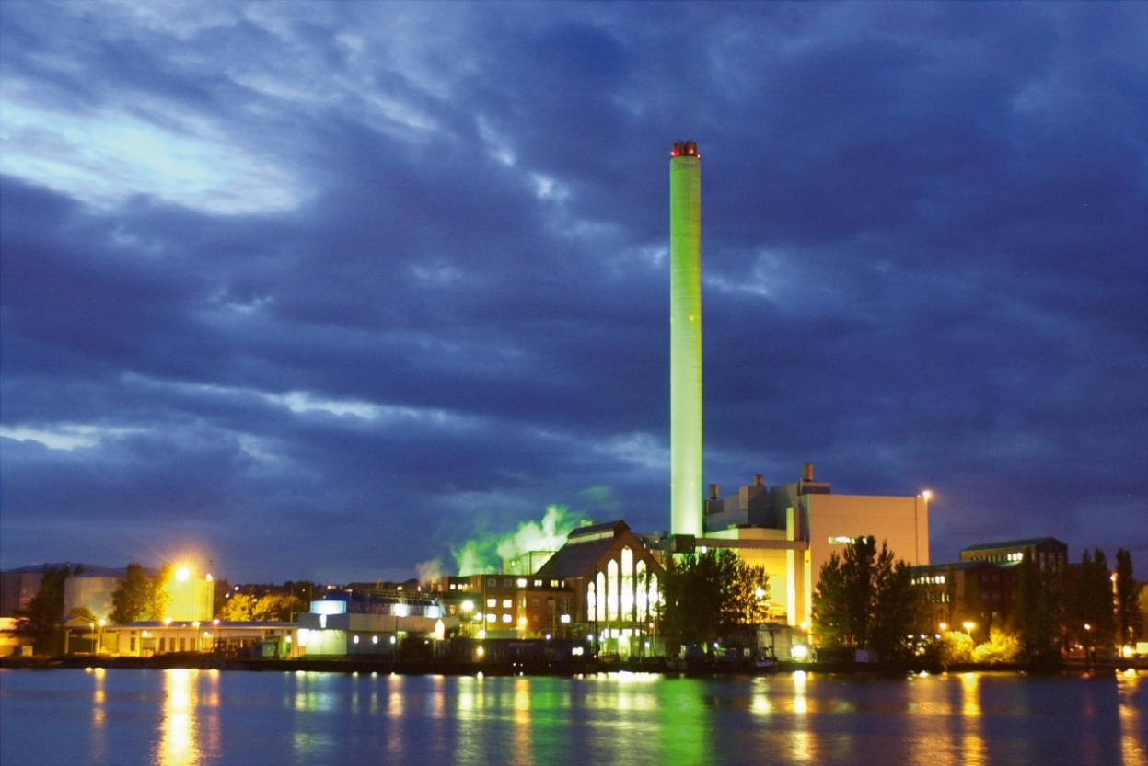
Cycles III
Combined Heat and Power Generation
Saves fuel in comparison to conventional technologies
Becomes less important with phase out of thermal power plants
May be a backup technology for times with low renewable generation in heating period

Slide 4
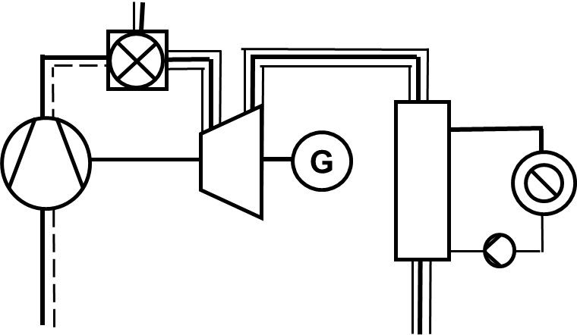
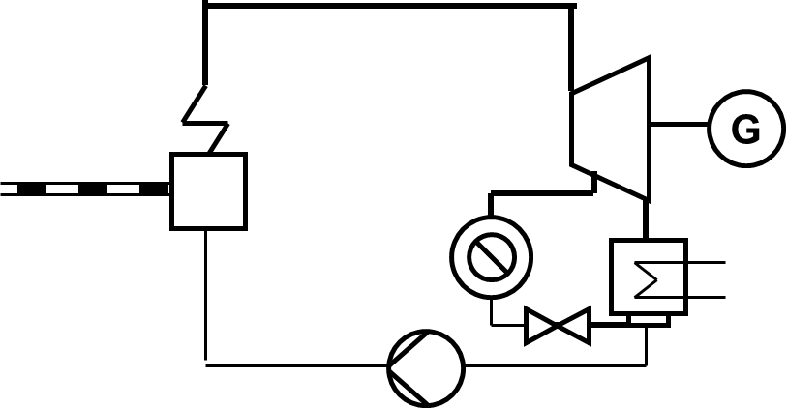
Cycles III
CHP Options for Gas Turbines or arbitraty fuels

Slide 5
Cycles III
Extraction turbine
Set up a simple CHP plant:
Life Steam: 100 bar/500°C
Heating condenser at 90 °C
Cooling water at 20°C
Net power output: 50 MW
Heating Power 50 MW
Turbomachinery efficiency: 90 %
Steam generator pressure loss: 10 %
Find missing info, do it stepwise!
c01
c11
c02
a02
a01
c12
c13
c04
c03

Slide 6
Cycles III
New TESPy components
Condenser:
Heat Exchanger
Includes condition of saturated liquid at hot side outlet
Temperature differences
Bus:
Allows to summarize power outputs and inputs including electro-mechanical efficiencies
Splitter and Merge
c01
c11
c02
a02
a01
c12
c13
c04
c03

Slide 7
Cycles III
Extraction turbine
Expand heating condenser to two-sided model
Test part load behaviour for different life steam mass flows at constant cooling water and district heating return temperatures and mass flows
(switch to off-design component-wise!)
Visualize results
c01
c11
c02
a02
a01
c12
c13
c04
c03

Slide 8
Cycles III
Next steps
For those who can‘t get enough
Try changing district heating duty
Introduce a valve to control forward temperature (twice)
Set up a cycle to produce steam with gas turbine exhaust gases
Next unit
Optimization with TESPy

