Slide 1

Optimization
Master Course
2025-06-02

Slide 2
Optimization
Overview
Single and multi-variate
Single and multi-objective
Constrained and unconstrained

Slide 3
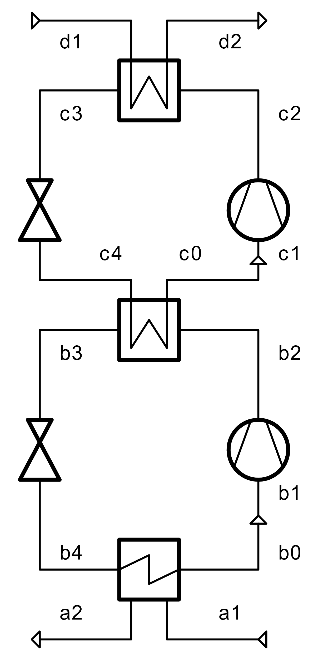
Cascaded Heat Pump
Build a heat pump model with the following specifications
Heat source
Fluid: air
Temperature: 20 °C
Pressure: 1 bar
Heat sink
Fluid: water
Saturated liquid at inlet, saturated vapor at outlet
Temperature: 110 °C
Cycle
Working fluids: R245FA (lower), R1233zd(E) (upper)
Evaporator outlets: saturated vapor
Condenser outlets: saturated liquid
Condensation temperature: 60 °C
Components
Compressor efficiency: 80 %
Heat exchanger minimal pinch: 10 K
Disregard pressure drops in heat exchangers

Slide 4
Heat pump: Single-variate optimization
Tasks
Implement a method, which allows you to maximize the COP of the heat pump
Think about which decision variable should be taken into consideration.
Use a custom method for this (think about the third lecture)!
Implement a method using scipy
Restructure your code in the way necessary for the tespy-pygmo integration

Slide 5
Heat pump: advanced optimization
Tasks
Use the tespy-pygmo integration for all upcoming tasks
Simultaneously optimize the
lower cycle condensation temperature
minimal pinch of all heat exchangers
Run a multi-objective optimization to maximize COP and minimize the total heat exchange area

Slide 6
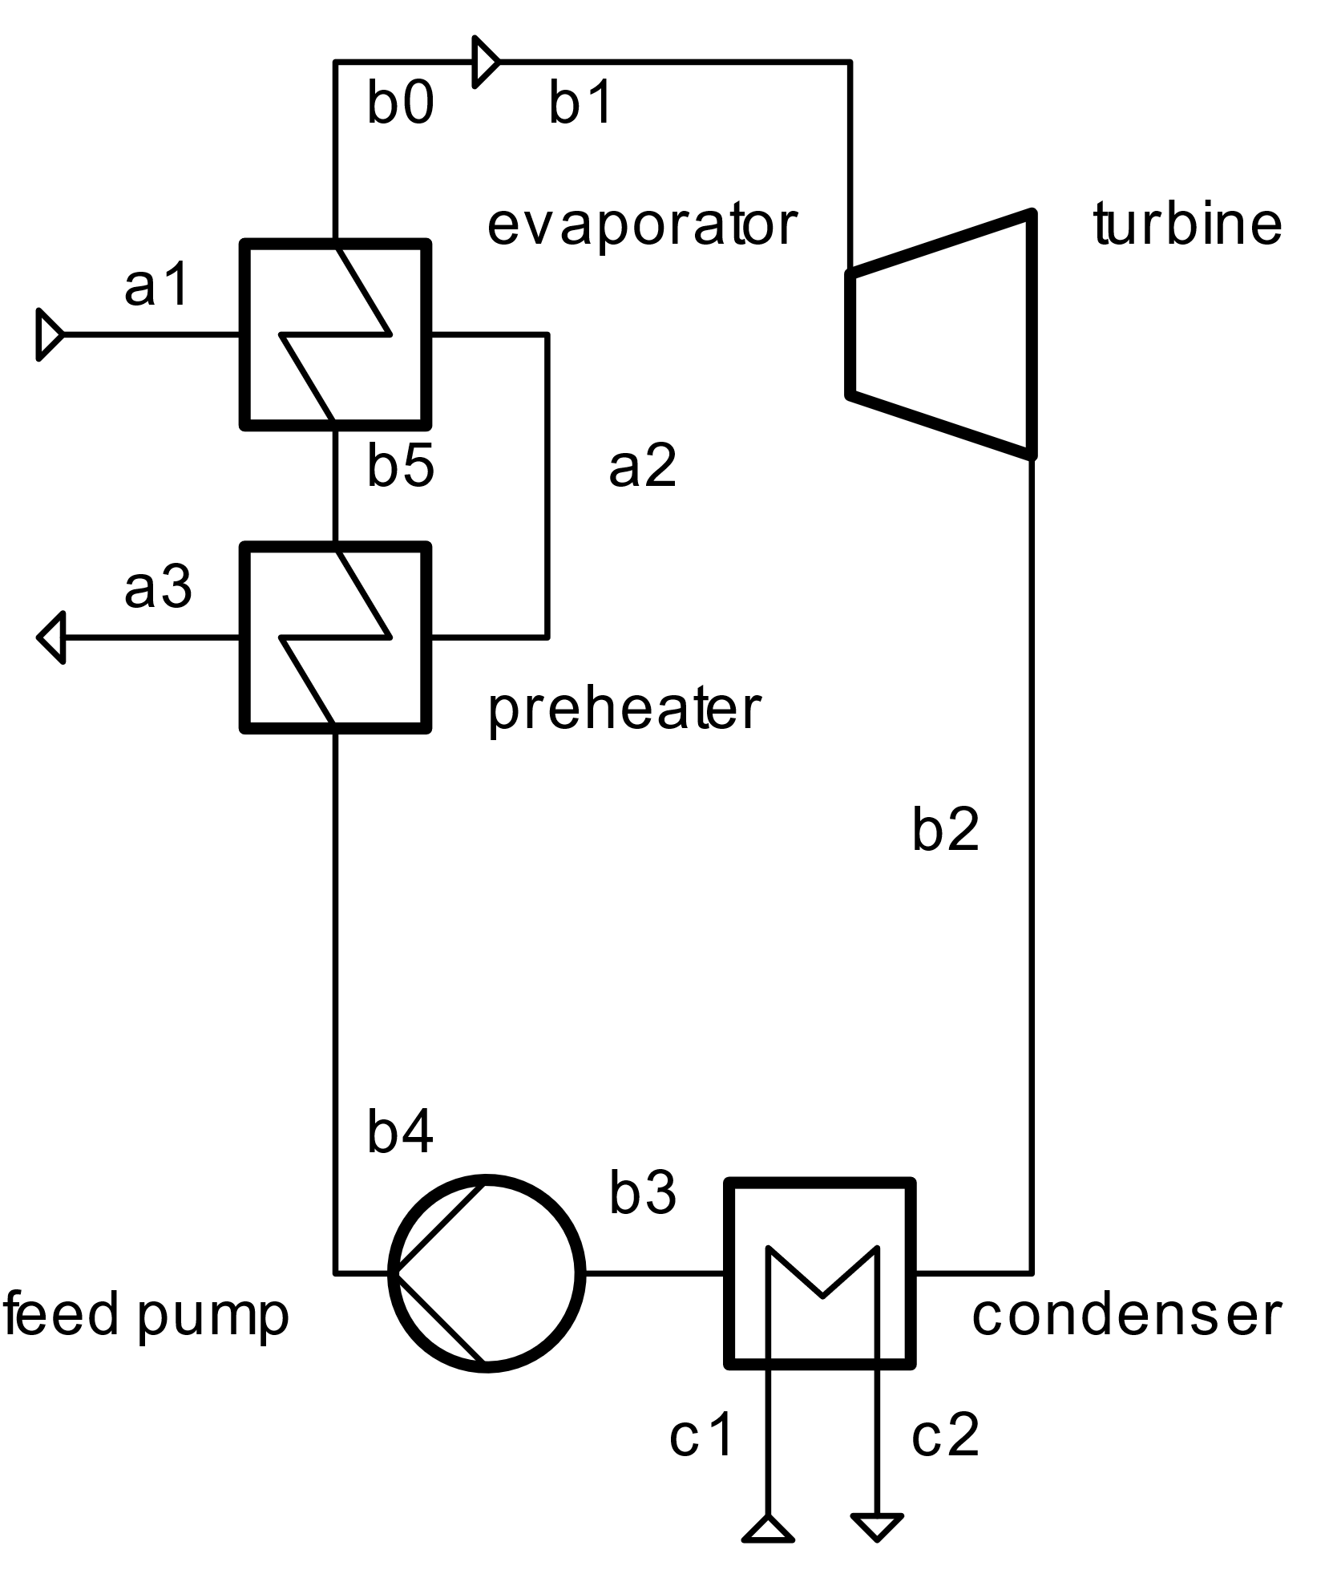
Simple ORC
Build an ORC model with the following specifications
Heat source
100 kg/s of air
Temperature: 160 °C
Pressure: 1 bar
Heat sink
Fluid: air
Temperature: 20 °C, air temperature increase: 15 K
Pressure: 1 bar
Cycle
Working fluid: water
Condenser outlet: saturated liquid
Evaporator inlet: saturated liquid
Evaporator outlet: saturated gas, 140 °C
Components
Pump efficiency: 75 %
Turbine efficiency: 85 %
Evaporator lower terminal temperature diff: 5 K
Condenser lower terminal temperature diff: 15 K
Disregard pressure drops in heat exchangers

Slide 7
Simple ORC: Single-variate optimization
Tasks
Implement a method, which allows you to maximize the power output of the plant
Think about which decision variable should be taken into consideration.
Use a custom method for this (think about the third lecture)!
Implement a method using scipy
Restructure your code in the way necessary for the tespy-pygmo integration

Slide 8
Simple ORC: advanced optimization
Tasks
Use the tespy-pygmo integration for all upcoming tasks
Implement a lower limit for the air discharge temperature, how do the results change?
Simultaneously optimize the
turbine inlet temperature
evaporator minimal pinch
preheater approach temperature difference
Run a multi-objective optimization to maximize power output and minimize the total heat exchange area

Slide 9
Next Time: Exam preparation
Things to prepare
Your questions on all of the lectures, scripts, methods, … we implemented

