Slide 1
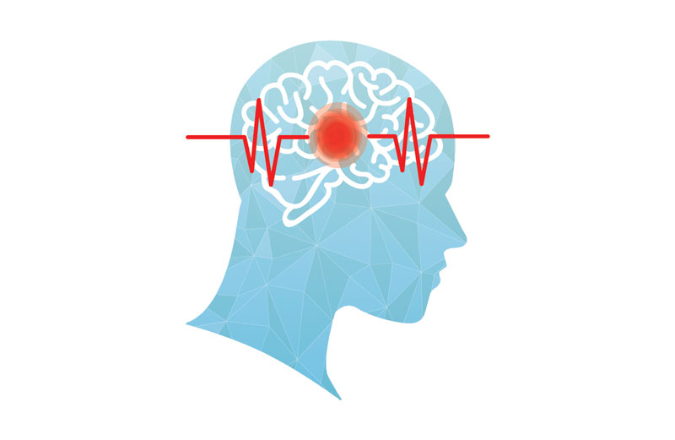
Stroke Risk Evaluation and Prediction
Team Member: Brian Lee, Yu-Hsi Chen, Ilkay Ates, Roy Jiang, Alexis Valdez

Slide 2

Stroke according to CDC Statistics
In 2020, 1 in 6 deaths from cardiovascular disease was due to stroke.
Every 40 seconds, someone in the United States has a stroke. Every 3.5 minutes, someone dies of a stroke.
Every year, more than 795,000 people in the United States have a stroke. About 610,000 of these are first or new strokes.
About 185,000 strokes—nearly 1 in 4—are people who have had a previous stroke.
About 87% of all strokes are ischemic strokes, in which blood flow to the brain is blocked.

Slide 3
Data Introduction
5110 data:
249 stroke
4861 without stroke
Features:
Gender
Age
Hypertension (or not)
Heart disease (or not)
Ever married (or not)
Work type (govt job/private/self-employed/children)
Residence type (Rural/Urban)
Avg glucose level
BMI
Smoking (or not)

Slide 4
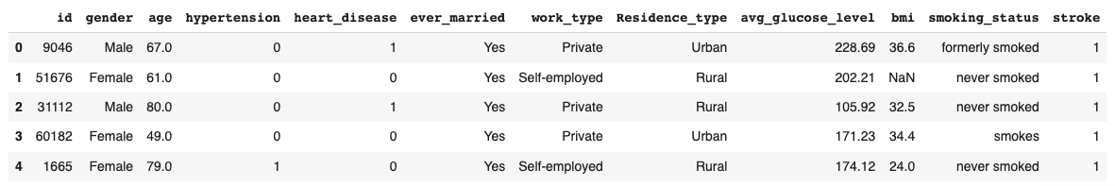
Raw data & clean data
2.
3.

Slide 5

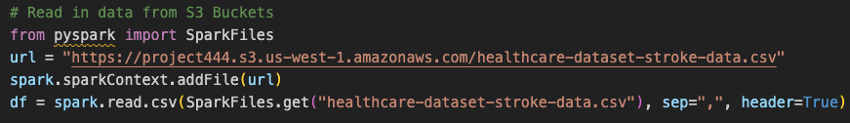

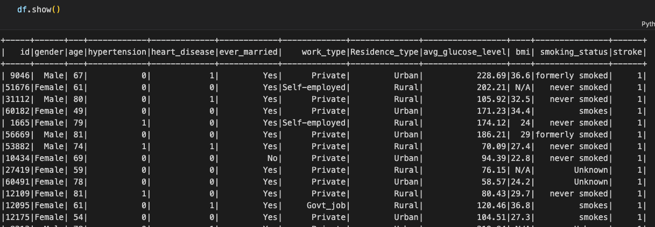
Load data into Amazon AWS S3
Spark and then convert to dataframe

Slide 6
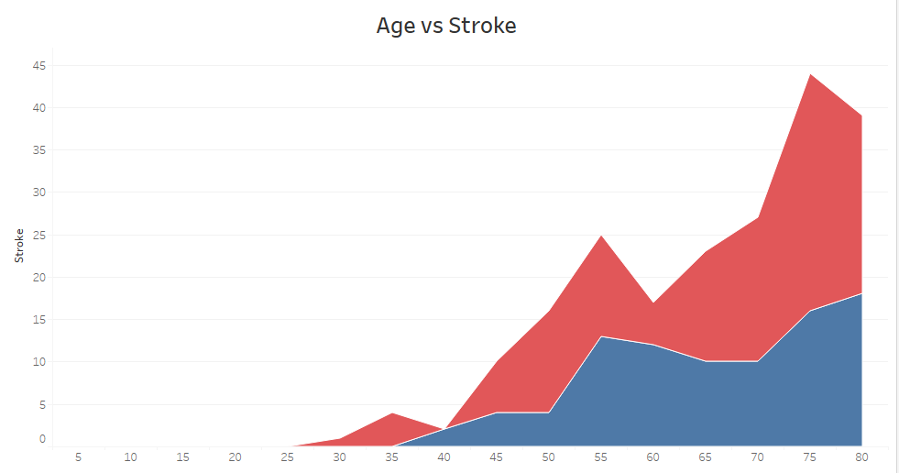

Age vs Stroke (EDA with Tableau)
According to CDC, stroke risk increases with age, but strokes may occur at any age.
Notes:
In our data set number of females are more than number of males.
Before starting this analysis, data cleaning was processed as below:
For BMI, `null` value rows were excluded.
For Gender,`other` category was removed.(has only one value)

Slide 7
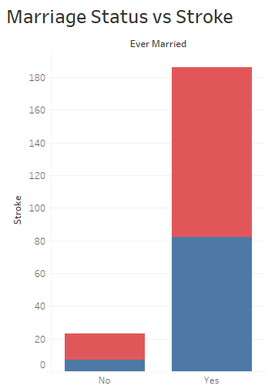
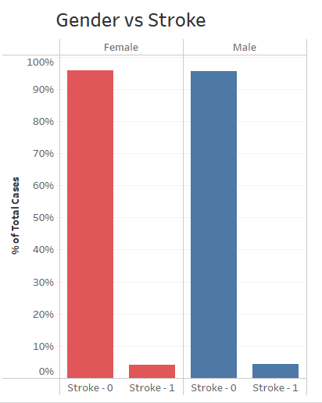
Gender/Marriage Status vs Stroke (EDA with Tableau)
It is easy to misinterpret marriage status graph.
However, from previous graph, we knew that aging is a strong predictor of stroke it gives more time to get married.
Further analysis about the relationship between age/marriage status and stroke will be helpful.
Notes:
It is easy to misinterpret marriage status graph. However, from previous graph, we knew that age is a strong predictor of stroke, and aging give more time to get married. Further analysis will be helpful.

Slide 8
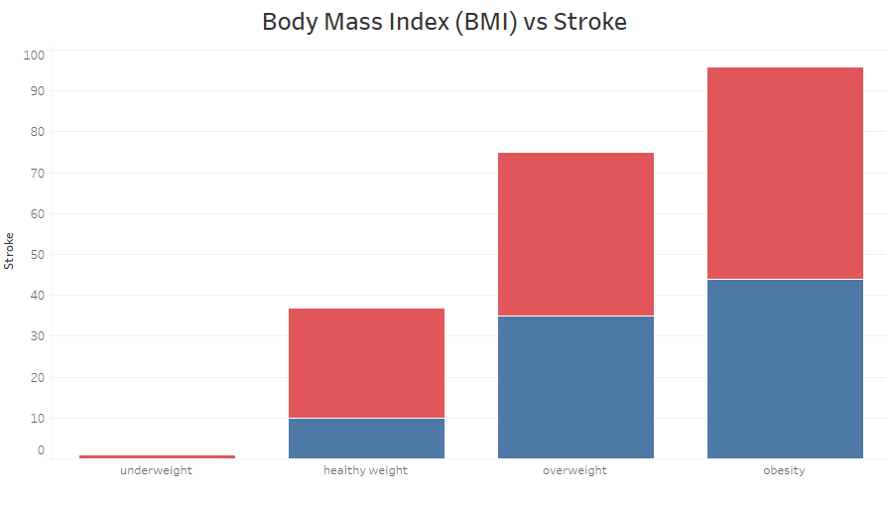
Body Mass Index (BMI) vs Stroke (EDA with Tableau)
Higher BMI (overweight or obese group) was associated with an increased overall risk of stroke.
CDC categorize BMI levels as follow:
BMI < 18.5 underweight
18.5 < BMI <25 healthy weight
25.0 < BMI <30 overweight.
BMI > 30.0 obesity
Notes:
CDC categorize BMI levels as follow:
If your BMI is less than 18.5, it falls within the underweight range.
If your BMI is 18.5 to <25, it falls within the healthy weight range.
If your BMI is 25.0 to <30, it falls within the overweight range.
If your BMI is 30.0 or higher, it falls within the obesity range.
The relationship between body mass index and stroke: a systemic review and meta-analysis
Xinyu Wang # 1 2, Yanan Huang # 1 2, Yanru Chen 1 2, Tingting Yang 1 2, Wenli Su 1 2, Xiaoli Chen 1 3 2, Fanghong Yan 1 2, Lin Han 4 5 6, Yuxia Ma 7 8 9

Slide 9
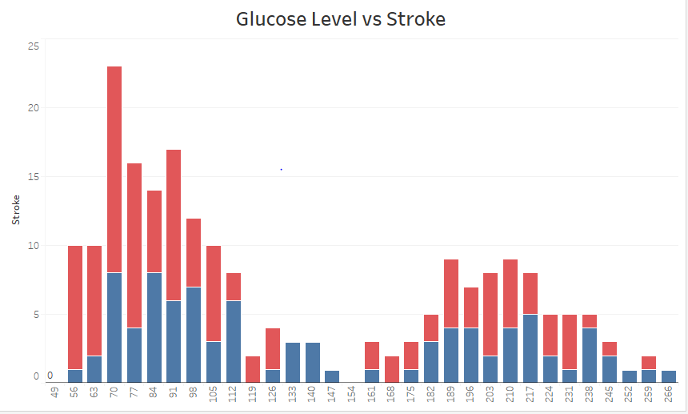
Glucose Level vs Stroke (EDA with Tableau)
Low levels of glucose on blood has similar effects as high levels of glucose in terms of stroke.
Notes:
High blood glucose levels can damage blood vessels over time, leading to a buildup of plaque in the arteries and increasing the risk of stroke. High glucose levels can also increase inflammation in the body, which can further increase the risk of stroke.
Low blood glucose levels can also increase the risk of stroke by causing a reduction in blood flow to the brain. Additionally, hypoglycemia can cause neurological symptoms such as confusion, dizziness, and weakness, which can increase the risk of falls and other accidents that can lead to stroke.

Slide 10
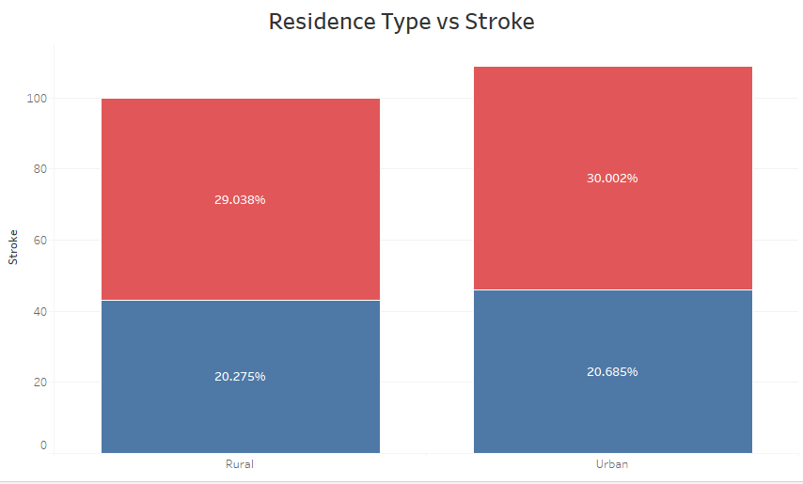
Residency Type vs Stroke (EDA with Tableau)
Urban cases are slightly higher than rural cases.
Notes:
Rural residence is associated with stroke incidence and mortality, but little is known about potential rural/urban differences in ambulatory stroke care.

Slide 11
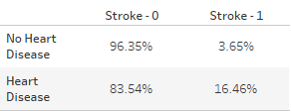
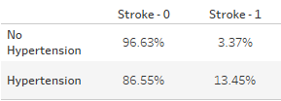
HyperTension & Heart Disease vs Stroke (EDA with Tableau)

Slide 12
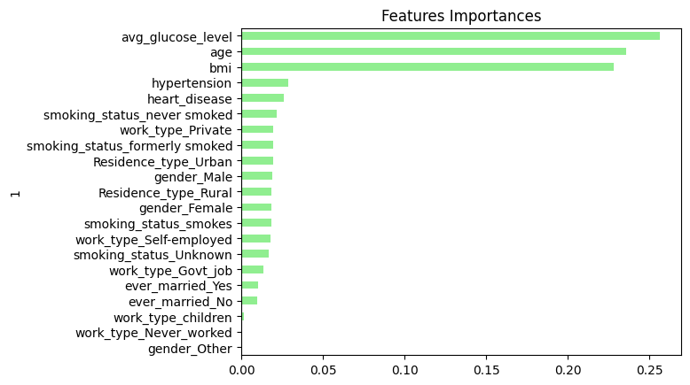
Features Importances

Slide 13
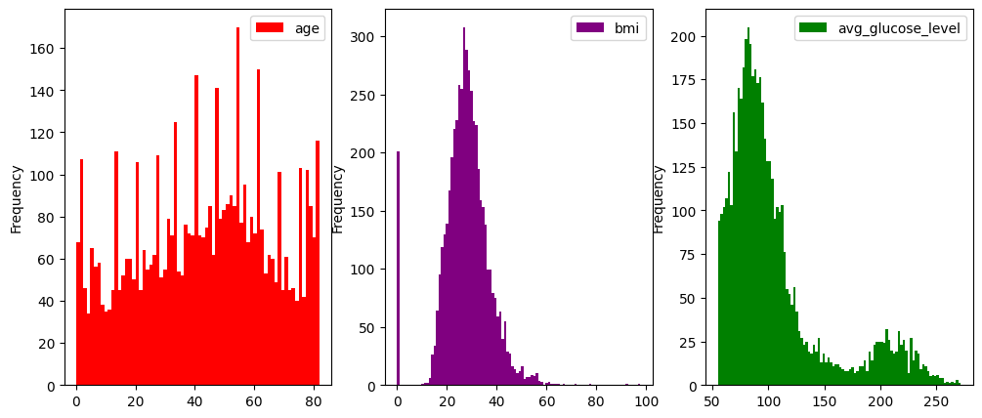
Frequencies of Age,BMI, and Average Glucose Levels
The graph displays the frequencies of three important factors that affect stroke.
Age ~ 40-50
BMI~20-40
Avg Gluc~100

Slide 14
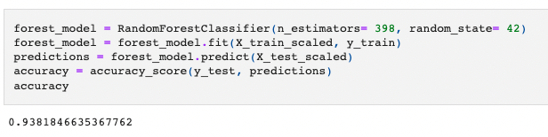
Machine learning model - Random Forest
High accuracy!

Slide 15
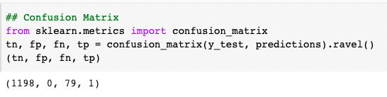
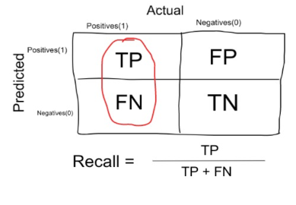
Confusion matrix
Recall = 1/(1+79) = 0.0125
But low recall!

Slide 16
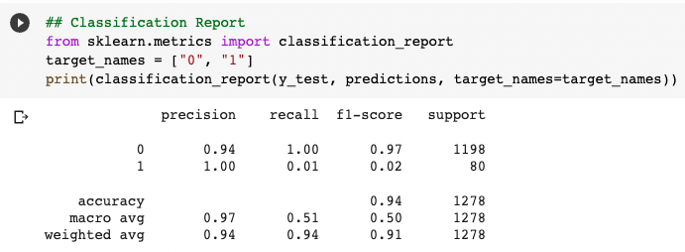
Classification Report
High accuracy but low recall.

Slide 17
Troubleshooting - imbalanced dataset
249 cases with stroke.
4860 cases with no stroke

Slide 18
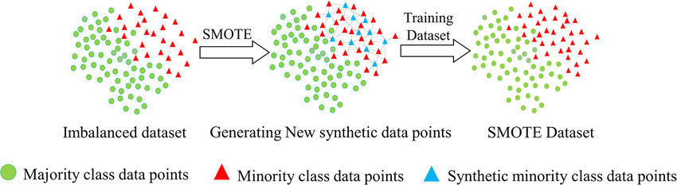
Troubleshooting - SMOTE
Synthetic Minority Over-sampling Technique (SMOTE)
oversample = SMOTE()
Resource: https://www.researchgate.net/figure/llustration-of-synthetic-minority-oversampling-technique_fig2_343326638

Slide 19
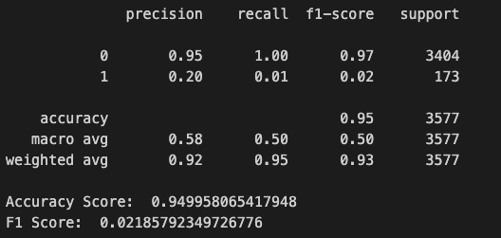
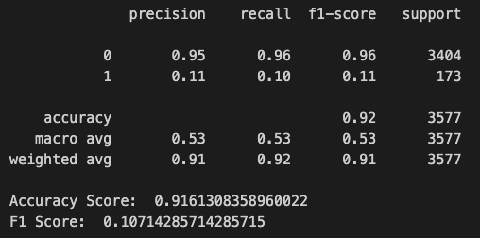
Random Forest with SMOTE
Synthetic Minority Over-sampling Technique (SMOTE)
oversample = SMOTE()
Resource: https://www.researchgate.net/figure/llustration-of-synthetic-minority-oversampling-technique_fig2_343326638

Slide 20
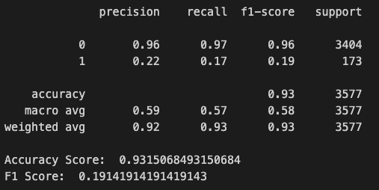
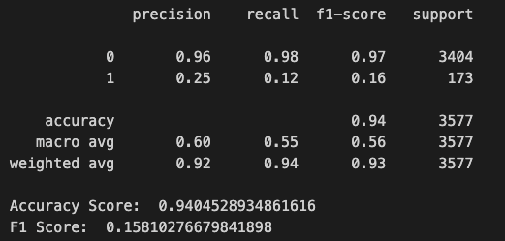
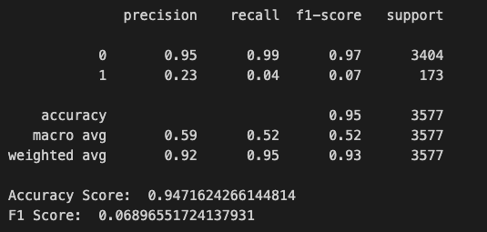

Optimization to improve recall - Logistic Regression
Logistic Regression - Trial version 1: Simple logistic regression model
Logistic Regression - Trial version 3: Grid Search
Reference:
Logistic Regression - Trial version 2: solver = ‘ibfgs’
logreg_pipeline = Pipeline(steps = [('scale',StandardScaler()),('LR',LogisticRegression(C=0.1,penalty='l2',random_state=42))])

Slide 21
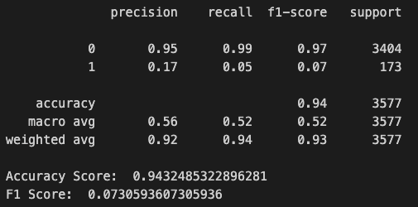
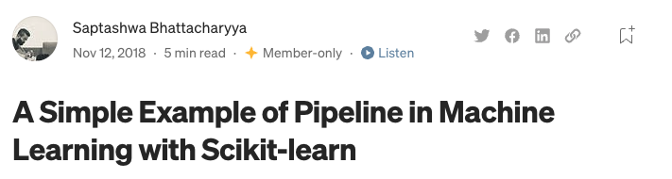
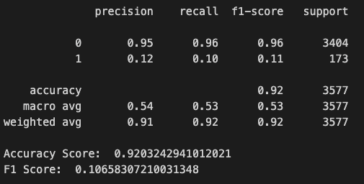
Optimization to improve recall - SVM
Trial version 1: Kernel-’Linear’
Reference:
Trial version 2: Optimizing gamma and C for SVM
Pipeline(steps = [('scale',StandardScaler()),('SVM',SVC(C=100,gamma=0.01,kernel='rbf',random_state=42))])

Slide 22
Model Comparison
Conclusion
 | Accuracy | Recall (0) | Recall (1)
Random Forest | 0.92 | 0.96 | 0.10
SVM | 0.92 | 0.95 | 0.10
Logistic Regression | 0.93 | 0.99 | 0.17
Various models suggest they are great at predicting non-stroke cases while not good at predicting stroke cases.
Data sources were very unbalanced at the beginning so collecting unbiased datasource is key.

Slide 23
References
Stroke Prediction Dataset - https://www.kaggle.com/datasets/fedesoriano/stroke-prediction-dataset/code
Can work stress be linked to stroke? / American Academy of Neurology - https://www.aan.com/PressRoom/Home/PressRelease/1412#:~:text=Having%20a%20high%20stress%20job,the%20American%20Academy%20of%20Neurology
The relationship between body mass index and stroke: a systematic review and meta-analysis / National Library of Medicine / https://pubmed.ncbi.nlm.nih.gov/35971008/
Stroke Facts / https://www.cdc.gov/stroke/facts.htm
Rural-Urban Differences in Stroke Risk Factors, Incidence, and Mortality in People With and Without Prior Stroke / https://www.ahajournals.org/doi/10.1161/CIRCOUTCOMES.118.004973

