Slide 1

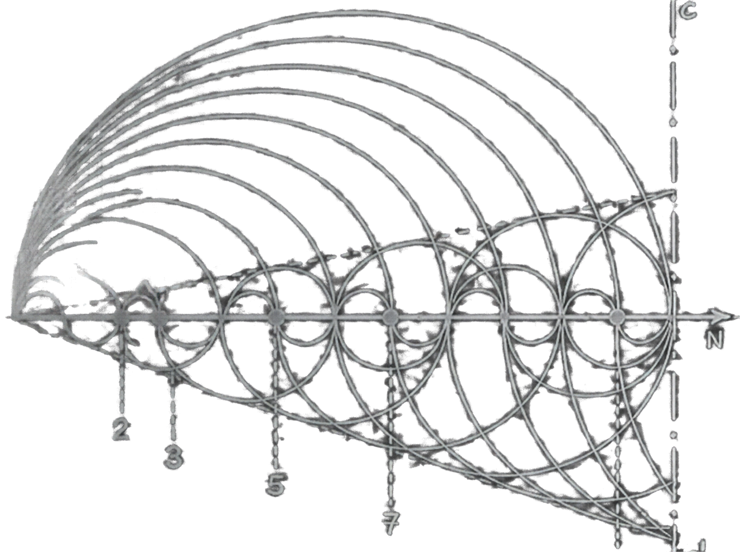
Fibonacci
Sequence
Generation in
VNMSim
COMPUTER SYSTEM STRUCTURE
/ TASK 6
Team members: Nikita Kevin Illia

Slide 2

Project goal
We chose Fibonacci because each new term comes from one addition. It is a simple way to practise loops and register updates.
Starting values
T1 = 0 T2 = 1
Each pass adds the two stored terms, then updates the registers for the next pass.
02

Slide 3
The Fibonacci rule
F0 = 0 F1 = 1
Fn = F(n-1) + F(n-2)
First terms
0 1 1 2 3 5 8 13 21 34
T1 holds the previous term, T2 the current term, and T3 receives their sum.
03

Slide 4
VNMSim components in the loop
RAM
Holds the program instructions and data values
PC
Selects the next instruction to execute.
IR and decoder
The IR holds the current instruction. The decoder interprets it.
ALU and ACC
Perform addition and hold the current calculation result.
JMP 5 sends the PC back to the first instruction of the loop.
04

Slide 5
The loop and JMP 5
0 // Fibonacci loop
1 LOD #0
2 STO T1
3 LOD #1
4 STO T2
5 LOD T1
6 ADD T2
7 STO T3
8 LOD T2
9 STO T1
10 LOD T3
11 STO T2
12 JMP 5
Register roles
T1 previous term
T2 current term
T3 new sum
Jump target
JMP 5 returns to line 5, LOD T1. The first line is numbered 0 in this listing.
05

Slide 6
Testing the register trace
Values after passes 1–4 match our screenshots; pass 5 is a prediction.
Checkpoint | T1 | T2 | T3 / new term
Before loop | 0 | 1 | n/a
After pass 1 | 1 | 1 | 1
After pass 2 | 1 | 2 | 2
After pass 3 | 2 | 3 | 3
After pass 4 | 3 | 5 | 5
Predicted pass 5 | 5 | 8 | 8
Passes 1–4 matched the VNMSim screenshots. We stopped the simulation manually.
06

Slide 7
Teamwork and AI assistance
AI assistance
Suggested speaking split
AI gave us a draft of the rolling loop and explained JMP 5. We checked the target and first four register states in VNMSim. AI also suggested a counter with JMZ for a finite run. We did not implement or test that option.
Nikita: explain the task and Fibonacci rule
Kevin: explain the code and registers
Illia: show the test results and AI use
Confirm this split with the team. All three members should speak.
07

Slide 8
What the program shows
What works
Current limits
It repeats the Fibonacci addition rule.
It uses JMP to return to the loop.
Three registers are enough for the rolling calculation.
The loop has no stop condition.
Older terms are overwritten, so the full sequence is not kept.
A counter with JMZ is a possible next step, but we did not test it.
08

