Slide 1
TLP-GP
Solving Temporally-Expressive
Planning Problems

Slide 2
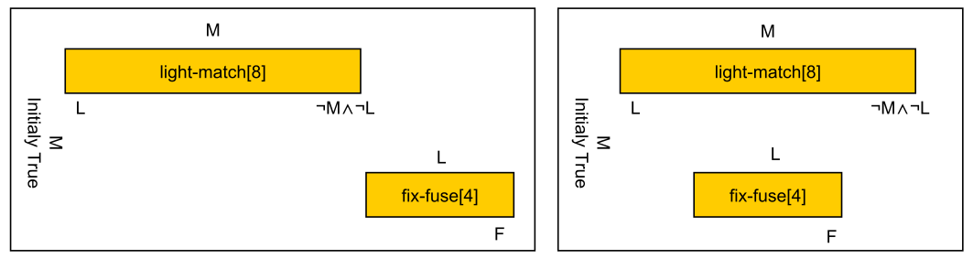

Slide 3
TLP-GP
Solves temporally-expressive planning problems
Planning graph built until goal obtained
  atemporal
Solution extraction from planning graph
  backwards
  places temporal constraints between actions

Slide 4
Example
∏ = <O, I, G>
I = {}
G = {b, d, e}
O = {(A, {}, {a_{[0]} , ¬a_{[5]} , b_{[5]} , ¬d_{[5]} }, 5) ;
(B, {a_{[0]} }, {c_{[0]} , d_{[4]} , ¬c_{[4]} }, 4) ;
(C, {c_{[0]} }, {¬b_{[1]} , e_{[1]} }, 1)}
(<name>, <pre>, <eff>, <dur>)

Slide 5
Example
∏ = <O, I, G>
I = {}
G = {b, d, e}
O = {(A, {}, {a_{[0]} , ¬a_{[5]} , b_{[5]} , ¬d_{[5]} }, 5) ;
(B, {a_{[0]} }, {c_{[0]} , d_{[4]} , ¬c_{[4]} }, 4) ;
(C, {c_{[0]} }, {¬b_{[1]} , e_{[1]} }, 1)}
(<name>, <pre>, <eff>, <dur>)

Slide 6
Example
∏ = <O, I, G>
I = {}
G = {b, d, e}
O = {(A, {}, {a_{[0]} , ¬a_{[5]} , b_{[5]} , ¬d_{[5]} }, 5) ;
(B, {a_{[0]} }, {c_{[0]} , d_{[4]} , ¬c_{[4]} }, 4) ;
(C, {c_{[0]} }, {¬b_{[1]} , e_{[1]} }, 1)}
(<name>, <pre>, <eff>, <dur>)

Slide 7
Example
∏ = <O, I, G>
I = {}
G = {b, d, e}
O = {(A, {}, {a_{[0]} , ¬a_{[5]} , b_{[5]} , ¬d_{[5]} }, 5) ;
(B, {a_{[0]} }, {c_{[0]} , d_{[4]} , ¬c_{[4]} }, 4) ;
(C, {c_{[0]} }, {¬b_{[1]} , e_{[1]} }, 1)}
(<name>, <pre>, <eff>, <dur>)

Slide 8
Example
∏ = <O, I, G>
I = {}
G = {b, d, e}
O = {(A, {}, {a_{[0]} , ¬a_{[5]} , b_{[5]} , ¬d_{[5]} }, 5) ;
(B, {a_{[0]} }, {c_{[0]} , d_{[4]} , ¬c_{[4]} }, 4) ;
(C, {c_{[0]} }, {¬b_{[1]} , e_{[1]} }, 1)}
(<name>, <pre>, <eff>, <dur>)

Slide 9
Example
∏ = <O, I, G>
I = {}
G = {b, d, e}
O = {(A, {}, {a_{[0]} , ¬a_{[5]} , b_{[5]} , ¬d_{[5]} }, 5) ;
(B, {a_{[0]} }, {c_{[0]} , d_{[4]} , ¬c_{[4]} }, 4) ;
(C, {c_{[0]} }, {¬b_{[1]} , e_{[1]} }, 1)}
(<name>, <pre>, <eff>, <dur>)

Slide 10
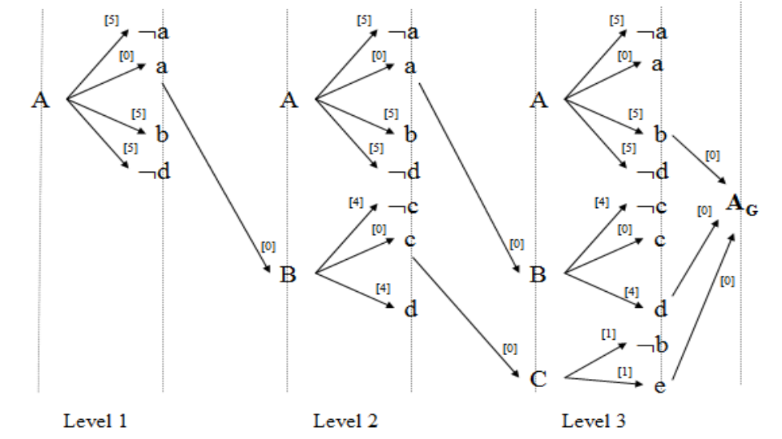
Example
Maris, Régnier, 2008.

Slide 11
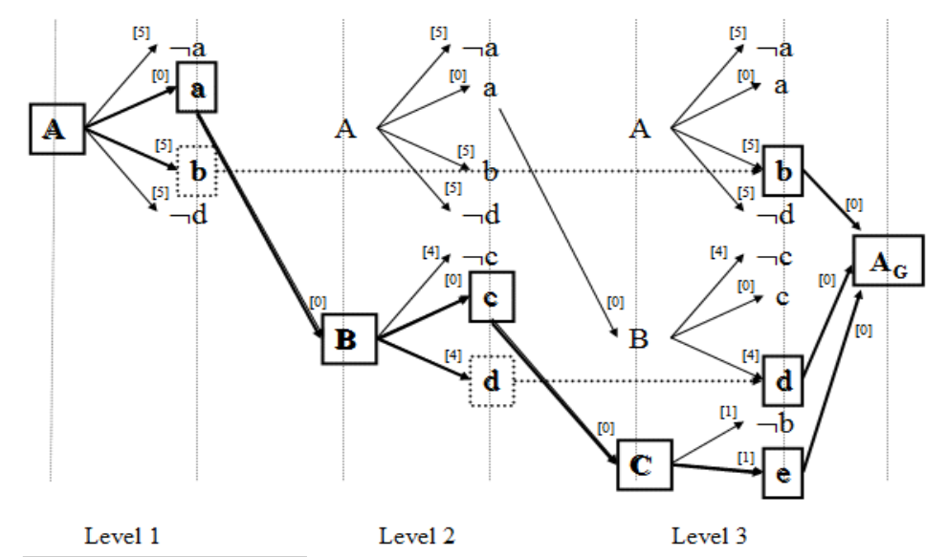
Example
Maris, Régnier, 2008.

Slide 12
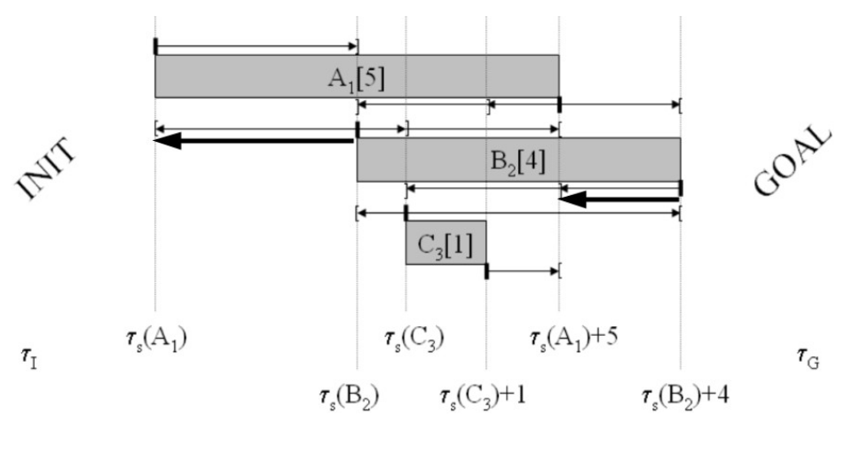
Example
Maris, Régnier, 2008.

Slide 14
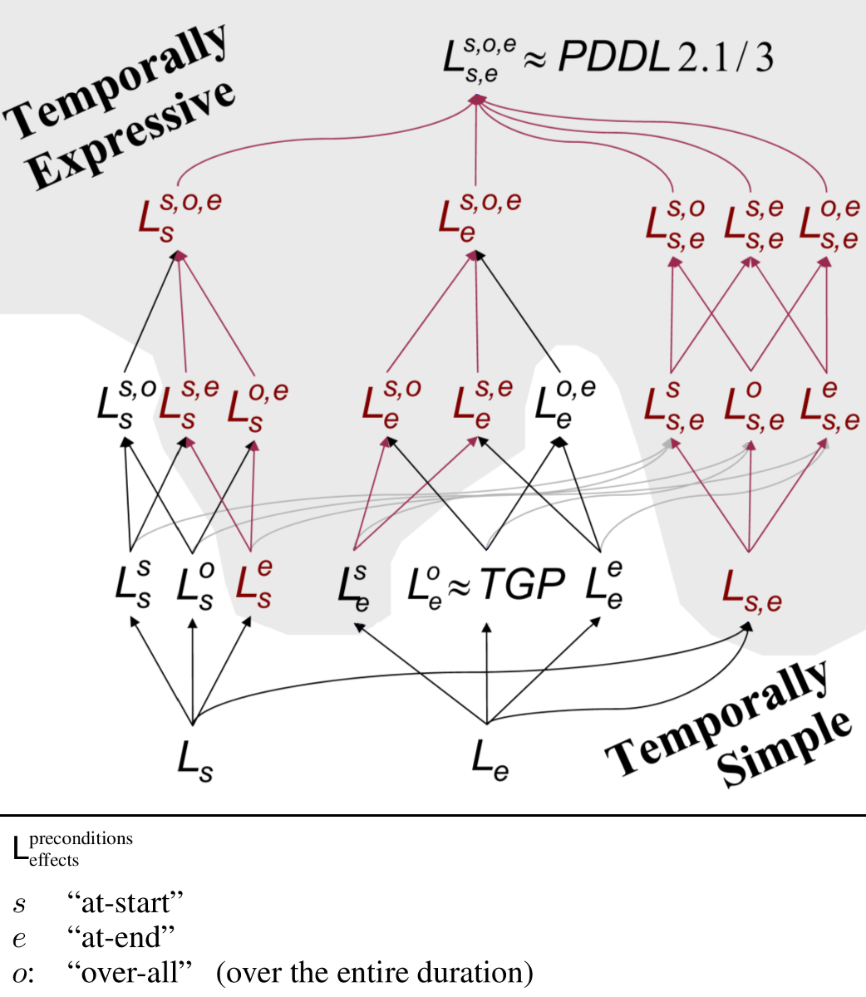
Cushing et al., 2007.

Slide 15
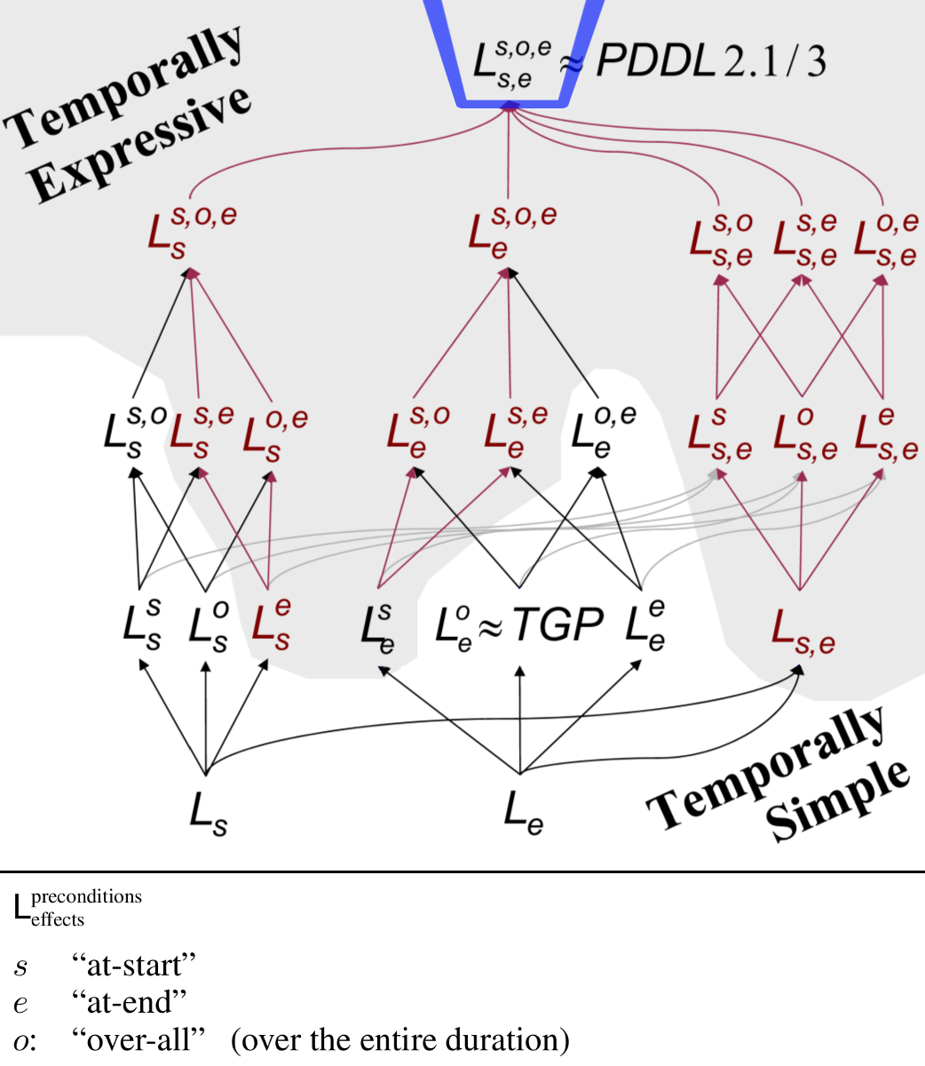
Cushing et al., 2007.

Slide 16
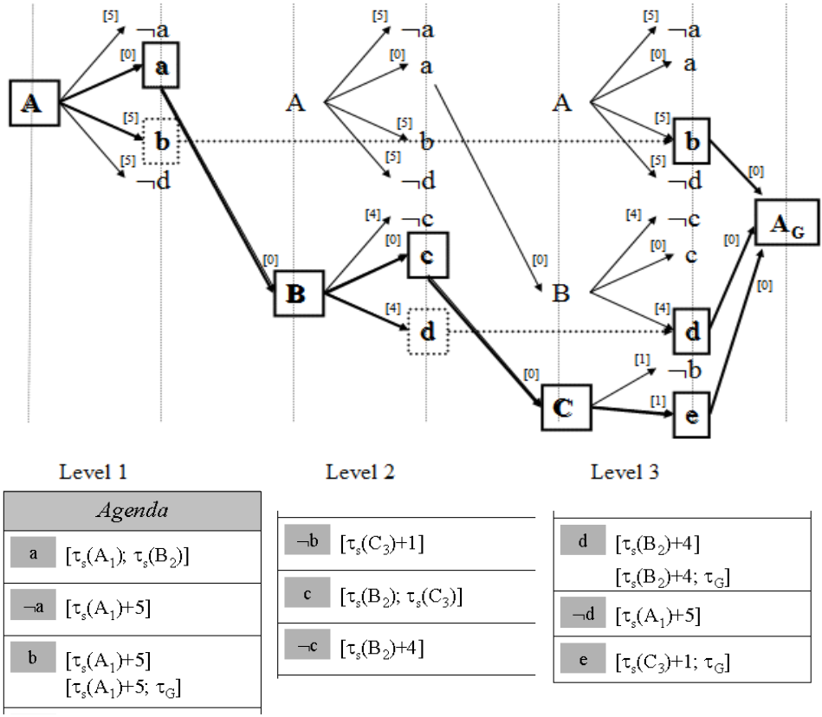
Maris, Régnier, 2008.

