Slide 1
Applications of AI Planning:
Story Telling

Slide 2
Preface
Application areas: strucutural similarity
Story: sequence of character actions
Benefit?

Slide 3
Preface
Application areas: strucutural similarity
Story: sequence of character actions
Benefit?
  when creating something new

Slide 4
Outline
Story world modeling
Differences to classical planning
Concrete Approaches
  Fabula
  Discourse
Conclusion

Slide 5
Story world modeling
On a basic level
  Attributes of main characters → Predicates
  Actions of main characters → Operators

Slide 6
Story world modeling
On a basic level
“In a fictional world with a continent named Westeros, the highborn refugee Viserys sold his younger sister Daenerys to a warlord in exchange for the warlord’s army. He used the army to conquer Westeros and become its king.”

Slide 7
Story world modeling
On a basic level
“In a fictional world with a continent named Westeros, the highborn refugee Viserys sold his younger sister Daenerys to a warlord in exchange for the warlord’s army. He used the army to conquer Westeros and become its king.”

Slide 8
Story world modeling
On a basic level
“In a fictional world with a continent named Westeros, the highborn refugee Viserys sold his younger sister Daenerys to a warlord in exchange for the warlord’s army. He used the army to conquer Westeros and become its king.”

Slide 9
Story world modeling
A = { V-army , V-king , D-sold }
O = { V-sell-D , V-conquer-W }
  V-sell-D = ⟨ ¬V-army ∧ ¬D-sold , V-army ∧ D-sold ⟩
  V-conquer-W = ⟨ V-army ∧ ¬V-king , V-king ⟩
I = ¬V-army ∧ ¬V-king ∧ ¬D-sold
γ = V-king

Slide 10
Story world modeling
On a basic level

Slide 11
Story world modeling
More sophisticated

Slide 12
Story world modeling
More sophisticated
  Story variations
  Interactivity
  Planning of story
  structures based on world rules

Slide 13
Differences to classical planning
Similar on basic level
Different in nature
  Purpose
  Key Properties
  More sophistication → challenges
Specialized planners (IPOCL)
Interactivity

Slide 14
Concrete approaches
Fabula
  Haslum
  Narrative planning: Compilations to classical planning
Discourse
  Porteous, Cavazza, Charles
  Applying planning to interactive storytelling: Narrative control using state constraints

Slide 15
Narrative Theory
“In simple terms, the [fabula] is the what in a narrative that is depicted, discourse is the how.” — Chatman

Slide 16
Planning a fabula
Based in IPOCL approach
Focus on intentionality
  Character goals
  Delegation
  Intentional plans, frames of commitment

Slide 17
Planning a fabula
γ

Slide 18
Planning a fabula
γ_{p}
γ
γ_{k}

Slide 19
Planning a fabula
γ_{p}
γ
γ_{k}

Slide 20
Planning a fabula
Def. Intentional plan:
  Intentional actions: associated with (intends A g)
  Final step s_{fin}∈ S' makes g true
  Motivating step s_{m}∉ S'
  Causal or motivational links to s_{fin}

Slide 21
Planning a fabula
Def. Intentional plan:
  Intentional actions: associated with (intends A g)
  Final step s_{fin}∈ S' makes g true
  Motivating step s_{m}∉ S'
  Causal or motivational links to s_{fin}

Slide 22
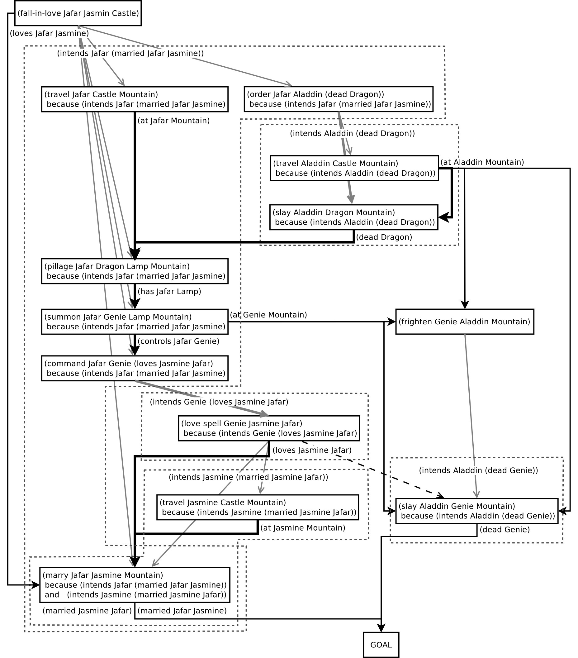

Slide 23
Planning a discourse
Goals
  Variation
  Interactivity
Methods
  PoV
  Decomposition

Slide 24
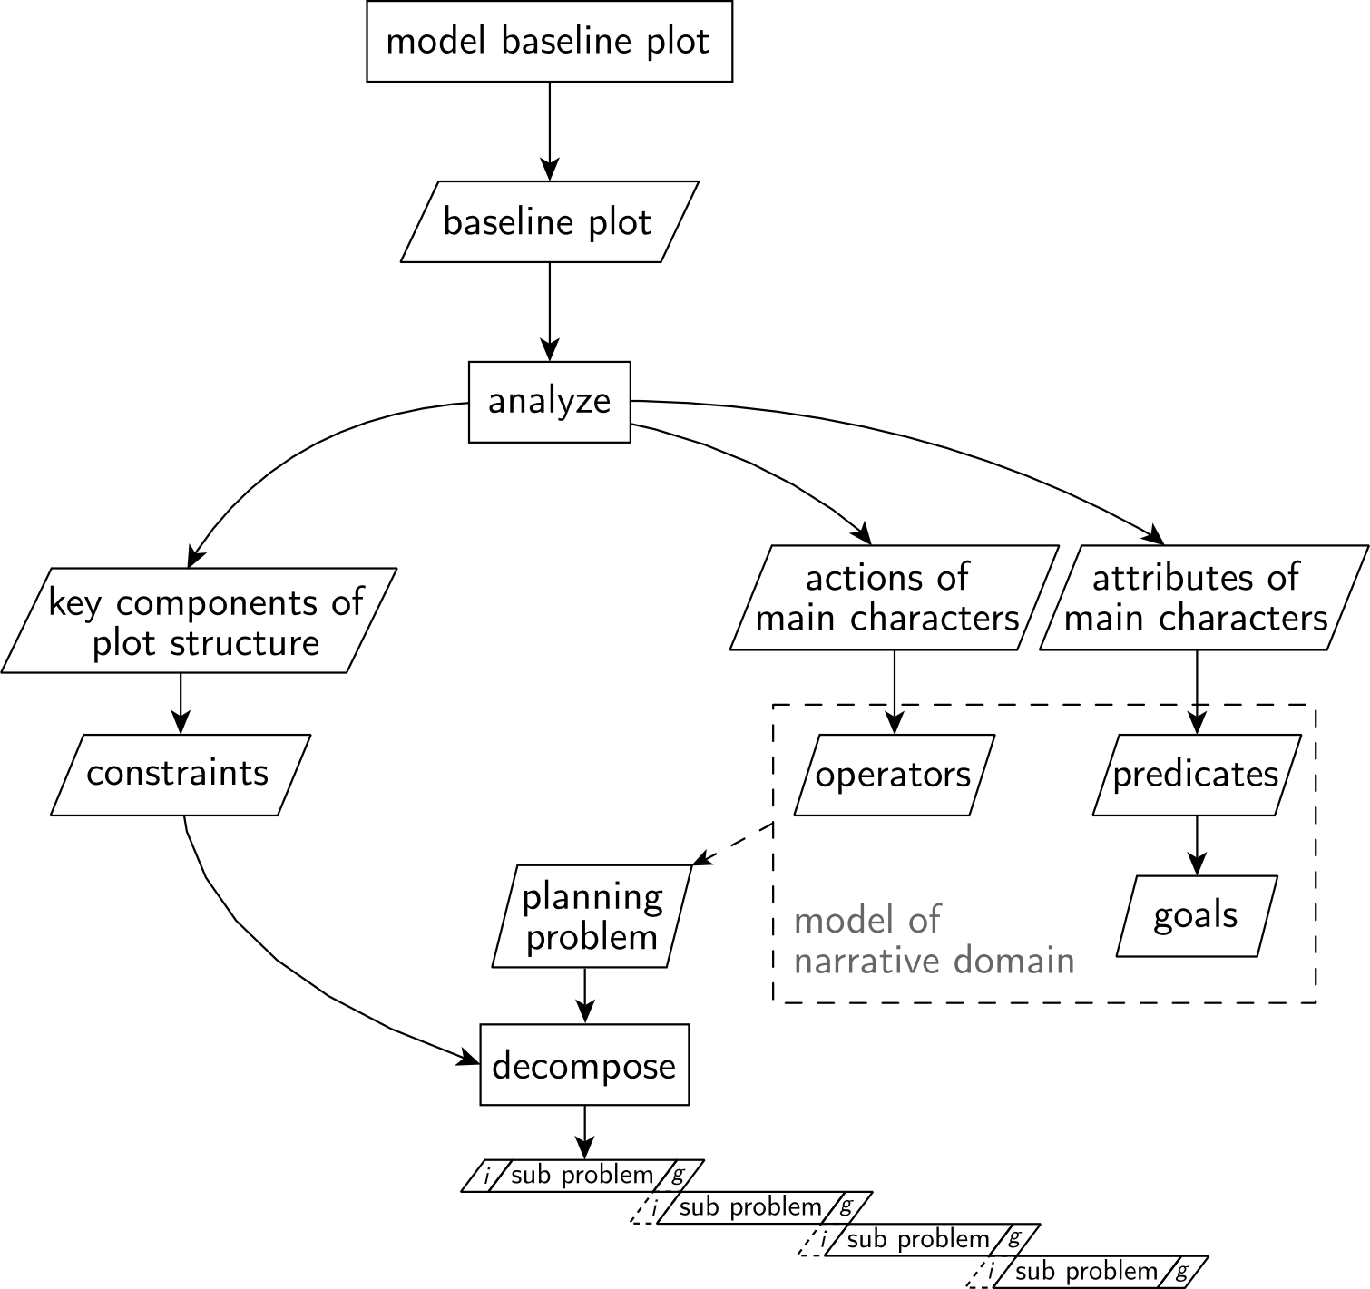
Planning a discourse

Slide 25
Conclusion
Approachable on different levels
Specialized planners vs. modeling
IS

Slide 26
Sources
Julie Porteous, Marc Cavazza, and Fred Charles. Applying planning to interactive storytelling: Narrative control using state constraints. ACM Trans. Intell. Syst. Technol., 1(2):10:1–10:21, 2010.
M.O. Riedl and R.M. Young. An intent-driven planner for multi-agent story generation. In Autonomous Agents and Multiagent Systems, 2004. AAMAS 2004. Proceedings of the Third International Joint Conference on, pages 186–193, July 2004.
S.B. Chatman. Story and Discourse: Narrative Structure in Fiction and Film. Cornell Paperbacks. Cornell University Press, 1980.
D. Herman, M. Jahn, and M.L. Ryan. Routledge Encyclopedia of Narrative Theory. Taylor & Francis, 2010.
Patrik Haslum. Narrative planning: Compilations to classical planning. Journal of Artificial Intelligence Research, 44:383–395, 2012.
Mark O. Riedl and R. Michael Young. Narrative planning: Balancing plot and character. Journal of Artificial Intelligence Research, 39(1):217–268, September 2010.
Alfonso E. Gerevini, Patrik Haslum, Derek Long, Alessandro Saetti, and Yannis Dimopoulos. Deterministic planning in the fifth international planning competition: PDDL3 and experimental evaluation of the planners. Artificial Intelligence, 173(5–6):619 – 668, 2009.
Stephen Ware, R. Young, Christian Stith, and Phillip Wright. Interactive narrative planning in the best laid plans. AAAI Conference on Artificial Intelligence, 2015.

