Slide 1
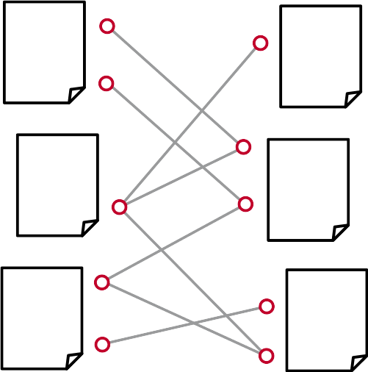
Semantic Approaches to
Citation Recommendation
Tarek Saier
Master‘s Thesis
Examiners: Prof. Dr. Georg Lausen
Prof. Dr. Christian Schindelhauer

Slide 2
Overview
Background
Data Set
Approaches
  Entity based
  Claim based
Evaluation
  Offline
  User study
Discussion

Slide 3
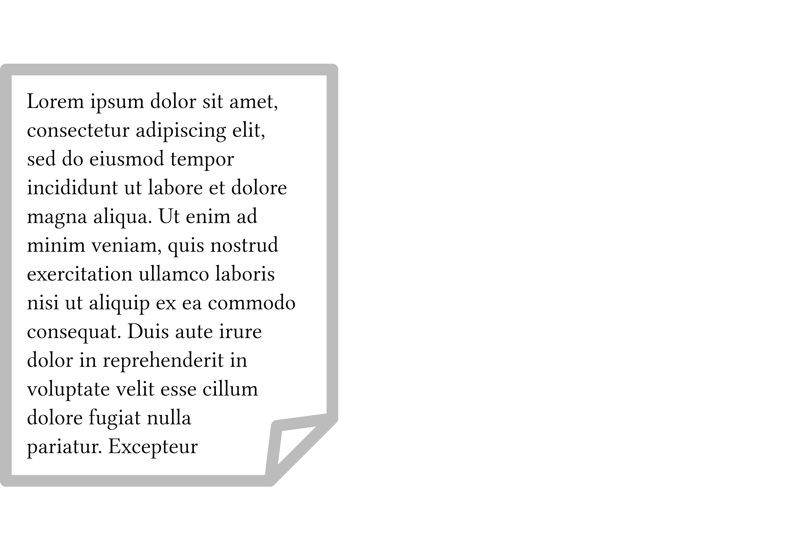
Background

Slide 4
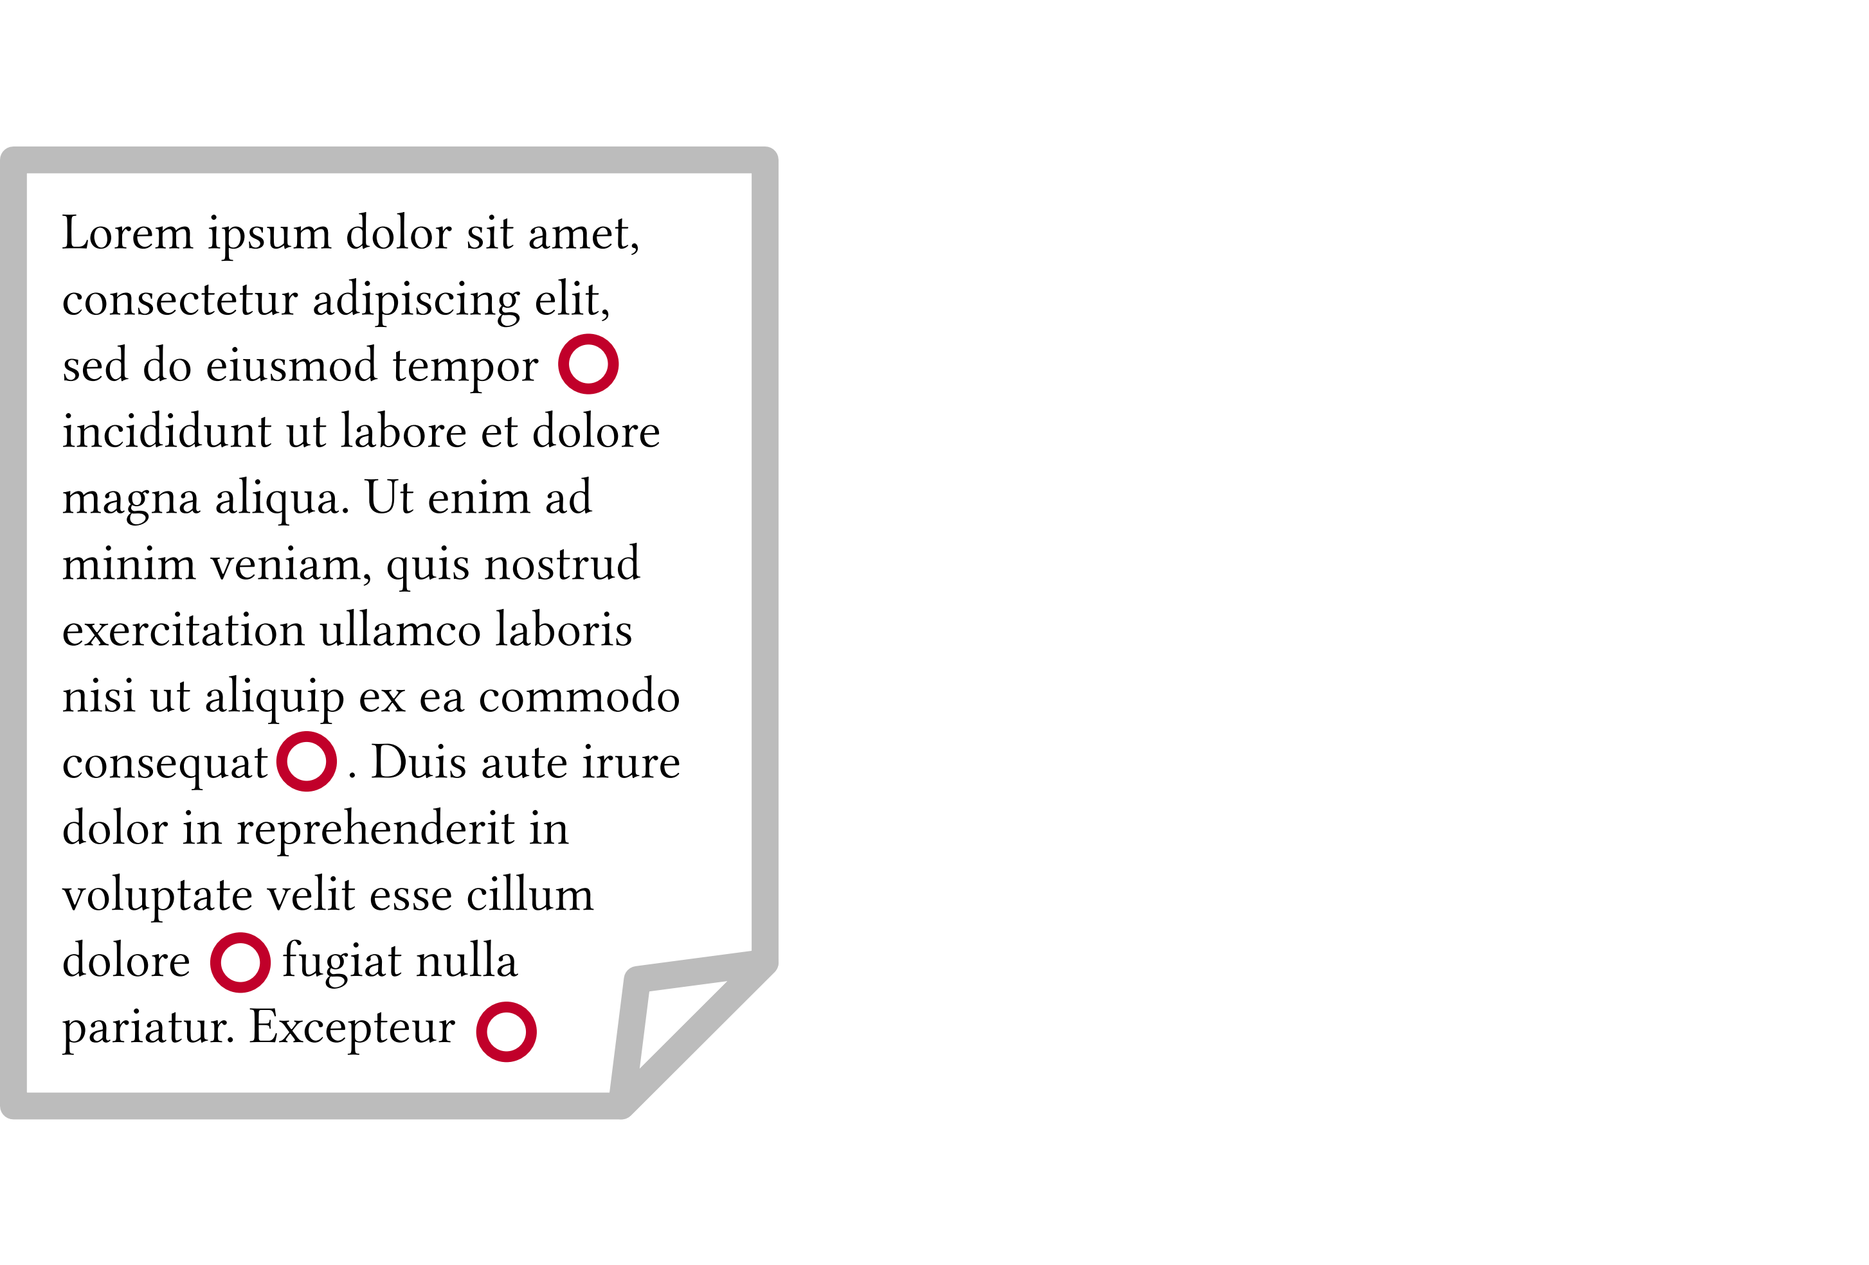
Background

Slide 5
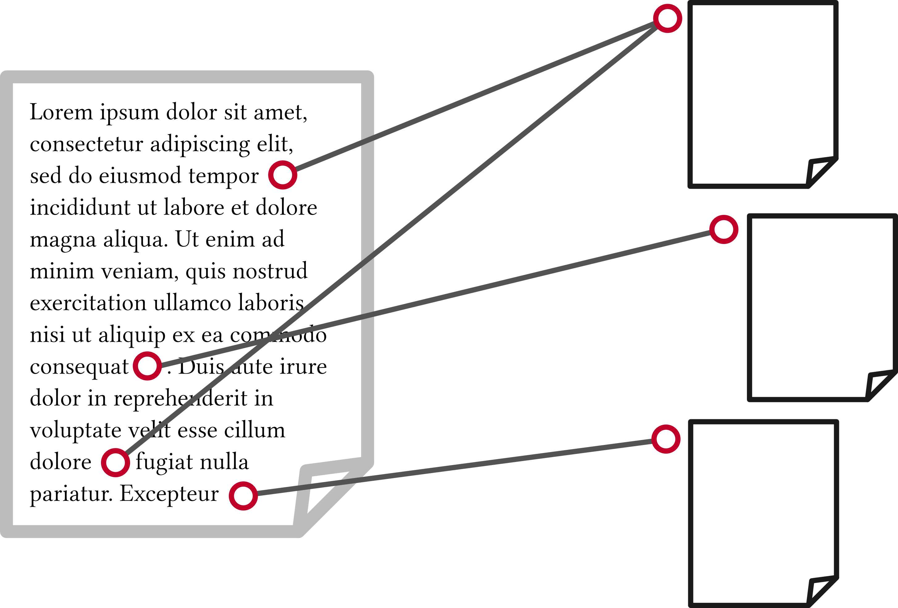
Background

Slide 6

Background

Slide 7

Background

Slide 8
Background
Automatic processing
  Processing of documents as is
  Semantic modelling of documents

Slide 9
Background
Automatic processing
  Processing of documents as is
  Semantic modelling of documents
Several approaches
  Development of ontologies (Peroni et al., 2012)
  Document exploration (Berger et al., 2016)
  Recommendation for reading (Beel et al., 2016)
  Redommendation for citing
    Global (Galke et al., 2018)
    Local co-citation (Kobayashi et al., 2018)
    Local (Ebesu et al., 2017)

Slide 10
Background
Automatic processing
  Processing of documents as is
  Semantic modelling of documents
Several approaches
  Development of ontologies (Peroni et al., 2012)
  Document exploration (Berger et al., 2016)
  Recommendation for reading (Beel et al., 2016)
  Redommendation for citing
    Global (Galke et al., 2018)
    Local co-citation (Kobayashi et al., 2018)
    Local (Ebesu et al., 2017) this, and also semantic

Slide 11
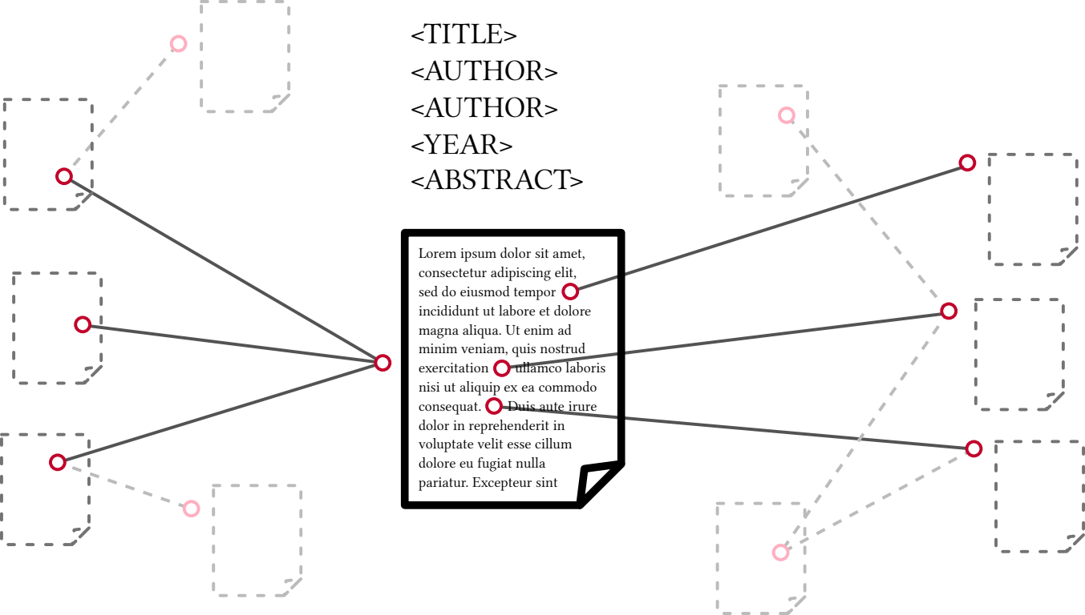
Background
Redommendation for citing
  Global paper → paper(s)
  Local co-citation sentence+cit. → paper(s)
  Local sentence → paper(s)

Slide 12
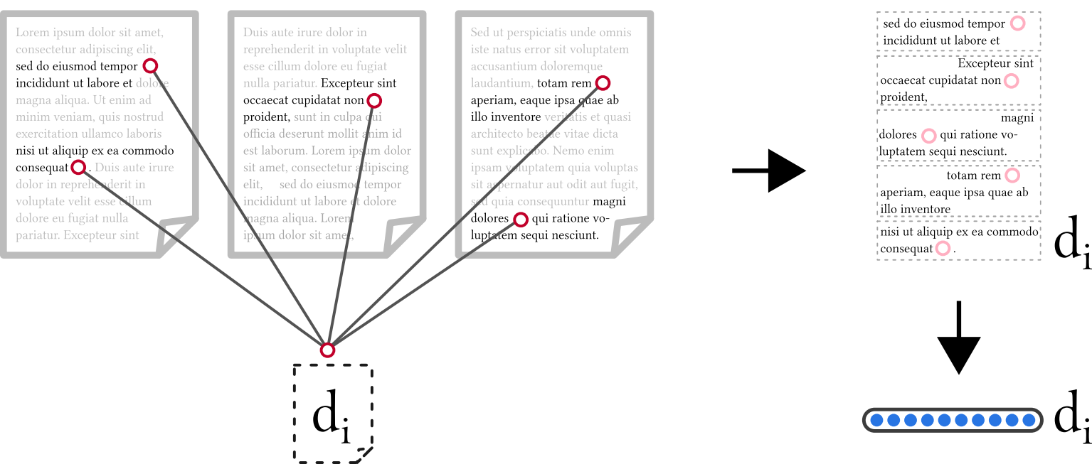
Background

Slide 13
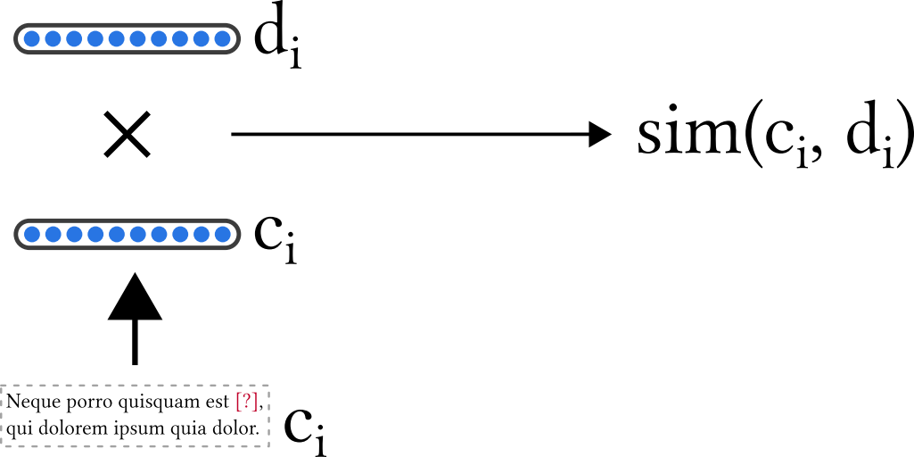
Background

Slide 14
Data Set
Existing data sets
  Quality issues
  No precise citation information (marker)
  No citation interlinking (reference resolution)
Create new data set

Slide 15
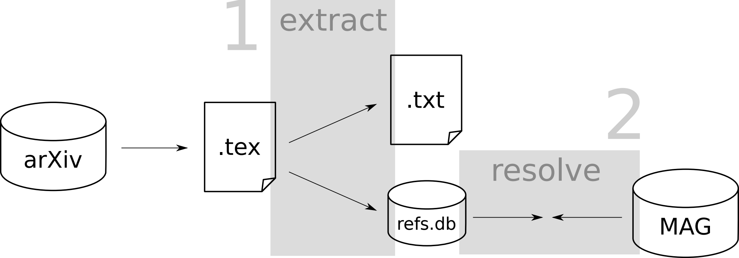
Data Set
Data sources
  arXiv.org (LaTeX sources)
  Microsoft Academic Graph (large)

Slide 16
Data Set
arXiv data set (1991-2017)
  large
    02.3M cited papers
    00.9M.0 citing papers
    13M.0 references
    25M.0 citation contexts
  accurate citation markers, interlinking
  spanning multiple disciplines
  flexible data format

Slide 17
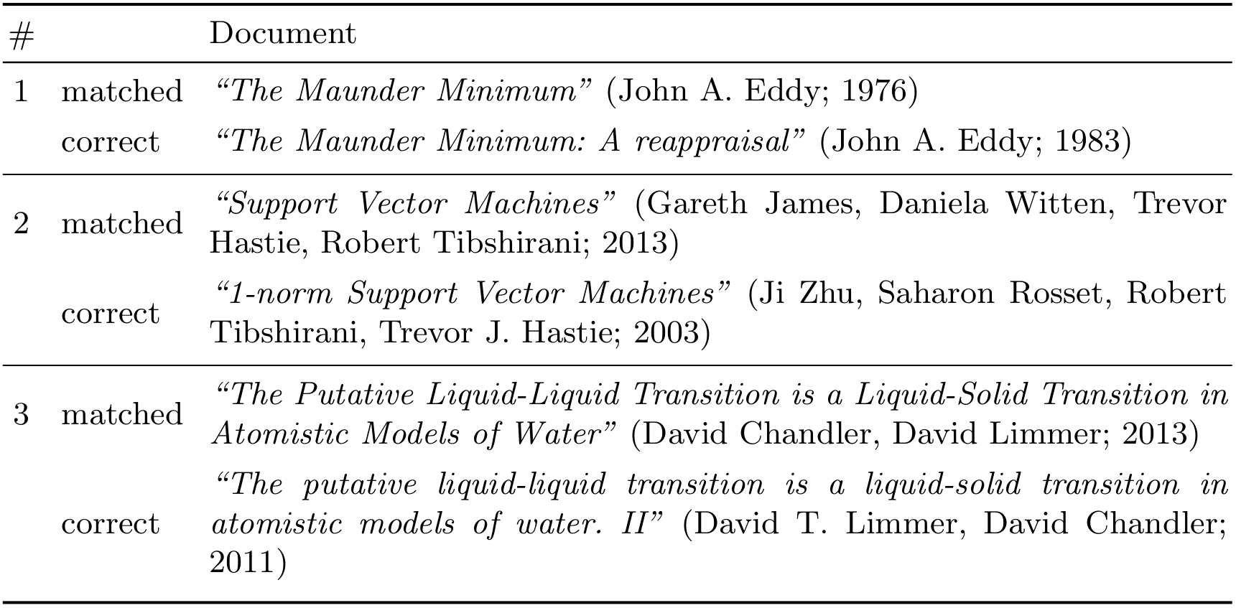
Data Set
Quality of reference resolution
  Manually check 300
  3 errors → accuracy estimate: ≥96%

Slide 18
Approaches
Semantic modelling of citation contexts

Slide 19
Approaches
Entities
  Reference publications
  Exemplifications
Claims
  Claims backed by citations

Slide 20
Approaches
Entities
  “CiteSeer^{x} [18]” / “Neural ParsCit [53]”
  “... approaches to citation recommendation [19–26]”
Claims
  “It has been shown, that ... [27].”
  “A common argument for X is, that ... [3-7].”

Slide 21
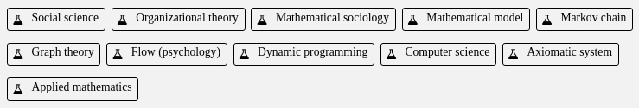
Entity Based Approach
Fields of Study in the MAG (230k)
Noun phrases (2.8M)
  “example”
  “noun phrase”
  “context-based co-citation recommendation”

Slide 22
Entity Based Approach
NP model
“We implement our M-CNN in the Caffe framework [1], with the proposed label prediction step as a new layer.”
NPmarker model
“We implement our M-CNN in the Caffe framework [1], with the proposed label prediction step as a new layer.”

Slide 23
Claim Based Approach
Identify claims with PredPatt
Traverse parse trees
Build predicate-argument tuples

Slide 24
Claim Based Approach
Claim model
“The paper shows that context-based methods can outperform global approaches.”

Slide 25
Claim Based Approach
Claim model
“The paper shows that context-based methods can outperform global approaches.”
?a shows ?b
?a : The paper
?b : SOMETHING := context-based methods
can outperform global approaches
?a can outperform ?b
?a : context-based methods
?b : global approaches

Slide 26
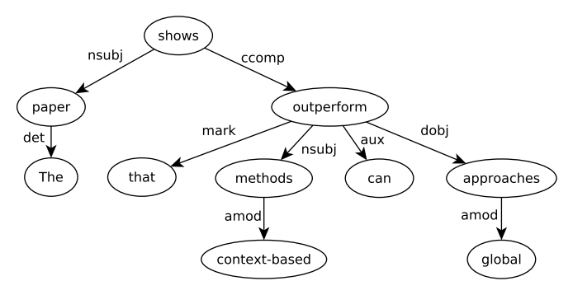
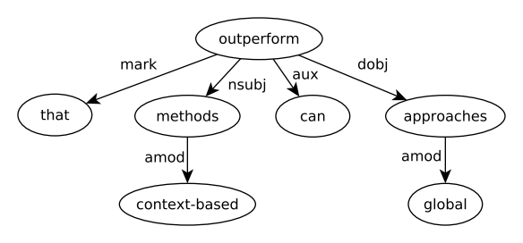
Claim Based Approach
Claim model
“The paper shows that context-based methods can outperform global approaches.”

Slide 27
Claim Based Approach
Claim model
“The paper shows that context-based methods can outperform global approaches.”

Slide 28
Claim Based Approach
Claim model
“The paper shows that context-based methods can outperform global approaches.”

Slide 29
Claim Based Approach
Claim model
“The paper shows that context-based methods can outperform global approaches.”
show:paper
show:context based methods
show:global approaches
outperform:context based methods
outperform:global approaches
→ sequential invariance

Slide 30
Approaches - Recommendation
Similarity measure
  Entities: cosine similarity
  Claims: cosine similarity of TFIDF weighted vectors
In both cases
  Candidates: aggregated contexts of cited docs
  Input: single citation context

Slide 31
Evaluation
Offline evaluation
  Large scale
  Limited assessment of relevance
User study
  Thorough assessment of relevance
  Limited in scale

Slide 32
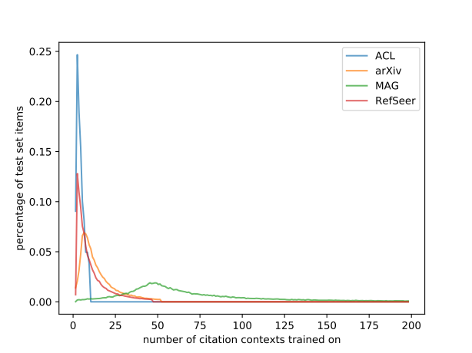
Offline Evaluation
Data sets
  arXiv
  MAG
  RefSeer
  ACL-ARC

Slide 33
Offline Evaluation
Models
  Bag-of-Words baseline
  (punctuation, stop words, TFIDF)
  NP
  NPmarker
  Claim
  Claim+BoW
  (combination of similarity scores)

Slide 34
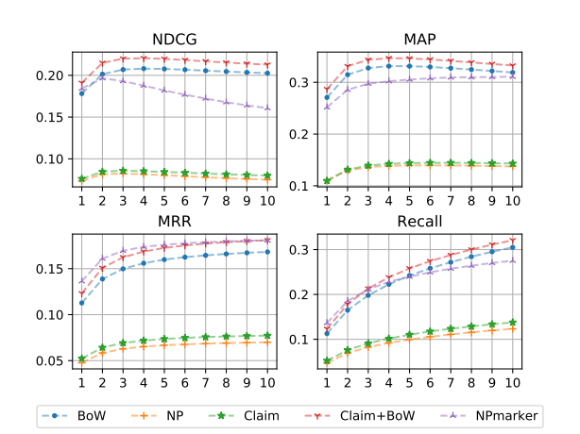
Offline Evaluation
arXiv data

Slide 35
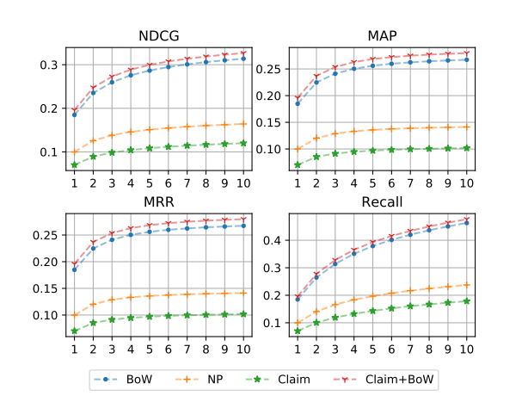
Offline Evaluation
MAG data

Slide 36
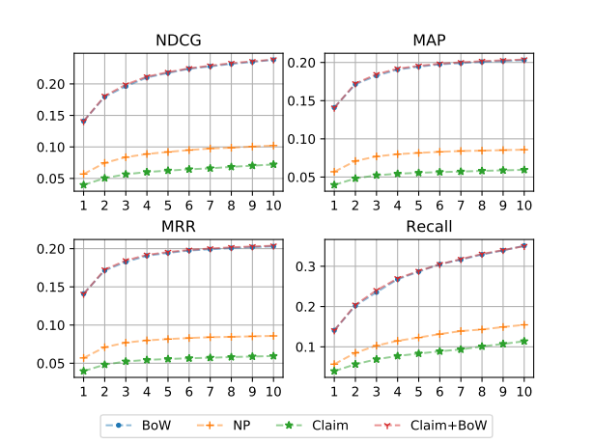
Offline Evaluation
ACL data

Slide 37
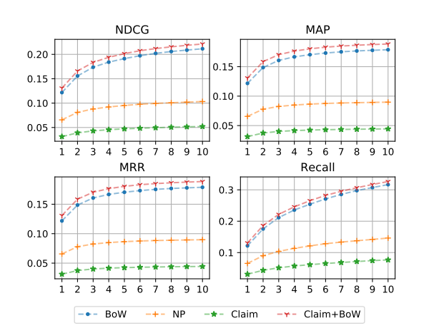
Offline Evaluation
RefSeer data

Slide 38
User Study
Motivation
  Insight into offline evaluation data
  Human judgement of recommendations
Setting
  2 raters
  100 citation contexts
    Top 5 recommendations of models
    BoW, Claim+BoW, NPmarker
    Citation characteristics (type / author‘s name / ...)

Slide 39
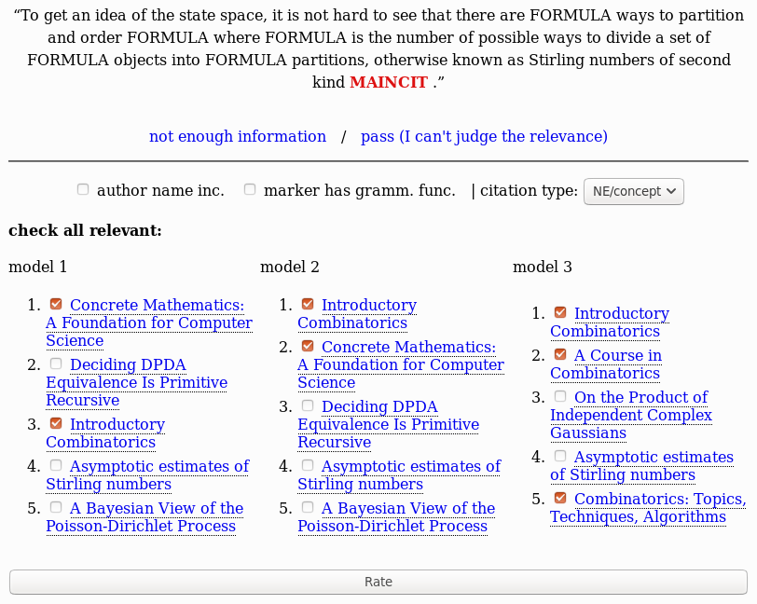
User Study

Slide 40
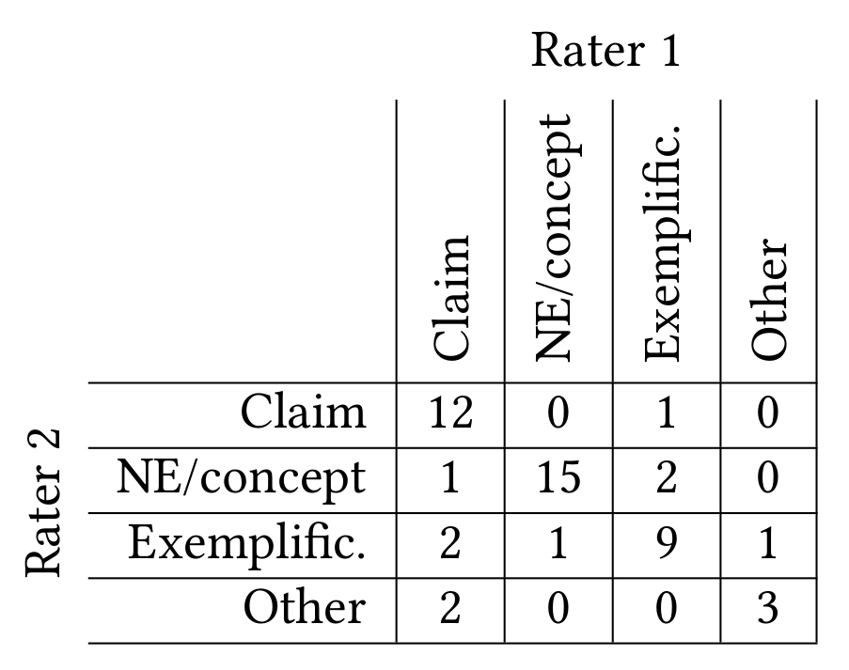
User Study
Inter rater agreement
  Overall: 87%
  Author‘s name: 100%
  Non-/syntactic: 100%
  Relevance: 86%
  Citation type: 78%

Slide 41
User Study
Contexts
  7/100 author‘s name
  5/100 syntactic
Models
  Claim+BoW only outperforms BoW in Recall metric
  NPmarker best for NE/concept type
  Claim+BoW best for claim type

Slide 42
Discussion
Data Set
Semantic models
Semantic citation recommendation

Slide 43
Discussion
Data Set
  Exact position of marker → especially useful for
  semantic models
  Several disciplines → comparative analysis
  Flexible format → experiments w/ e.g.
  context length
  From hereon
    Update w/ recent papers (Saier & Färber, 2019)
    Formulas (Aizawa et al., 2014; Zanibbi et al., 2016)

Slide 44
Discussion
Semantic models
  First step towards semantic citation rec.
  Citations in general
    Can enhance recommendation
  Applied to specific citation types
    Suitable for conceptualized type
  From hereon
    Marker aware model (solve non-syntactic citations)
    Test on more data (NPmarker)

Slide 45
Discussion
Semantic citation recommendation
  Refined search based on claim model, e.g.:
  is:NP-hard
  improve:local citation recommendation
From hereon
  Thorough & systematic examination of cit. types
  Specialized models
  Closer to LD modelling
  Credibility of claims, argumentative structures, ...

Slide 46
Sources
Peroni, S. & Shotton, D. FaBiO and CiTO: Ontologies for describing bibliographic
resources and citations, Journal of Web Semantics, 2012, 17, 33 - 43
Berger, M.; McDonough, K. & M. Seversky, L. Cite2vec: Citation-Driven Document
Exploration via Word Embeddings, IEEE Transactions on Visualization and
Computer Graphics, 2016, 23, 1-1
Beel, J.; Langer, S.; Genzmehr, M.; Gipp, B.; Breitinger, C. & Nürnberger, A. Research
Paper Recommender System Evaluation: A Quantitative Literature Survey,
Proceedings of the International Workshop on Reproducibility and Replication in
Recommender Systems Evaluation, ACM, 2013, 15-22
Galke, L.; Mai, F.; Vagliano, I. & Scherp, A. Multi-Modal Adversarial Autoencoders for
Recommendations of Citations and Subject Labels, Proceedings of the 26th
Conference on User Modeling, Adaptation and Personalization, ACM, 2018, 197-205
Kobayashi, Y.; Shimbo, M. & Matsumoto, Y. Citation Recommendation Using Distributed
Representation of Discourse Facets in Scientific Articles, Proceedings of the 18th
ACM/IEEE on Joint Conference on Digital Libraries, ACM, 2018, 243-251
Ebesu, T. & Fang, Y. Neural Citation Network for Context-Aware Citation Recommendation,
Proceedings of the 40th International ACM SIGIR Conference on Research and
Development in Information Retrieval, ACM, 2017, 1093-1096

Slide 47
Sources
Saier, T. & Färber, M. Bibliometric-Enhanced arXiv: A Data Set for Paper-Based and
Citation Based Tasks, Proceedings of the 8th International Workshop on
Bibliometric-enhanced Information Retrieval (BIR), 2019, 14-26
Aizawa, A.; Kohlhase, M.; Ounis, I. & Schubotz, M. NTCIR-11 Math-2 Task Overview,
Proceedings of the 11th NTCIR Conference, 2014, 11, 88-98
Zanibbi, R.; Aizawa, A.; Kohlhase, M.; Ounis, I.; Topic, G. & Davila, K. NTCIR-12 MathIR
Task Overview, Proceedings of the 12th NTCIR Conference, 2016, 12

Slide 48
Thank you.

Slide 49
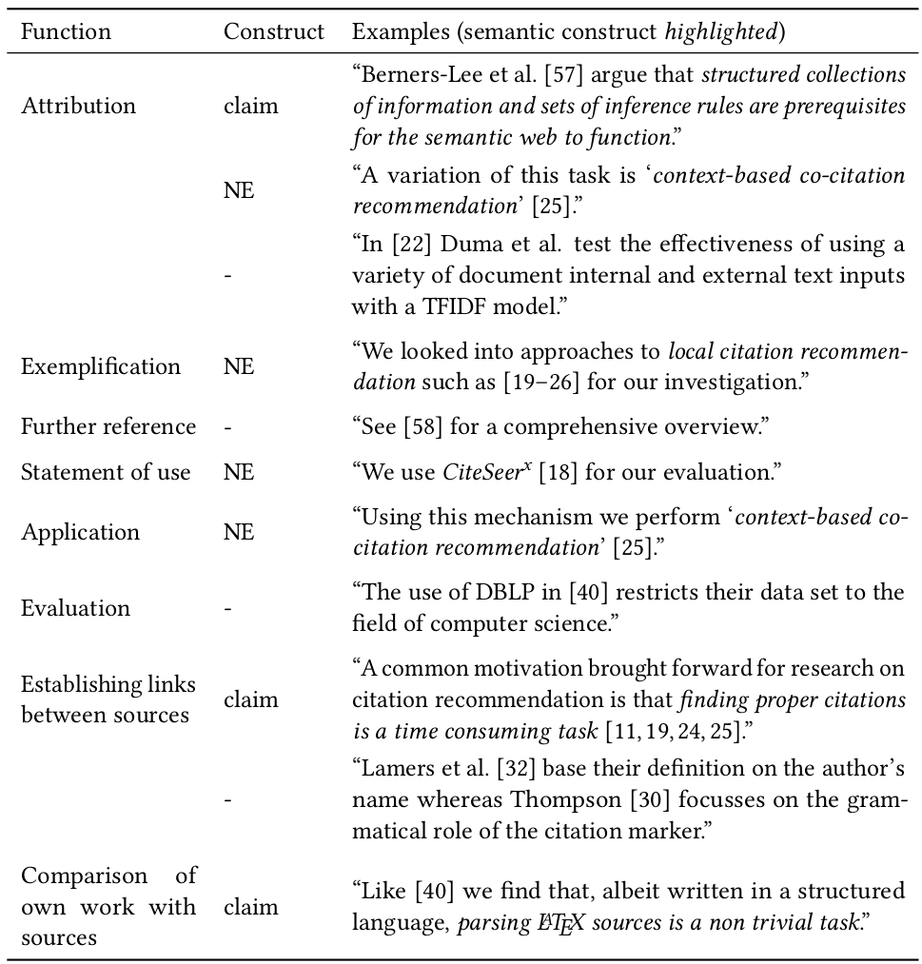
Citation Types

Slide 50
Data Set Format
Format
1412.3684.txt
[…] It has over 79 million images stored at the resolution of FORMULA .
Each image is labeled with one of the 75,062 non-abstract nouns in English, as listed in the Wordnet{{cite:9ad20b7d-87d1-47f5-aeed-10a1cf89a2e2}} {{cite:298db7f5-9ebb-4e98-9ecf-0bdda28a42cb}}
lexical database. [...]
refs.db
uuid
9ad20b...
298db7...
in_doc
1412.3684
1412.3684
mag_id
2081580037
2038721957
reference_string
George A. Miller (1995). Wo...
Christiane Fellbaum (1998),...

Slide 51
Data Set Format
A New Data Set
Format
MAG
paperid
2081580037
2038721957
originaltitle
WordNet : an electronic lexical database
WordNet: a lexical database for English
publisher
MIT Press
ACM
...
extracted_contexts.csv
2038721957 | 2081580037 | 1412.3684 | It has over 79 million images stored at the resolution of FORMULA . Each image is labeled with one of the 75,062 non-abstract nouns in English, as listed in the Wordnet CIT
MAINCIT lexical database. It has been noted that many of the labels
are not reliable CIT .

Slide 52
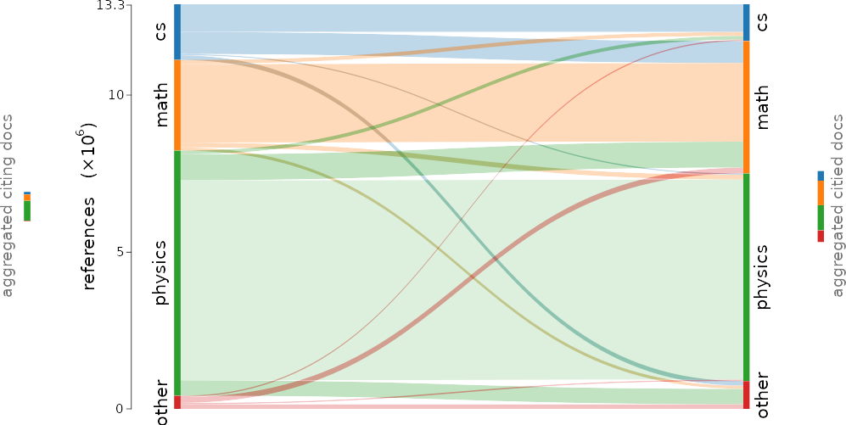
Data Set Citation Flow

