Slide 1
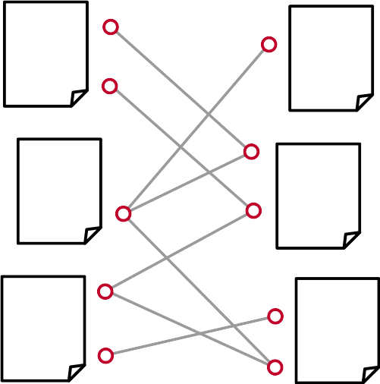
Bibliometric-Enhanced arXiv
A Data Set for Paper-Based and Citation-Based Tasks
Tarek Saier, Michael Färber
BIR Workshop 2019

Slide 2

Background
Mining scholarly discourse
  Paper recommendation
  Citation recommendation
  Citation context-based document summarization
  Detection of bias
  Detection of plagiarism
  ...

Slide 3

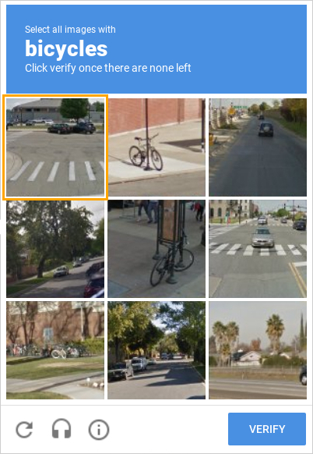
Background
Crowdsourcing image annotations

Slide 4

Background
Crowdsourcing ...

Slide 5
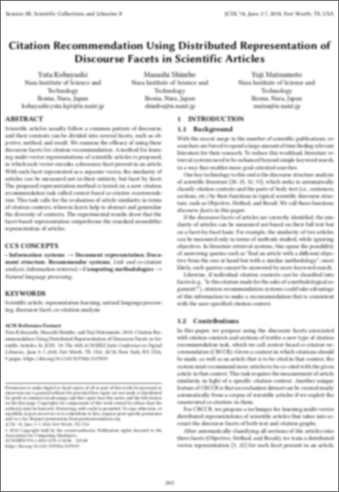
Background
Crowdsourcing citations

Slide 6
Background
Lots of valuable information to be harvested
but ...
Utilization requires
  Machine readable formats
  Sufficient amounts of data
  Clean data
  ...

Slide 7
Existing Data Sets
PDF
  Scholarly
  ACL-AAN
  ACL-ARC*
JATS XML
  PMC-OAS
  PLOS
Extracted plain text
  CiteSeer^{X}
  arXiv CS

Slide 8
Existing Data Sets
PDF
  Scholarly 200k
  ACL-AAN 018k
  ACL-ARC* 011k
JATS XML
  PMC-OAS 002M
  PLOS 200k
Extracted plain text
  CiteSeer^{X} 005M
  arXiv CS 090k

Slide 9
Existing Data Sets
PDF
  Scholarly 200k -
  ACL-AAN 018k -
  ACL-ARC* 011k -
JATS XML
  PMC-OAS 002M PubMed, MEDLINE, ...
  PLOS 200k -
Extracted plain text
  CiteSeer^{X} 005M internal
  arXiv CS 090k DBLP

Slide 10
Existing Data Sets
——[3]——
———[3]—
———[7]—
—[7]———
—[1]———
————[1]
describing: citing documents + cited document

Slide 11
Existing Data Sets
——[3]——
———[3]—
[3] V. N. Senoguz and Q. Shafi, arXiv:hep-ph/0412102
———[7]—
—[7]———
[7] V.N. Senoguz and Q. Shafi, Phys. Rev. D 71 (2005) 043514.
—[1]———
————[1]
[1] V. N. Şenoğuz and Q. Shafi, ''Reheat temperature in super-
Symmetric hybrid inflation models,'' Phys. Rev. D 71, 043514
(2005) [hep-ph/0412102].
describing: citing documents + cited document

Slide 12
Existing Data Sets
——[3]——
———[3]—
[3] V. N. Senoguz and Q. Shafi, arXiv:hep-ph/0412102
———[7]—
—[7]———
[7] V.N. Senoguz and Q. Shafi, Phys. Rev. D 71 (2005) 043514.
—[1]———
————[1]
[1] V. N. Şenoğuz and Q. Shafi, ''Reheat temperature in super-
Symmetric hybrid inflation models,'' Phys. Rev. D 71, 043514
(2005) [hep-ph/0412102].
describing: citing documents + cited document

Slide 13
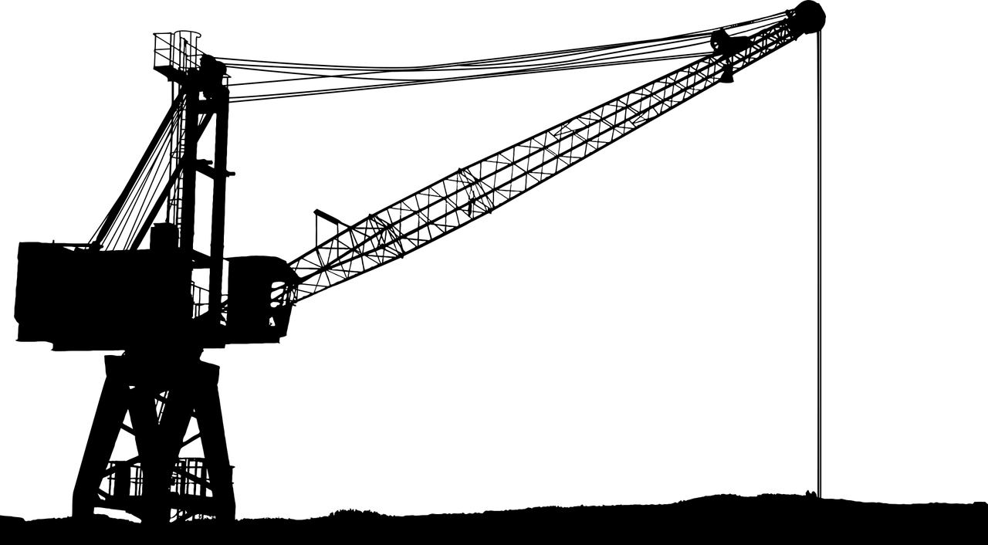
A New Dataset

Slide 14
Data Sources
arXiv.org
  Operates since 1991
  1.5M papers
  LaTeX sources of papers available
Microsoft Academic Graph (MAG)
  Automatically generated
  Metadata on 213M papers

Slide 15
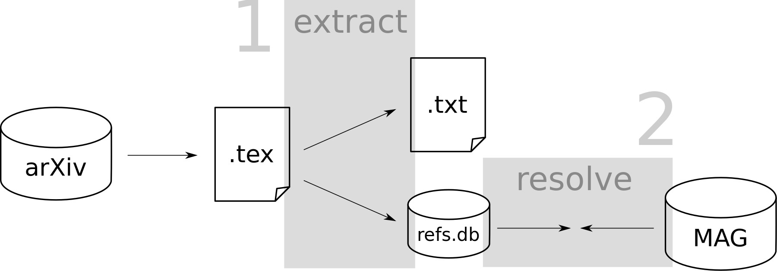
Creation Process
Generation process

Slide 16
Creation Process
Extract (93%)
  flatten
  convert to XML
  extract text + references
Resolve references (43%)
  identify title (arXiv ID, DOI, Neural ParsCit)
  match with MAG

Slide 17
Challenges
Extraction
Reference resolution

Slide 18
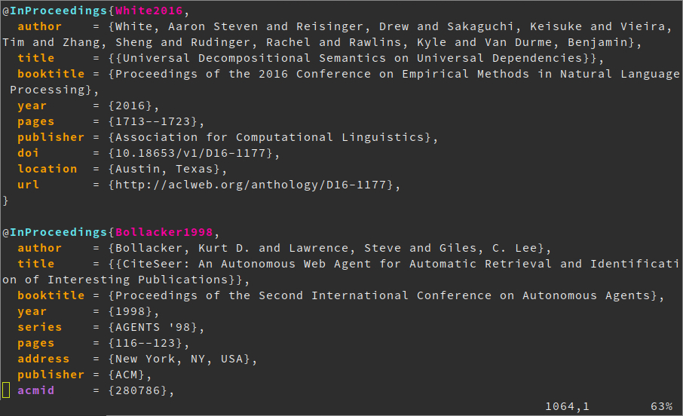
Challenges

Slide 19
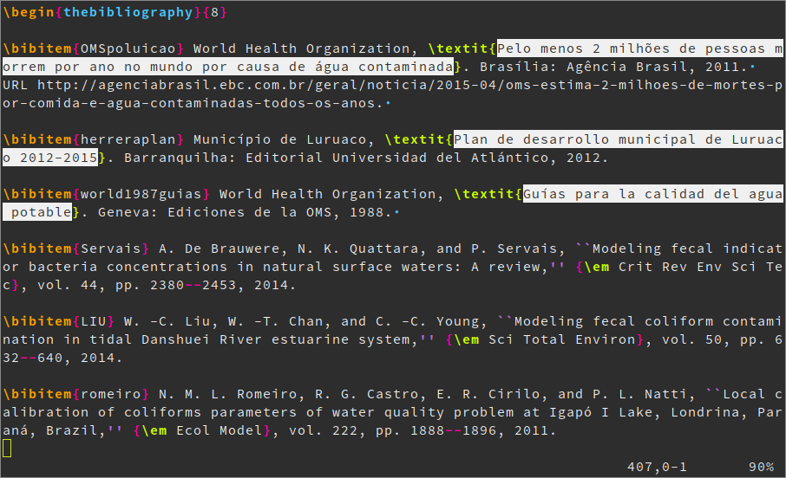
Challenges

Slide 20
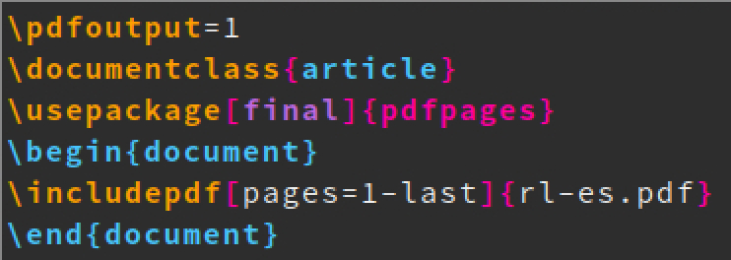
Challenges
“LaTeX sources”

Slide 21
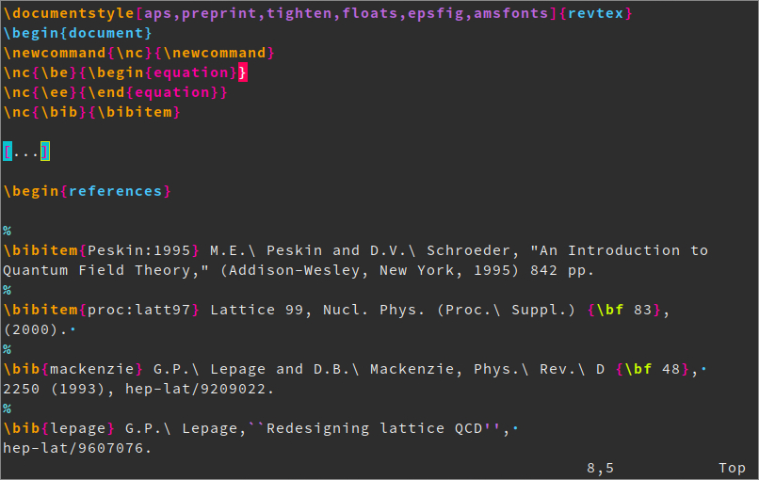
Challenges
newcommand for newcommand

Slide 22
Challenges
Extraction
  .bbl not .bib
  Free spirited use of LaTeX
  External packages for citations (e.g. natbib)
Reference resolution

Slide 23
Challenges
Only minimal information
  V.Sauli, JHEP 02, 001 (2003).
Formulas in titles
  Aaij, Roel, et al. "Search for the $B^{0}_{s} \to \eta^{\prime}\phi$ decay" Journal of High Energy Physics 2017.5 (2017): 158.

Slide 24
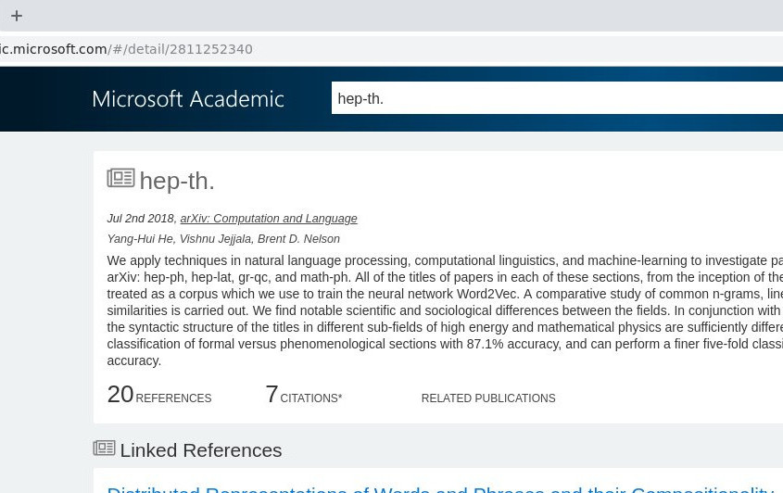
Challenges
“hep-th.”

Slide 25
Challenges
“K. Kondo, hep-th/0303251.”

Slide 26
Challenges
“K. Kondo, hep-th/0303251.”
author
author
title
Neural ParsCit

Slide 27
Challenges
“K. Kondo, hep-th/0303251.”
“hep th 0303251” normalize
author
author
title
Neural ParsCit

Slide 28
Challenges
“K. Kondo, hep-th/0303251.”
“hep th 0303251” normalize
“hep th” try substrings
author
author
title
Neural ParsCit

Slide 29
Challenges
“K. Kondo, hep-th/0303251.”
“hep th 0303251” normalize
“hep th” try substrings
2341106557 ✔ title match
author
author
title
Neural ParsCit

Slide 30
Challenges
“K. Kondo, hep-th/0303251.”
“hep th 0303251” normalize
“hep th” try substrings
2341106557 ✔ title match
Yang-Hui He, ✔ author match
Vishnu Jejjala,
Brent D. Nelson
author
author
title
Neural ParsCit

Slide 31
Challenges
“K. Kondo, hep-th/0303251.”
“hep th 0303251” normalize
“hep th” try substrings
2341106557 ✔ title match
Yang-Hui he, ✔ author match
Vishnu Jejjala,
Brent D. Nelson
author
author
title
Neural ParsCit

Slide 32
Challenges
Extraction
  .bbl not .bib
  Free spirited use of LaTeX
  External packages for citations (e.g. natbib)
Reference resolution
  Minimal information
  Formulas in titles
  MAG noise

Slide 33
Result
Structure
  arXiv full texts (txt)
  in-text annotated citations
  resolved to MAG IDs
Size
  citing papers (full text): 1M
    663k phys / 237k math / 112k CS / 31k other
  cited papers (pointer): 2.7M
  resolved references: 16M
  citation contexts: 29M

Slide 34
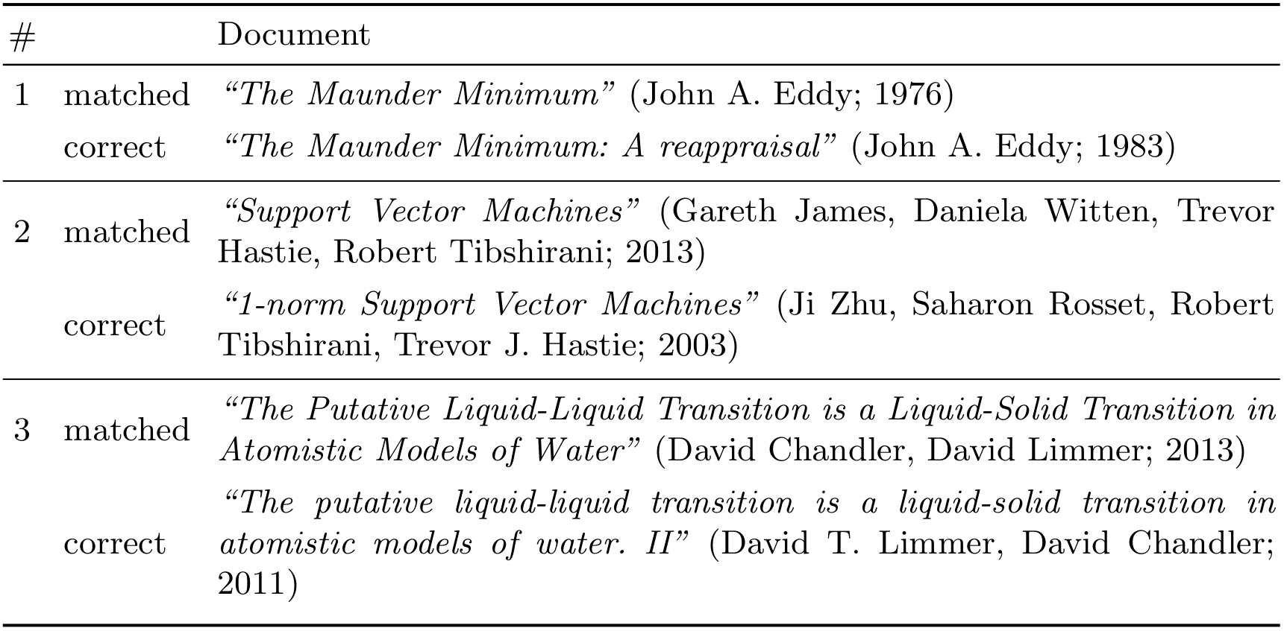
Result
Quality of reference resolution
  Manually check 300
  3 errors → accuracy estimate: 96%

Slide 35
Result
Format
1412.3684.txt
[…] It has over 79 million images stored at the resolution of FORMULA .
Each image is labeled with one of the 75,062 non-abstract nouns in English, as listed in the Wordnet{{cite:9ad20b7d-87d1-47f5-aeed-10a1cf89a2e2}} {{cite:298db7f5-9ebb-4e98-9ecf-0bdda28a42cb}}
lexical database. [...]
refs.db
uuid
9ad20b...
298db7...
in_doc
1412.3684
1412.3684
mag_id
2081580037
2038721957
reference_string
George A. Miller (1995). Wo...
Christiane Fellbaum (1998),...

Slide 36
Result
A New Data Set
Format
MAG
paperid
2081580037
2038721957
originaltitle
WordNet : an electronic lexical database
WordNet: a lexical database for English
publisher
MIT Press
ACM
...
extracted_contexts.csv
2038721957 | 2081580037 | 1412.3684 | It has over 79 million images stored at the resolution of FORMULA . Each image is labeled with one of the 75,062 non-abstract nouns in English, as listed in the Wordnet CIT
MAINCIT lexical database. It has been noted that many of the labels
are not reliable CIT .

Slide 37
Result
Context export script
  context_size (in words/sentences)
  min_contexts
  min_citing_docs
  sample_size
  restrict_fos_citing

Slide 38
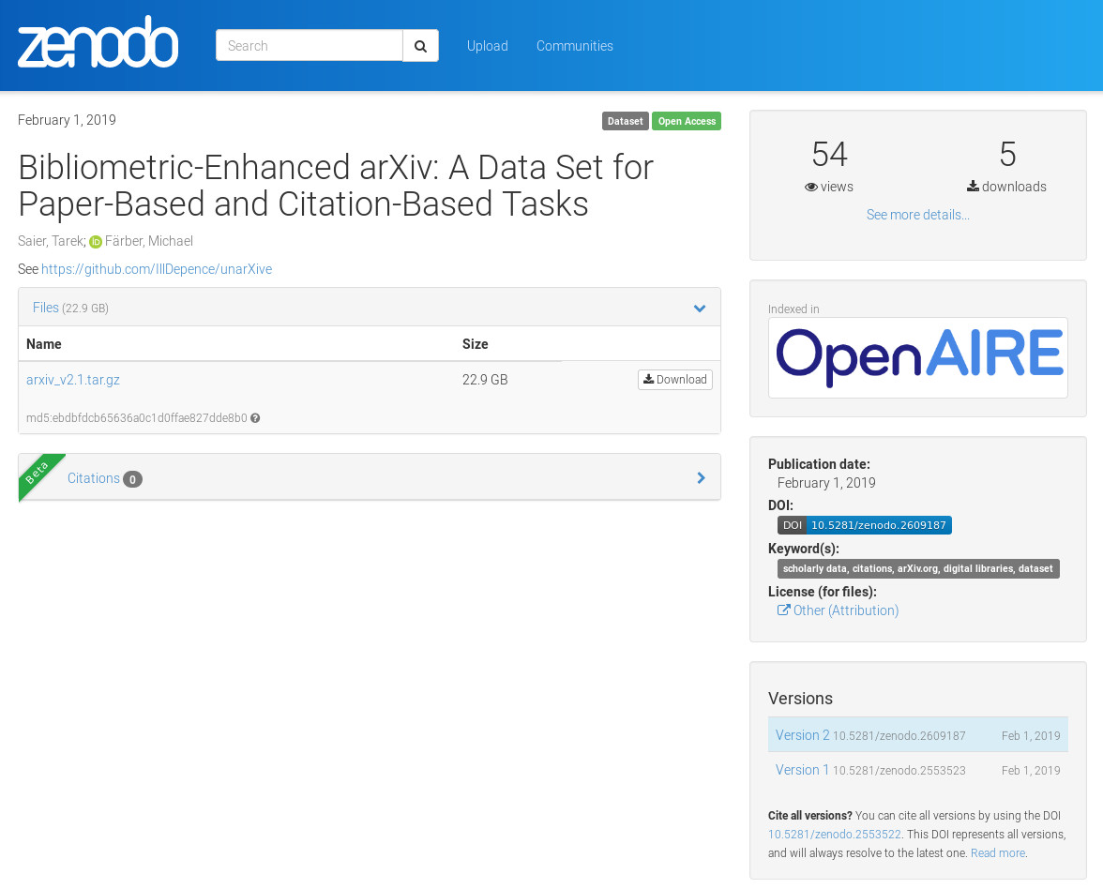
Result
Data on Zenodo
doi.org/10.5281/zenodo.2609187

Slide 39
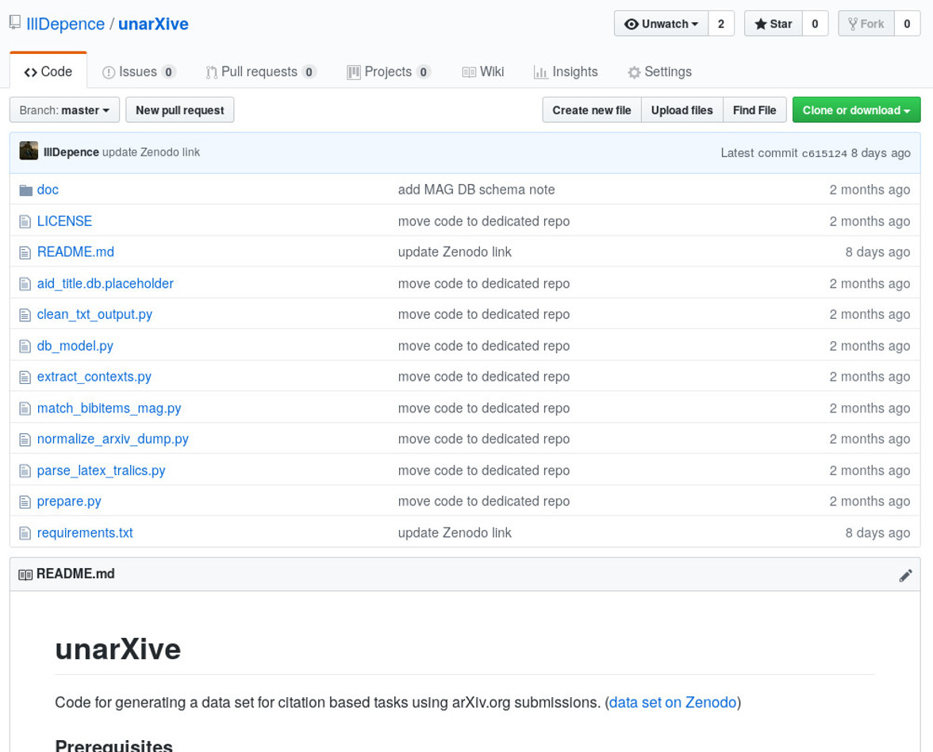
Result
Implementation on GitHub
github.com/IllDepence/unarXive

Slide 40
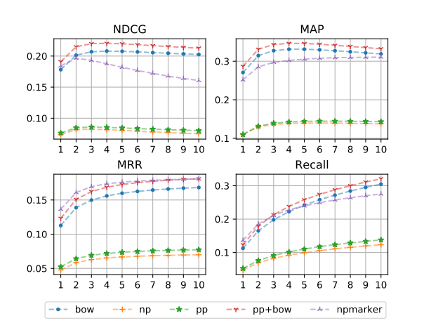
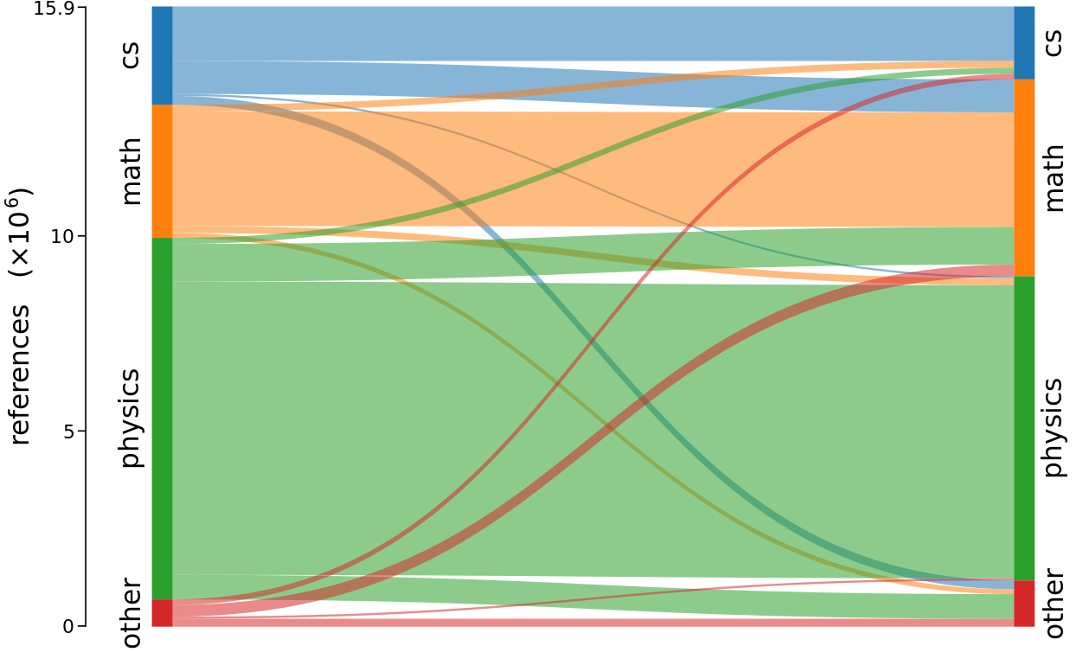
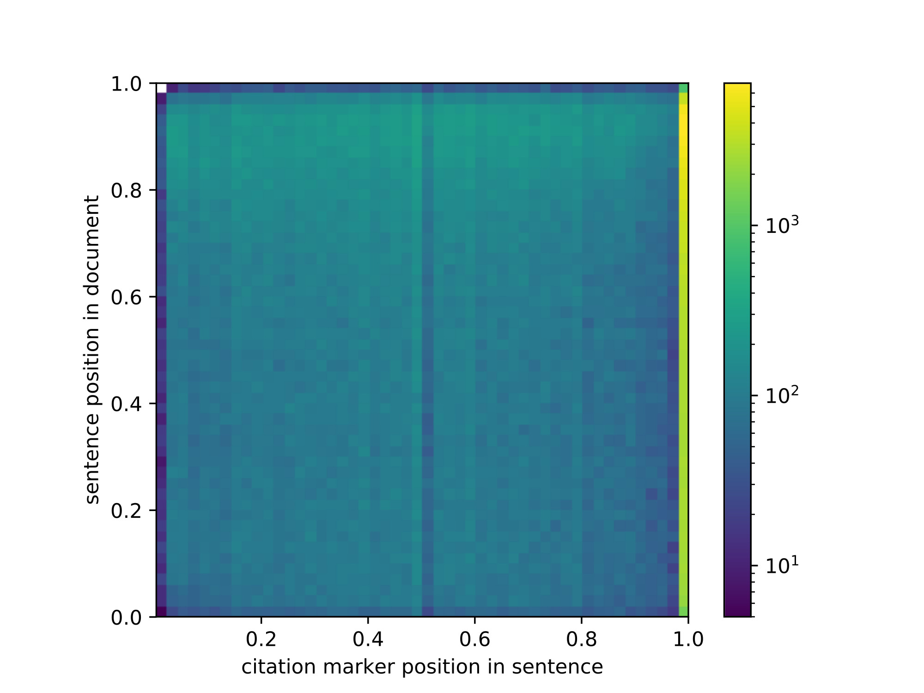
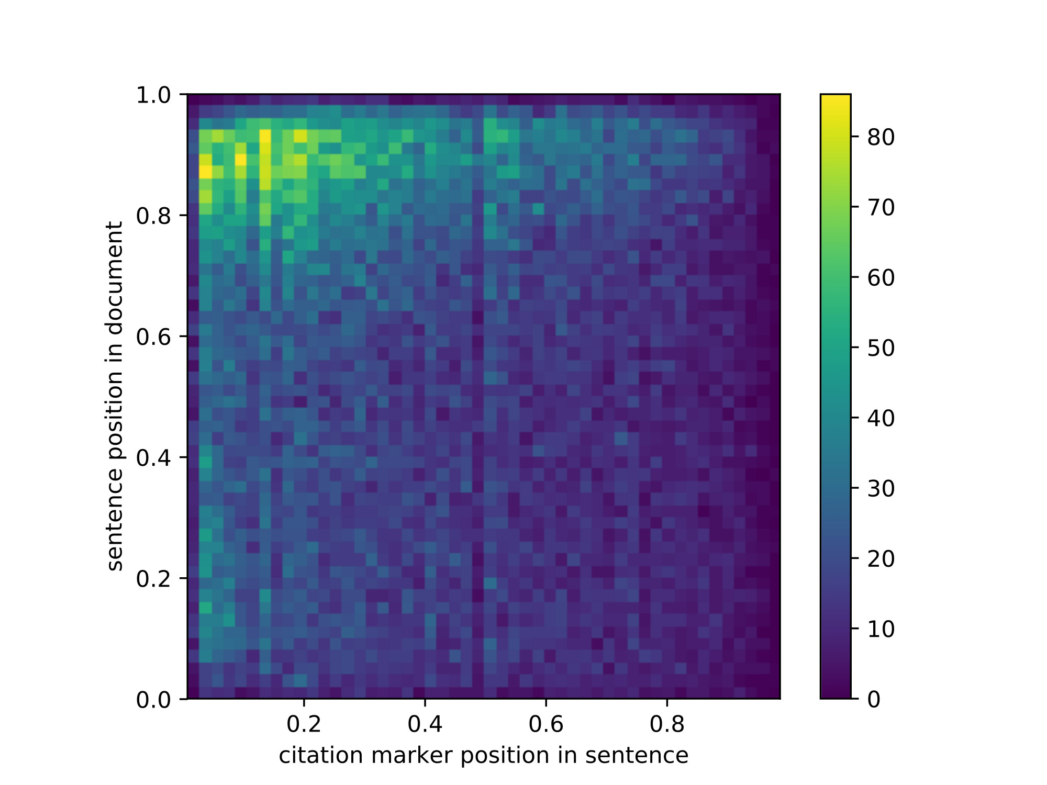
Application

Slide 41

Thank you.

Slide 42
References
Scholarly Sugiyama, K., Kan, M.: A Comprehensive Evaluation of Scholarly Paper Recommendation Using Potential Citation Papers. International Journal on Digital Libraries 16(2) (2015) 91–109
ACL-AAN Radev, D.R., Muthukrishnan, P., Qazvinian, V., Abu-Jbara, A.: The ACL anthology network corpus. Language Resources and Evaluation 47(4) (2013) 919–944
ACL-ARC Bird, S., Dale, R., Dorr, B.J., Gibson, B.R., Joseph, M.T., Kan, M., Lee, D., Powley, B., Radev, D.R., Tan, Y.F.: The ACL Anthology Reference Corpus: A Reference Dataset for Bibliographic Research in Computational Linguistics. In: Proceedings of the Sixth International Conference on Language Resources and Evaluation. LREC’08 (2008)
PMC-OAS https://www.ncbi.nlm.nih.gov/pmc/tools/openftlist/
PLOS https://www.plos.org/text-and-data-mining
CiteSeer^{X} Caragea, C., Wu, J., Ciobanu, A.M., Williams, K., Ramı́rez, J.P.F., Chen, H., Wu, Z., Giles, C.L.: CiteSeer x : A Scholarly Big Dataset. In: Proceedings of the 36th European Conference on IR Research. ECIR’14 (2014) 311–322
arXiV CS Färber, M., Thiemann, A., Jatowt, A.: A High-Quality Gold Standard for Citation-based Tasks. In: Proceedings of the 11th International Conference on Language Resources and Evaluation. LREC’18 (2018)
MAG Sinha, A., Shen, Z., Song, Y., Ma, H., Eide, D., Hsu, B.P., Wang, K.: An Overview of Microsoft Academic Service (MAS) and Applications. In: Proceedings of the 24th International Conference on World Wide Web. WWW’15 (2015) 243–246
Tralics https://www-sop.inria.fr/marelle/tralics/
Neural ParsCit Prasad, A., Kaur, M., Kan, M.Y.: Neural ParsCit: A Deep Learning Based Reference String Parser. International Journal on Digital Libraries 19 (2018) 323–337

