Slide 1
Abusive behavior in social media
Albert-Ludwigs-Universität zu Freiburg
SS 2017
Tarek Saier
Notes:
- Abusive behavior in social media
- structured as follows

Slide 2
Outline
Introduction
  Abusive behavior
  Problem definition
  Challenges
  Solution approaches
Abusive Yahoo! comments
Agressive Twitter accounts
Conclusion
Notes:
- Introduction
- what we mean by “Abusive beh.” + in social media context
- Problem definition
- what kind of challenges we face
- solution approaches
- Two papers: ML classifier for …
- Colclusion

Slide 3
Abusive behavior
Notes:
- what does “abusive behavior” encompass?

Slide 4

Abusive behavior
Notes:
- physical abuse

Slide 5

Abusive behavior
Notes:
- rumor spreading

Slide 6
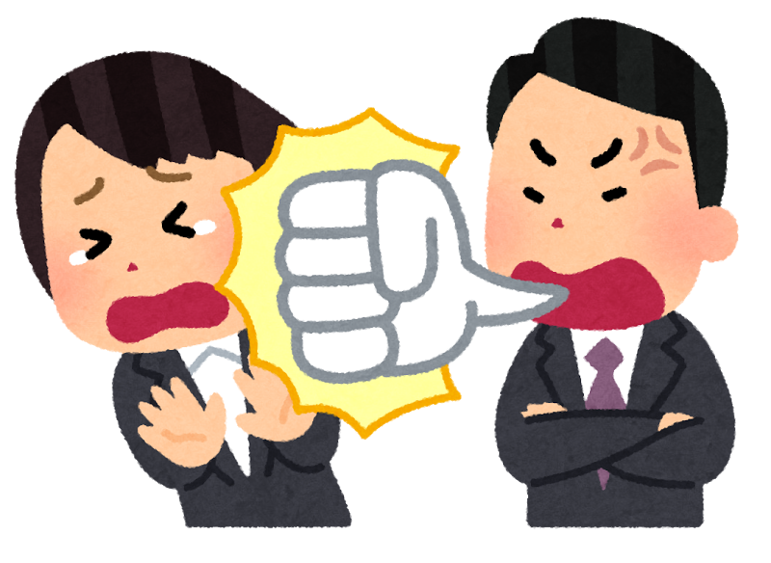
Abusive behavior
Notes:
- abusive language

Slide 7

Abusive behavior
Notes:
- bullying

Slide 8
Abusive behavior
Types
  Frequency (aggressive behavior ↔ bullying)
  Channel (physical, verbal, relational, property)
Offline
  All of the above
Notes:
- distinguish types of abusive behavior by …
- frequency (once vs. often)
- channel (physical, verbal, relational, damage to property)
- offline → all of the above

Slide 9
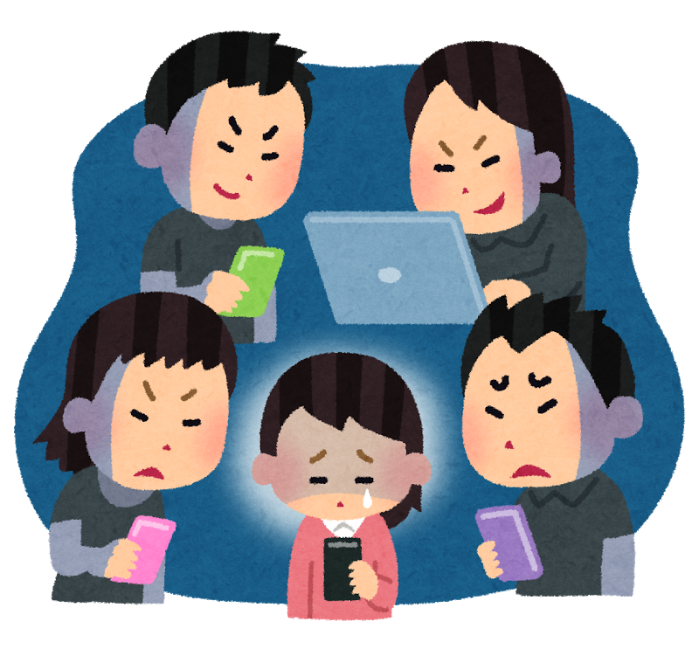
Abusive behavior
Notes:
- what about online?

Slide 10
Abusive behavior
Types
  Frequency (aggressive behavior ↔ bullying)
  Channel (physical, verbal, relational, property)
Offline
  All of the above
Online
  Pysical ✗
  Property ?
  Relational ✓
  Verbal ✓
Notes:
- property: delete digital assests (RCE)
- relational: sockpuppet accs, mods
- due to content of papers

Slide 11
Abusive behavior
Types
  Frequency (aggressive behavior ↔ bullying)
  Channel (physical, verbal, relational, property)
Offline
  All of the above
Online
  Pysical
  Property
  Relational
  Verbal 🡄
Notes:
- focus only on verbal
- which leads us to ...

Slide 12
Problem definition
General
  detect (stop) abusive behavior
  here “behavior” = textual communication
Operator’s perspective
  available information
      actor (≈real person/consistent ↔ anonymous)
  problem modeling
      abusive user
      abusive content
Notes:
- problem definition

Slide 13
Problem definition | Examples
Facebook
  user ≈ real person
  friends
  likes
  activity patterns
  (→ qualities of user that engages in abusive behavior)
4chan
  consistency throughout one session
  … maybe
  (→ abusive content)

Slide 14
Challenges
User
  intentional obfuscation
  sarcasm
      false positives
      bullying
Language
  multi sentence
  social context
  language changes
Notes:
- attributed to users:
- intentional obfuscation
- sarcasm
- due to the nature of language:
- abusiveness streched over multiple sentences
- abusiveness only in certain social contexts
- language changes

Slide 15
Challenges | Examples
Intentional obfuscation
  $hit
  SHІT
  ⬑ cyrillic capital letter byelorussian-ukrainian i (U+0406)
  s‌h‌it
  ⬑ zero width non-joiner (U+200C)
Notes:
- non printable: filter out
- more critical for domains (phishing)

Slide 16
Challenges | Examples
Sarcasm
  false positives:
  “oh of course we should kill them all that would clearly solve
  all the problems.”
  bullying:
  “what a genius idea!”
  “who would’ve thought of that? amazing!”
  “damn you’re smart!”
  “you REALLY know what you’re talking about!”
  ...

Slide 17
Challenges | Examples
Multi sentence
  “I tell you the [ethnic group] are the reason.
  We’d better get rid of them all.”
Social context
  utterance X
      acceptable to group A
      not acceptable to group B
Language changes
  offensive words loose their impact over time
  → new offensive words
Notes:
- reason: … They essentially brough new life to the community.
- get rid of: Those outdated regulations on trade ..
- damn

Slide 18
Solution approaches
Word lists
  ✘ blacklists
  ✔ features
n-grams
  example: 3-grams → exa, xam, amp, mpl, ple
  padded: $$p, $pa, pad, add, dde, ded, ed$, d$$
  level: character / token
Notes:
- blacklists easily circumvented by obfuscation
- but for features (hatebase.org)
- n-grams to counter obfuscation

Slide 19
Solution approaches
tf-idf
  word importance
POS tags
  word-category disambiguation
      noun
      verb
      preposition
→ similarity
#Doc
#term|_{Doc} ⋅ log
#Doc|_{contains term}
Notes:
- tf-idf: “concentrate on important words”
- filter stop words
- better judge similarity of documents/posts

Slide 20
Solution approaches
Domain specific
  URLs
  hashtags
  CAPS
  mentions
  emojis
  etc.
→ similarity
Notes:
- number of ...
- better judge similarity of documents/posts

Slide 21
Solution approaches
Distributional semantics
  word embeddings
      “the ice cream melted quickly” 0 1 0 0 0
      “the ice cream melted quickly” 1 0 1 1 1
  word2vec: king – man + woman = queen
Inter word dependencies
  “[ethnic group] are lower class pigs”
→ context
Notes:
- provide context to words → word similarity
→ better “understanding” → better similarity

Slide 22
Solution approaches
Beyond just text
  user
      likes
      activity patterns
      profile (picture, age, ...)
  network
      centrality
      polularity
      reciprocity
  … if possible
Notes:
- better “understanding” of a post/message/tweet
→ similarity

Slide 23
Two concrete approaches
Targets
  Abusive Yahoo! comments [1]
  Aggressive Twitter accounts [2]
Discussion
  Data
  Features
  Experiments
[1] C. Nobata, J. Tetreault, A. Thomas, Y. Mehdad, and Y. Chang.
Abusive language detection in online user content.
WWW ’16, pages 145–153, 2016.
[2] D. Chatzakou, N. Kourtellis, J. Blackburn, E. D. Cristofaro, G. Stringhini, and A. Vakali.
Mean birds: Detecting aggression and bullying on twitter.
CoRR, abs/1702.06877, 2017.
Notes:
- Nobota et al.: Abusive language detection in online user content
- Chatzakou et al.: Mean birds: Detecting aggression and bullying on twitter
- both supervised machine learning

Slide 24
Two concrete approaches
Targets
  Abusive Yahoo! comments [1]
      abusive content
  Aggressive Twitter accounts [2]
      abusive users
[1] C. Nobata, J. Tetreault, A. Thomas, Y. Mehdad, and Y. Chang.
Abusive language detection in online user content.
WWW ’16, pages 145–153, 2016.
[2] D. Chatzakou, N. Kourtellis, J. Blackburn, E. D. Cristofaro, G. Stringhini, and A. Vakali.
Mean birds: Mean birds: Detecting aggression and bullying on twitter.
CoRR, abs/1702.06877, 2017.
Notes:
- main difference

Slide 25
Abusive Yahoo! comments
Detect
  hate speech
  derogatory language
  profanity
In
  Comments
      Yahoo! News
      Yahoo! Finance

Slide 26
Abusive Yahoo! comments | Data
Data sets % abusive
  primary (2.1 M) 13
  temporal (1.2 M) 17
  WWW15 (1 M) 16
  evaluation (2 K) 50 (tripple labels)
Labels
  Yahoo! employees
  Amazon Mechanical Turk*
Notes:
- prim: Oct. 2012 – Jan. 2014 (10% rnd)
- temp: Apr. 2014 – Apr. 2015
- 15: 6 month period
- eval: Mar. 2015 – Apr. 2015
- ground truth based on human judgement
- turk for eval (agreement rate, abusive / 3 categ.)
empl: 0.92 / 0.6 turk: 0.87 / 0.4

Slide 27
Abusive Yahoo! comments | Features
Features
  n-grams
  syntactic
  linguistic
  distributional semantics
Notes:
- n-grams and distr. sem. as shown before
- as for syntactic and linguistic

Slide 28
Abusive Yahoo! comments | Features
Features
  n-grams
  syntactic
  linguistic
  distributional semantics
Syntactic
  inter word dependencies, POS tags
Linguistic
  average word length, number of CAPS,
  URLS, tokens, punctuations, hate speech words, ...
Notes:
- what the authors call “syntactic features”

Slide 29
Abusive Yahoo! comments | Experiments
Primary data set F-scores
  all features: 0.80 0.82
  token n-grams: 0.77 0.74
  char. n-grams: 0.73 0.77
Goal and interpretation
  assess feature contribution (only highlights shown above)
  n-grams alone give high quality results
Notes:
- Finance | News
- use all features and every feature alone
- f-score = weighted average of the precision and recall (best 1, worst 0)
2 * (p*r)/(p+r)

Slide 30
Abusive Yahoo! comments | Experiments
WWW15 dataset
  F-score: 0.78 -
  AUC now: 0.90
  AUC ‘15: 0.80
Goal and interpretation
  outperforms approach from 2015 [3]
[3] N. Djuric, J. Zhou, R. Morris, M. Grbovic, V. Radosavljevic, and N. Bhamidipati.
Hate speech detection with comment embeddings.
WWW ‘15, 2015.
Notes:
- F-score for comp. w/ last slide
- ‘15 only Finance, only AUC
––––––––––
- AU[ROC]: expectation/probability that random pos is ranked higher than a random neg
- area under receiver operating characteristic curve
- ‘15 “deep learning”, this “mach. learning” but this uses same as ‘15 + more

Slide 31
Abusive Yahoo! comments | Experiments
Evaluation dataset
  F-score all agree: 0.84
  F-score majority: 0.83
  F-score 2 of 3: 0.43
Goal and interpretation
  test ground truth (calculation) variations
  lanugage is hard to judge
Notes:
- test ways to calculate ground truth
- all agree n=1766, maj. n=2000, 2of3 n=234
- where humans don’t agree, ML not so good

Slide 32
Abusive Yahoo! comments | Experiments
Temporal data set
  Original train(primary) predict(t)
  Each slice train(t) predict(t+1)
  Accumulated train(0..t) preditct(t+1)
Goal
  assess how much training data is necessary
  assess if updating a model is necessary
Notes:
- 20k comment slices

Slide 33
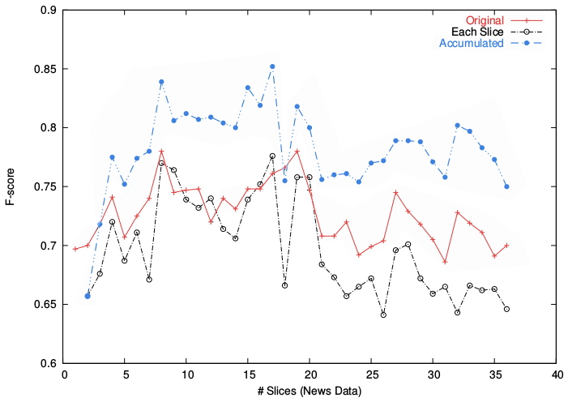
Abusive Yahoo! comments | Experiments
Notes:
- original starts one earlier b/c trained on orig.
- orig. and each slice close
- accumulated mostly above, fast rise than steady

Slide 34
Abusive Yahoo! comments | Experiments
Temporal data set
  Original train(primary) predict(t)
  Each slice train(t) predict(t+1)
  Accumulated train(0..t) preditct(t+1)
Interpretation
  Each slice close to Original
  → reasonable predictions for small training data
  Accumulated best
  → recent training data more important than much

Slide 35
Aggressive Twitter accounts
Detect
  bullying
  aggressive behaviour
In
  Twitter accounts
      Tweets
      profile

Slide 36
Aggressive Twitter accounts | Data
Data sets
  baseline (1 M)
  hate related (650 K)
      #GamerGate
Labels
  CrowdFlower
  fivefold, majority
  → 9,484 annotated
      60% normal
      32% spam
      4.5% bully
      3.5% aggressive
Notes:
- tweets gathered 2 ways
- #GamerGate as seed, 309 hashtags result
- labeld only 9,484
- 60% normal
- 32% spam
- 4.5% bully
- 3.5% aggressive
(- preprosessing:
- noise removal (e.g. stop words)
- spam removal (>5 hashtags/tweet avg.)
- group into sessions→split into batches)

Slide 37
Aggressive Twitter accounts | Features
User
  account age, verified,
  interarrival time, num. tweets,
  session statistics
Text
  num. hashtags, emoticons, URLs,
  hate score, word embeddings
Network
  num. friends, followers, polularity (fo/fr),
  reciprocity, centrality scores
Notes:
- 3 types of features

Slide 38
Aggressive Twitter accounts | Experiments
Features
  12 not useful
      (session stats, hate score, word embeddings, etc.)
Classification
  4-classes: bully, aggressive, normal, spam
  3-classes: bully, aggressive, normal
Notes:
- 12 features not useful for distinguishing classes
- exclude: verified acc, default profile image, session stats, avg. emotional score, hate score, avg. word embedding, avg. curse score, closeness centrality, Louvian modularity

Slide 39
Aggressive Twitter accounts | Experiments
Features
  12 not useful
      (session stats, hate score, word embeddings, etc.)
Classification precision recall (in %)
  4-classes: 72 73
  3-classes: 90 92
Interpretation
  actual textual content comparably not very useful
  approach works well
Notes:
- not visible here but most contribution by user- & network-features
- 3 and 6 months later check:
aggr del: 21% 26%, sus: 14% 19%
bully del: 33% 38%, sus: 0% 0%
norm del: 6% 7%, sus: 7% 8%

Slide 40
Conclusion
Central differences
  abusive content vs. behavior
  target: comments vs. users
Take-home messages
  natural language is hard
  context is valuable
  what about other languages?
  what about non-textual abusive behavior?
Notes:
- central difference: content vs. users
- take home messages:
- natural language is hard
- context is valuable → twitter paper mostly context (tweets are short)
- other languages
- non-textual abusive behavior

Slide 41
Discussion & Questions
”Participation in discussions […] is
also part of the final grade assigned”
(no pressure)

Slide 42
Sources
  C. Nobata, J. Tetreault, A. Thomas, Y. Mehdad, Y. Chang.
Abusive language detection in online user content.
  WWW ’16, pages 145–153, 2016.
  D. Chatzakou, N. Kourtellis, J. Blackburn, E. D. Cristofaro,
  G. Stringhini, A. Vakali.
  Mean birds: Detecting aggression and bullying on twitter.
  CoRR, abs/1702.06877, 2017.
  N. Djuric, J. Zhou, R. Morris, M. Grbovic, V. Radosavljevic,
  N. Bhamidipati.
  Hate speech detection with comment embeddings.
  WWW ‘15, 2015.
  V. Le Quoc, T. Mikolov
  Distributed Representations of Sentences and Documents.
  CoRR, abs/1405.4053, 2014.

