Slide 1
BIOLOGICALLY INSPIRED ARTIFICIAL INTELLIGENCE
TOPIC: “BRAIN TUMOR DETECTION FROM MRI IMAGES”
Supervisor: mgr inż. Marcin Wierzchanowski
Student: Illia Karpenko

Slide 2
PROJECT OBJECTIVES
Utilize the U-Net architecture for precise segmentation of images.
Strive for high performance, Intersection over Union above 0.80 and Dice Coefficient above 0.80 in test results.
Validate model performance across diverse data samples.
Address and resolve issues related to GPU processing and numerical stability.
Find insights into the model's performance and areas for improvement.
Gain hands-on experience with deep learning frameworks and tools, specifically Keras and TensorFlow.

Slide 3
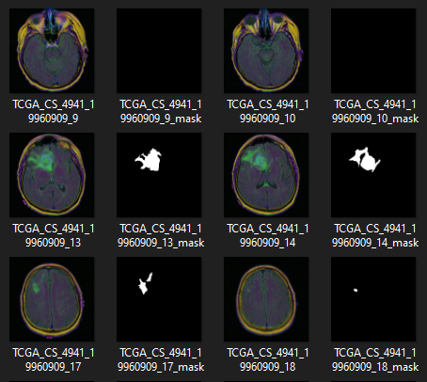
DATA COLLECTION
Data source:
A publicly available dataset from Kaggle.
The dataset includes images and corresponding segmentation masks necessary for training and evaluating the model.
Data Preprocessing:
Images should be normalized.
To enhance model generalization, data augmentation techniques will be used, such as rotation, width and height shift, shear, and zoom,
Img.1 “Example of the dataset”

Slide 4
MODEL SELECTION
Chosen Architecture: U-Net
U-Net is a convolutional neural network architecture designed for biomedical image segmentation.
Advantages:
High Performance in Segmentation Tasks: U-Net has consistently shown superior results in medical and other image segmentation tasks.
Symmetric Architecture: The encoder-decoder structure allows for efficient downsampling and upsampling, preserving spatial information.
Disadvantages:
High Computational Demand: U-Net can be computationally intensive, requiring significant GPU resources.
Complexity: The architecture is more complex compared to simpler models, which can make it harder to tune and train.

Slide 5
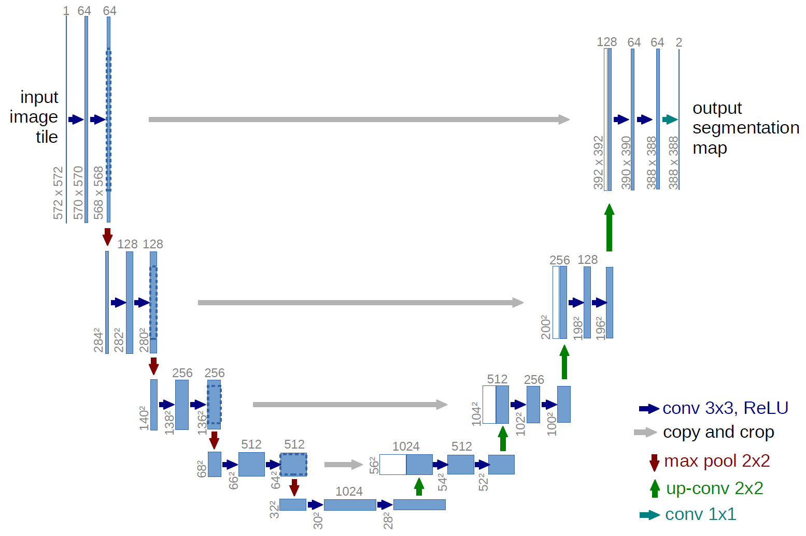
U-NET ARCHITECTURE
Encoder path
Convolutional layers:
The encoder path consists of repeated application of two 3x3 convolutions, each followed by a ReLU activation and a 2x2 max pooling operation with stride 2 for downsampling.
Feature extraction:
This path captures the context of the image by progressively downsampling it, doubling the number of feature channels at each step.
Img.2 “U-Net architecture”

Slide 6
U-NET ARCHITECTURE
Decoder path
Upsampling:
Each step in the decoder path consists of an upsampling of the feature map followed by a 2x2 convolution that halves the number of feature channels.
Skip connections:
The feature map is then concatenated with the corresponding feature map from the encoder path, ensuring that spatial information is preserved.
Convolutions:
Followed by two 3x3 convolutions and ReLU activations.
Img.2 “U-Net architecture”

Slide 7
U-NET ARCHITECTURE
Bottleneck:
At the bottom of the U-Net, the bottleneck connects the encoder and decoder paths. It consists of two 3x3 convolutions followed by ReLU activations, without downsampling.
Img.2 “U-Net architecture”

Slide 8
U-NET ARCHITECTURE
Final Convolution:
A 1x1 convolution is applied at the end to map each 64-component feature vector to the desired number of classes (usually binary for segmentation).
Img.2 “U-Net architecture”

Slide 9
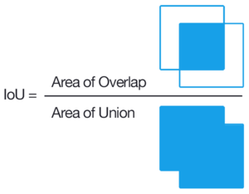
EVALUATION METRICS
Intersection over Union (IoU):
Measures the overlap between the predicted segmentation mask and the ground truth mask.
Provides a robust metric for evaluating the accuracy of our segmentation, particularly for object detection tasks.
Formula: IoU = (True Positives) / (True Positives + False Positives + False Negatives)
Img.3 “Visualized calculation of IoU”

Slide 10
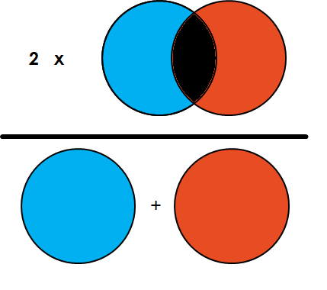
EVALUATION METRICS
Dice coefficient:
Measures the similarity between the predicted and ground truth masks, emphasizing correct overlap.
Useful for medical imaging and other fields where the shape and continuity of the segmented object are critical.
Formula: Dice = (2 * True Positives) / (2 * True Positives + False Positives + False Negatives)
Img.4 “Visualized calculation of dice coefficient”

Slide 11
CHALLENGES
Training deep learning models like U-Net is computationally intensive, requiring significant processing power and memory.
Large datasets required for training can be difficult to manage and process efficiently.
The risk of overfitting the model to the training data, leading to poor generalization on unseen data.
Finding the optimal set of hyperparameters (learning rate, batch size, etc.) can be time-consuming.

Slide 12
THANK YOU FOR YOUR ATTENTION!

